Slide 1

Cyber-Physical System for Patient-Centric Healthcare Using Cloud and Big Data
By
K. SRI VIRAJA
C
14121A1245
IV B.Tech (I-Semester)
Department of Information Technology
SREE VIDYANIKETHAN ENGINEERING COLLEGE
(AUTONOMOUS)
(Approved by AICTE, Accredited by NBA and Affiliated to JNTUA, Anantapur)
2017-2018
Supervisor Head of the Dept.
Ms. K. Lakshmi Prasanna, M. Tech. Dr. K. Ramani, M .Tech., Ph.D.
Assistant Professor Professor and HOD

Slide 2
Abstract
Introduction
Literature Survey
Existing Solutions
Proposed System
ROCHAS
Conclusion
References
CONTENTS

Slide 3
ABSTRACT
New technologies in healthcare domain made healthcare data not only much bigger but also much more difficult to handle and process.
To provide a more convenient service of healthcare, a cyber-physical system for patient-centric healthcare applications and services, called Health-CPS, built on cloud and big data analytics technologies is proposed.
This system consists of :
a data collection layer,
a data management layer and
a data-oriented service layer.

Slide 4
INTRODUCTION
In the past two decades, information technology has been widely utilized in medicine.
With the assistance of cloud computing and big data, healthcare data from cyber-physical systems (CPS) can be efficiently managed.
The contributions of healthcare CPS using technologies of cloud and big data (Health-CPS) can be summarized as follows:
A unified data collection layer for the integration of public medical resources and personal health devices.
A cloud-enabled and data-driven platform for the storage and analysis of multisource heterogeneous healthcare data.

Slide 5
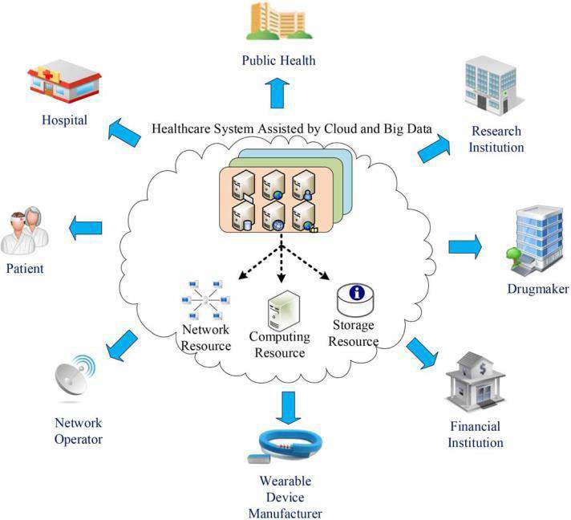
Fig: 1.1. Illustration for the extended healthcare ecosystem.
A healthcare application service cloud, which provides a unified application programming interface (API) for the developers and a unified interface for the users

Slide 6
LITERATURE SURVEY
[1] M. Chen, Y. Ma, S. Ullah, W. Cai, and E. Song, “ROCHAS: Robotics and cloud-assisted healthcare system for empty nester,” in Proc. BodyNets,Boston, MA, USA, Sep. 30–Oct. 2 2013, pp. 1–4.
Explanation:
A household robot serves as bridge for empty-nester to communicate with his/her children in other places.
The robot also has intelligent speech recognition and entertainment functions.
Advantages: These functions mainly provide spiritual consolation for empty-nester.
Disadvantages : High bandwidth , cost of robot and interoperability between robot and cloud platform.

Slide 7
[2] J. Wan et al., “Cloud-enabled wireless body area networks for pervasive healthcare,” IEEE Netw., vol. 27, no. 5, pp. 56–61, Sep./Oct. 2013.
Explanation :
Integrates WBANs with MCC to provide tremendous opportunities for pervasive healthcare systems.
Transmits vital data to the cloud by using data security mechanisms.
Advantages :
Performance efficiency, Patient-centric services, High reliability.
Disadvantages :
Less performance and
QoS of cloud-enabled WBANs must be improved

Slide 8
[3] M. Chen, “NDNC-BAN: Supporting rich media healthcare services via named data networking in cloud-assisted wireless body area networks,” Inf. Sci., vol. 284, pp. 142–156, Nov. 2014.
Explanation :
User’s heart rate, respiratory rate etc., will be collected by body sensors
User’s physiological status is stored, processed, managed and analyzed over a long-term period in the cloud platform.
The physiological information stored in cloud platform can be distributed to hospital, doctor or immediately family members, etc.
Advantages :
Efficient Content Delivery from Cloud, Flexible and Personalized Interaction, Supports High User Mobility.
Disadvantages:
Issues in user mobility, content delivery latency, and personalized interaction

Slide 9
[4] M. Chen, S. Gonzalez, A. Vasilakos, H. Cao, and V. Leung, “Body area networks: A survey,” ACM/Springer Mobile Netw. Appl., vol. 16, no. 2, pp. 171–193, Apr. 2011.
Explanation :
BANs enable wireless communications in or around a human body by means sophisticated pervasive wireless computing devices.
Communication is twofold Intra-BAN communications, Inter-BAN communications.
Advantages :
High data rate and mobility than WSNs.
Disadvantages :
less scalability and QoS, breach of security and privacy.

Slide 10
[5] Y.-J. Ma, Y. Zhang, O. M. Dung, R. Li, and D.-Q. Zhang, “Health internet of things: recent applications and outlook,” Journal of Internet Technology, vol. 16, no. 2, pp. 351–362, 2015.
Explanation :
The sensing device collects the physiological data from human body, and these collected data will help users check their own physical situations at any time or help doctors diagnose for patients.
Advantages :
Many medical health problems are solved by timely detection using sensors.
Disadvantages :
The technologies in this aspect are at the development stage, and are not mature enough.

Slide 11
EXISTING SOLUTIONS
A more convenient service of healthcare is provided with Health-CPS, built on cloud and big data analytics technologies.
Health-CPS is far more efficient to deal with health records.
This system consists of a data collection layer with a unified
standard, a data management layer for distributed storage and parallel computing, and a data-oriented service layer.
Healthcare data can be efficiently managed.

Slide 12
PROPOSED SYSTEM
Nowadays, medicine is relying much more on specific data collection and analysis.
Therefore, medical knowledge published and shared via cloud is popular in practice.
The information and knowledge base can be enriched and
shared by the doctors over the cloud.
The patients can also actively participate in medical activities assisted by big data.
Through smart phones, cloud computing and wireless sensors, the medical right returns to the patients, and the role of a doctor is as a consultant to provide decision support to the patients.

Slide 13
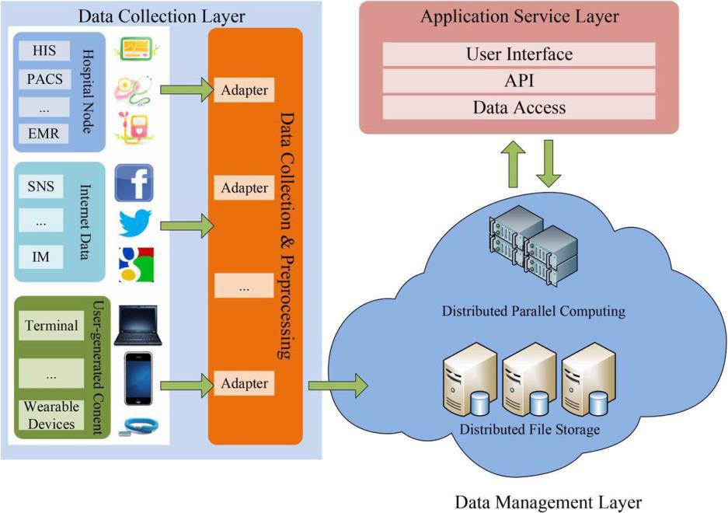
CLOUD AND BIG DATA ASSISTED ARCHITECTURE
Fig: Health-CPS architecture.

Slide 14
The architecture of Health-CPS consists of the following three layers:
Data collection layer:
Consists of data nodes and adapters.
Through an adapter, raw data can be pre-processed to ensure the availability and security of the data transmission
Data management layer:
Consists of a distributed file storage (DFS) module and a distributed parallel computing (DPC) module.
DFS enhances the performance of the healthcare system, DPC provides corresponding processing and analysis methods.
Application service layer:
Provides an open unified API for the developers aiming
at user-centric applications .

Slide 15
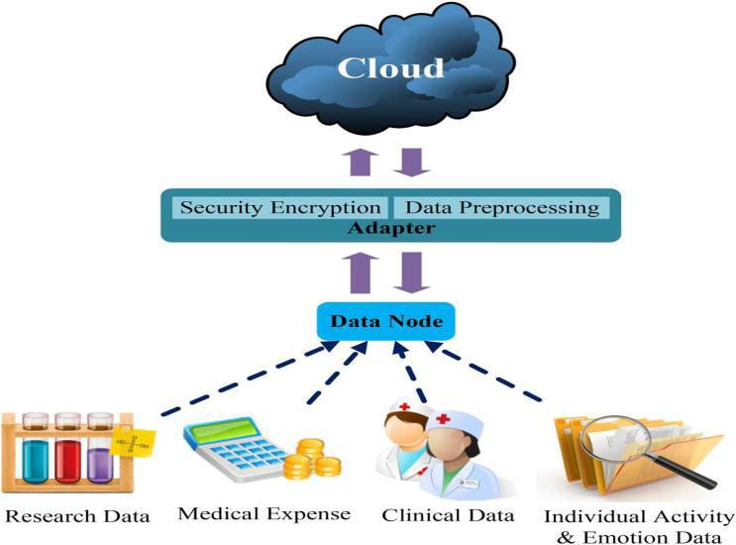
DATA COLLECTION LAYER
Fig: Data collection layer.

Slide 16
In the data collection layer, various healthcare data are collected by the data nodes and are transmitted to the cloud through the adapters .
Data Node :
Research data : Drug research and development institutions
Medical expense data : Medical bill and medical insurance reimbursement
Clinical data : Collected by medical service providers for clinical diagnosis such as EMR
Emotion data : Physiological data collected by wearable
devices

Slide 17
Adapter :
A middleware to provide a data node with access to the system.
A raw data preprocessor and encrypter .
The encryption module encrypts the preprocessed data to ensure security.
Any unauthorized devices cannot decrypt the data package even if they have access to the system.

Slide 18
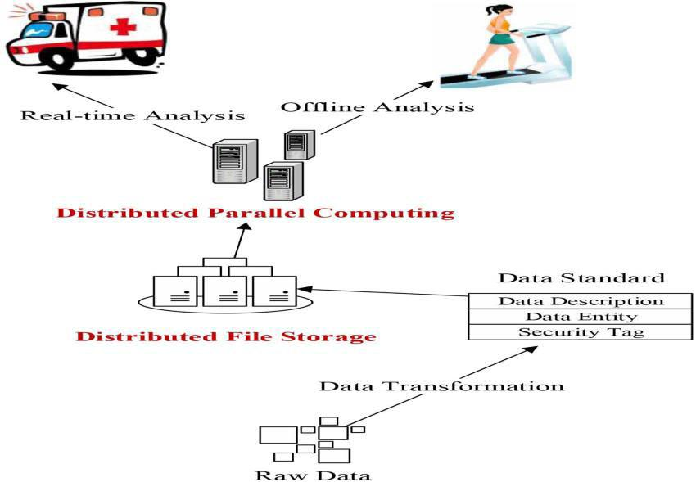
DATA MANAGEMENT LAYER
Fig : Data Management Layer

Slide 19
This layer consists of a DFS module and a DPC module to support efficient management and analysis of heterogeneous data.
DFS Module :
Provides efficient storage, high-throughput data upload and download, rapid data retrieval and exchange etc.
To manage multisource heterogeneous data, the following components are involved to establish the data standards :
Data Description: Stored data are expected to provide a description including data source, data size, metadata number, data age, and data administrator.
Security Tag : It defines data security and authorization levels.

Slide 20
DPC Module :
Analyzes and processes data from DFS and ultimately
discovers knowledge.
Supports real-time analysis as well as offline analysis.
Real-time analysis :
In the scenarios of intensive care, sudden disease detection.
Analysis results are expected to return quickly.
Data such as heart rate, blood pressure will be kept in memory for improving the analysis efficiency.
Offline analysis:
In the scenarios without high expectations of response time(e.g., health status evaluation, medical recommendation)

Slide 21
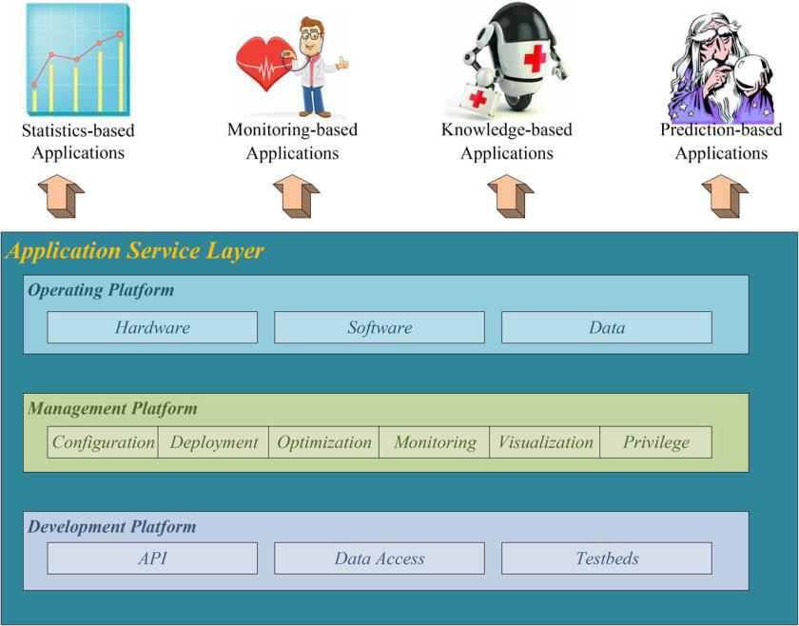
APPLICATION SERVICE LAYER
Fig: Framework of the application service layer.

Slide 22
Framework of Application Service Layer :
Provides an operating platform, a management platform, and a development platform for both users and developers.
Operating platform provides resources for running healthcare applications, i.e., hardware, software, and data.
Management platform manages various applications like monitoring management, visualization management, and privilege management etc.
Development platform provides a uniform API, data access, and test beds.

Slide 23
Data-Oriented Healthcare Applications and Services :
Statistics-based applications: Provide basic statistics and report services. For example, an individual health status report
Monitoring-based applications: Utilized to monitor individual vital signs. A user’s physiological changes can be immediately detected to avoid sudden diseases.
Knowledge-based applications: Example chronic disease diagnosis, genetic disease analysis, treatment evaluation, side effect identification .
Prediction-based applications: Have the highest technical complexity. For example, individual eating habits can be deduced and some potential health risks can be predicted, like obesity and high blood pressure.

Slide 24
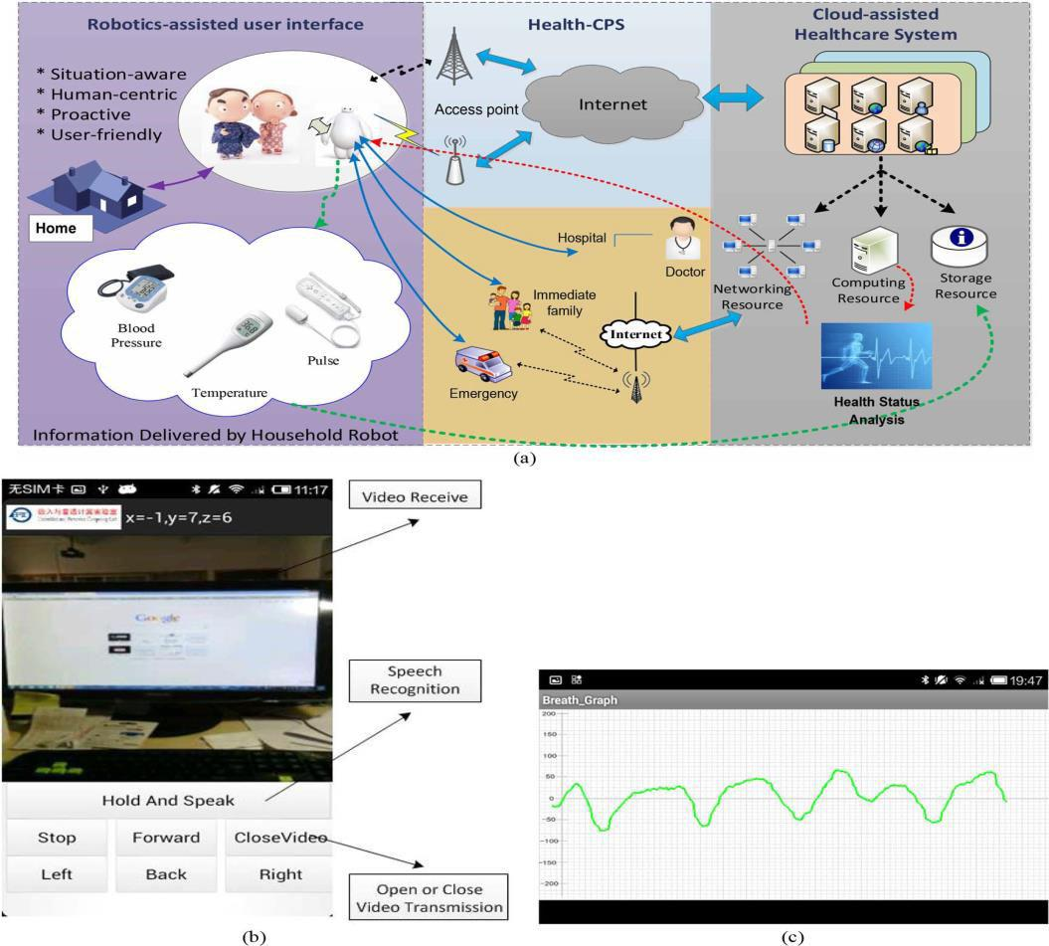
ADVANCED ROCHAS: A TESTBED FOR HEALTH-CPS BASED ON ROBOT TECHNOLOGY
Fig: ROCHAS testbed architecture and software interfaces. (a) ROCHAS testbed architecture. (b) Interface to control robot. (c) Sensory data representation.

Slide 25
Testbed Architecture :
Robotics-assisted user interface
1) robot hardware, e.g.,environment sensors, biosensors, and camera,
2) embedded software, e.g., motion control for robot, speech recognition, and sensory data preprocessing.
Health-CPS
Provides a robot with healthcare services supported by a cloud assisted system, and communication to the doctor, family, and emergency.
Cloud-assisted healthcare system
Provides rich networking, computing, and storage resource for sensory data analysis and health modeling.

Slide 26
Technical Details :
The controller of the robot is an ARM board integrated with Cortex-A8.
The operation system is Android 4.0.
The embedded and driver software are written in C, whereas the interface is written in Java.
The robot is equipped with various sensors to collect temperature, humidity, heart rate, and electrocardiogram.
Both home and remote users can control the robot via a smart Phone.
After processing of sensory data, various physical conditions are stored in the cloud which can be used for the assisted decision of treatment.

Slide 27
CONCLUSION
The big data technologies have been developed gradually and will be used everywhere. Consequently, health care will also enter the big data era.
The theories and technologies in health IOT are at the development stage, and are not mature enough.
Health-IoT is closely related to the human health, so there are still many moral and law restrictions during the practical application.

Slide 28
REFERENCES
[1] M. Chen, Y. Ma, S. Ullah, W. Cai, and E. Song, “ROCHAS: Robotics and cloud-assisted healthcare system for empty nester,” in Proc. BodyNets,Boston, MA, USA, Sep. 30–Oct. 2 2013, pp. 1–4
[2] J. Wan et al., “Cloud-enabled wireless body area networks for pervasive healthcare,” IEEE Netw., vol. 27, no. 5, pp. 56–61, Sep./Oct. 2013.
[3] M. Chen, “NDNC-BAN: Supporting rich media healthcare services via named data networking in cloud-assisted wireless body area networks,” Inf. Sci., vol. 284, pp. 142–156, Nov. 2014.
[4] M. Chen, S. Gonzalez, A. Vasilakos, H. Cao, and V. Leung, “Body area networks: A survey,” ACM/Springer Mobile Netw. Appl., vol. 16, no. 2, pp. 171–193, Apr. 2011.
[5] Y.-J. Ma, Y. Zhang, O. M. Dung, R. Li, and D.-Q. Zhang, “Health internet of things: recent applications and outlook,” Journal of Internet Technology, vol. 16, no. 2, pp. 351–362, 2015.

Slide 29


