Slide 1

Virtual Internship Task-2 Booking Prediction by Gottipalli Sri Vishnu Satwik

Slide 2
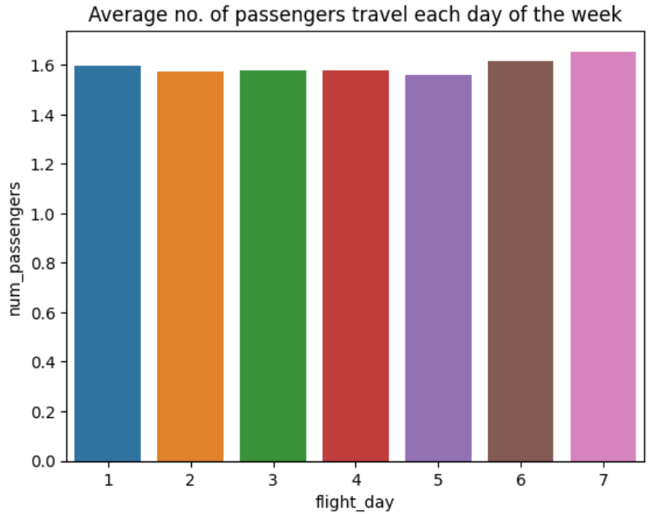
We can see that on weekends the average number of are more.

Slide 3
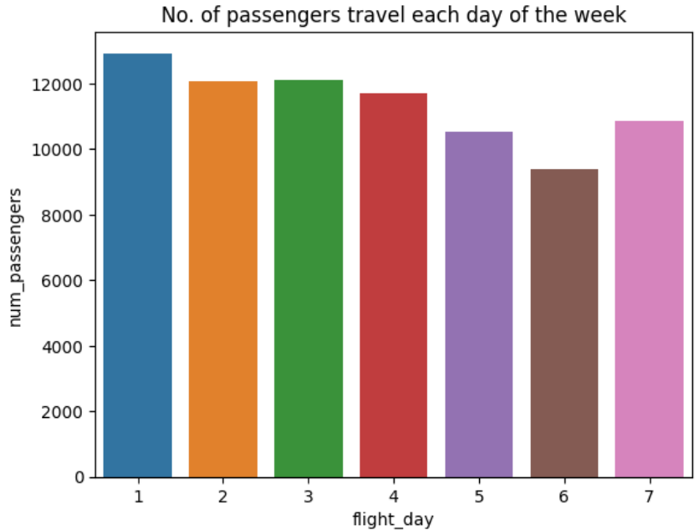
We can see that weekends have fewer flights than weekdays, so we need to consider adding flight schedules on weekends, but to be effective we need to see what routes have schedules on weekends with the most passengers.

Slide 4
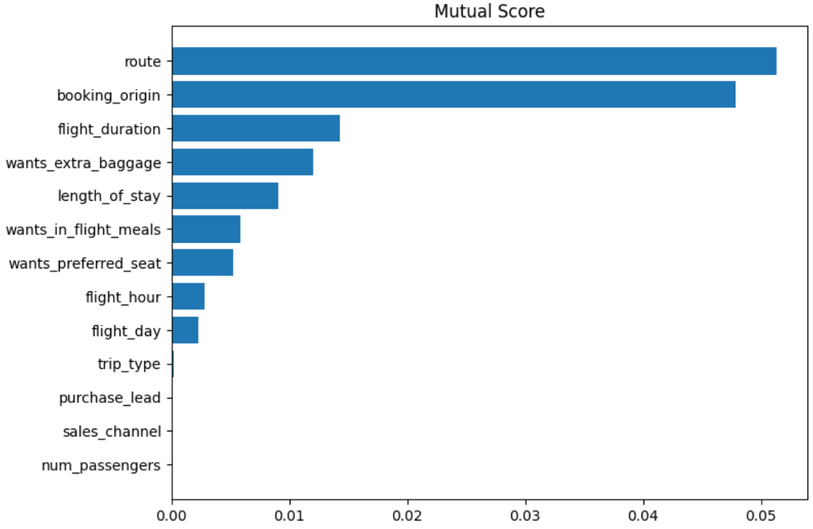
Predictive model to understand factors that influence buying behaviors
We have trained the data set with Random forest classifier model :
ACCURACY: 84.73%
1. Route
2. Booking origin
3. Flight duration
4. Wants_extra_baggage
5. Length_of_stay
Are the Top 5 Features which influence
Customer buying behavior

