Slide 1

Multi Level Parking Management System using Java
Team No. 3 | KLH University | PSP (Java) Project
2620030159
2620030478
2620090036
Kaushal
Sreekar
Chaitanya

Slide 2
ABSTRACT
System Overview
The Multi Level Parking Management System is a console-based Java application that manages vehicle parking across four levels — T1 and T2 for two-wheelers, and F1 and F2 for four-wheelers — with five slots each, totalling 20 parking spaces.
The system handles the full lifecycle of a parking session:
20 Total Slots
4 levels × 5 spots each
Customer and vehicle registration with input validation
Prevention of duplicate active vehicle registrations
Slot allocation by vehicle type and expected duration
Unique token generation and token-based record retrieval
Exit billing: elapsed time rounded up to the next hour, minimum one hour
Rates: ₹20/hr (two-wheeler) and ₹40/hr (four-wheeler)
Text-file persistence — records restored on restart
Auto Billing
Time-based, rounded up per hour
File Persistence
Records survive program restarts

Slide 3

PROBLEM STATEMENT
Understanding the Problem
A. The Problem
Manual management of multi-level parking leads to:
Difficulty identifying available slots across levels
Inability to quickly retrieve a vehicle's parking record
Risk of duplicate active registrations for the same vehicle
Inconsistent billing at exit time
C. Proposed Workflow
B. Project Objectives
Customer Input
Input Validation
Vehicle Selection
Slot Allocation
Token Generation
Manage 20 slots across four levels with type-based allocation
Validate customer, phone, vehicle, and duration inputs
Prevent duplicate active registrations
Generate tokens and support token-based search
Calculate and display exit bills; save and restore records
Console-based Java application with local text-file storage.

Slide 4

CO1
Java Foundations
Topics Applied
Code Examples
Constant Declaration:
Data Types & Variables
Constants
int, long, double, boolean, String — store customer names, vehicle numbers, levels, tokens, and statuses.
static final int SLOTS_PER_LEVEL = 5; — defines parking capacity and hourly rates.
static final int SLOTS_PER_LEVEL = 5;
static final int TWO_WHEELER_RATE = 20;
static final int FOUR_WHEELER_RATE = 40;
Input Parsing:
Console I/O
Operators & Parsing
int choice = Integer.parseInt(
sc.nextLine().trim()
);
Scanner, System.out.println(), and System.out.printf() drive all user interaction.
Arithmetic, relational, logical, and conditional operators; Integer.parseInt(); tokenCounter++ for token generation.
Token Increment:
String token = "PKT" + (++tokenCounter);
Variables, constants, and I/O form the entry point for every parking operation — from registration to billing.

Slide 5


CO2
Control Flow
Control Flow Constructs Used
Display Menu
Read Choice
1
switch
Selects the dashboard operation; break isolates each case.
2
if / if-else
Return to Menu
Execute Operation
Validates customer details, phone, vehicle type, duration, and existing registrations.
Core loop:
do {
showDashboard();
choice = readInt("Enter choice: ");
switch (choice) { ... }
} while (choice != 7);
3
do-while & while
Keeps the menu active until option 7; retries on invalid integer input.
4
for & nested for
Iterates across levels and slots to locate available parking spaces.

Slide 6

CO3
Methods & Arrays
Modular Method Design
Array Structure — 20 Total Slots
Additional helpers: showAvailableSlots(), searchToken(), viewAllDetails(), showDashboardSummary().
Level | S1 | S2 | S3 | S4 | S5
T1 (2W) | ○ | ○ | ○ | ○ | ○
T2 (2W) | ○ | ○ | ○ | ○ | ○
F1 (4W) | ○ | ○ | ○ | ○ | ○
F2 (4W) | ○ | ○ | ○ | ○ | ○
A 2-D boolean occupied[][] array tracks slot occupancy. findSpot() returns the allocated position as int[].
01
02
parkVehicle()
findSpot()
Registers a vehicle and invokes findSpot().
Traverses the 2-D array; returns level & slot as an int[].
03
04
removeVehicle()
saveRecords() / loadRecords()
Completes the session and generates the time-based bill.
Serialize and restore all parking sessions via text file.

Slide 7

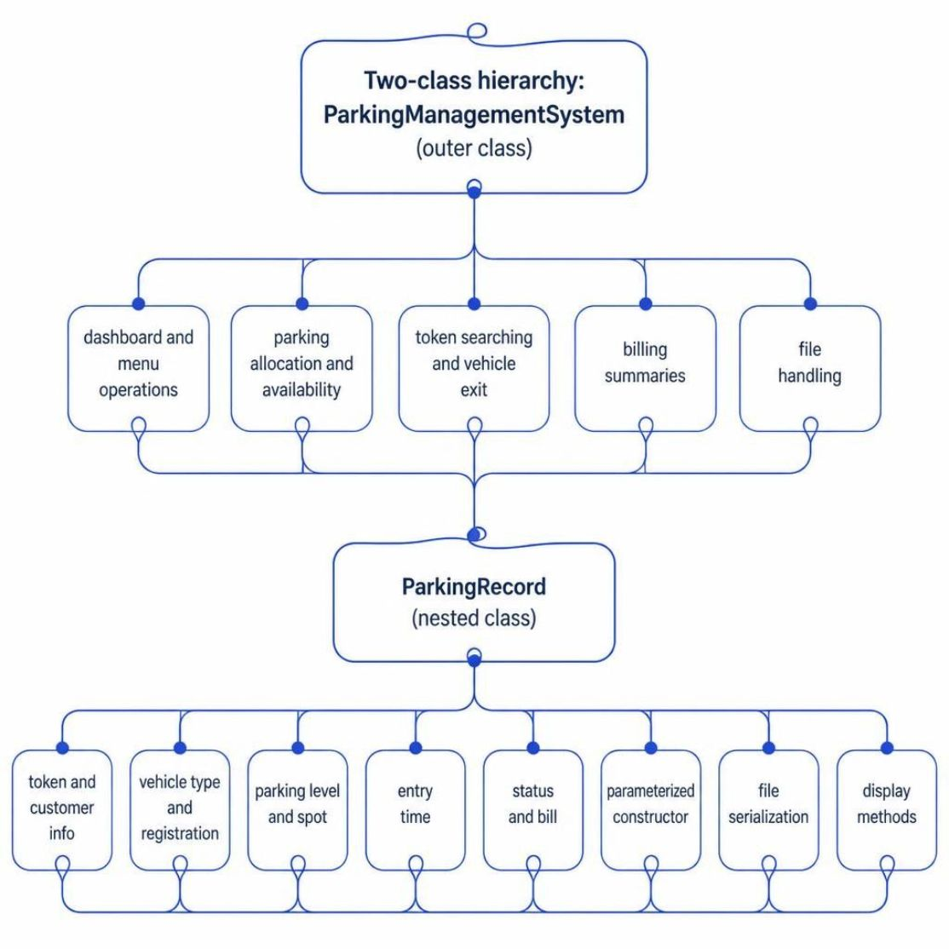
CO4
OOP & Exception Handling
Key OOP Concepts
Object-Oriented Structure
Class & Objects
Static Members
Nested ParkingRecord class groups all session data using parameterized constructors and this keyword.
Shared application state and static final constants defined at class level.
Exception Handling
try-catch blocks handle NumberFormatException (invalid input) and IOException (file errors), preventing abnormal termination.
Code Reference:
ParkingRecord(String token, String name,
String phone, String vehicle,
String type, String level,
int slot, long entryTime,
int duration) {
this.token = token; ...
}

Slide 8



CO5
Strings & File I/O
File Persistence Workflow
String Processing Methods
ParkingRecord Objects
Convert to Pipe-Delimited
trim()
toUpperCase()
Removes surrounding whitespace from all user inputs.
Normalizes vehicle registration numbers for consistent storage.
Read & Reconstruct Records
Write to parking_records.txt
equalsIgnoreCase()
matches()
Code References
Case-insensitive comparisons for status and type checks.
Validates 10-digit phone numbers using a regular expression.
// Write records
Files.write(Path.of(FILE), lines);
// Read and parse on startup
String[] p = line.split("\\|", -1);
split("\\|", -1)
Separates pipe-delimited fields when loading saved records.
Text-file persistence allows parking records to survive program restarts without an external database.

Slide 9

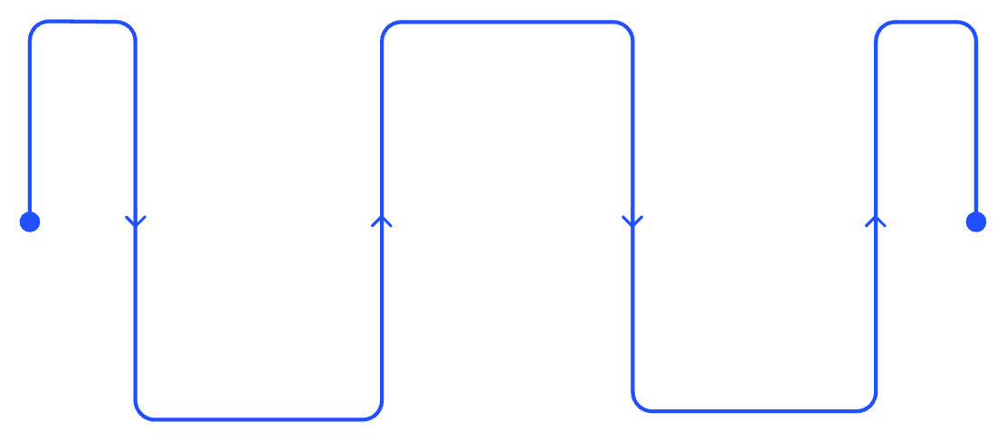
CO6
Collections & Generics
Data Processing Flow
Collections Used in the Project
Iterate & Search
ArrayList<ParkingRecord>
Enhanced for loop traverses list
Primary store for all parking sessions — active and completed. Records are added with add() and traversed with enhanced for loops.
Store Records
Dashboard Summary
ArrayList<String>
ArrayList holds sessions
Compute counts and totals
Holds pipe-delimited lines to be written to the text file during saveRecords().
for (ParkingRecord r : records) {
if (r.status.equals("ACTIVE"))
active++;
total += r.bill;
}
Generics for Type Safety
Type parameters ensure the compiler enforces correct element types throughout the application.
Arrays.asList().indexOf()
Finds the configured parking-level index when reconstructing records from file.
The project uses ArrayList, generics, and iteration only. It does not implement streams, lambdas, HashMap, or HashSet.

Slide 10
CONCLUSION
Summary
Learning Outcomes
The project integrates all six COs: Java fundamentals, control flow, methods & arrays, OOP & exceptions, strings & file I/O, and collections — demonstrating modular design, input validation, and data persistence in a practical application.

Slide 11
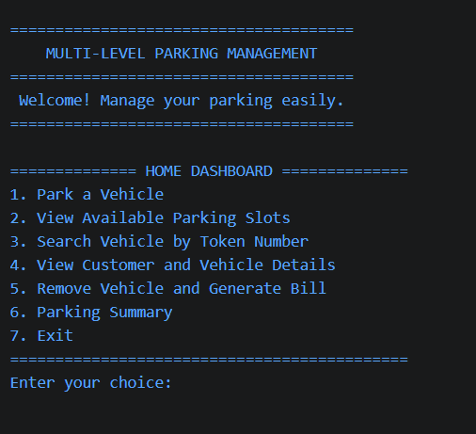
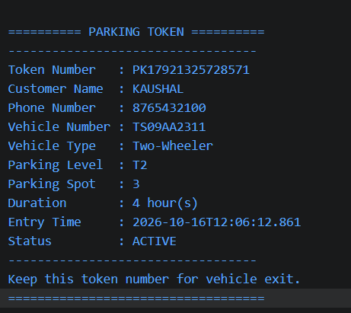
Screen Shots
Parking Dashboard
PARKING A TWO WHEELER

Slide 12
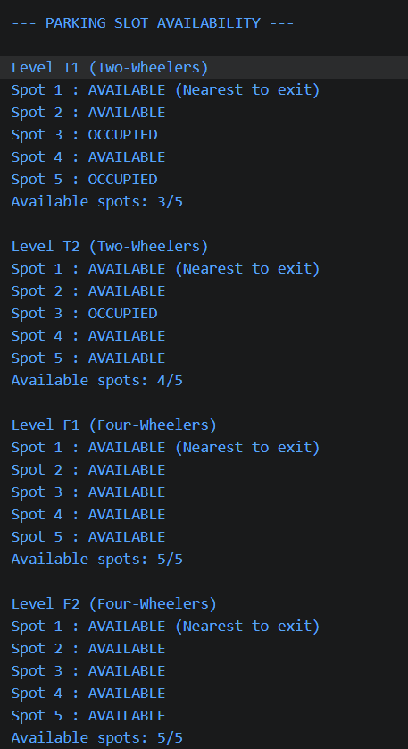
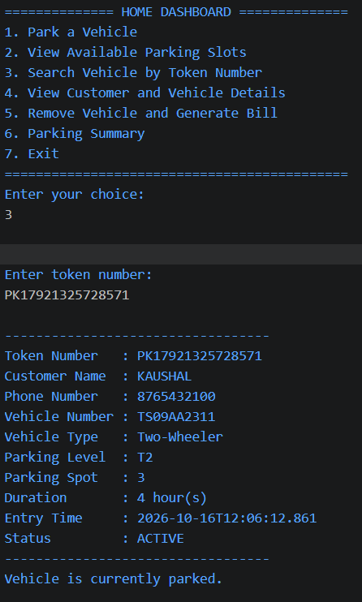
PARKING SLOT AVAILABILITY
SEARCH VEHICLE USING TOKEN NUMBER

Slide 13
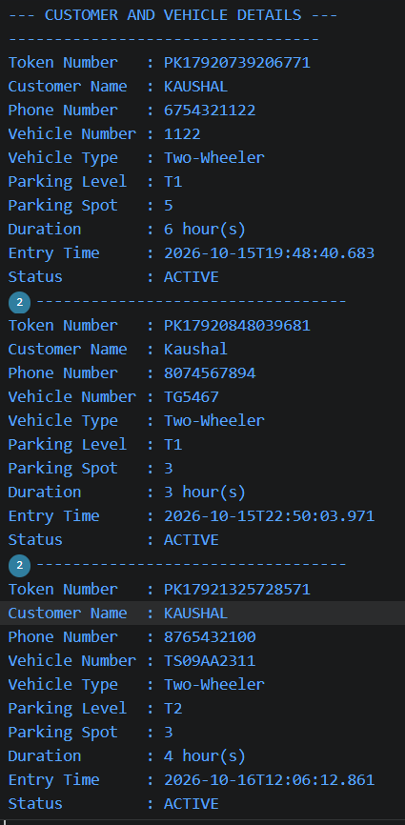
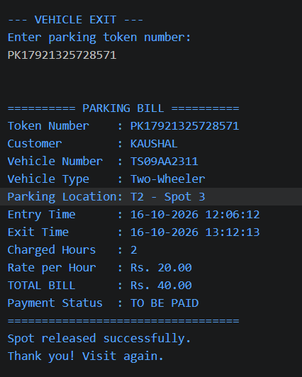
OBTAINING CUSTOMER DETAILS
VEHICLE EXIT

Slide 14
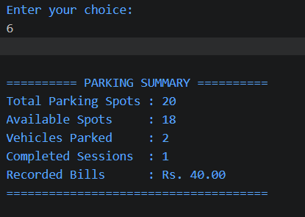
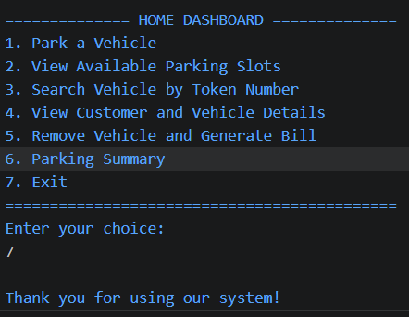
Obtaining the Parking Summary
EXIT THE INTERFACE

Slide 15
Geo Tag Photo and GitHub Link
GITHUB REPOSITORY
https://github.com/srivishwachaitanya/KLH-PSPJ-S16-TEAM.NO-3

