Slide 1
BREADTH FIRST SEARCH IN GRAPH AND ITS APPLICATIONS IN GENOME ASSEMBLY
BATCH A
GROUP 3

Slide 2
Table of contents
Introduction
Literature Review
Background Study
Method
Result
Conclusion
References

Slide 3
INTRODUCTION
Objective
Understanding BFS
Its various applications in real world and in genome sequencing
Implementing one of the applications of it in genome assembly
Scope
Implementing the BFS path finding algorithm
Understanding it's working.
Insight on its advantages and flaws.

Slide 4
Literature Review
BFS has multiple advantages;
Path finding algorithm is based on BFS or DFS
Finding the shortest path between two nodes u and v, with path length measured by number of edges
BFS is used in Ford-Fulkerson algorithm to find maximum flow in a network.
Enabling Graph Appliance for Genome Assembly - Rina Singh , Jeffrey A. Graves , Sangkeun Lee, Sreenivas R. Sukumar and Mallikarjun Shankar
Graph Theory – Breadth First Search – Kelvin Jose
Maximum Likelihood Genome Assembly - Paul Medvedev and Michael Brudno

Slide 5
BACKGROUND STUDY
Genome assembly
Genome sequencing is the technique of determining the sequences of nucleotide bases in an organism's genome.
Medical diagnostics, molecular biology, forensic biology, biotechnology, and biological research
Biomedical and data scientists, assembling such a vast amount of data is one of the most difficult computing issues.

Slide 6
BACKGROUND STUDY
BFS
technique used to explore the edges and vertices of a graph
Time complexity - O(V+E) , where O, V, and E stand for Big O, vertices, and edges, respectively
Traversal - the breadth before the depth.
Various applications like general application as well as path finding.

Slide 7
METHODS
A recursive algorithm for searching all the vertices of a network or tree is called Breadth-First Search.
The algorithm Breadth-First Search (BFS) is used to traverse graphs or trees.
Traversing a graph entails visiting every node.
Data structures such as a dictionary and lists can be used to build BFS in Python.
The breadth-first search in a tree and a graph is nearly same.
The only difference is that the graph might have cycles, allowing us to return to the same node.

Slide 8
STEPS OF THE ALGORITHM :
Put any of the graph's vertices at the end of the queue to begin.
Take the first item in the queue and add it to the list of items that have been visited.
Make a list of the nodes that are next to that vertex. Toss individuals who aren't on the visited list to the back of the line.
Steps two and three should be repeated until the queue is empty.
Because a graph might sometimes have two separate unconnected portions, we can execute the BFS algorithm at each node to ensure that we've visited every vertex.

Slide 9
Pseudo CODE
The pseudocode for BFS in python goes as below:
create a queue Q
mark v as visited and put v into Q
while Q is non-empty
remove the head u of Q
mark and enqueue all (unvisited) neighbors of u

Slide 10
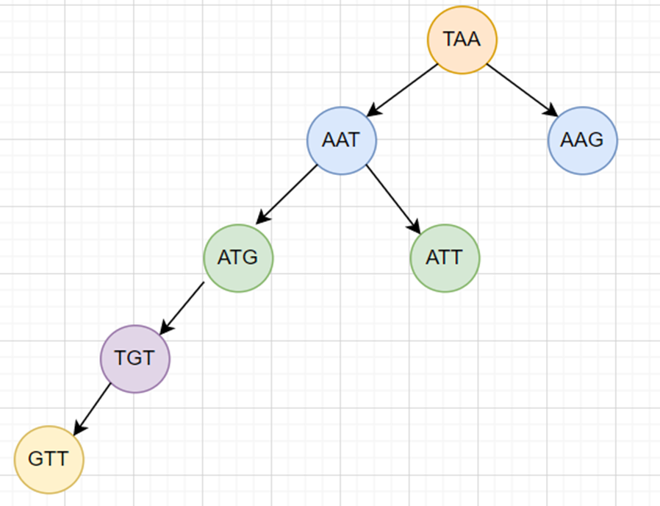
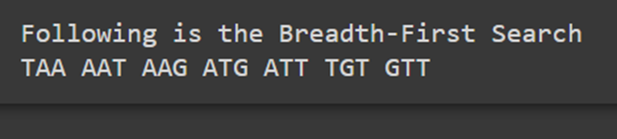
RESULT
INPUT :
SCREEN SHOT OF THE OUTPUT :

Slide 11
Discussion
BFS selects a single node in a graph and then visits all the nodes adjacent to the selected node.
The visited and marked data is placed in a queue by BFS.
A queue works on FIFO basis and performs pop for result.
The BFS algorithm can never get caught in an infinite loop.
High precision and robust implementation

Slide 12
Conclusion
Various applications of BFS was discussed, and one of these application was successfully implemented.
It consumes a significant amount of memory.
It has a greater level of time complexity.
It always finds a path and is efficient.
It has long pathways when all paths to a destination have about the same search depth.

Slide 13
References
Medvedev, Paul, and Michael Brudno. “Maximum likelihood genomeassembly.” Journal of computational biology : a journal of com-putational molecular cell biology vol. 16,8 (2009): 1101-16.doi:10.1089/cmb.2009.0047
Wenyu Shi, Peifeng Ji, Fangqing Zhao, The combination of direct andpaired link graphs can boost repetitive genome assembly, Nucleic AcidsResearch, Volume 45, Issue 6, 7 April 2017, Page e43
https://www.tutorialspoint.com/applications-of-dfs-and-bfs-in-data-structures#:~:text=Using%20GPS%20navigation%20system%20BFS,maximum%20flow%20in%20a%20network
https://www.cd-genomics.com/blog/dna-sequencing-definition-methods-and-applications/#:~:text=Homologous%20DNA%20sequences%20from%20different,of%20diseases%20and%20epidemiology%20studies
https://www.writeexpress.com/recomm06.html

Slide 14
THANK YOU

