Slide 1
Customer segmentation using K-means clustering
Members
AM.EN.U4AIE20046 MADDALA H S M KRISHNA KARTHIK
AM.EN.U4AIE20042 KONIJETI SRI VYSHNAVI
AM.EN.U4AIE20049 METHUKU SAMHITHA
AM.EN.U4AIE20070 SURAVARAPU ANKITH

Slide 2
INTRODUCTION
Segmentation is an essential tool used by a majority of businesses to understand and categorize customers based on their spending habits, income group, age, etc.
Clustering can also be extended and used in the imaging domain to split or subdivide images according to the colour pattern, grey level, contract, etc.
For businesses like E-commerce, understanding customer segments plays a vital role in up-selling and cross-selling.
This is just the tip of the iceberg. Customer segmentation is a broad concept altogether.

Slide 3

PROBLEM STATEMENT : Customer segmentation using k means clustering
It is finding the most profitable customer groups within the entire pool of customers.
With this we can better understand customer interests, choices and purchasing patterns which will give us an idea of which attributes are more tightly related to the customers and the business as well.

Slide 4
Challenges
As we are owing a supermarket mall and through membership cards, we have some basic data about your customers like Customer ID, age, gender, annual income and spending score.
We want to understand the customers like who are the target customers so that the sense can be given to marketing team and plan the strategy accordingly.

Slide 5

SOLUTION APPROACH
K-means clustering algorithm is an unsupervised machine learning algorithm that uses multiple iterations to segment the unlabeled data points into ‘k’ different clusters in a way such that each data point belongs to only a single group which has similar properties.
Steps in K-means:
Initialization, Cluster Assignment, Moving Centroid , Optimization, Convergence.

Slide 6
K Means Clustering Algorithm
Specify number of clusters K.
1
Initialize centroids by first shuffling the dataset and then randomly selecting K data points for the centroids without replacement.
2
Keep iterating until there is no change to the centroids. i.e assignment of data points to clusters isn’t changing.
3

Slide 7
DATA
The dataset used in this project is Mall_Customers.csv which contains data about the customers from a mall.
The dataset can be downloaded from the Kaggle website which can be found here.
The data includes the following features:
1. Customer ID
2. Customer Gender
3. Customer Age
4. Annual Income of the customer (in Thousand Dollars)
5. Spending score of the customer (based on
customer behavior and spending nature)
GitHub links: 1 , 2

Slide 8
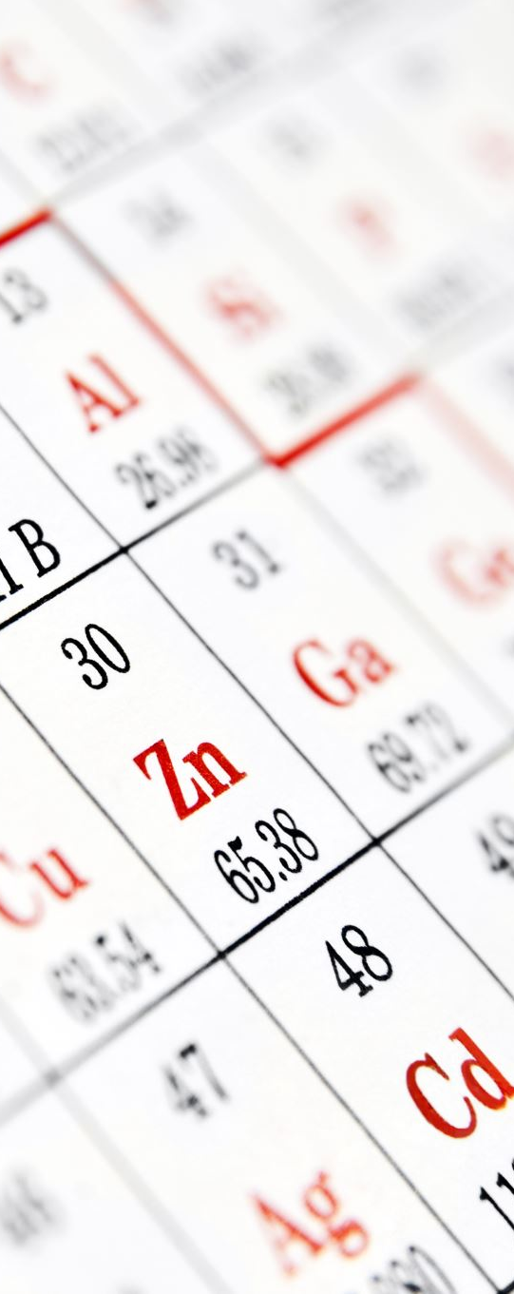
IMPLEMENTATION
Number of customers in the dataset are 200.
Shape of the data: (200, 5)
We used python for the implementation.
For the implementation we started by importing necessary libraries.
We looked into the data distribution like "Annual income", "Age", "Spending Sore".
We have made more visualizations to understand the data analysis and overall data exploration.

Slide 9
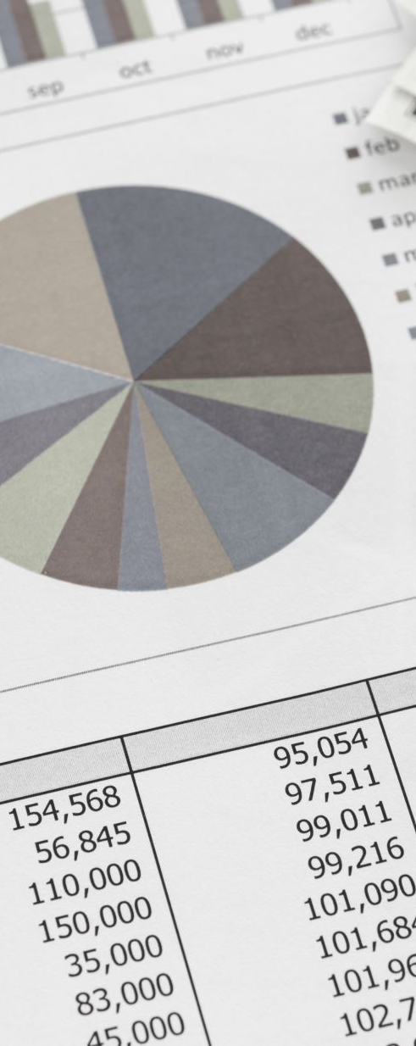
Contd...IMPLEMENTATION
For better understanding we plotted graphs for "Number of customers vs Customer age", "Number of customers" vs "Spending scores", "Number of customers" vs "Income"
CLUSTERING BASED ON 2 FEATURES :
We worked with two features only, annual income and spending score.
After plotting the input data, we calculated the Within cluster sum of squared error(WSS) to figure out the optimal number of cluster values.

Slide 10
Contd...IMPLEMENTATION
The obtained plot will be an elbow curve.
We took the new data frame with the clustering. Plotting the graph, we can clearly see the customers with " Least income and least spending score" and " Most income and most spending score".
K-MEANS CLUSTERING ON THE BASIS OF 3D DATA :
Working on 3 types of data like the "spending scores", "annual income of customers", "age of the customers".
Calculated the WCSS for different values of k and plotted the graph.

Slide 11
OBSERVATION
From the above customer segregation I have come to know that:
Customers with the highest spending value are between the ages of 20–40. This tells us that young and old alike are the biggest buyers which is why they spend so much money.
Customers with a maximum annual income of between 70 (approx) to 140 (k $) have a maximum spending rate of between 60–100. This tells us that the highest annual income has a direct relationship with the average spending rate so the more opportunities you get the more you will spend on purchasing.

Slide 12
REFERENCES
REFERENCE 1
REFERENCE 2
REFERENCE 3
REFERENCE 4
REFERENCE 5
REFERENCE 6
REFERENCE 7

