Slide 1

Improving the classification accuracy in the case of Unbalanced dataset
Group-19
Konijeti Sri Vyshnavi AM.EN.U4AIE20042
Maddala H S M Krishna Karthik AM.EN.U4AIE20046
Methuku Samhitha AM.EN.U4AIE20049
Suravarapu Ankith AM.EN.U4AIE20070
Presenter : Konijeti Sri Vyshnavi AM.EN.U4AIE20042

Slide 2
Problem Statement
Credit card payment is one of the prevalent means of transactions carried out in both online and offline purchases.
Latest technology and worldwide communications, fraud has increased significantly.
In Credit card fraud transactions there are so many ways to find like Random forest,rule based mining, neural network etc.
The Best method to detect that transaction is fraud or not by using XGBoost method.
It having more accuracy with compared to other models.
We are doing XGBoost with imbalance in the dataset with using resampling techniques.

Slide 3
Methods Implementation
Step 1: Start the process
Step 2: Load the available Credit Card Fraud Detection(CCFD) dataset.
Step 3: Normalize the number of features
Step 4: Divide the dataset into two parts first one is in training & the other one is in testing
Step 5: After this get undersampled transaction data
Step 6: On this undersampled transaction data apply XGBoost classifier to classify fraud activities
Step 7: Evaluate results by accuracy, precision, recall, AUC and ROC curves.
Step 8: Stop.
Github link

Slide 4
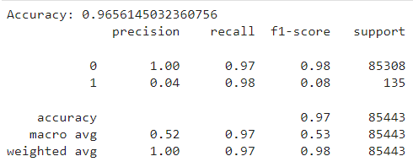
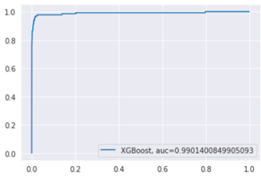
Result and Conclusion
The performance of the classifier is measured and it has an accuracy of 97%.
Also, the performance is measured using ROC and AUC curves. And it has an AUC of 0.99.
As we know that the greater the AUC, the better the model is at distinguishing between normal and fraud transactions.
We conclude that we have reached a very satisfactory number in detecting fraud in relation to the original model, which has increased to 97%.

Slide 5
References
C. V. Priscilla and D. P. Prabha, "Influence of Optimizing XGBoost to handle Class Imbalance in Credit Card Fraud Detection," 2020 Third International Conference on Smart Systems and Inventive Technology (ICSSIT), 2020, pp. 1309-1315, doi: 10.1109/ICSSIT48917.2020.9214206
Vedant Mayekar, Siddharth Mattha, Sohan Choudhary, Prof Amruta Sankhe. “ONLINE FRAUD TRANSACTION DETECTION USING MACHINE LEARNING”, International Research Journal of Engineering and Technology (IRJET) Volume: 08 Issue: 05, May 2021
Nishant Sharma, “CREDIT CARD FRAUD DETECTION PREDICTIVE MODELING”, A Paper Submitted to the Graduate Faculty of the North Dakota State University of Agriculture and Applied Science, May 2019.
L. L. Minku, S. Wang, and X. Yao, “Online ensemble learning of data streams with gradually evolved classes,” IEEE Transactions on Knowledge and Data Engineering, vol.28, no. 6, pp. 1532–1545, 2016.
] Bhusari, V., & Patil, S. (2016). Study of hidden markov model in credit card fraudulent detection. In 2016 World Conference on Futuristic Trends in Research and Innovation for Social Welfare (Startup Conclave) (pp. 1-4). IEEE.

