Slide 1
Social Distance detection Technology Demonstration
Group – 06
Sai Nikitha Anumakonda (811234655)
Manogna Reddy Voladri (811291665)
Sriya kotu (811294038)
Sai Bhargavi Pusuluri (811284151)
Abhinaya Kapilavai (811289494)
Deepika Mothukuri (811287048)

Slide 2
The Social Distance Detection System is a software solution designed to monitor and enforce social distancing measures in public spaces, workplaces, and other environments. Its purpose is to mitigate the spread of infectious diseases, such as COVID-19, by alerting individuals when they are too close to others. The system aims to deliver enhanced public health and safety by promoting adherence to social distancing guidelines.

Slide 3
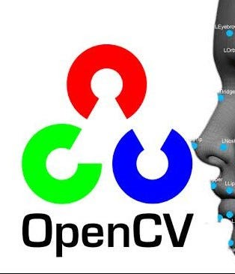
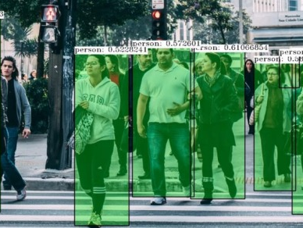
OpenCV
OpenCV, or Open-Source Computer Vision Library, is an open-source computer vision and machine learning software library. It provides a wide range of tools and algorithms for processing images and videos, including capabilities such as object detection, facial recognition, image segmentation, motion tracking, and more
The cv2 module is the main module in OpenCV that provides developers with an easy-to-use interface for working with image and video processing functions.

Slide 4
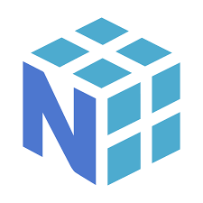
Numpy NumPy is a fundamental package for numerical computing in Python. It provides support for multidimensional arrays, matrices, and mathematical functions to operate on these arrays efficiently. NumPy stands for Numerical Python.

Slide 5
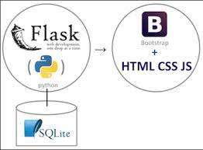
Flask Flask is a lightweight and flexible web framework for Python. It is designed to make it easy to build web applications quickly. Flask is classified as a micro-framework because it does not require any particular tools or libraries, allowing developers to choose the components they need for their projects.

Slide 6
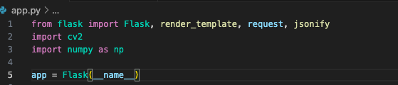
Imports..

Slide 7
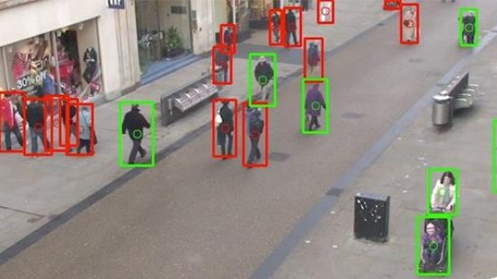
YOLO YOLO is a Convolutional Neural Network (CNN), a type of neural network, which are very good at detecting patterns (and by extension objects and the like) in images. YOLOv3 (You Only Look Once, Version 3) is a real-time object detection algorithm that identifies specific objects in videos, live feeds or images.

Slide 8
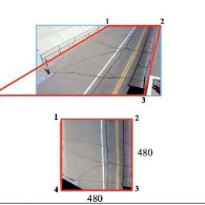
Camera View Calibration
Camera calibration is the process of determining certain parameters of a camera to fulfill desired tasks with specified performance measures. The reader is referred to entry Calibration for a general discussion on calibration. We typically follow the below steps in our project.
Camera View Calibration
Object detection
Estimate Object Dimensions
Compute Distance

Slide 9

GITHUB for collaboration https://github.com/manogna27/Social_Distance_Detection

Slide 10
Thank You !!

