Slide 1
Cricket Analytics: Predicting IPL Match Results using Historical Data and Machine Learning
Team4 Members:
Sadiya Sayara Chowdhury Puspo
Sai Padma Sriya Pothula
Mohan Adhi

Slide 2
Sadiya Sayara Chowdhury Puspo
Ph.D. Student
Information Science & Technology
Research Field: Natural Language Processing

Slide 3
Outline
Motivation
Problem Statement
Research Questions & Hypothesis
How?
Exploratory Data Analysis
Model Implementation
What?
Results Analysis
Model-drive Insights
Conclusion & Future Work
Dataset Analysis
Why?
Related Work

Slide 4
Why?
Motivation
Problem Statement
Research Questions & Hypothesis
Related Work

Slide 5
Motivation
Complexity: Cricket outcomes depend on performance, strategies, pitch/weather, and external factors like crowd and home advantage.
Unpredictability: Unlike fixed-parameter sports, cricket's variability makes predictions difficult.
IPL & T20: Competitive matches with top players and fast-paced T20 format (20 overs) make small errors decisive, requiring a balance of aggression and strategy.

Slide 6
Problem Statement
Develop a data-driven machine learning model to predict IPL match outcomes and analyze critical factors influencing results.
Focus on Smarter Decision-making
Deciding whether to bat or bowl first after winning the toss.
Allocating key players strategically during the match.
Beyond Match Predictions
Assess player performance.
Aid in team selection and match preparation.

Slide 7
Research Questions & Hypothesis
How does winning the toss affect the probability of winning a match?
Hypothesis: Winning the toss increases the likelihood of winning by enabling strategic decisions aligned with conditions.
What is the role of powerplay performance in determining match outcomes?
Hypothesis: Teams with higher runs and fewer wickets lost during powerplays are more likely to win.
Can individual player metrics predict the Player of the Match award?
Hypothesis: Higher strike rates, economy rates, and runs scored or wickets taken strongly correlate with Player of the Match awards.

Slide 8
Related Work
Success and Challenges:
Lamsal & Choudhary (2018): Random Forest, 68.33% accuracy (toss outcomes, team composition).
Singhvi et al. (2015): SVM, Random Forest, 63.89% accuracy (T20 matches).
Limited features hinder model performance.
Advances in ODI Analysis:
Naik et al. (2018): Player stats, bowler performance, batting order.
Swetha & Saravanan (2017): Impact of weather, pitch, and crowd support.
Emerging Techniques:
LSTM Models: Temporal analysis of dynamic games (Sundar et al., 2021).
Reinforcement Learning: Tactical optimization (Gupta et al., 2022).
Explainable AI: SHAP for interpretable predictions.

Slide 9
How?
Dataset Analysis
Exploratory Data Analysis
Methodology &
Model Implementation

Slide 10
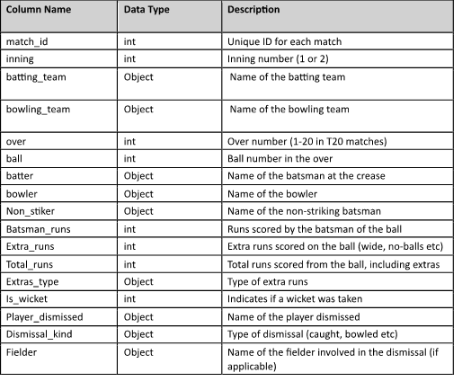
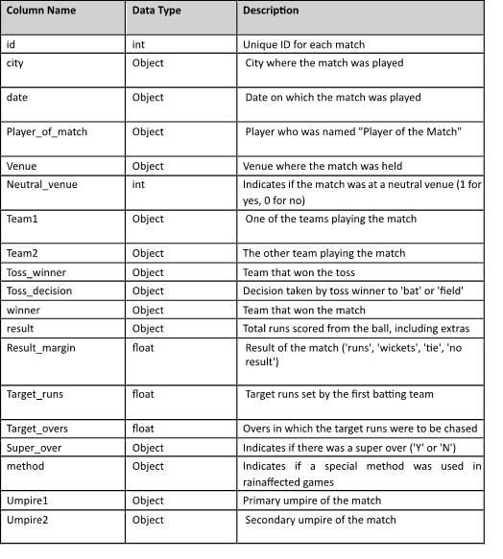
Dataset Analysis
The dataset for this project was sourced from Kaggle*
Matches Dataset: Contains match-level data from 2008 to 2020, highlighting toss results, venue details, and match outcomes.
Deliveries Dataset: Provides ball-by-ball data for all IPL matches, enabling analysis of specific game phases like powerplays and death overs.
*www.kaggle.com/datasets/patrickb1912/ipl-complete-dataset-20082020

Slide 11
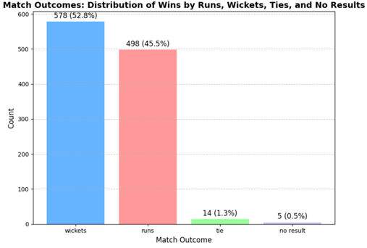
Exploratory Data Analysis - 1
Match Outcome Distribution:
The Bar chart here showcases the match outcomes by wickets, runs, ties, and no results.
Data summary:
Wins by wickets: 578 (52.8%)
Wins by runs: 498 (45.5%)
Ties: 14 (1.3%)
No results: 5 (0.5%)
Teams tend to win more often by wickets than runs, indicating a preference for chasing teams.
The rarity of ties and no results underscores the decisive nature of the league.

Slide 12
Sai Padma Sriya Pothula
Master’s in Data Analytics Engineering

Slide 13
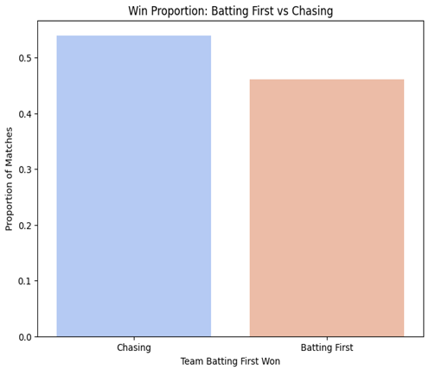
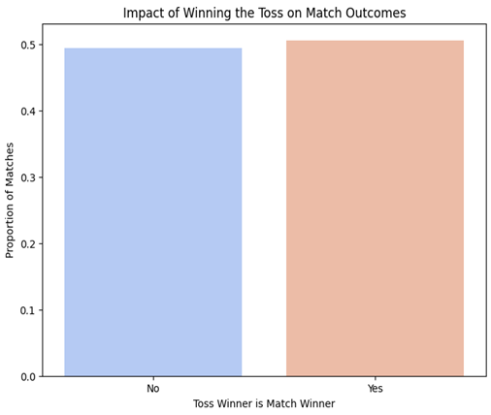
Exploratory Data Analysis - 2
Graph 1: Winning the toss has minimal impact on match outcomes if the bars are similar in height, indicating other factors play a more significant role.
Graph 2: A taller blue bar suggests chasing is often advantageous, while a taller salmon bar implies batting first may offer a strategic edge.

Slide 14
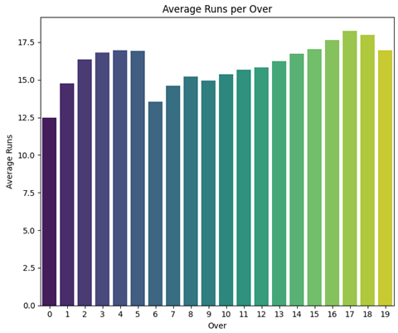
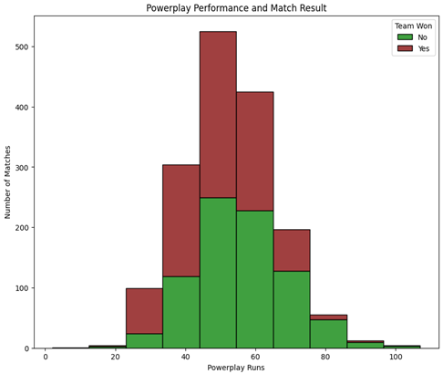
Exploratory Data Analysis - 3
Graph 1: Scoring rates increase progressively towards the final overs, suggesting teams take more risks in the latter part of the innings to maximize their total score.
Graph 2: While a strong Powerplay performance (30-60 runs in the first 6 overs) is crucial, the overlap between winning and losing teams indicates it is not always a decisive factor in determining match outcomes.

Slide 15
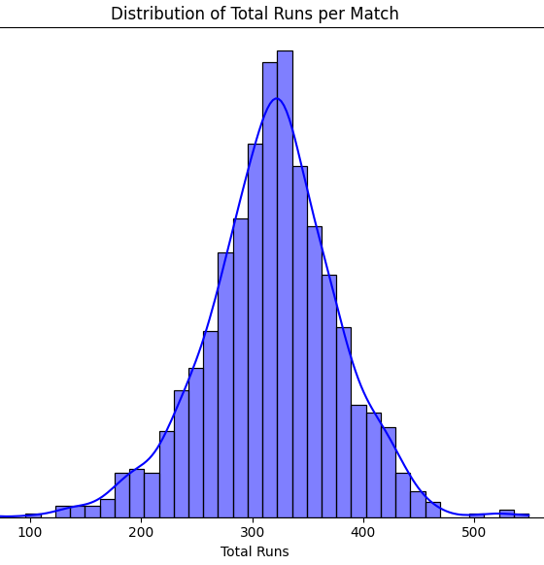
Exploratory Data Analysis - 4
The histogram shows the distribution of total runs scored in cricket matches, forming a bell-shaped curve.
Most matches end with total scores clustering around 300 runs, which is the peak of the distribution.
Scores below 200 runs and above 400 runs are less frequent, highlighting the typical scoring range in matches.
The symmetrical distribution indicates consistency in match conditions, such as pitch behavior and team strategies.
The histogram helps identify average scoring patterns, which can be useful for analyzing team performance and setting competitive targets.

Slide 16
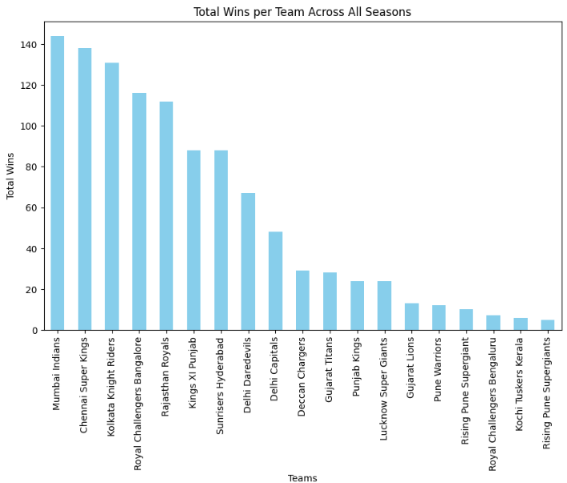
Exploratory Data Analysis - 5
Total wins per Team across all Seasons:
Mumbai Indians lead with the highest number of wins, followed closely by Chennai Super Kings, indicating their consistent dominance in the league.
Teams like Sunrisers Hyderabad and Delhi Capitals show mid-tier performance with moderate win counts.
Newer or short-lived teams, such as Gujarat Titans, Lucknow Super Giants, and Rising Pune Supergiants, have fewer wins due to limited participation.
The chart highlights disparities in performance, with certain teams maintaining long-term success while others show variability or limited opportunities.

Slide 17
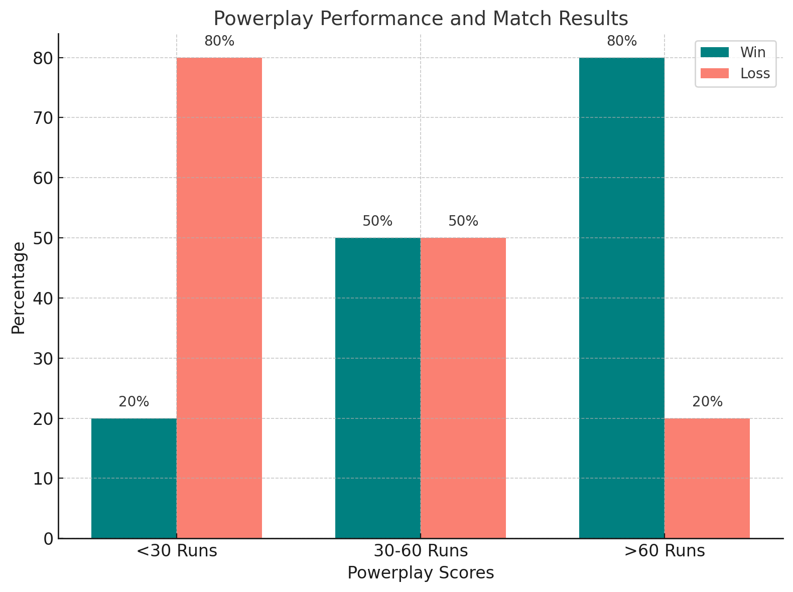
Exploratory Data Analysis - 6
Powerplay Performance and Match Results:
The graph shows a clear trend where higher powerplay scores correlate with increased chances of winning.
Teams scoring less than 30 runs in the powerplay have only a 20% chance of winning, highlighting the importance of early momentum.
Balanced outcomes are observed for scores between 30-60 runs, with a 50% win probability.
Scoring over 60 runs in the powerplay significantly boosts the win probability to 80%, emphasizing the advantage of aggressive starts.
The graph reflects how powerplay performance is a critical phase, impacting team strategies and overall match outcomes.

Slide 18
Methodology
Implemented Models:
Naïve Bayes
Random Forest and
Logistic Regression
Dataset Split:
training (60%)
validation(20%)
testing (20%)
Evaluation Metrices:
Accuracy
F1-score
Precision
Recall

Slide 19
Adhi Mohan
Master’s in Data Analytics Engineering

Slide 20
What?
Results Analysis
Model-drive Insights
Conclusion & Future Work

Slide 21
Does Winning the Toss Affect Match Outcomes?
Model | Accuracy | Precision (Loss/Win) | Recall (Loss/Win) | F1-Score (Loss/Win)
Naïve Bayes | 54.29 | 0.54 / 0.54 | 0.49 / 0.60 | 0.54 / 0.54
Random Forest | 48.00 | 0.47 / 0.49 | 0.42 / 0.53 | 0.44 / 0.51
Logistic Regression | 56.83 | 0.61 / 0.56 | 0.29 / 0.82 | 0.39 / 0.67
Research Question 1
Naive Bayes: Accuracy of 54.29%, with balanced accuracy of 54.19%, indicating moderate prediction performance.
Random Forest: Accuracy of 48%, with slightly better performance in predicting wins (F1-score: 0.51) compared to losses (F1-score: 0.44).
Logistic Regression: Best accuracy at 56.83%, excelling in predicting wins (Recall: 82%) but weaker for losses (Recall: 29%).
Insights: Toss outcomes have a limited impact on match results, with other factors like powerplay performance playing a larger role.

Slide 22
Role of Powerplay Performance in Determining Match Outcome
Model | Accuracy | Precision (Loss/Win) | Recall (Loss/Win) | F1-Score (Loss/Win)
Naïve Bayes | 64.37% | 0.65 / 0.63 | 0.61 / 0.68 | 0.65 / 0.63
Random Forest | 56.00% | 0.53 / 0.58 | 0.52 / 0.59 | 0.52 / 0.59
Logistic Regression | 63.00% | 0.61 / 0.65 | 0.61 / 0.65 | 0.61 / 0.65
Research Question 2
Naive Bayes: Accuracy of 64.37%, with balanced accuracy of 64.37%, showing moderate prediction capability for losses (Sensitivity: 60.86%) and wins (Specificity: 67.89%).
Random Forest: Accuracy of 56.00%, performing slightly better for wins (F1-score: 0.59) compared to losses (F1-score: 0.52).
Logistic Regression: Best accuracy at 63.00%, with consistent performance for both wins and losses (Precision: 0.61 / 0.65, Recall: 0.61 / 0.65).
Insights: Powerplay performance moderately impacts match outcomes, with all models showing reasonable predictive ability.

Slide 23
Influence of Individual Performance Metrics on Player of the Match
Model | Accuracy | Precision (No Award/Won Award) | Recall (No Award/Won Award) | F1-Score (No Award/Won Award)
Naïve Bayes | 86.23% | 0.04 / 0.00 | 0.94 / 0.00 | 0.04 / 0.00
Random Forest | 92.00% | 0.97 / 0.25 | 0.94 / 0.42 | 0.96 / 0.32
Logistic Regression | 86.57% | 0.87 / 0.00 | 1.00 / 0.00 | 0.93 / 0.00
Research Question 3
Naïve Bayes: Accuracy of 86.23%, with high recall for "No Award" (94%) but fails to predict "Won Award" (Recall: 0%).
Random Forest: Best accuracy at 92%, performing well for "No Award" (F1-score: 0.96) but moderately for "Won Award" (F1-score: 0.32).
Logistic Regression: Accuracy of 86.57%, excelling in predicting "No Award" (F1-score: 0.93) but fails for "Won Award" (F1-score: 0%).
Conclusion: Models perform better at predicting "No Award" but struggle with "Won Award" due to class imbalance, suggesting the need for additional features or balanced data.

Slide 24
Conclusion
Impact of Toss:
Slight improvements in accuracy suggest toss has minimal influence on match outcomes.
Indicates other factors play a more significant role.
Powerplay Performance:
Moderate correlation with match outcomes (runs scored, wickets lost).
Naïve Bayes and Logistic Regression performed relatively better, making this stage a valuable predictive feature.
Individual Player Metrics:
Challenges in predicting "Player of the Match" awards due to class imbalance.
Random Forest struggled with minority classes, emphasizing the need for improved feature engineering.

Slide 25
Future Work
Enhanced Features:
Incorporate detailed player stats (e.g., boundary frequency, strike rates at different game stages, performance in high-pressure situations).
Analyze effects of pitch and weather conditions on match outcomes.
Advanced Techniques:
Explore ensemble methods or deep learning models for capturing complex data relationships.
Temporal Insights:
Conduct temporal analysis of player performance across different match phases to improve predictive accuracy

Slide 26
Timeline
14 Sep
Problem Statement and generating Research Questions
17 Sep
Project Proposal
29 Sep
Data Preprocessing
7 Oct
Project Milestone 1
29 Oct
Preliminary Results from Baseline
11 Nov
Project Milestone 2
25 Nov
Preparaing Final Report & presentation
6 Dec
Project Submission
Exploratory Data Analysis
20 Oct

Slide 27
Website Link
https://mason.gmu.edu/~spuspo/project.html

Slide 28
Thank you! Any Questions?

