Slide 1

Engineering Exploration Project Seminar on Handwritten Digit Recognition
Bodagala Geethika – 160121733142
Chintha Sowjanya – 160121733144
Ega Sriya Reddy – 160121733147
Nandipati Abhitesh – 160121733186
Core branch: CSE, C3
Mentor: K. Sagar Designation: Professor

Slide 2
Contents
Background
Motivation
Problem Statement
Formulation
Theory
Implementation/Work Flow
Results & Discussion
Summary
Future scope
References

Slide 3
Background
Countless documents such as orders, delivery notes and invoices are issued on a daily basis. These documents must then be captured in corporate IT systems in some way.
Scientists have always dreamed of using machines to replicate human capabilities. This includes reading and categorizing what is read. The origins of optical character recognition (OCR) date back to 1870 an American inventor, invented the retina scanner – an image transfer system that uses a mosaic of photocells.
It was not until the 1950s and the invention of the Optacon that the potential applications that OCR can have in the business world were recognized. From that time on, the focus of development was also on the possible applications of OCR for businesses.

Slide 4
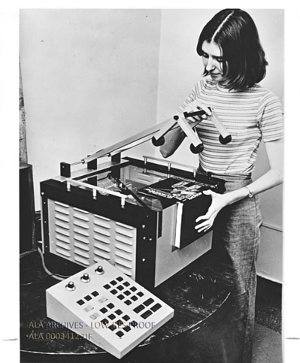
Background
The first OCR was at the American magazine Reader’s Digest. This device was used to convert typewritten sales reports into punch cards that could be read and searched by computers.
A few years ago, the first attempts to combine OCR with machine learning were made. In 2013 the famous MNIST (Modified National Institute of Standards and Technology database) was established. This database consists of handwritten letters and numbers and is used for machine learning training. With this, document capture has made the step into the latest digital revolution and the focus has been on complete automation since then.

Slide 5

Motivation
There are many OCR based applications available that can extract text from an image but they lack the accuracy to provide the same function for handwritten text. In addition, the process of typing every word would be a time consuming and daunting task. Another benefit of converting handwritten notes into a computerized text document is that we do not need to worry about the maintenance of the book. In addition, new information can be added and modified something that cannot be done on a simple scanned text document.

Slide 6
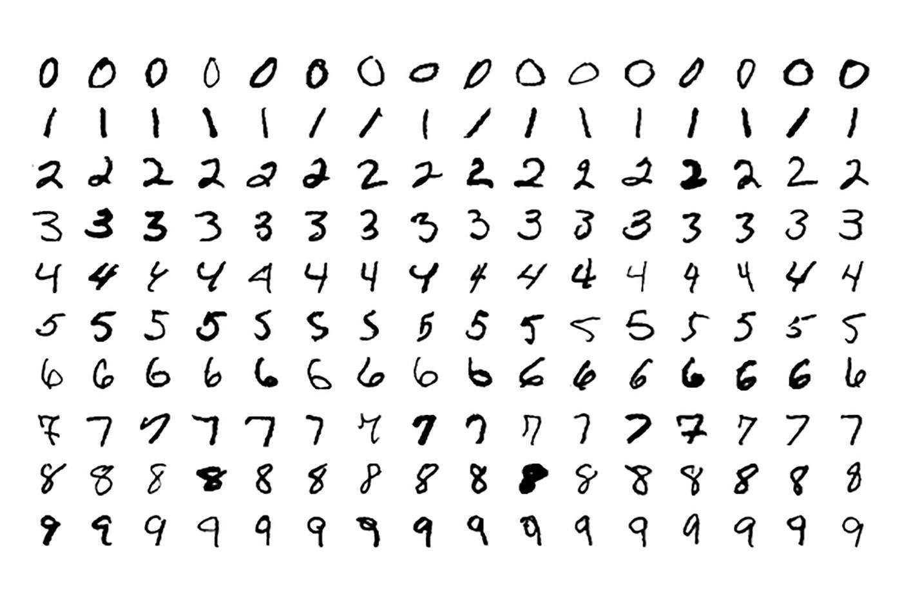
Problem Statement
It is easy for the human to perform a task accurately by practicing it repeatedly and memorizing it for the next time. Human brain can process and analyze images easily. Also, recognize the different elements present in the images.
In this competition, the goal is to correctly identify digits from a dataset of tens of thousands of handwritten images and experiment with different algorithms to learn first-hand what works well and how techniques compare.

Slide 7
Formulation
Importing Libraries
Preprocessing and getting Data
Shrinking/Normalizing Images
Expanding Dimensions of Images
Specifying the values to the CNN Model
Optimizing the model
Callbacks (Early Stopping, Model Checkpoint)
Model Training
Making GUI

Slide 8
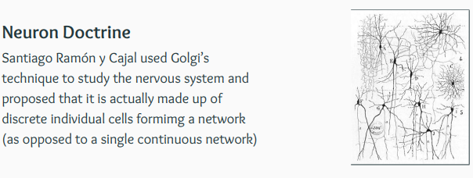
Theory

Slide 9
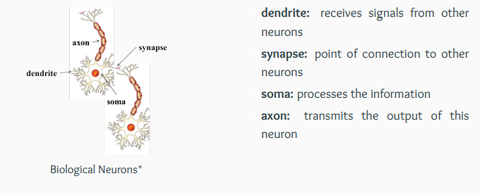
Theory

Slide 10
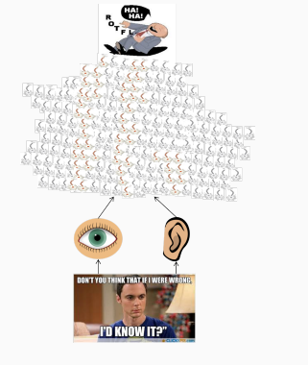
Theory

Slide 11
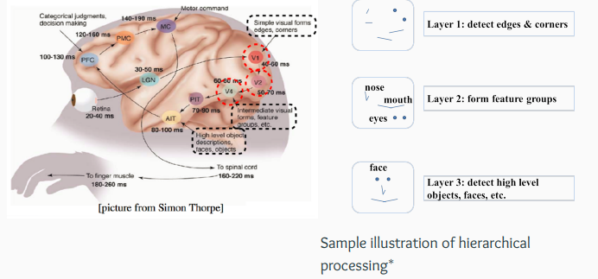
Theory

Slide 12
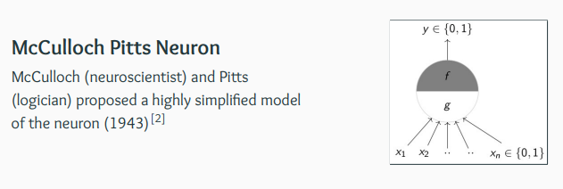
Theory

Slide 13
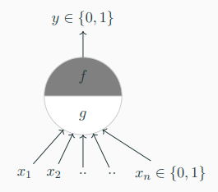
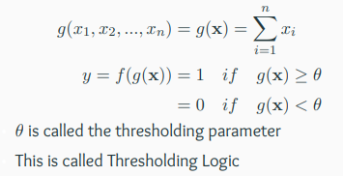
Theory

Slide 14
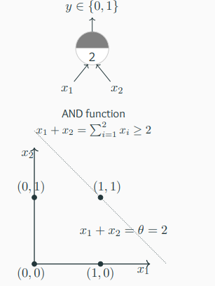
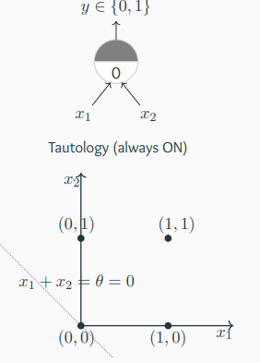
Theory

Slide 15
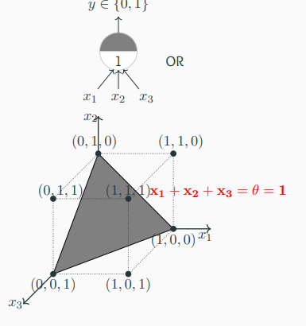
Theory

Slide 16
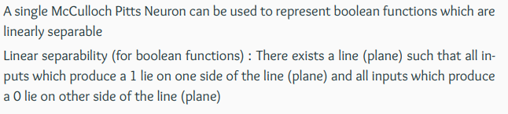
Theory

Slide 17
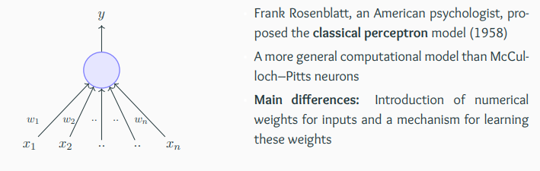
Theory

Slide 18
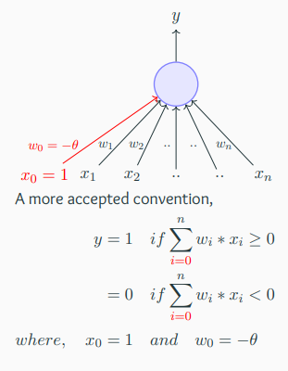
Theory

Slide 19
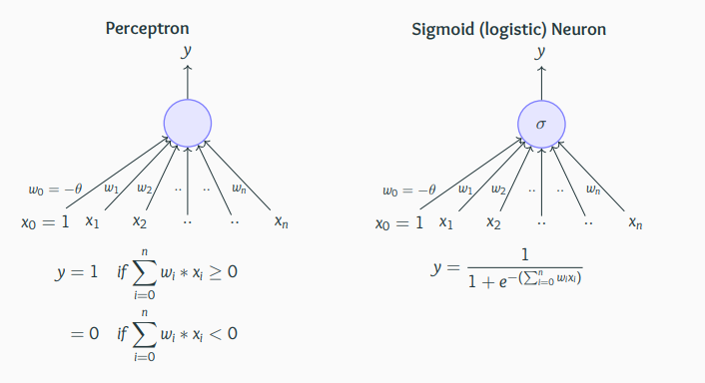
Theory

Slide 20
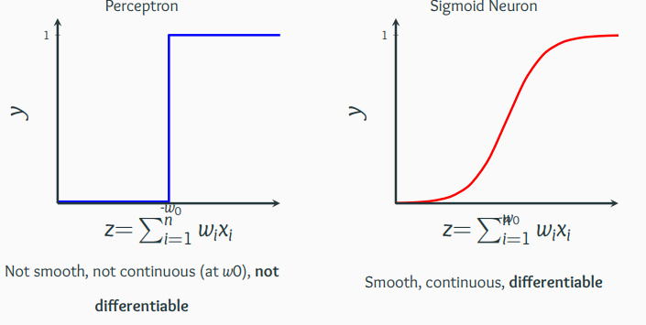
Theory

Slide 21
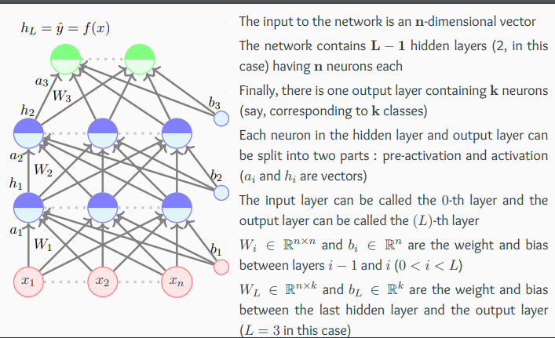
Theory

Slide 22
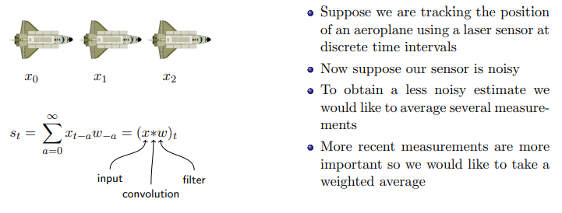
Theory

Slide 23
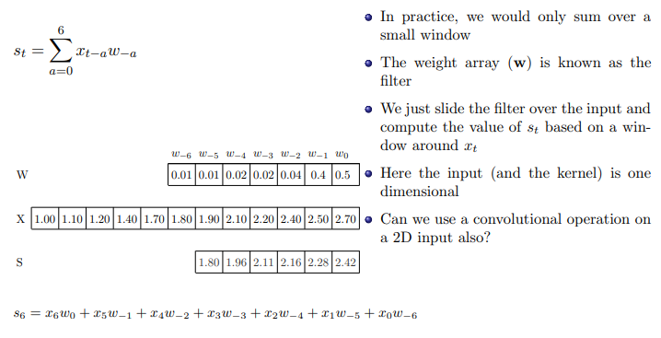
Theory

Slide 24
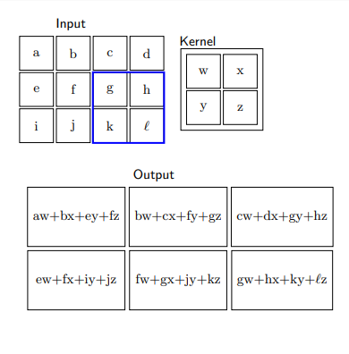
Theory

Slide 25
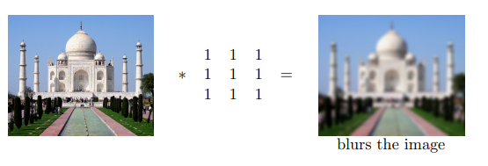
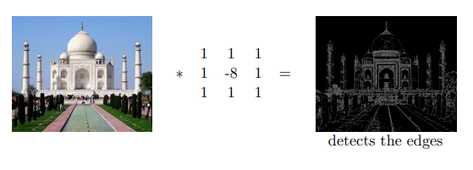
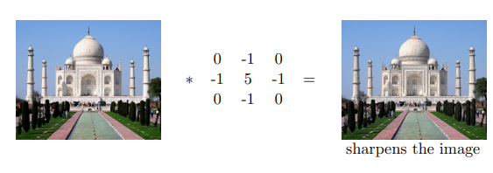
Theory

Slide 26
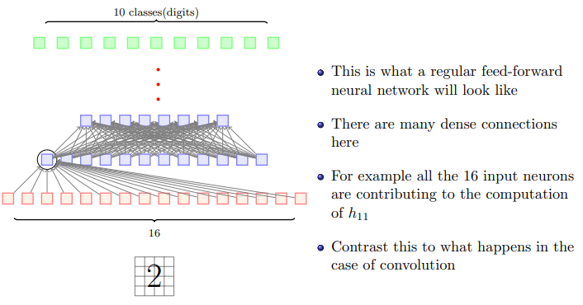
Theory

Slide 27
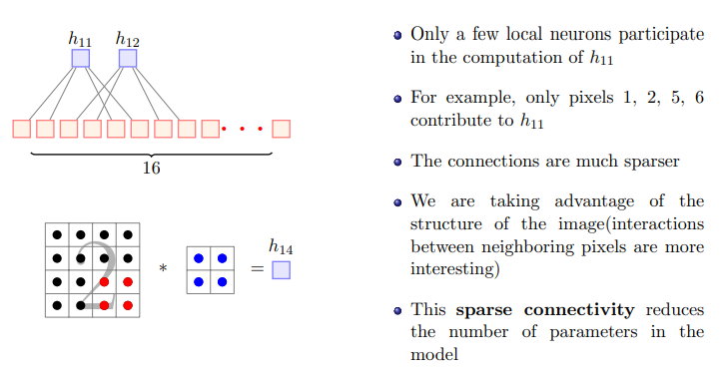
Theory

Slide 28
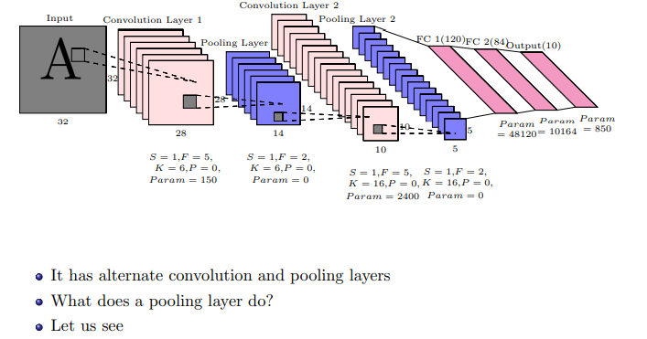
Theory

Slide 29
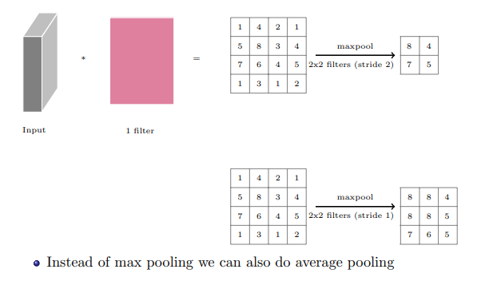
Theory

Slide 30
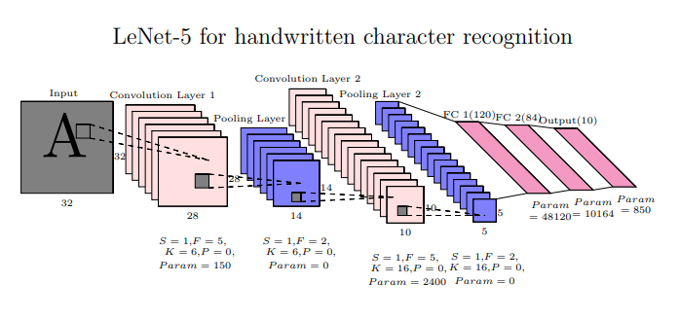
Theory

Slide 31
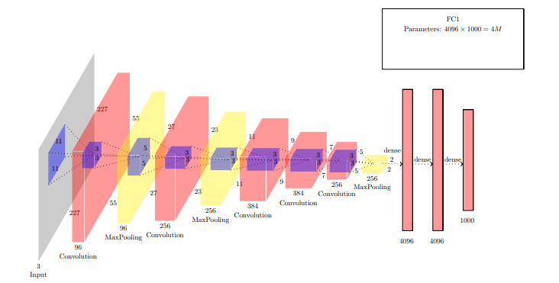
Theory

Slide 32
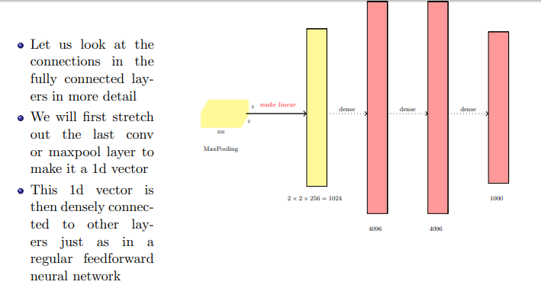
Theory

Slide 33
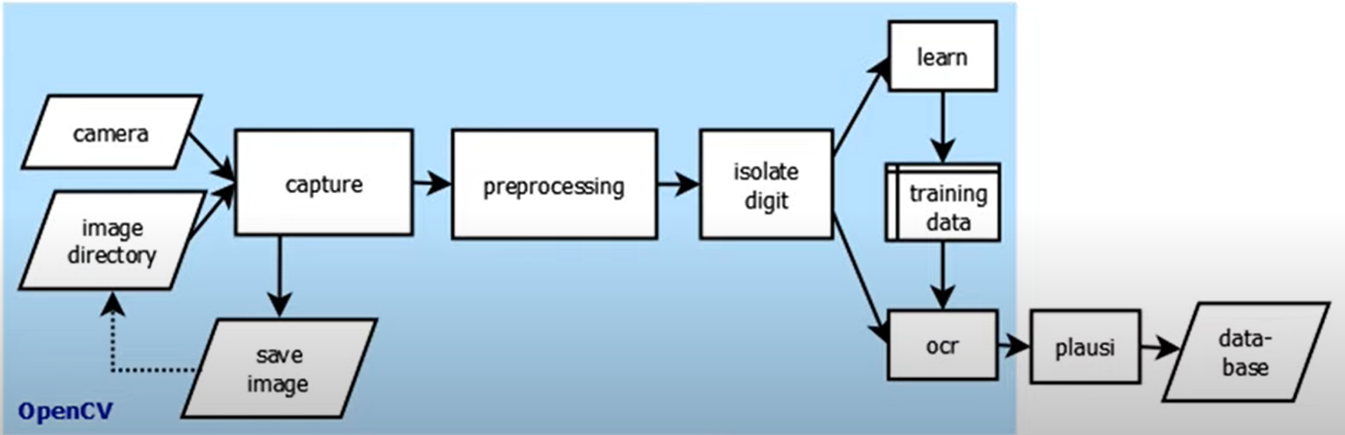
Implementation/Work Flow

Slide 34
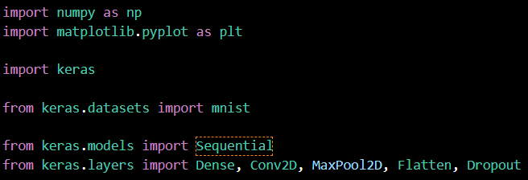
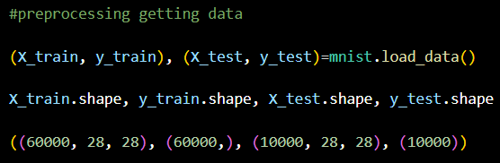
Results & Discussion

Slide 35
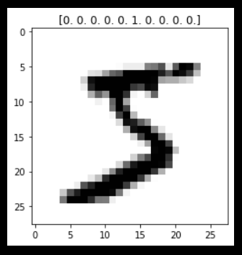
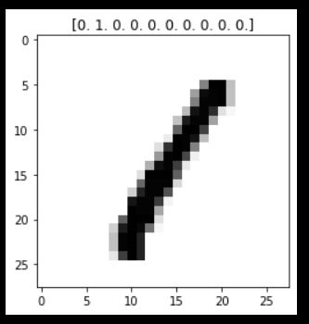
Results & Discussion

Slide 36
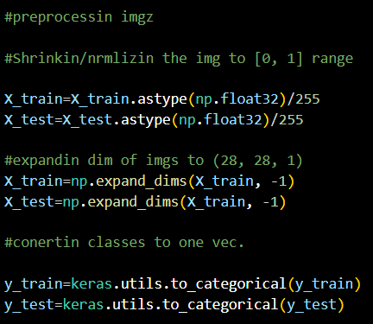
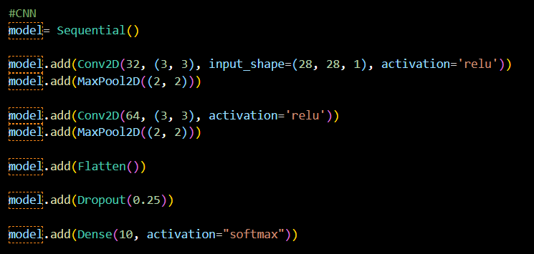
Results & Discussion

Slide 37
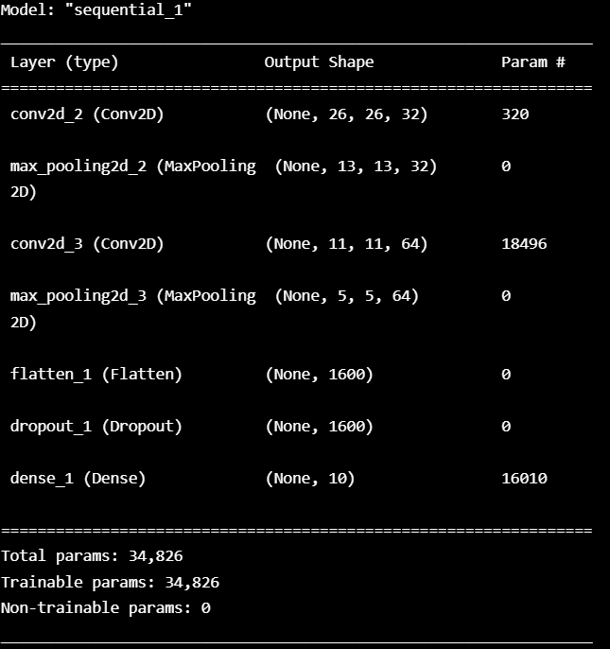
Results & Discussion

Slide 38
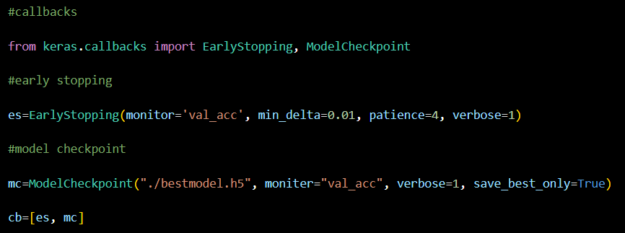
Results & Discussion

Slide 39

Results & Discussion

Slide 40
Results & Discussion

Slide 41
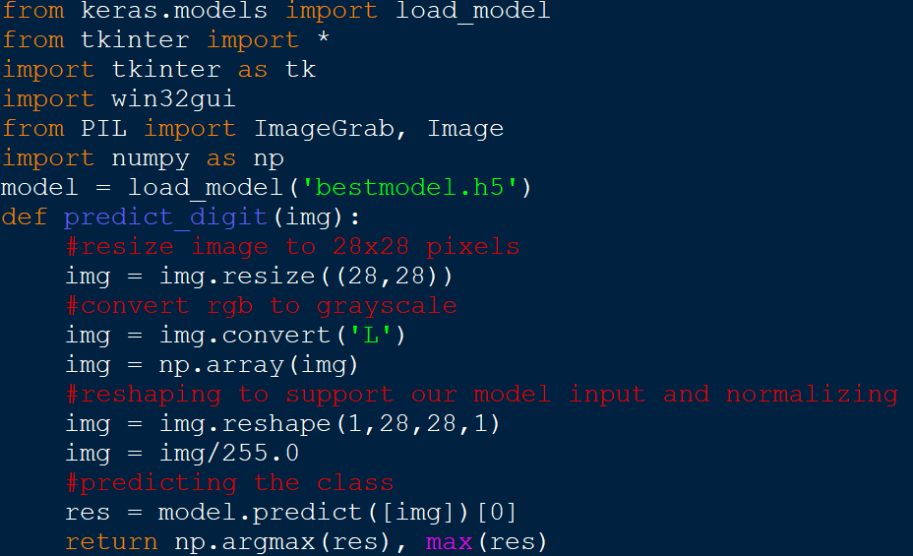
Results & Discussion

Slide 42
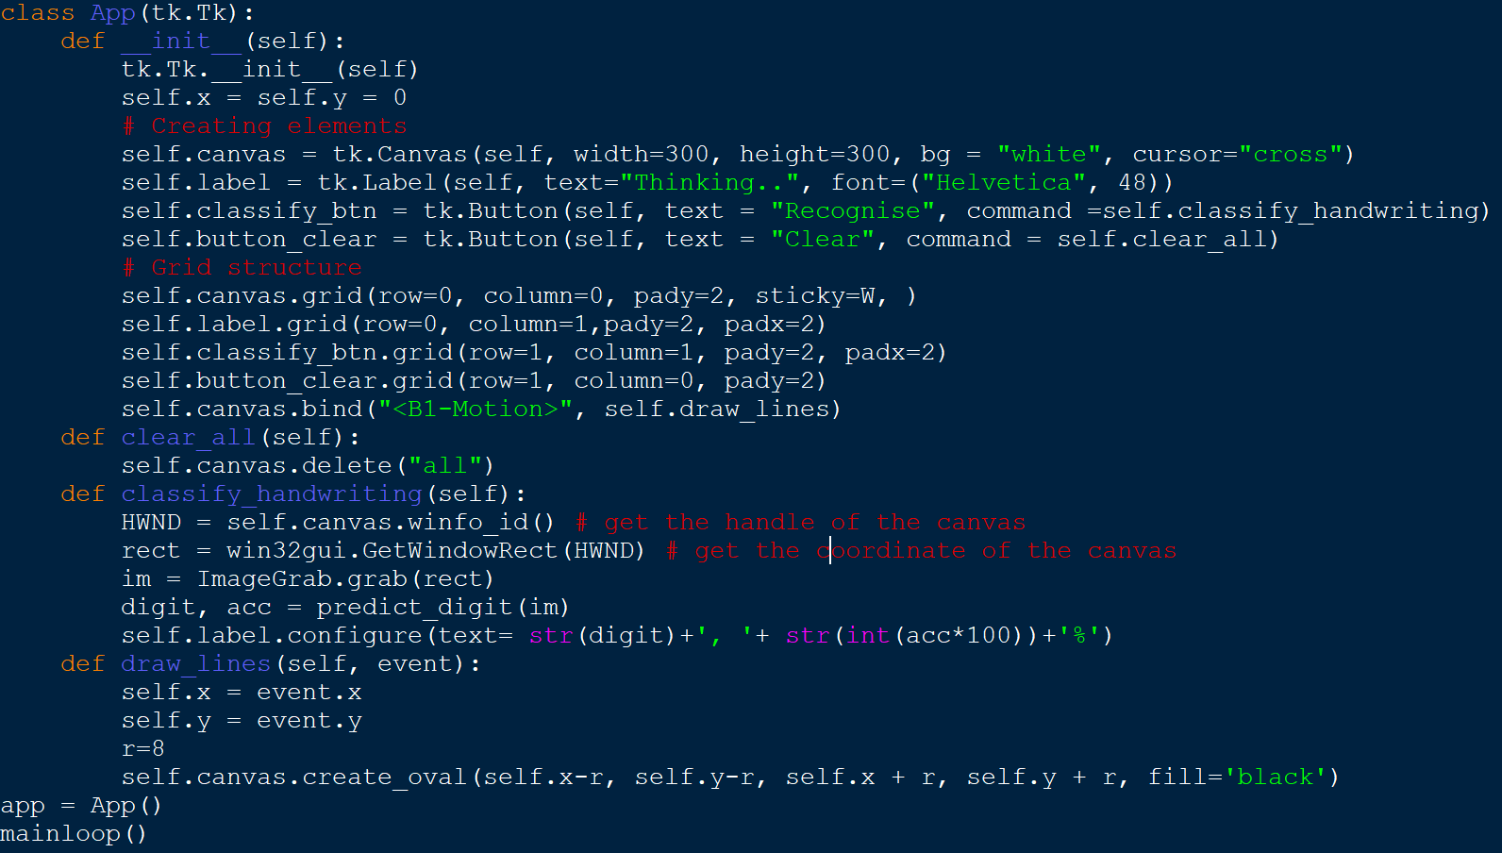
Results & Discussion

Slide 43
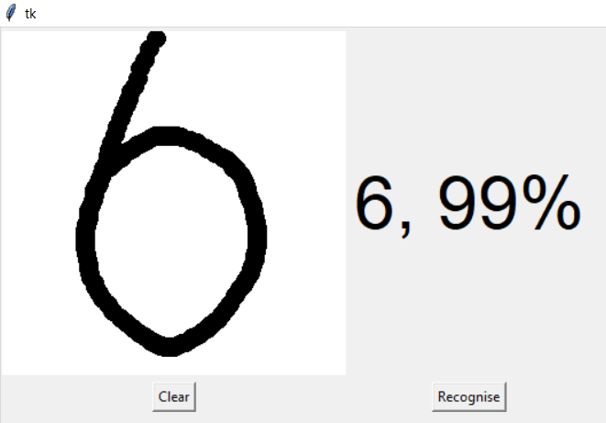
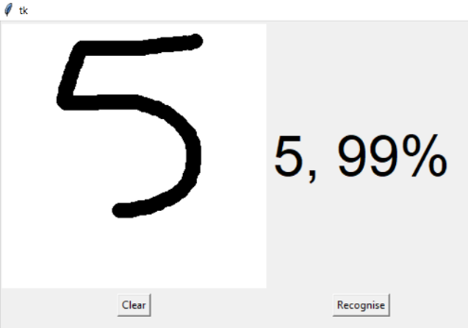
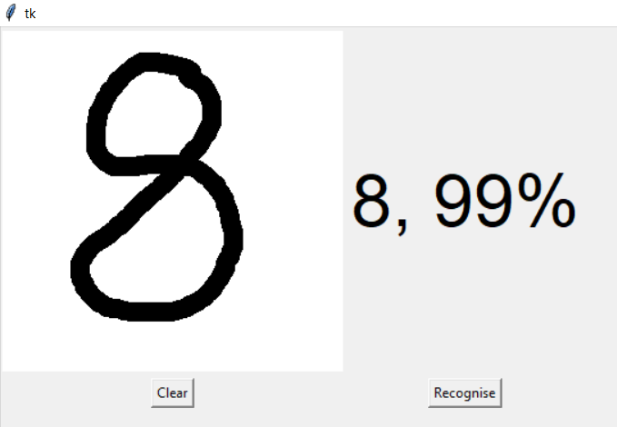
Results & Discussion

Slide 44

Summary
We have successfully built a Python deep learning project on handwritten digit recognition app. We have built and trained the Convolutional neural network which is very effective for image classification purposes. Later on, we build the GUI where we draw a digit on the canvas then we classify the digit and show the results.
Utilizing these deep learning techniques, a high amount of accuracy can be obtained. Compared to other research methods, this method focuses on which classifier works better by improving the accuracy of classification models by more than 99%. Using Keras a CNN model is able to give accuracy of about 99.09%.

Slide 45
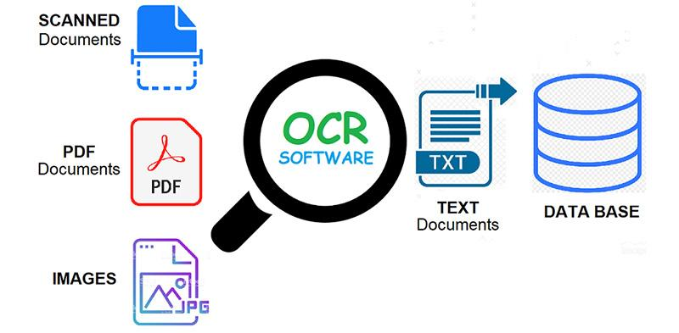
Future scope
Recently, the new generation of engineers revived OCR by the integration with Machine Learning built on Artificial Intelligence (AI). This new technology is not limited by the comparison between characters based on the rules of traditional OCR software.
Covid-19 has made digital transformation increasingly important for many organizations across the world, and technologies will continue to develop and help automate business processes. Whilst these technologies are already heavily relied upon today, in the next few years there will be a much higher demand to deliver remote working solutions.

Slide 46
References
https://www.skynettoday.com/overviews/neural-net-history
https://parashift.io/en/the-evolution-of-document-capture/
https://medium.com/swlh/handwritten-digit-recognition-using-nlp-986ab5525a05
http://www.cse.iitm.ac.in/~miteshk/CS6910.html
https://docs.python.org/3/library/tkinter.html
https://keras.io/
https://numpy.org/
https://matplotlib.org/
https://pypi.org/project/win32gui/
https://pypi.org/project/Pillow/

