Slide 1
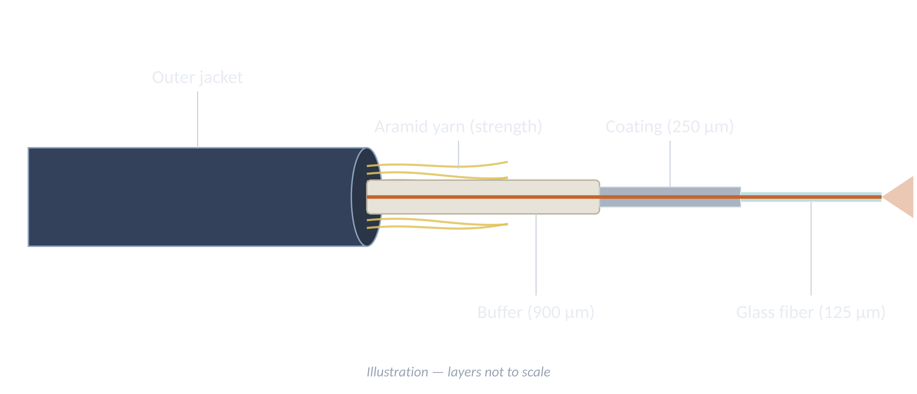
B.TECH · LABORATORY DEMONSTRATION
Fusion Splicing, OTDR Testing & Link Loss Measurement
Optical Fiber Communication Laboratory
A Fusion splicing B OTDR testing C Link loss
Student name
Your student name here
Roll number
Your roll number here
Department
Your department here
College
Your college here
Faculty
Your faculty here
Notes:
Three parts: join the fiber (A), test it with an OTDR (B), and work out the link loss (C).

Slide 2
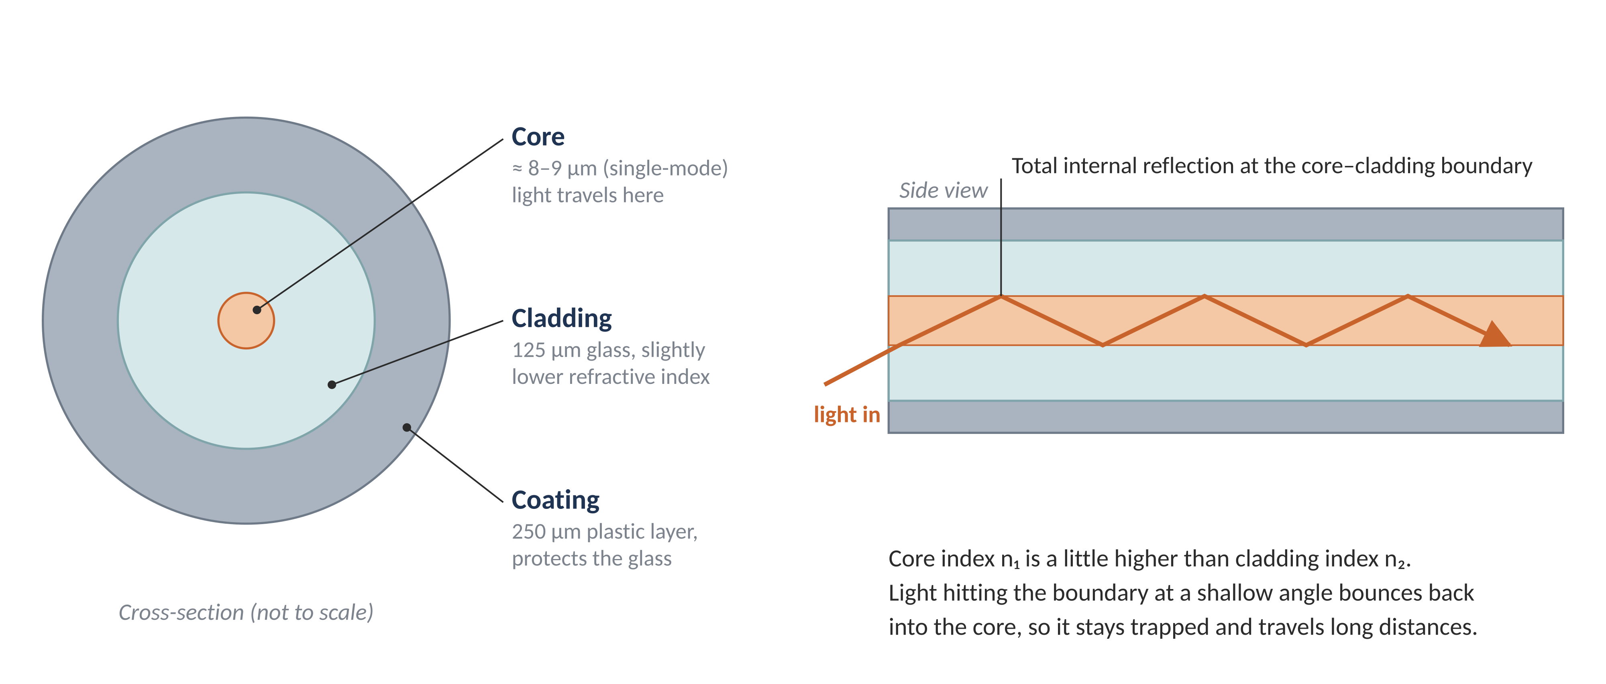
Optical Fiber and Fusion Splicing
PART A · FUSION SPLICING
What is splicing?
Joining two fibers end-to-end so light passes from one core into the other.
Fusion splicing
An electric arc melts the two glass ends into one piece. The joint is permanent, with very low loss (typically below 0.1 dB).
Light travels in the tiny core. The cladding has a slightly lower refractive index, so light keeps reflecting back into the core (total internal reflection).
Why alignment matters
The core is only about 9 µm wide. Dirty, angled or offset ends lose light at the joint.
Notes:
Single-mode core ≈ 8–9 µm, cladding 125 µm, coating 250 µm.

Slide 3
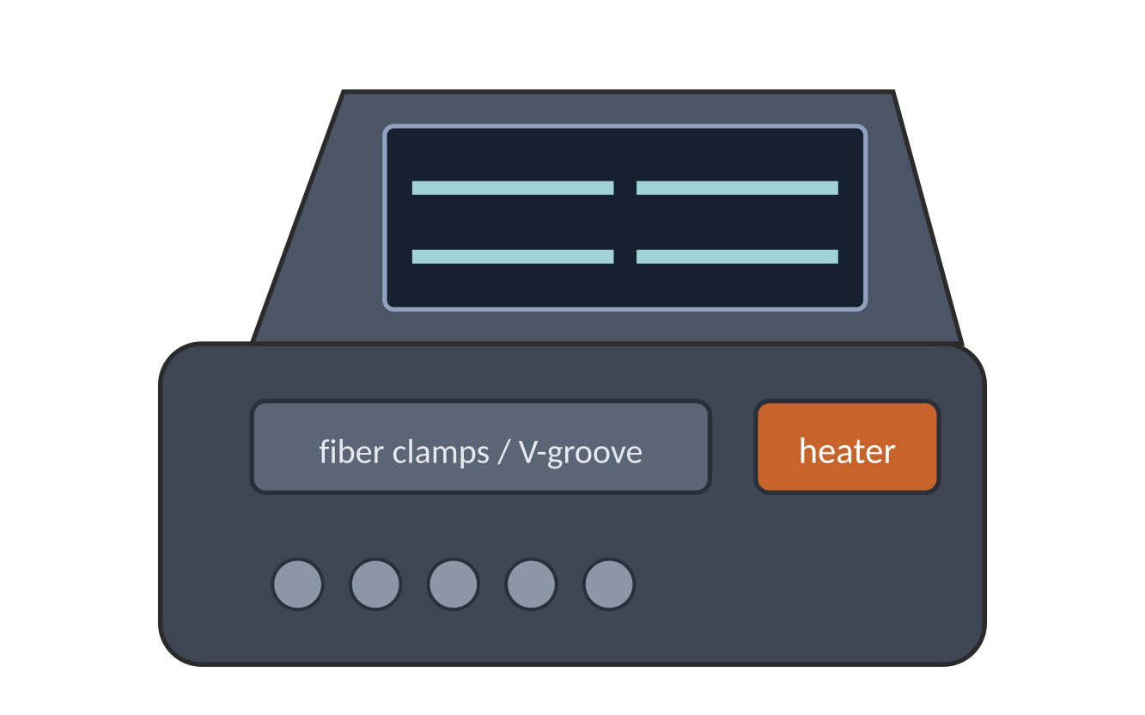
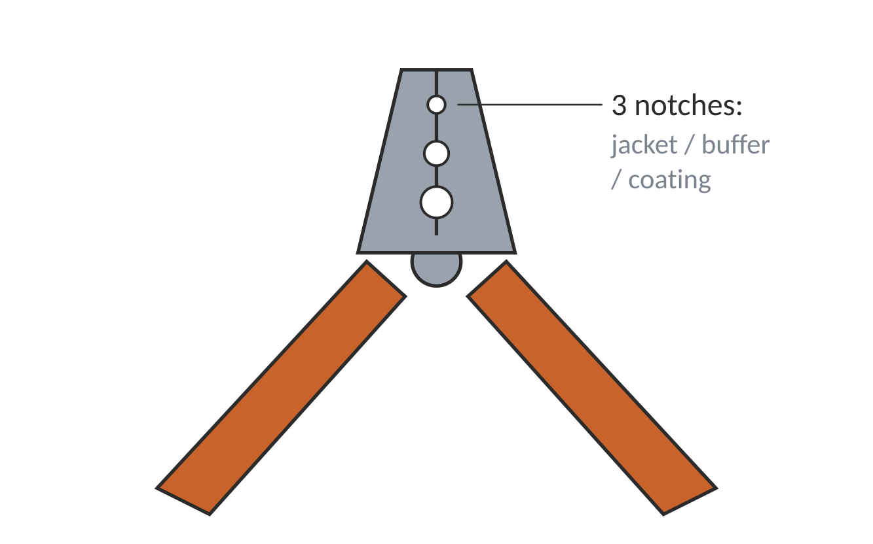
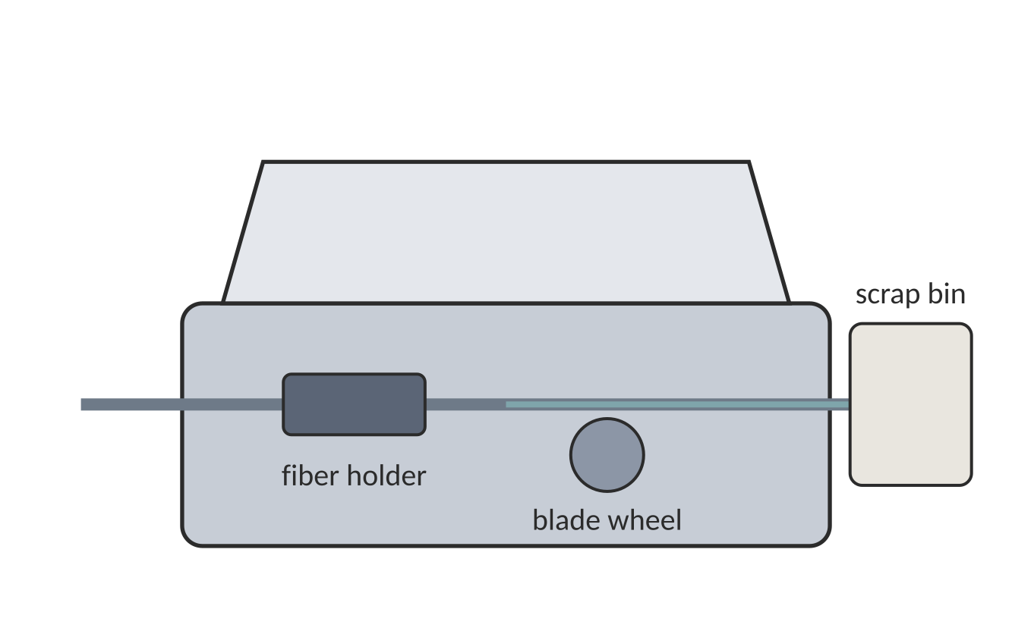
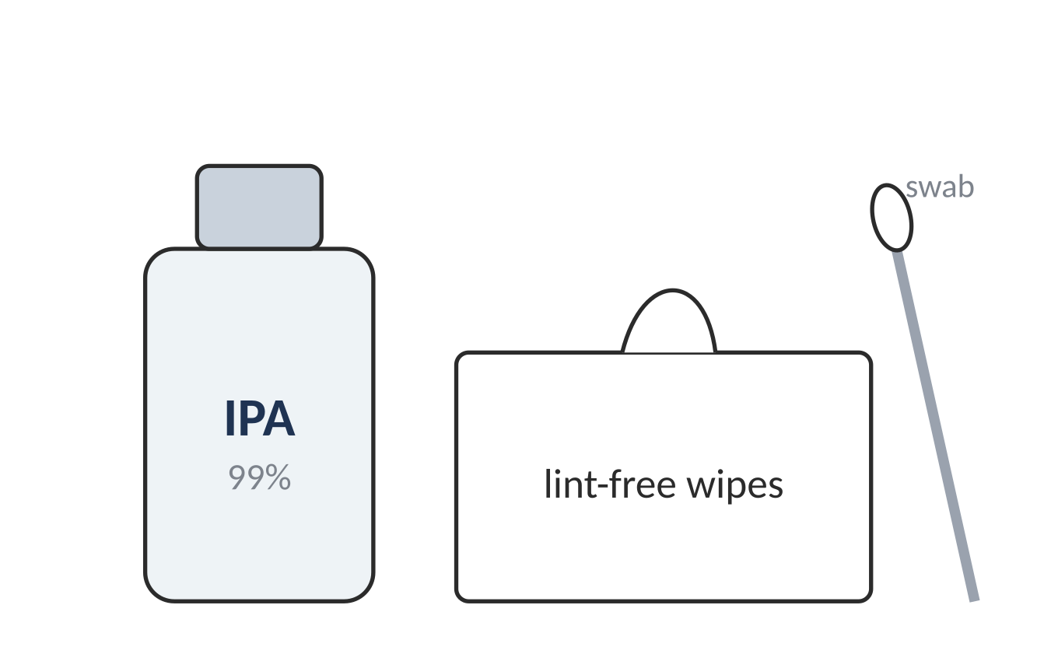
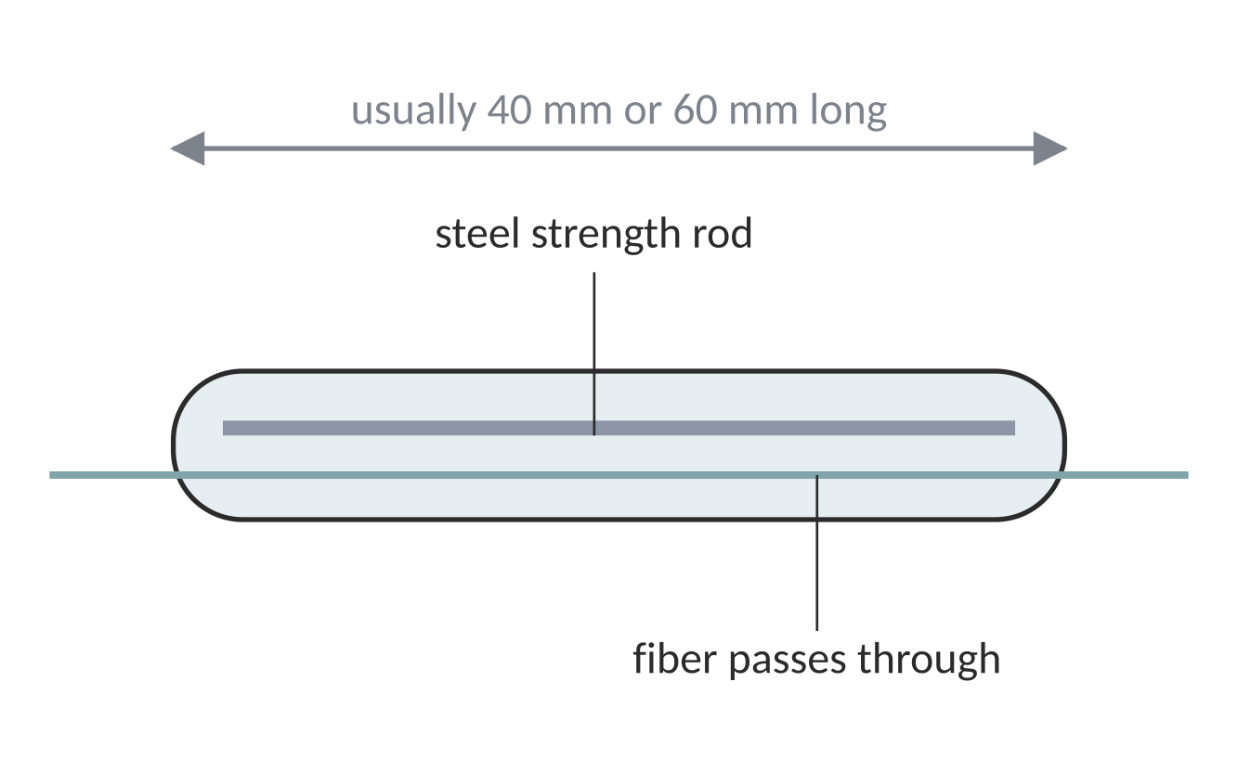
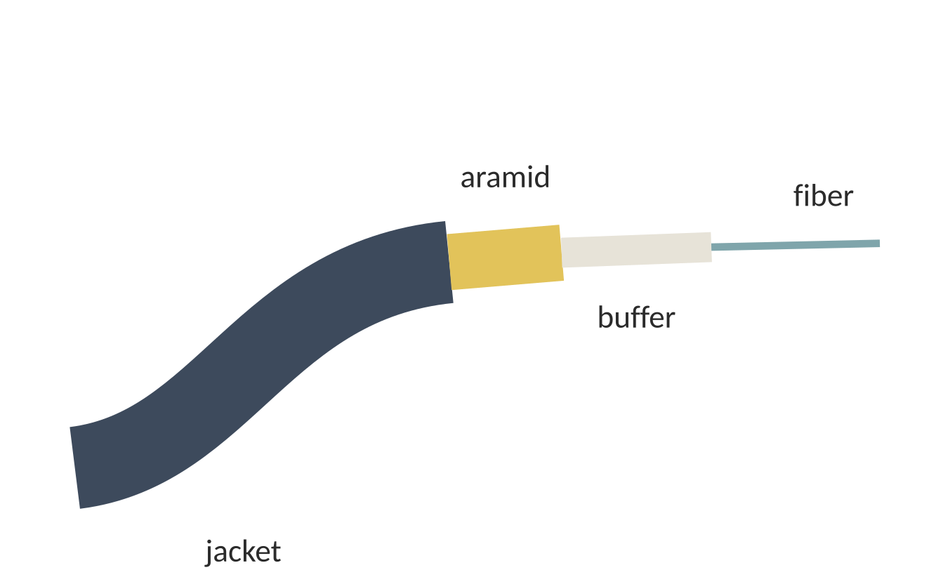
Equipment Required for Fusion Splicing
PART A · FUSION SPLICING
ILLUSTRATIONS — real models differ
Fusion splicer
Fiber stripper
Precision cleaver
Aligns the two fibers with cameras and motors, then fuses them with an electric arc.
Removes the jacket, buffer and 250 µm coating without scratching the glass.
Cuts the bare fiber so the end is flat and at 90° to its length.
Cleaning kit
Heat-shrink sleeve
Optical fiber cable
99% isopropyl alcohol and lint-free wipes remove dust and oil from the glass.
A tube with a steel rod that shrinks over the joint to protect it.
The fiber to be joined; check its type before you start.
Notes:
Also keep a fiber scrap bin, safety glasses and a splice tray ready before starting.

Slide 4
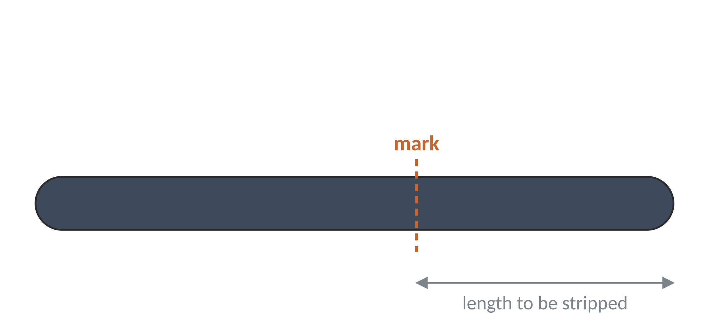
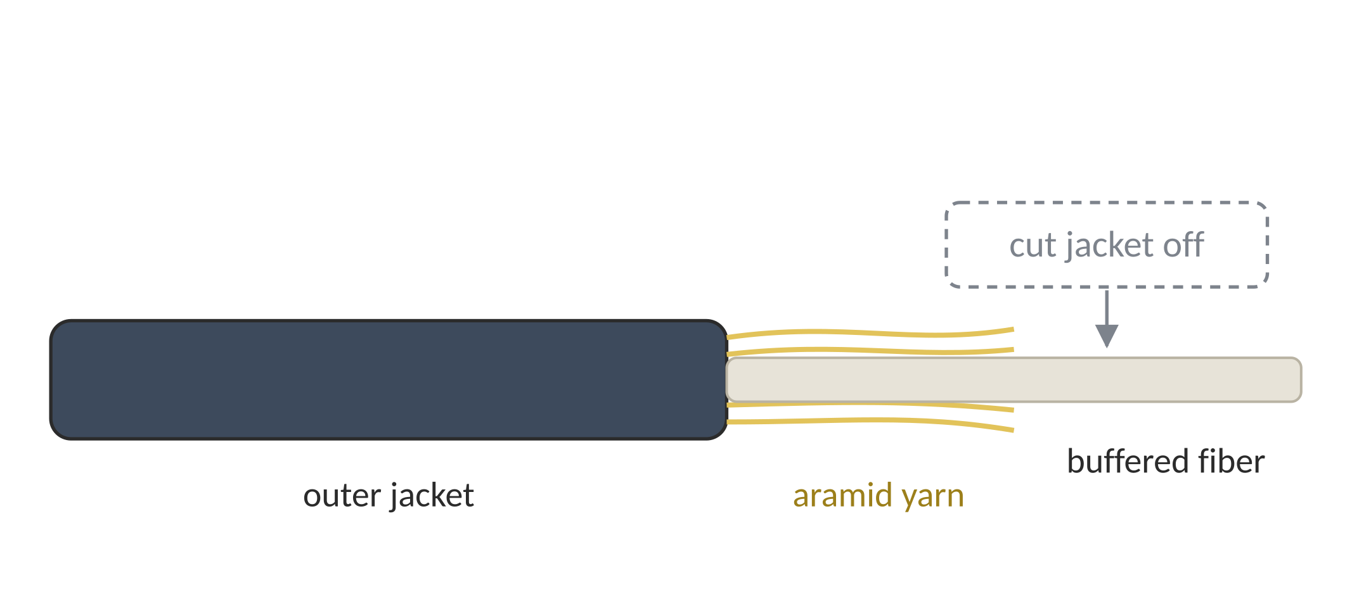
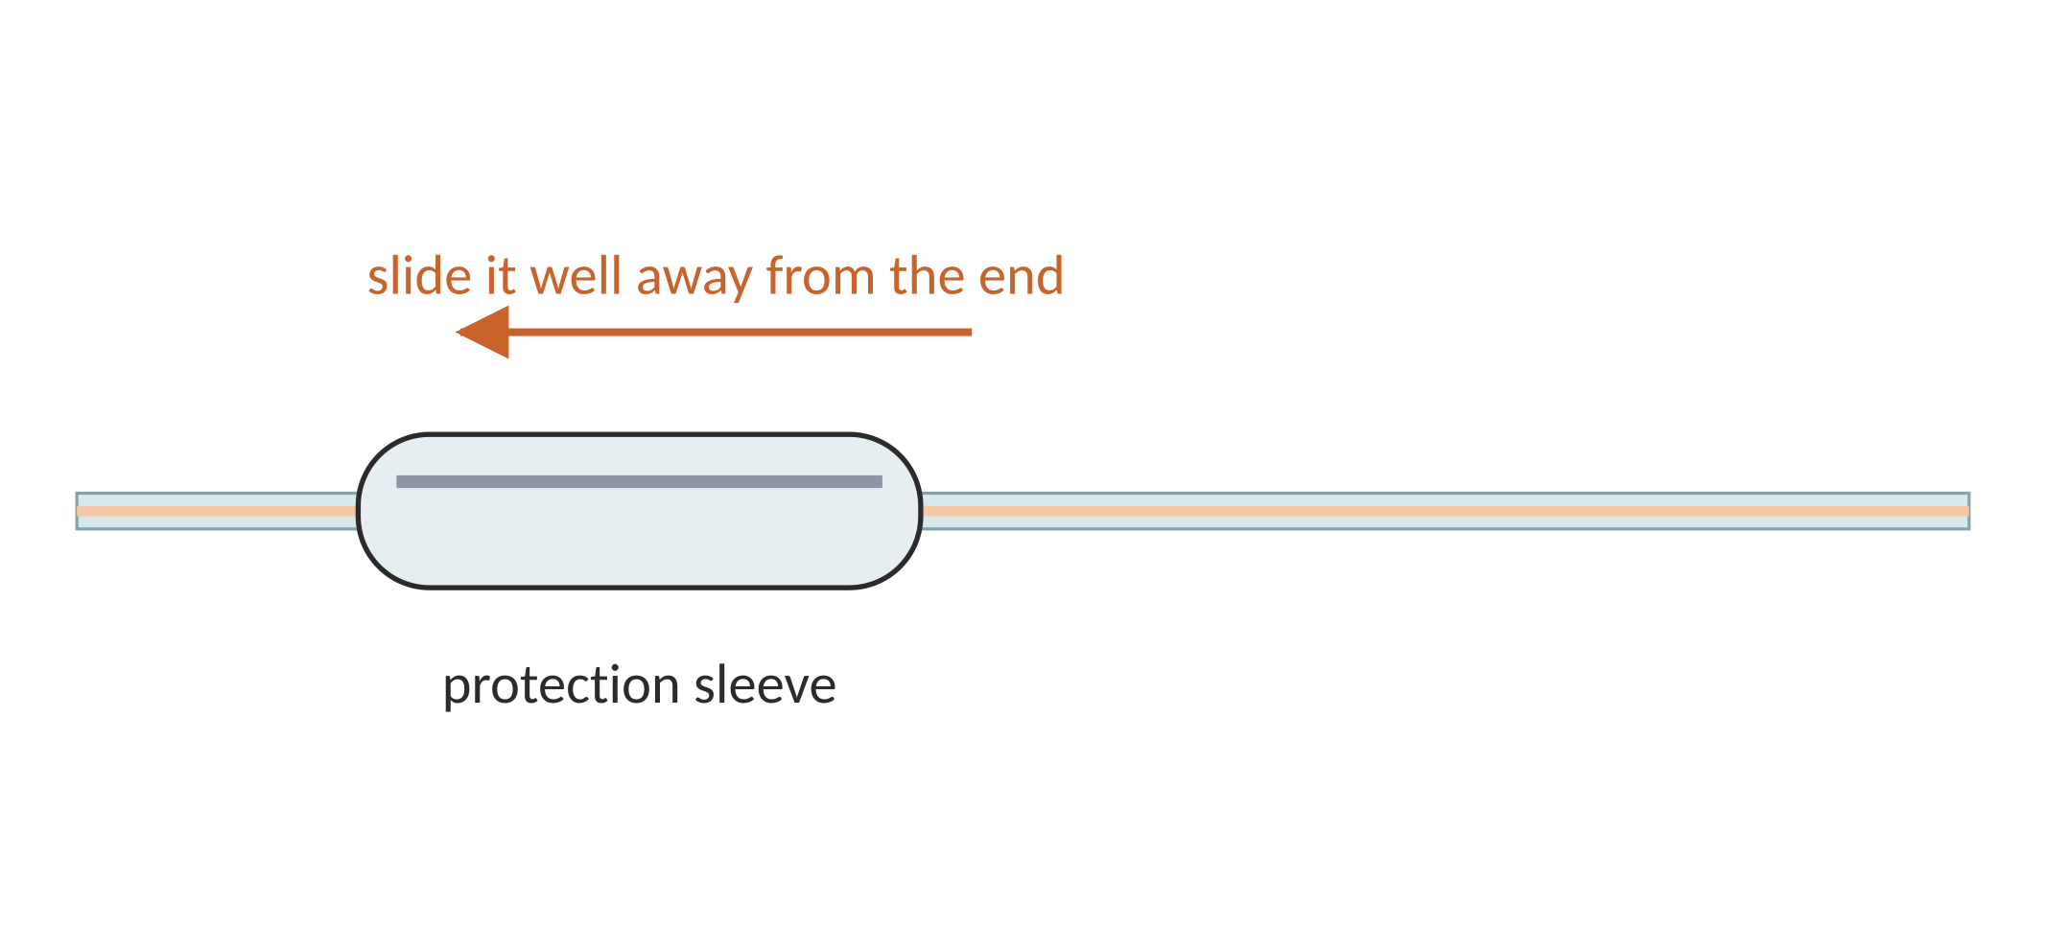
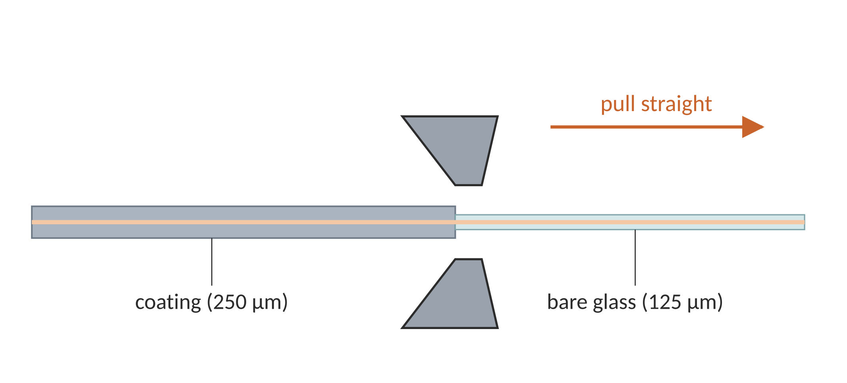
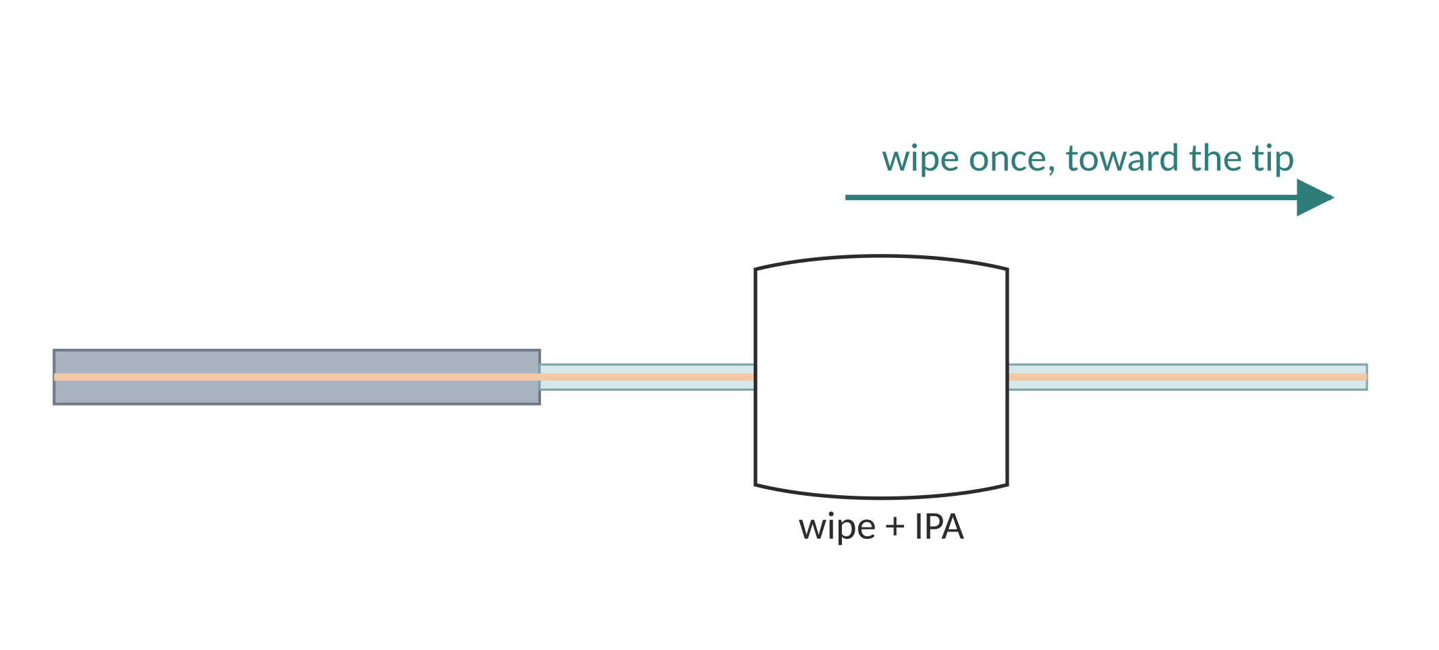
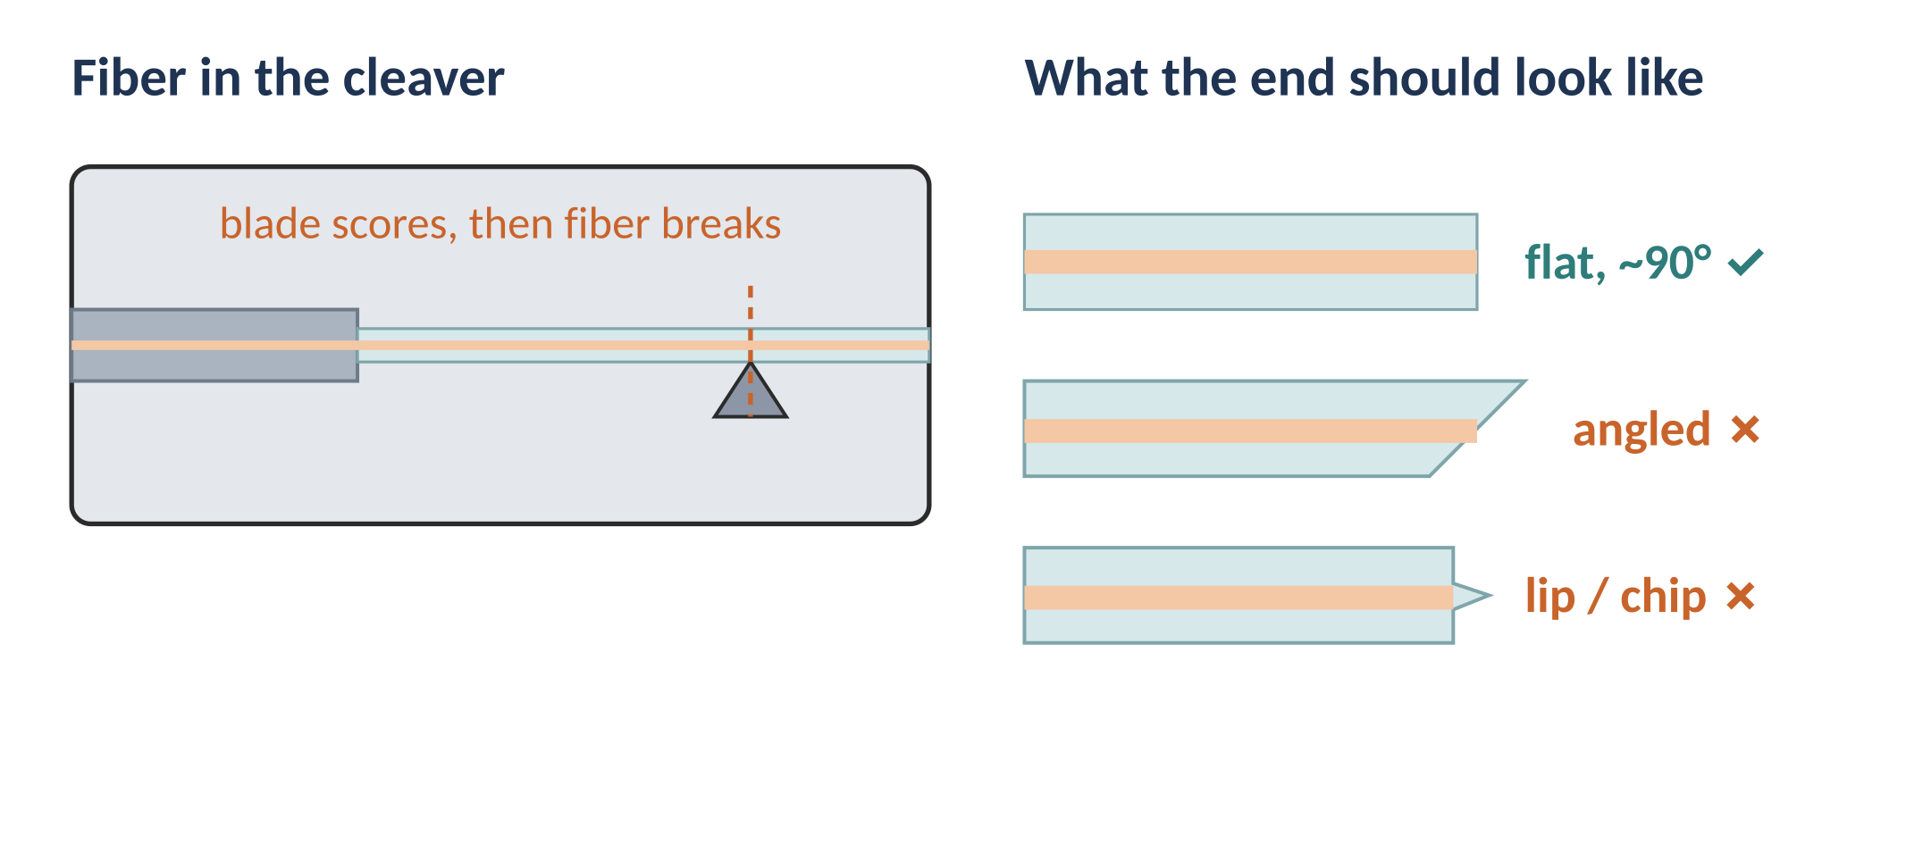
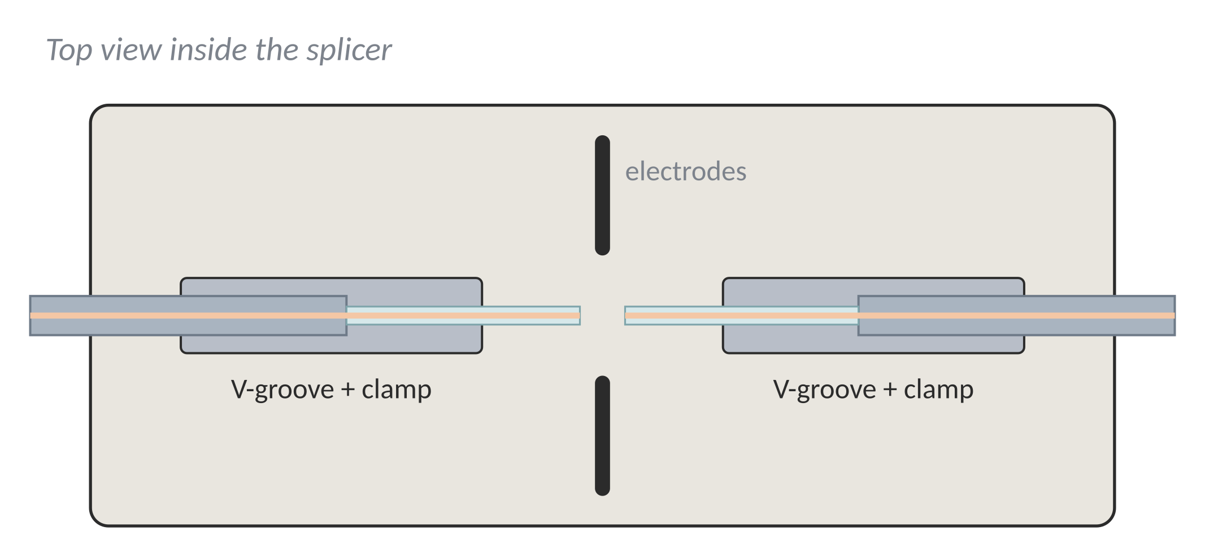
Fusion Splicing Procedure (1/2)
PART A · FUSION SPLICING · STEPS 1–7
1
Prepare the cable
2
Remove the jacket
3
Slide on the sleeve
4
Strip the coating
Check the fiber type and mark how much jacket to remove.
Strip the outer jacket; cut the aramid yarn with scissors.
Put the heat-shrink sleeve on one fiber now — it can't be added later.
Remove the 250 µm coating in one smooth pull (about 3–4 cm).
Safety: bare-fiber offcuts are tiny glass needles. Pick them up with tape and put them in the scrap bin.
5
Clean the fiber
6
Cleave the ends
7
Load the splicer
Wipe the bare glass once with 99% IPA on a lint-free wipe.
Cut a flat, square end (within about 1°). Bin the offcut.
Lay both fibers in the V-grooves, tips near the electrodes. Close the clamps.
Notes:
Step 3 is the most commonly forgotten. The cleave quality decides the splice quality.

Slide 5
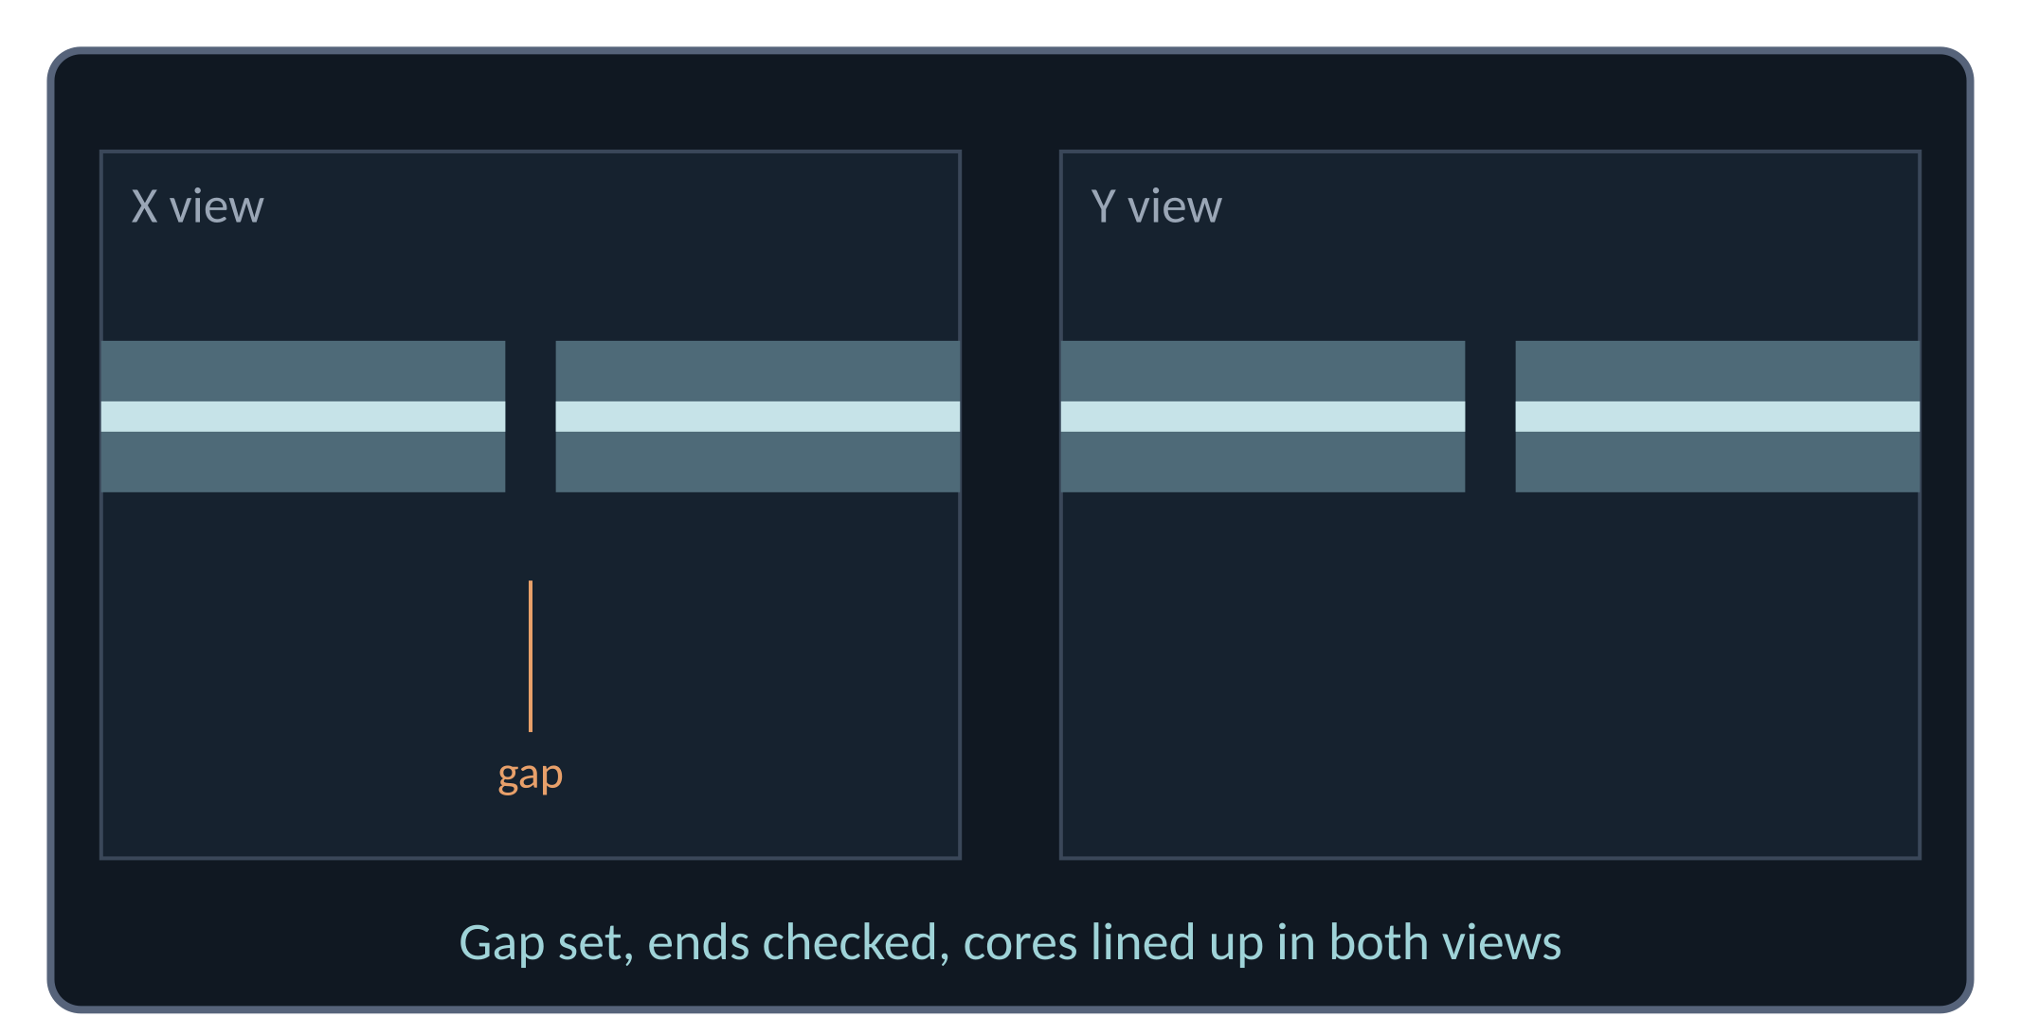
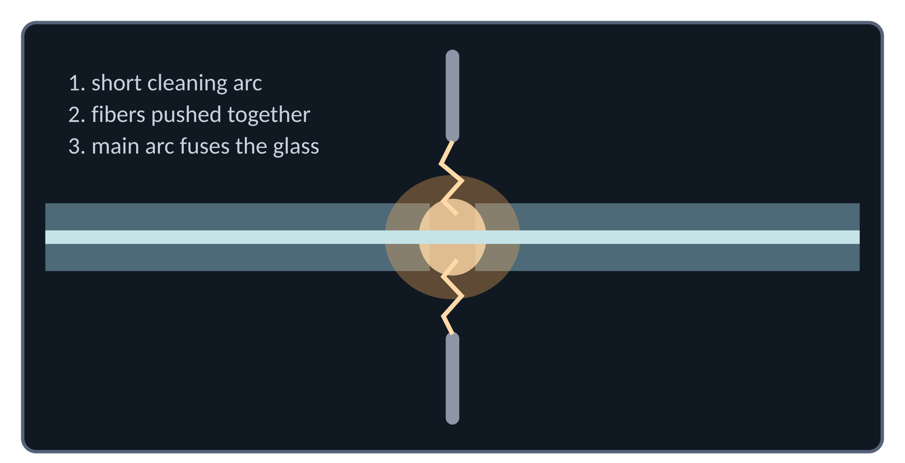
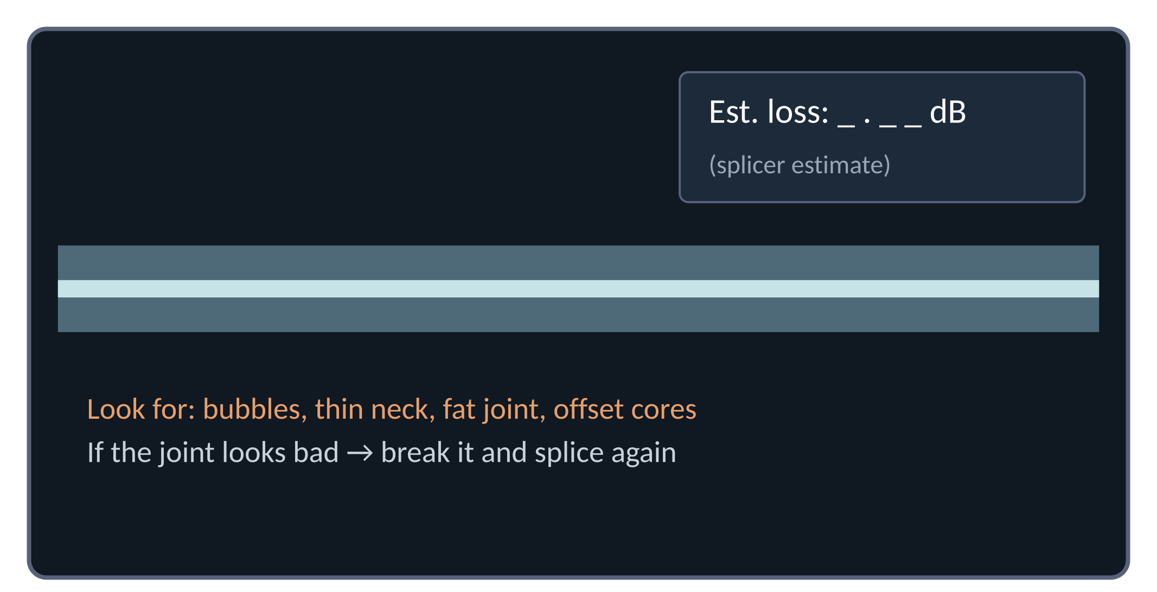
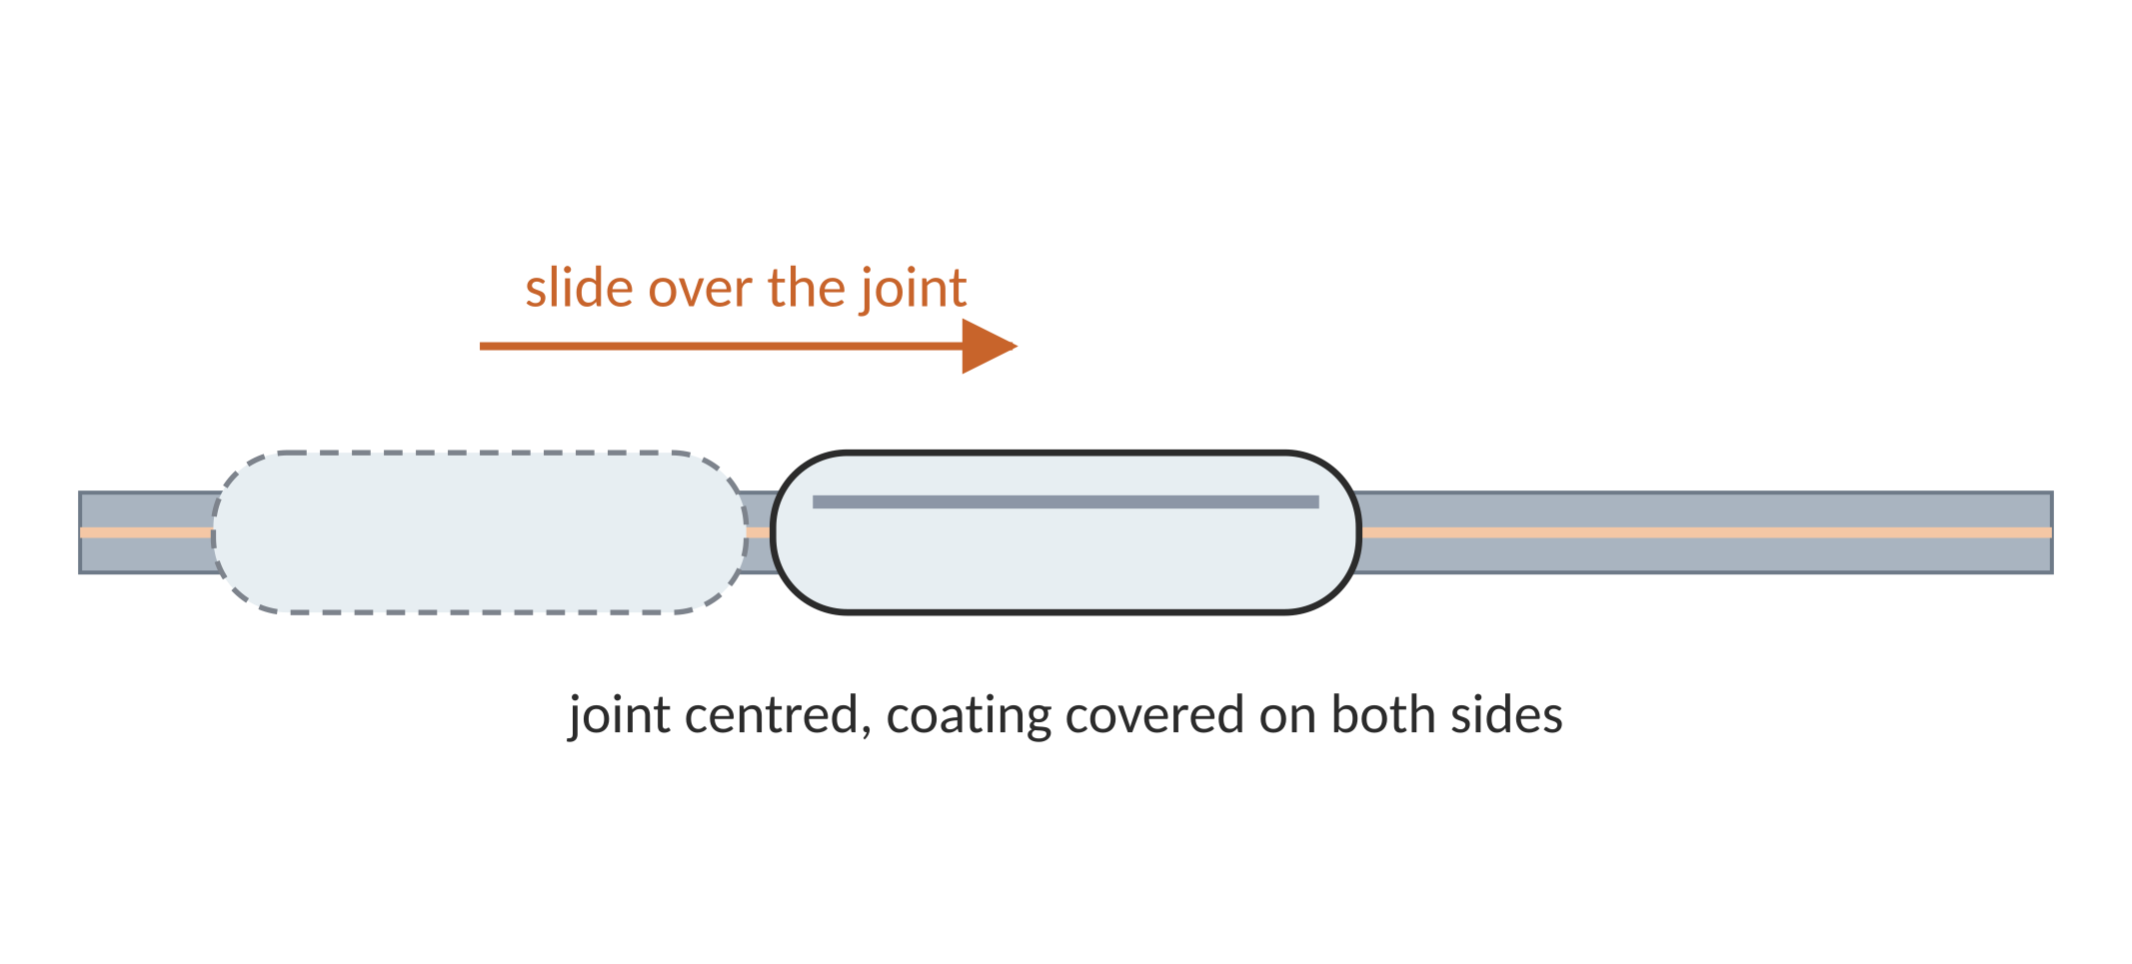
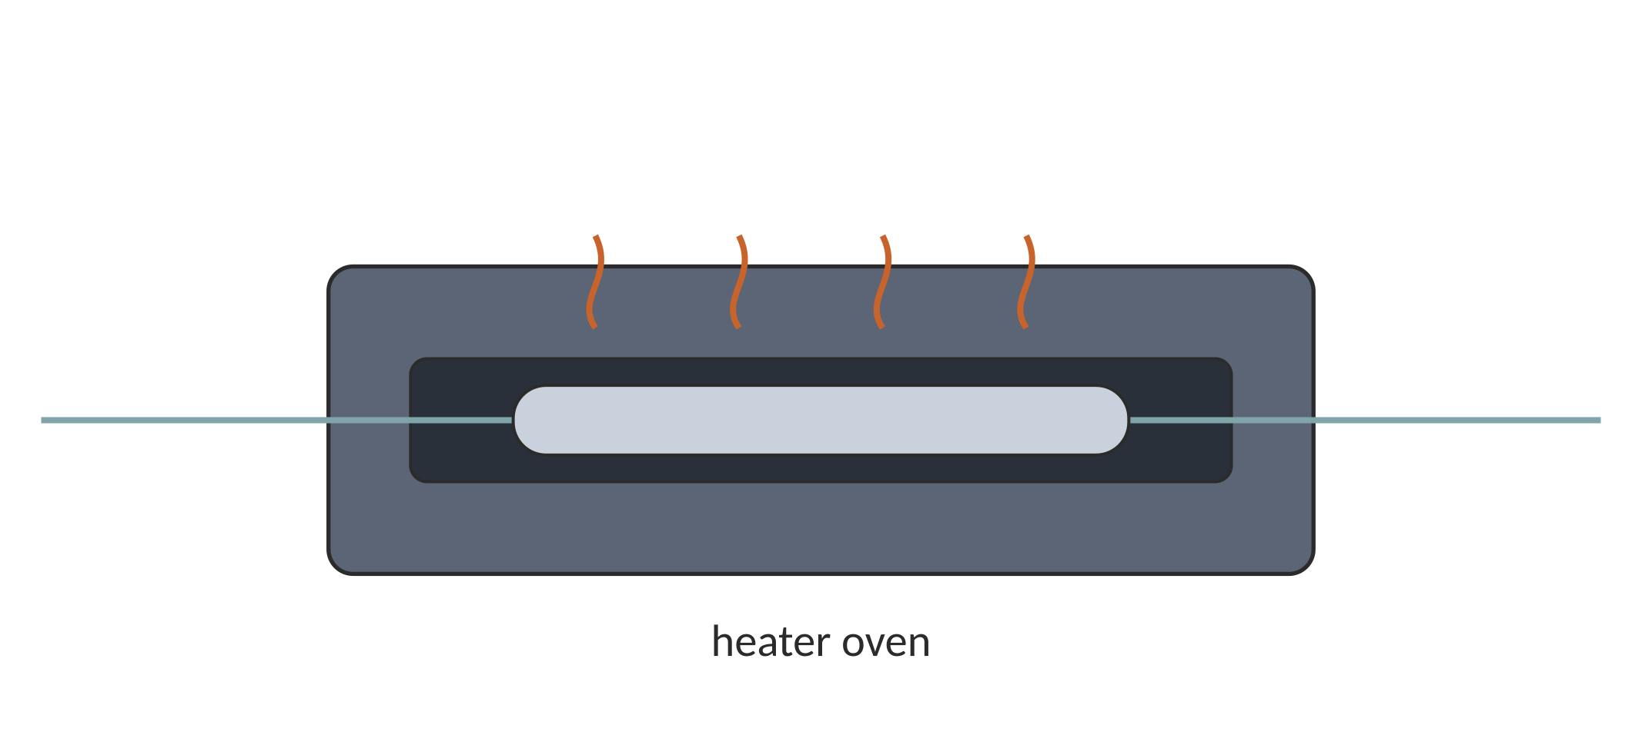
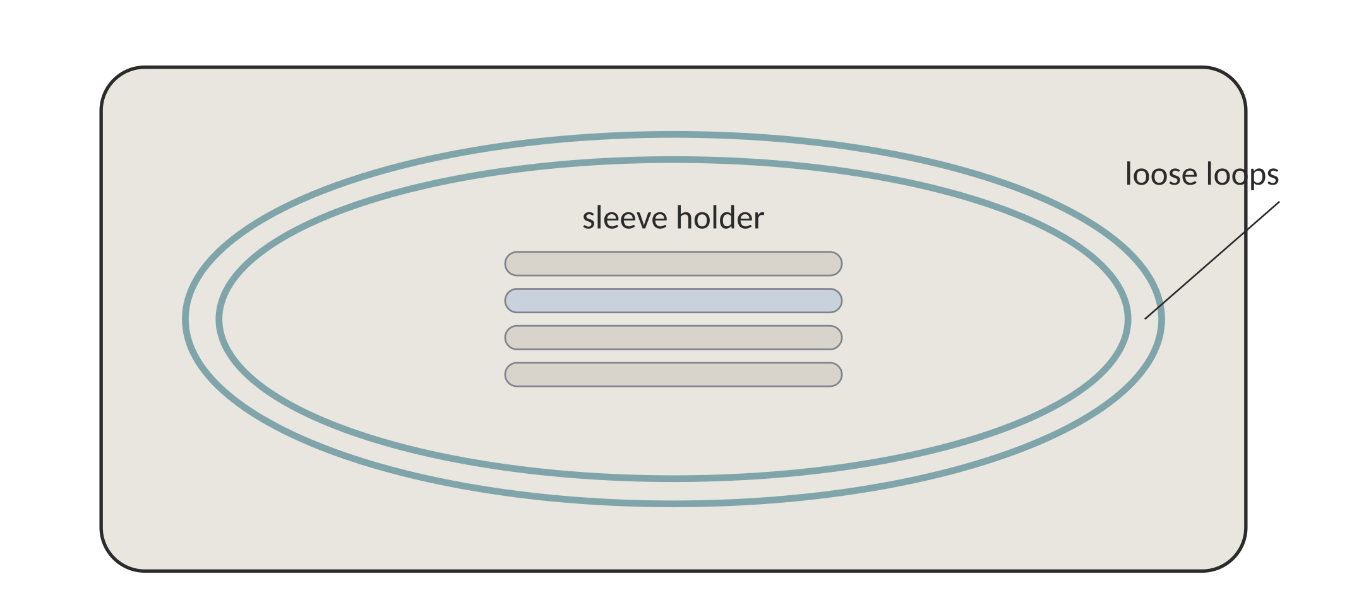
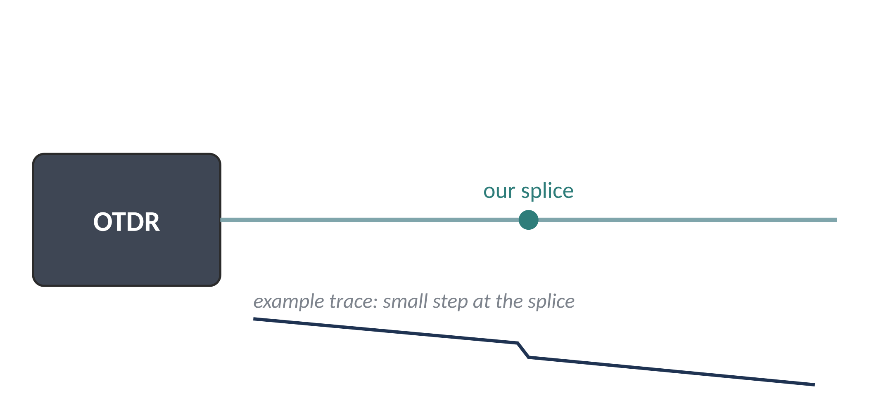
Fusion Splicing Procedure (2/2)
PART A · FUSION SPLICING · STEPS 8–14
8
Align the cores
9
Fuse with the arc
10
Inspect the splice
11
Move the sleeve
Cameras view the fibers in X and Y; the splicer lines up the cores.
A short cleaning arc, then the main arc melts the ends into one.
Check the joint on screen. The loss shown is only an estimate.
Slide the sleeve so the joint sits in its centre.
The splicer's loss value is an estimate from its camera image. Record the measured loss from step 14. (Screen views are illustrations; we did not record a splice-loss value.)
12
Heat-shrink
13
Splice tray
14
Test the joint
Shrink the sleeve in the heater. Let it cool before handling.
Fix the sleeve in the tray; coil spare fiber in large loops.
Measure the real loss with an OTDR or a power meter.
Notes:
Screens shown are drawings of a typical splicer display, not screenshots from our machine.

Slide 6
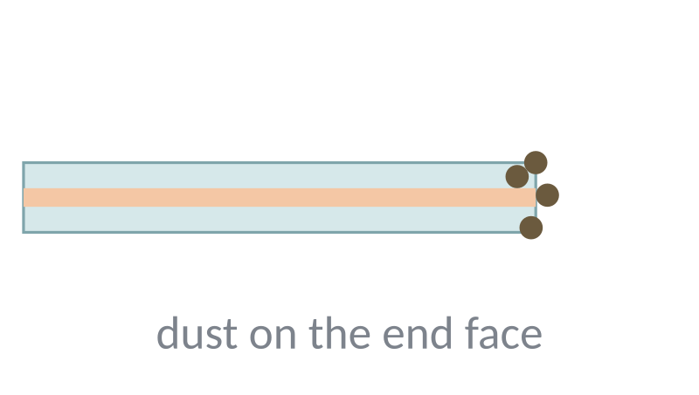
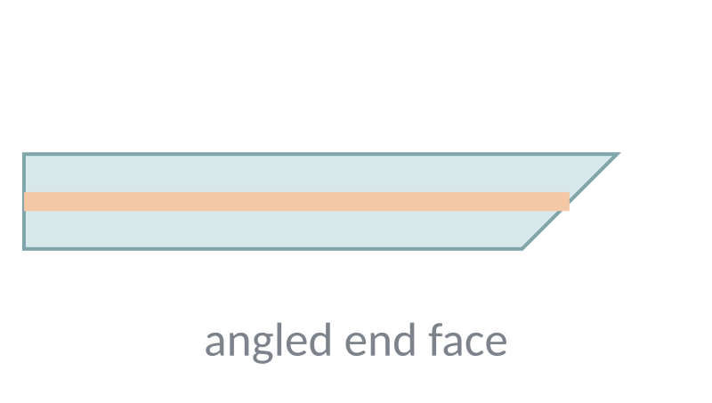
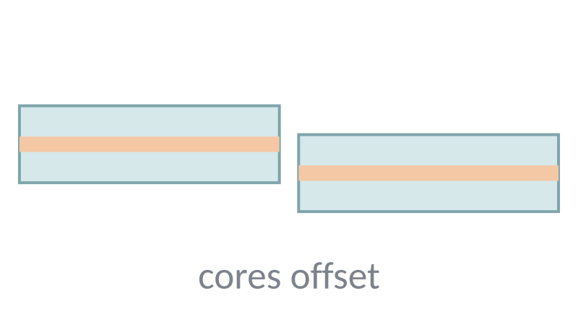
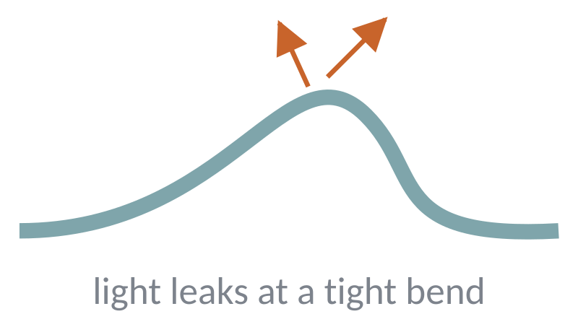
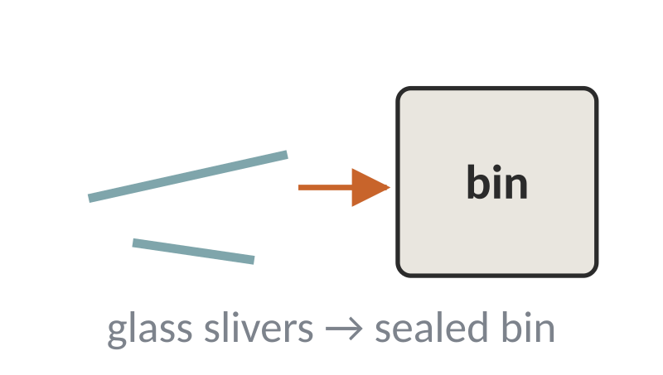
Splicing Precautions and Common Mistakes
PART A · FUSION SPLICING
PROBLEM
WHAT TO DO
Dirty fiber ends
Clean with 99% IPA just before cleaving. Do not touch bare glass.
Dust or skin oil burns in the arc and causes bubbles and high loss.
Poor cleaving
Keep the blade clean, rotate it when worn, and re-cleave any bad end.
Angled, chipped or lipped ends do not fuse well.
Incorrect alignment
Seat fibers properly in the V-grooves; clean the grooves; let the splicer align.
If cores are offset, part of the light misses the next core.
Sharp fiber bends
Keep large loops in the tray and follow the bend-radius guides.
Light leaks out at tight bends (worse at 1550 nm).
Unsafe fiber fragments
Wear safety glasses, use a scrap bin, don't eat or drink at the bench.
Glass slivers can enter skin and eyes.
Notes:
These five problems cause most failed splices in student labs.

Slide 7
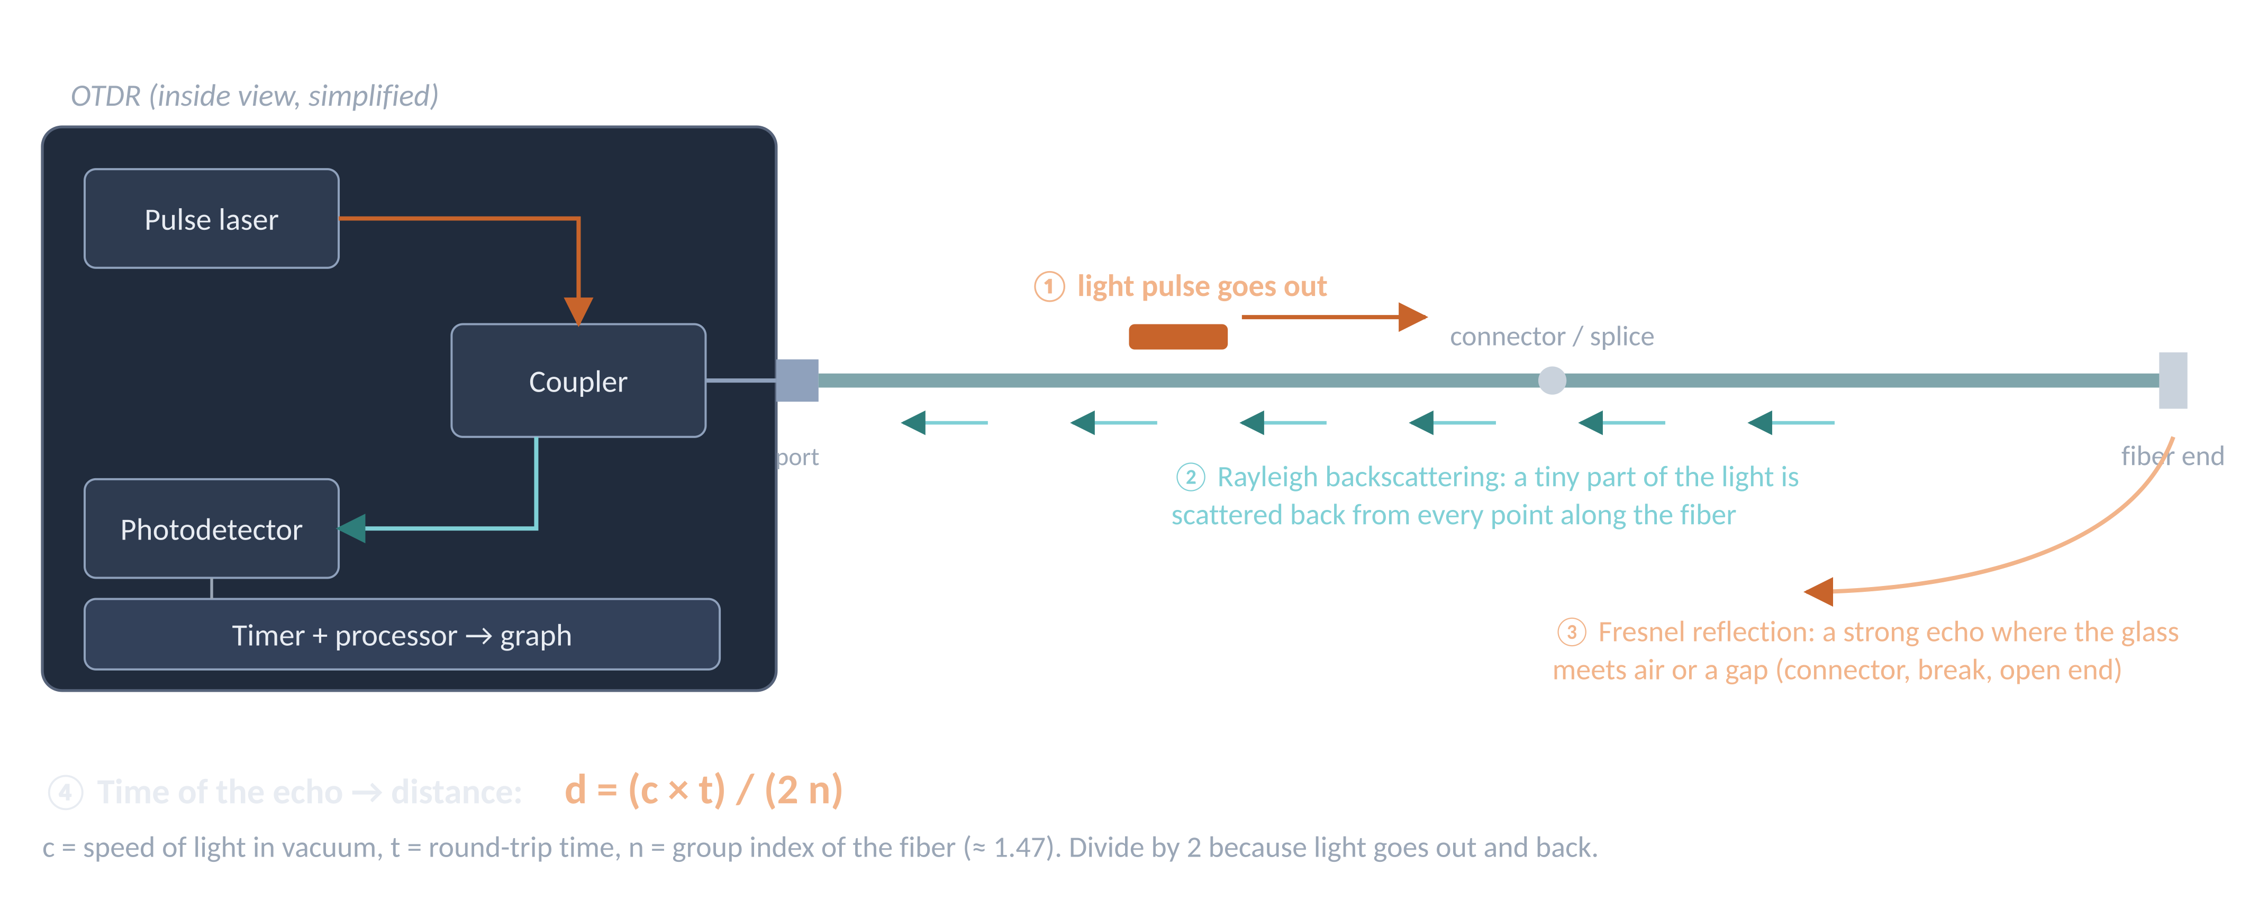
What Is an OTDR and How It Works
PART B · OTDR TESTING
OTDR = Optical Time Domain Reflectometer. It finds the length, losses and faults of a fiber from just one end — it sends light pulses and times the light that comes back.
Notes:
Rayleigh backscatter comes from every point and shows gradual loss. Fresnel reflection is a strong echo at a glass–air surface (connector, break, open end).

Slide 8
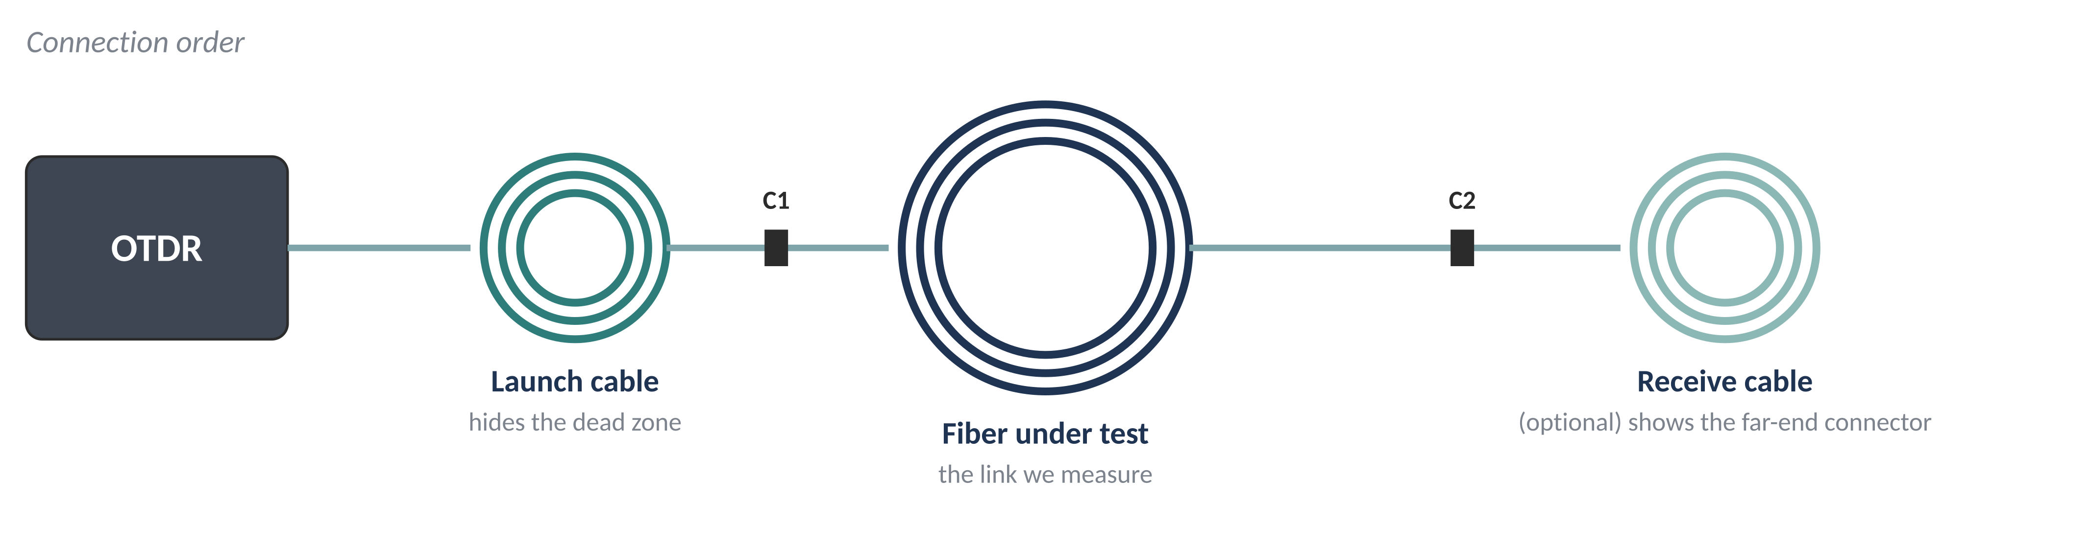
Connecting and Running the OTDR Test
PART B · OTDR TESTING
Connect
Run the test
Why launch / receive cables?
Switch on the OTDR.
Inspect and clean all connectors.
Connect launch cable (if available), then the fiber under test.
Check connections are firm.
Make sure no live signal is on the fiber.
Open the Test Setting menu.
Set wavelength, range, pulse width, time, resolution, power mode.
Return to the main screen.
Press AVG to start the averaged test.
Wait, then read the trace and event table.
The strong reflection at the OTDR port hides the first few metres (dead zone). A launch cable moves the first connector out of it; a receive cable lets the last connector be measured.
⚠ Never look into the OTDR port or a fiber end — the laser light is invisible.
Notes:
Averaging (AVG) repeats the pulse many times during the test time and averages the results, giving a clean trace.

Slide 9
OTDR Test Settings We Used
PART B · OTDR TESTING
Parameter | Our value | What it means
Test wavelength selection | 1310/1550 nm | Wavelength(s) of laser light used for the test
Test range | 10 km | Longest distance shown; set longer than the fiber
Pulse width | 50 ns | Pulse length: short = fine detail, long = reaches farther
Test mode | Manual | We chose the settings ourselves (not Auto)
Test time | 50 seconds | Averaging time: longer gives a smoother trace
Resolution | Standard | How finely the trace points are spaced
Launch cable setting | None | No launch cable length entered or removed
End cable setting | None | No receive (end) cable entered
Power mode | Standard | Instrument power option, left at default
LAB PHOTO
Photo 1 — test-settings screen
Insert the original photograph here (right-click → Change Picture), or place it in photos/ and rebuild.
Short pulse + long averaging = a clear, detailed trace for a short (few-km) fiber like ours.
Values copied exactly from our settings screen (Photo 1).
Notes:
The settings allowed 1310 and 1550 nm. The result screen we photographed shows the 1310 nm measurement.

Slide 10
Understanding the OTDR Graph
PART B · OTDR TESTING
X-axis
LAB PHOTO
Photo 2 — our OTDR trace (1310 nm)
Insert the original photograph here (right-click → Change Picture), or place it in photos/ and rebuild.
Distance along the fiber, in kilometres.
Y-axis
Level of the returned signal, in dB.
Sloping straight line
Normal fiber attenuation — the light weakens a little every km.
Sudden downward step
A loss event: possibly a splice, bend or other loss point.
Upward spike
A reflection: usually a connector or the fiber end.
Sharp drop to noise
End of the measured fiber link.
We only mark events that the OTDR actually shows on our screen and event table. We do not guess faults that are not on the trace.
Notes:
Point to each part of the trace on the photo while explaining.

Slide 11
Our OTDR Observations
PART B · OTDR TESTING
Parameter | Observed value
Test wavelength | 1310 nm
Pulse width | 50 ns
Fiber distance | 4.822 km
Total loss | 1.550 dB
Displayed attenuation slope | 0.317 dB/km
Optical Return Loss (ORL) | 29.37 dB
Instrument result | PASS
LAB PHOTO
Photo 2 — result screen
Insert the original photograph here (right-click → Change Picture), or place it in photos/ and rebuild.
All values read directly from the result screen (Photo 2). Nothing here is calculated.
What PASS means: the measured results were within the thresholds set in the instrument. It is not proof that the link meets every possible performance requirement.
Notes:
ORL is the ratio of light sent in to light reflected back, in dB. A higher ORL means less reflection.

Slide 12
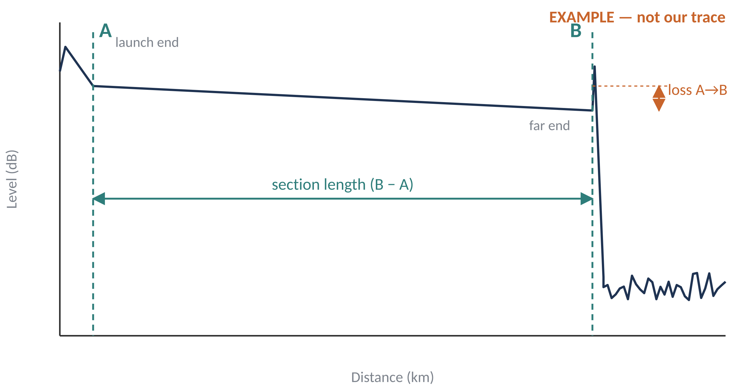
Link Loss: Meaning and Formulas
PART C · LINK LOSS
Link loss is the total drop in optical power as light travels through a fiber link (fiber + splices + connectors). Fiber attenuation is the loss per km.
Link Loss (dB) = P_{in} (dBm) − P_{out} (dBm)
End-to-end insertion loss — measured with a light source and an optical power meter.
Attenuation (dB/km) = Total Loss (dB) / Length (km)
With the OTDR
Average loss for every kilometre of the link.
Run the averaged (AVG) test.
Put cursor A at the start and B at the end of the link.
Read the A–B loss in dB and the length in km.
Divide loss by length for dB/km.
An OTDR does not use the first formula. It estimates loss from backscattered light and gives the section loss (dB) in its event table or between the A–B cursors.
Trace above is an example, not our measurement.
Notes:
dBm is power relative to 1 mW; dBm − dBm gives a loss in dB.

Slide 13
Calculation Using Our Readings
PART C · LINK LOSS
GIVEN (measured)
0.3214
0.317
Fiber length, L = 4.822 km
Total loss = 1.550 dB
dB/km · calculated by us
(total loss ÷ length)
dB/km · attenuation slope
shown by the OTDR (measured)
CALCULATION
Average attenuation = Total loss / L
= 1.550 dB / 4.822 km
≈ 0.3214 dB/km
Why are they slightly different?
The OTDR's slope is a straight-line fit over a smooth part of the trace. It leaves out events such as splices and connectors.
Total loss covers the whole section, so any event loss inside it is included.
So 0.317 is NOT simply 1.550 ÷ 4.822 — the two numbers come from different methods.
Difference = 0.3214 − 0.317 ≈ 0.004 dB/km (about 1.4%). Check: 0.317 dB/km × 4.822 km ≈ 1.529 dB, which is about 0.02 dB less than the measured 1.550 dB.
Notes:
Both values are close to what we expect for single-mode fiber at 1310 nm, which is roughly 0.3 to 0.4 dB/km.

Slide 14
Results and Conclusion
RESULTS
4.822 km
Discussion
Average attenuation ≈ 0.321 dB/km (calculated); OTDR slope 0.317 dB/km.
PASS only means the results were inside the instrument's set thresholds.
Launch/end cables were 'None', so the first and last connector losses are not accurate.
fiber length · at 1310 nm
1.550 dB
Conclusion
total loss · at 1310 nm
Fusion splicing joins fibers permanently using an electric arc; clean, square cleaves give low loss.
An OTDR measures length and loss and locates faults from one end of the fiber.
Link loss is read from the OTDR trace; our link: 1.550 dB over 4.822 km at 1310 nm.
PASS
instrument result · at 1310 nm
References: G. Keiser, Optical Fiber Communications (McGraw-Hill) · J. M. Senior, Optical Fiber Communications (Pearson) · FOA Online Reference Guide, thefoa.org/tech/ref · ITU-T G.652 · TIA-568.3-D · lab OTDR and splicer manuals.
Notes:
All values are from the OTDR result screen except 0.321 dB/km, which we calculated (1.550 ÷ 4.822).

Slide 15
Thank You
Questions?
Fusion Splicing, OTDR Testing & Link Loss Measurement · Optical Fiber Communication Laboratory

