Slide 1
Proposing Energy Efficient Urban Spaces
Using IoT and Data Visualisation

Slide 2
Anubhav Singh Guleria, 18BCE1086 Nitin Pramod Ranjan, 18BCE0272 Srinivasan Sharma, 18BCE0931
Guide: Dr B Gladys Kiruba

Slide 3
Motivation
Countries all over the world have also pledged to become carbon neutral or carbon negative before the end of the first half of the 21st century
And governments are increasingly trying to fit both a smart city and green energy resources like the sun and the wind in one single pipeline
develop models that can compare and demonstrate impacts of energy-efficiency based improvements on the same.

Slide 4
Objective
Visualising energy consumption of buildings in an urban setup.
Developing a computer-aided benchmark and base

Slide 5
Goals
1. Using models of machine learning and statistics to visualise energy consumption of buildings in an urban setup.
2. Developing a computer-aided benchmark and baseline for energy efficiency of buildings in cities.
3. Aiding in the implementation of the following UNDP goals

Slide 6
System Requirements
H/W Requirements
1. A computer with RAM greater than 16GB and a hard disk with at least 256GB free storage shall be sufficient for the data of an entire city.
2. IoT devices depending on the scope and scape of installation
S/W Requirements (details about Application Specific Software)
1. Python 3.8 or above
2. R can be used too, but python is far superior in data visualisation tools.

Slide 7
Design Approach
1. Studying a large amount of data;
2. Establishing patterns of energy use – both seasonal and overall;
3. Working out a methodology;
4. Making it cost-efficient;
5. Checking compatibility with tools/solutions already available;
6. Making it transparent, easy to audit and control.

Slide 8
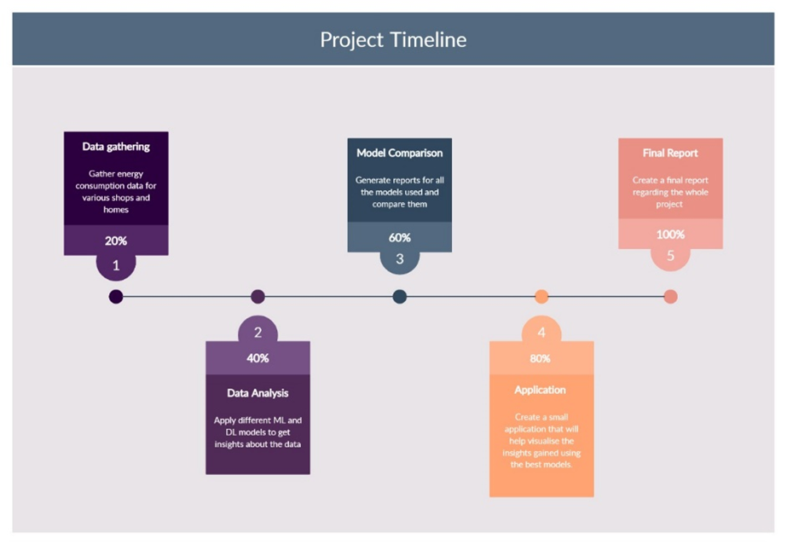

Slide 9
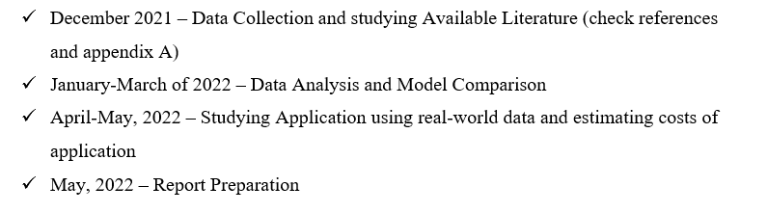
Timeline completion Dates

Slide 10
The Proposed Algorithm
The link - https://drive.google.com/file/d/1I69tCUPBjuCdPmOE8sdiVcIUQ7wZqmf2/view?usp=sharing

Slide 11
Step: Collection and visualisation of data
The tools: Tableau and Python.
Tableau is used to create interactive dashboards in order to consolidate all data. This step is to understand –
a) The most common forms of energy used in cities.
b) The way in which energy consumption has changed over years, thus predicting the patterns of future.
c) The power consumption pattern in buildings in order to prepare benchmarks for the same.
Tableau Link: https://public.tableau.com/views/EnergyTrendsViz/CoverPage?:language=en-US&:display_count=n&:origin=viz_share_link
India Data Exploratory: https://www.kaggle.com/code/nitinr2510/indiadataexploratory

Slide 12
Step : Statistical Analysis of Data
Tools: Python, Excel
Step is performed to estimate measures like mean, median, mode, variance and deviation etc. in the data. The most prominent and recurrent derived values shall serve as the benchmarking criterion.

Slide 13
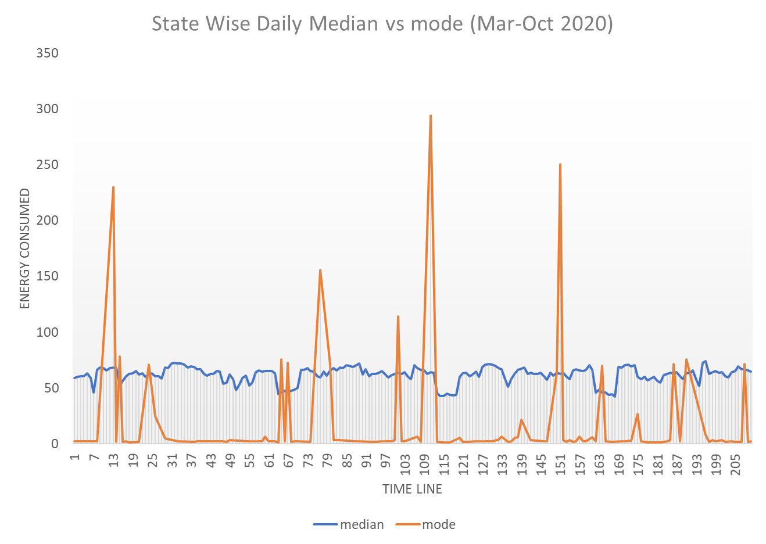
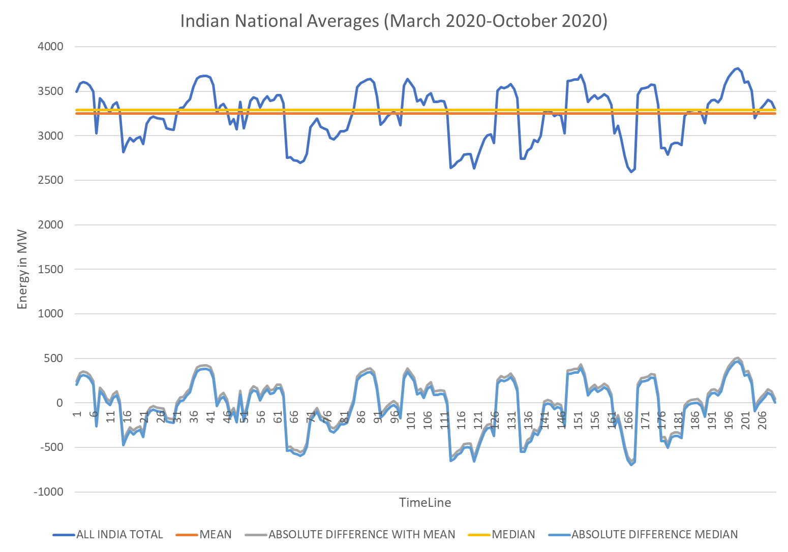

Slide 14
Step : Simulation
Tools: Cisco Packet Tracer
Since the project is based on an urban landscape, it is important to simulate it to find if it is technologically possible.

Slide 15
Cisco Packet Tracer Demonstration

Slide 16
RESULTS, COST ANALYSIS AND DISCUSSION
https://docs.google.com/document/d/1V1zWYZFeWTSx3nlj5UYqcrGmuGncba7HhLEZ3Sx89S8/edit?usp=sharing

Slide 17
Summary
Link to tableau presentation
https://public.tableau.com/views/EnergyTrendsViz/CoverPage?:language=en-US&:display_count=n&:origin=viz_share_link
Poster
https://drive.google.com/file/d/1YqYMcIk2Ut7VtiX1CBsES3t_F2T49r9h/view?usp=sharing

Slide 18
Thankyou

