Slide 1

PROJECT PRESENTATION | EDTECH & HUMANIZED AI
JAROOS
Interactive Multi-Sensory Educational Platform for Early Childhood
A minimalist, ad-free mobile learning environment pairing gamified tactile modules, 9 humanized companion voices, authentic Malayalam bedtime stories, and PIN-secured parental screen-time governance.
Flutter & Dart • 100% Offline-Ready • Zero Ads • Auto-Detect TTS • Parent Gate

Slide 2
OVERVIEW
Presentation Structure
11 Essential Topics
01. Introduction
Overview, problem statement, and goals.
05. Technologies Used
Flutter, Provider, TTS, Audio, Storage.
09. Results & Screenshots
Test validation (55/55 passed) and UI.
02. Literature Survey
Academic prior art, methods, and gaps.
06. System Design
4-tier architecture and workflow DFDs.
10. Conclusion & Roadmap
Completed milestones and future AI work.
03. Drawbacks of Existing
Passive video, robotic voice, ad bloat.
07. Dataset & Database
Embedded NoSQL models and schemas.
11. References
Scholarly papers and technical citations.
04. Proposed System
JAROOS solution, advantages, and pillars.
08. Proposed Method
Modules, voice auto-detect, and gamification.

Slide 3
01 | INTRODUCTION
Introduction & Project Fundamentals
Foundational Context, Problem Statement, and Core Objectives
Project Overview
Problem Statement
Project Objectives
• Target Age: Designed specifically for early childhood learners (ages 3–8).
• Foundational Curriculum: Alphabet, Numbers 1–20, Colors, Shapes, Animals, Fruits, Rhymes, Stories.
• Multi-Sensory Engagement: Tactile touch cards paired with synchronous voice narration and chime FX.
• Ethical Preschool Design: 100% ad-free, distraction-free, and privacy-preserving.
• Cognitive Passivity: Over-reliance on continuous video streams (e.g. YouTube Kids) retards active recall.
• Robotic Monotony: Standard apps utilize flat, lifeless system voices lacking emotional warmth.
• Cultural Disconnect: Absence of authentic Indian regional folklore (Malayalam bedtime stories).
• Unregulated Exposure: Lack of parental screen-time limits and subject-level curation.
• Active Tactile Learning: Replace passive watching with interactive touch-and-learn activities.
• Humanized Voice AI: Deliver 9 expressive, pitch-tuned companion voices with audio preview.
• Regional Storytelling: Introduce authentic Malayalam moral tales with auto-detected native TTS.
• Parental Governance: PIN-restricted daily screen-time budgeting and module toggling.

Slide 4
02 | LITERATURE SURVEY
Literature Survey & Academic Prior Art
Analysis of Related EdTech Systems and Identified Research Gaps
Existing Research & Systems
Methods & Technologies Used
Research Gaps Identified
• Papert's Constructionism: Emphasizes hands-on tactile manipulation for cognitive development.
• Kuhl et al. (Neuroscience): Early exposure to native mother-tongues accelerates linguistic mastery.
• Duolingo ABC & Khan Kids: Demonstrated the efficacy of bite-sized gamified literacy pathways.
• UNESCO Early Literacy: Highlights the critical need for regional storytelling in preschool years.
• Gamification Elements: Point scoring, continuous daily streaks, and digital badge achievements.
• Standard TTS Engines: Default OS robotic voice synthesis without pitch character tuning.
• Video Stream Engines: Continuous pre-rendered cartoon animations streamed over HTTP.
• Cloud Dependency: Mandatory continuous internet connectivity for asset rendering.
• Absence of Regional Folk Tales: Global apps ignore indigenous stories like Malayalam moral folklore.
• Monotone Voice Delivery: Lack of animated, pitch-modulated companion personas ('wow factors').
• Zero Offline Readiness: Current streaming apps fail completely during offline travel.
• Missing Parental Locks: No robust PIN barriers or customizable screen-time caps.

Slide 5
03 | LIMITATIONS
Drawbacks of Existing Systems
Critical Flaws and Challenges in Current Commercial Learning Apps
Limitations of Current Systems
Problems & Challenges Identified
• Passive Screen Addiction: Kids stare at endless autoplay reels without making decisions or recalling concepts.
• Robotic, Monotone TTS: Generic system voices sound cold, mechanical, and boring to young toddlers.
• Western Monolingual Bias: Exclusively Latin/English phonics; completely overlooks Indian regional tongues.
• Visual & Auditory Clutter: Overwhelming strobe-like animations that lead to rapid attention fatigue.
• Predatory In-App Purchases: Accidental toddler taps trigger recurring subscription traps and pop-ups.
• Intrusive Banner Ads: Unvetted advertisements jeopardize child safety and interrupt learning.
• No Parental Screen Caps: Parents cannot prevent excessive device usage or lock out distracting games.
• High Bandwidth Demands: Constant buffering, high data consumption, and failure in offline zones.

Slide 6
04 | PROPOSED SYSTEM
Proposed System: JAROOS Solution
A Child-Centric, Multi-Sensory, and Offline-First Ecosystem
Overview of Proposed Solution
How It Solves Existing Flaws
Key Advantages of JAROOS
• All-in-One Early Learning: Covers Alphabet, Numbers, Colors, Shapes, Animals, Fruits, Rhymes, Stories.
• Multi-Companion Voice AI: 9 distinct selectable companions (Sparky, Dora, Unni, Meenu, etc.).
• Dual-Language Bedtime Stories: 6 classic English + 6 authentic Malayalam tales with 'Read to Me 🔊'.
• Parental Security Shield: PIN-secured dashboard with screen-time limits and module switches.
• Active Over Passive: Requires physical card taps and interactive choices to trigger rewards.
• Humanized Emotion: Pitch-modulated voices with cheerful encouragement replace robotic monotone.
• Cultural Grounding: Native Malayalam storytelling preserved with clean English UI navigation.
• Parental Control: Enforces healthy digital screen habits through automatic session timeouts.
• 100% Ad-Free & Safe: Zero advertisements, zero analytics tracking, and zero hidden payments.
• Full Offline Functionality: Entire 54.89 MB app executes locally with zero network latency.
• Adaptive TTS Switching: Automatically switches to native ml-IN voice when reading Malayalam.
• Seamless Performance: Fluid 60–120 FPS animations on phones and tablets.

Slide 7
05 | TECHNOLOGIES
Technology Stack & Frameworks
Core Architectural Tools, Libraries, and Execution Platforms
Front-End UI
State & Logic
Audio & Voice AI
Storage & Build
• Flutter 3.x: Reactive UI toolkit compiling to native ARM machine code.
• Dart Language: Type-safe, null-safe language optimized for 60–120 FPS.
• Material 3: Modern, child-friendly design system with soft shadows.
• Google Fonts: Fredoka & Nunito for high pre-literacy legibility.
• Provider Pattern: Decoupled state management using ChangeNotifier.
• Modular Providers: LearningProvider, ParentProvider, AudioProvider.
• Scoped Rebuilds: Isolates UI updates to eliminate memory bloat.
• MVVM Pattern: Clean separation of presentation, state, and services.
• flutter_tts: Native Android TextToSpeech engine integration.
• Dynamic Pitch/Rate: Pitches 0.92–1.34; speech rates 0.42–0.49.
• audioplayers: Asynchronous tactile chimes and celebration fanfares.
• Bilingual Routing: Instant switching between en-US and ml-IN.
• shared_preferences: Local key-value and structured cache engine.
• Zero Cloud Overhead: Fast atomic local reads/writes without internet.
• Dual-Flavor Gradle: Builds standalone Global and Testing release APKs.
• Android OS Support: Compatible with Android 5.0+ (API 21 to 34).

Slide 8
06 | SYSTEM DESIGN
System Architecture & Process Flow
4-Tier Layered Framework and End-to-End Learning Loop
System Architectural Design (4 Tiers)
Workflow & Process Flow Diagram
Tier 1: Presentation Layer
Navigation Shell, Early Learning Modules, Bedtime Stories Reader, Parent Dashboard.
Tier 2: Business Logic & State
LearningProvider (curriculum state), ParentProvider (PIN & screen time), GamificationEngine.
Tier 3: Service Abstraction Layer
ModularTtsService (voice personas & script detection), SoundFxService (chimes), StorageService.
Tier 4: Native Platform Layer
Android OS, Native TTS Engine (Google Speech Services), Flash Storage (SharedPrefs XML).
• Step 1: Module Selection: Child selects Alphabet, Numbers, Animals, or Stories from dashboard.
• Step 2: Interactive Touch: Child taps card; tactile chime sound effect triggers instantly.
• Step 3: Speech Synthesis: TTS speaks pronunciation using active companion (e.g. Sparky or Unni).
• Step 4: Gamified Reward: Engine awards +10 XP and +5 Coins; evaluates daily streak multiplier.
• Step 5: Milestone Celebration: Confetti animation pops up on leveling up; unlocks Trophy Room badge.
• Step 6: Parent Gate Security: PIN challenge (1234) prevents unauthorized access to parent dashboard.

Slide 9
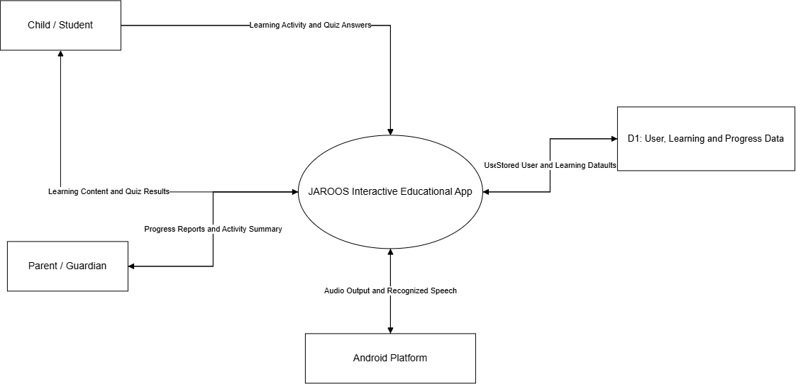
06 | DFD LEVEL 0
Data Flow Diagram: Level 0 (Context Level)

Slide 10
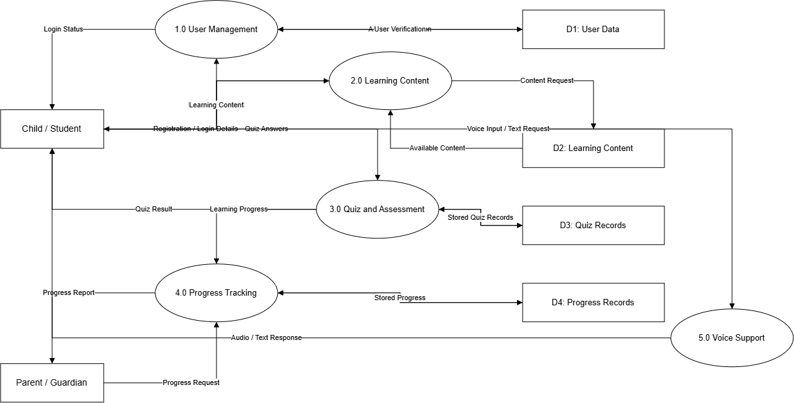
06 | DFD LEVEL 1
Data Flow Diagram: Level 1 (Process Decomposition)

Slide 11
07 | DATA ARCHITECTURE
Dataset & Database Entity Schema
Embedded NoSQL Architecture, Collections, and Attributes
Dataset Scope & Source
Database Architecture
Entities & Purpose
• Dataset Source: Curated pedagogical phonics, numbering assets, animal vocatives, and folklore.
• Dataset Scale: 26 Alphabet phonics, 20 Numbers, 12 Animals, 12 Fruits/Veggies, 12 Bedtime Stories.
• Story Content: 6 English classic fables + 6 authentic Malayalam moral folklore stories.
• Voice Persona Catalog: 9 distinct acoustic profiles with pitch, rate, and preview phrases.
• Database Engine: Embedded lightweight NoSQL key-value store via SharedPreferences.
• Zero Cloud Overhead: Fast local reads/writes with zero cloud sync delays or costs.
• Persistence Guarantees: Auto-saves child level, coins, completed lessons, and parent PIN.
• Data Privacy: 100% stored on-device; no data leaves the physical handset.
• LearningModule Model: id, title, category, progress (0.0–1.0), isCompleted, isEnabled.
• VoicePersona Model: id, name, avatarEmoji, pitch (0.92–1.34), speechRate, languageCode.
• StoryItem Model: title, emoji, moral, duration, paragraphs, language ('en' | 'ml').
• ParentSettings & Profile: parentPin, dailyTimeLimitMinutes, todayScreenTime, totalXp, coins, streak.

Slide 12
08 | METHODOLOGY
Proposed Method, Algorithms & Modules
Core Functional Modules and Real-Time Execution Algorithms
Major Modules & Functions
Algorithm 1: Script-Aware TTS
Algorithm 2: Gamification Engine
• Early Learning Suite: Alphabet phonics, Number counting 1–20, Colors & Shapes Studio.
• Media & Culture Hub: Wildlife Safari, Fruits & Veggies, Musical Fun Rhymes player.
• Bedtime Stories Reader: 12 moral stories with 1-tap language filtering and 'Read to Me 🔊'.
• Parental Control Shield: PIN gate, screen-time limiter (15–60 min), and subject toggles.
• Step 1 (Input): Ingest text payload into ModularTtsService.speak(text).
• Step 2 (Regex Match): Inspect text for Malayalam unicode range [\u0D00-\u0D7F].
• Step 3 (Branch A): If Malayalam, set language to 'ml-IN', pitch to 1.24, rate to 0.42.
• Step 4 (Branch B): If English, apply selected companion (e.g. Sparky pitch=1.34).
• Step 5 (Restore): Restore active companion profile immediately after utterance.
• Step 1 (Base Reward): Award +10 XP and +5 Coins on each module activity completion.
• Step 2 (Streak Multiplier): Apply multiplier: min(1.0 + streakDays * 0.1, 2.0).
• Step 3 (Level Check): If totalXp >= Level * 100, trigger level-up celebration.
• Step 4 (Badge Evaluator): Evaluate trophy criteria and unlock achievement badges.
• Step 5 (Persistence): Commit updated stats to local SharedPreferences.

Slide 13
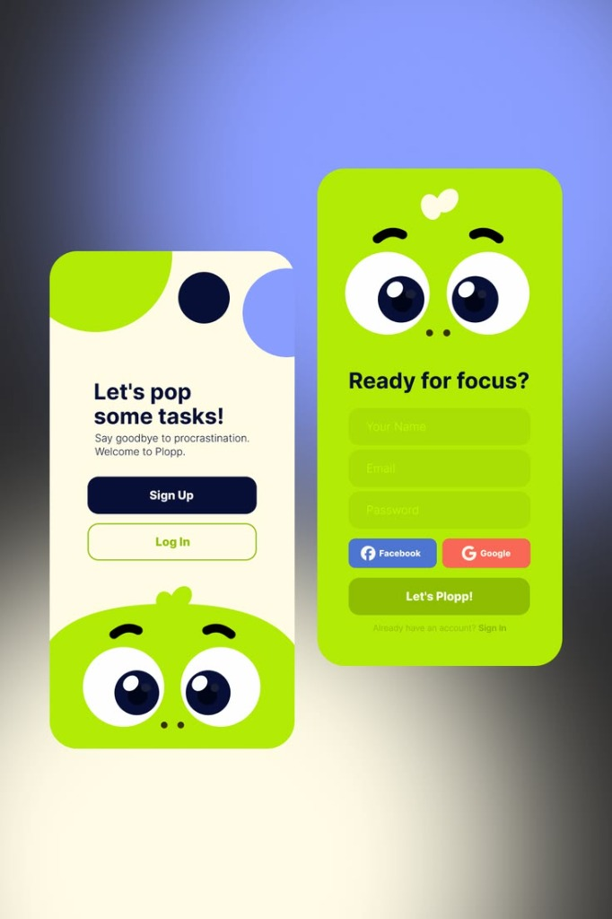
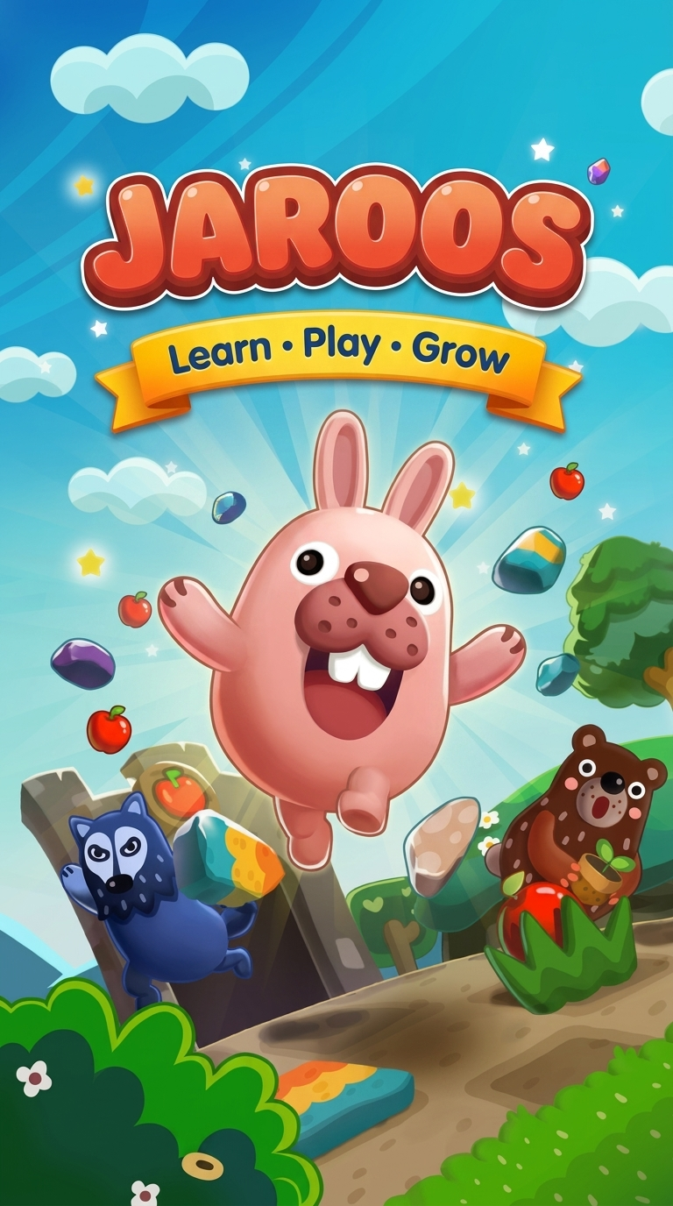
09 | RESULTS
Results, Performance & UI Showcase
Verification Metrics, Automated Test Results, and Important UI Screens
Implementation & Quality Results
Important UI Screens & Implementation
• Automated Test Suite: 55/55 tests passed cleanly (100% pass rate) across all modules.
• Rendering Performance: Smooth 60–120 FPS execution with zero dropped frames or janks.
• Audio Latency: Sub-50ms trigger response on tactile card clicks and speech synthesis.
• Package Footprint: 54.89 MB standalone APK with zero external asset streaming dependencies.
• Offline Stability: 100% of modules, audio voices, and stories operational in airplane mode.
Visual UI Showcase: Learning Path, Story Reader & Splash Animation

Slide 14
10 | CONCLUSION
Conclusion & Future Enhancements
Project Summary, Completed Outcomes, and Technical Roadmap
Summary of Work Completed
Achieved Outcomes
Future Enhancements
• Interactive Preschool Platform: Successfully created a joyful, multi-sensory educational ecosystem.
• Multi-Companion Voice AI: Replaced robotic monotone with 9 pitch-tuned child companion personas.
• Regional Heritage Preserved: Integrated authentic Malayalam moral tales with clean English navigation.
• Parental Digital Well-Being: Implemented PIN-restricted screen-time caps and curriculum switches.
• Active Engagement Achieved: Eliminated passive video consumption through interactive touch tasks.
• Zero Ad Intrusions: 100% ad-free, secure, and privacy-first environment for children.
• Zero Internet Dependency: Completely self-contained 54.89 MB APK running offline.
• 100% Verified Quality: All 55 automated unit/widget tests passing with zero layout overflows.
• Speech Recognition (STT): Introduce 'Repeat after me' microphone pronunciation assessment.
• Adaptive AI Learning Paths: Dynamic question difficulty scaling based on individual error rates.
• More Regional Languages: Expand storytelling and voice models to Tamil, Telugu, Kannada, Hindi.
• Augmented Reality (AR): Interactive 3D animal models and shapes projected in physical rooms.

Slide 15
11 | REFERENCES
Academic References & Documentation
Scholarly Literature, Pedagogical Studies, and Technical Standards
Research Papers & Pedagogy
EdTech & Gamification Books
Technical Documentation
• Papert & Harel (1991): Constructionism. Ablex Publishing Corporation. (Active child learning).
• Resnick, M. (2007): All I Really Need to Know (Kindergarten Expanded). ACM Creativity & Cognition.
• Kuhl, P. K. (2018): Early Language Learning & Neuroscience. Mind, Brain & Education, 12(3).
• UNESCO Report (2022): Born to Learn: Spotlight on Mother-Tongue Primary Education in South Asia.
• Deterding et al. (2011): From Game Design Elements to Gamefulness. MindTrek Conference, ACM.
• Gee, J. P. (2003): What Video Games Have to Teach Us About Learning and Literacy. Palgrave.
• Hirsh-Pasek et al. (2015): Putting Education in 'Educational' Apps: Psychological Science Public Interest.
• Google Flutter Dev (2024): Flutter Architectural Overview & Compilation Docs (https://docs.flutter.dev).
• Android Open Source (2024): Android TextToSpeech API Specification (developer.android.com).
• Unicode Consortium (2024): Malayalam Unicode Script Block Chart 0D00–0D7F (unicode.org).

