Slide 1
EVALUATION OF A MARKETING CAMPAIGN Suraaj Shrestha

Slide 2
BANK MARKETING DATASET
Published by OpenML, retrieved from Kaggle. Data from a Portuguese Banking Institution.
Marketing focused on term deposit subscriptions.
Attributes are information related to the clients of the Bank from the current Marketing campaign and the previous one.

Slide 3
RESEARCH SCENARIO
Classify and predict the outcome of the current campaign.
Find characteristics to keep in mind for the next marketing campaign.

Slide 4
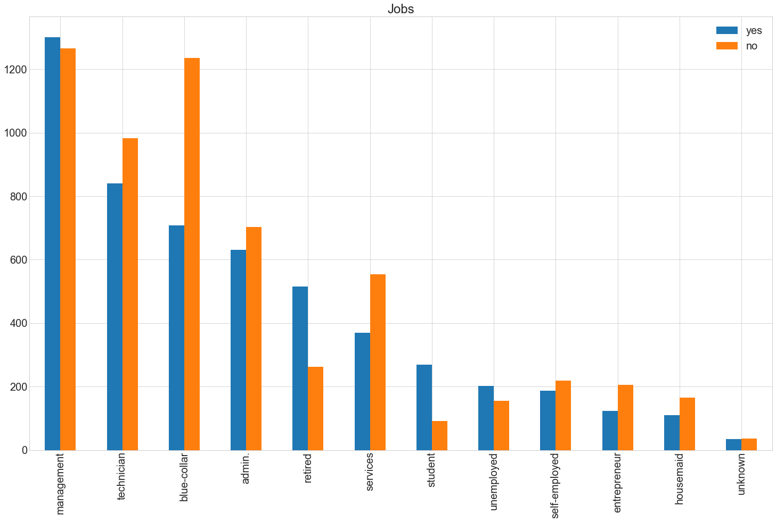
TERM DEPOSIT DEMOGRAPHICS

Slide 5
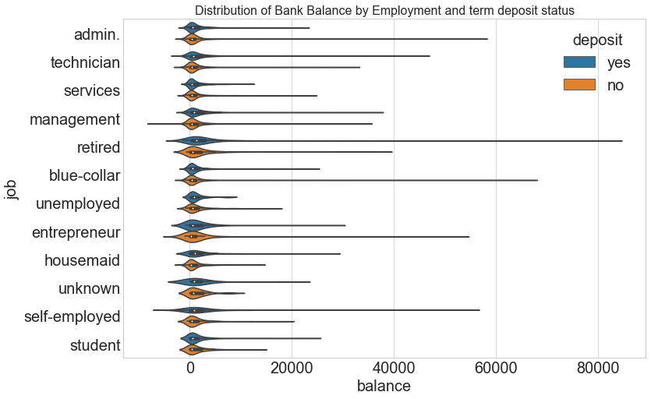

Slide 6
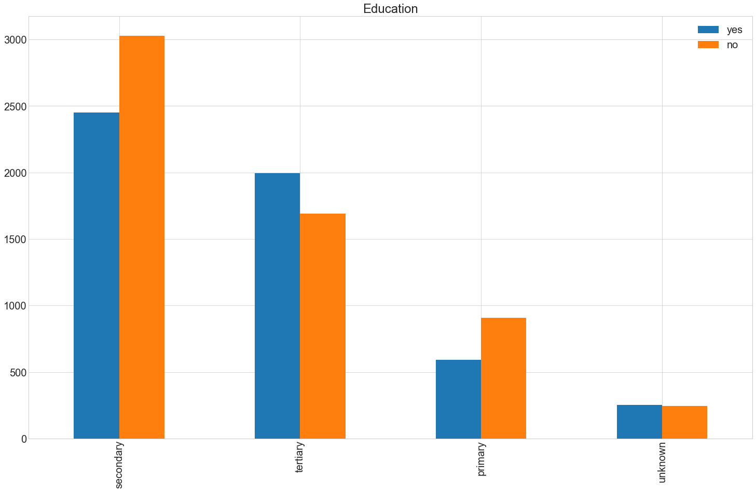

Slide 7
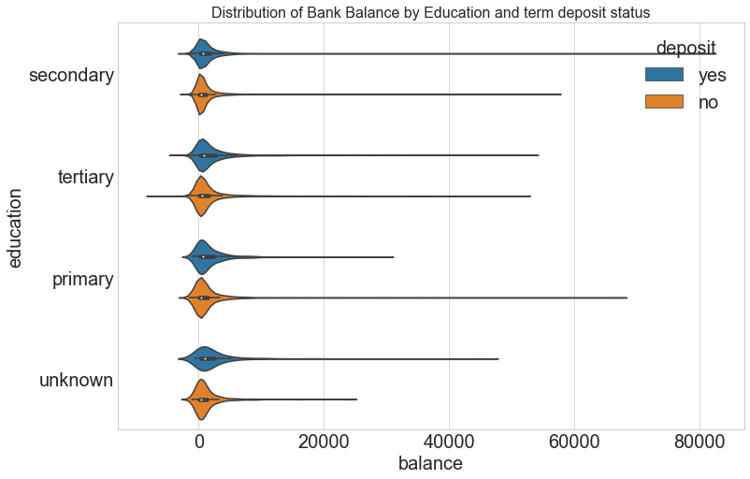

Slide 8
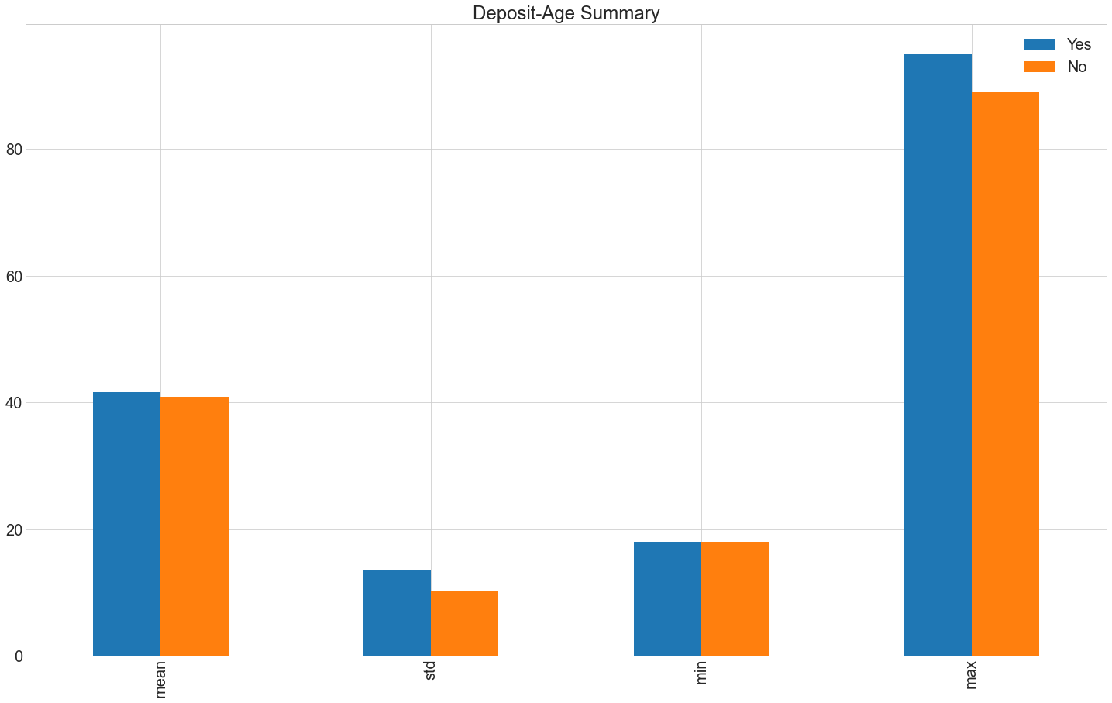

Slide 9
PREPARING THE DATA
Check for null and duplicate values and drop Irrelevant columns
Turned Categorical Variables into Dummy Variables and Numerical Binary Variables
50:50 split of dataset into training and test set

Slide 10
ALGORITHM ANALYSIS: ACCURACY
Logistic Regression : 0.7968, True Positive Rate: 79.74, True Negative Ratio: 79.62
Random Forest : 0.8420, True Positive Rate: 87.39, True Negative Ratio: 81.19.
Ada Boosting : 0.8104, True Positive Rate: 78.93, True Negative Ratio: 83.03.

Slide 11
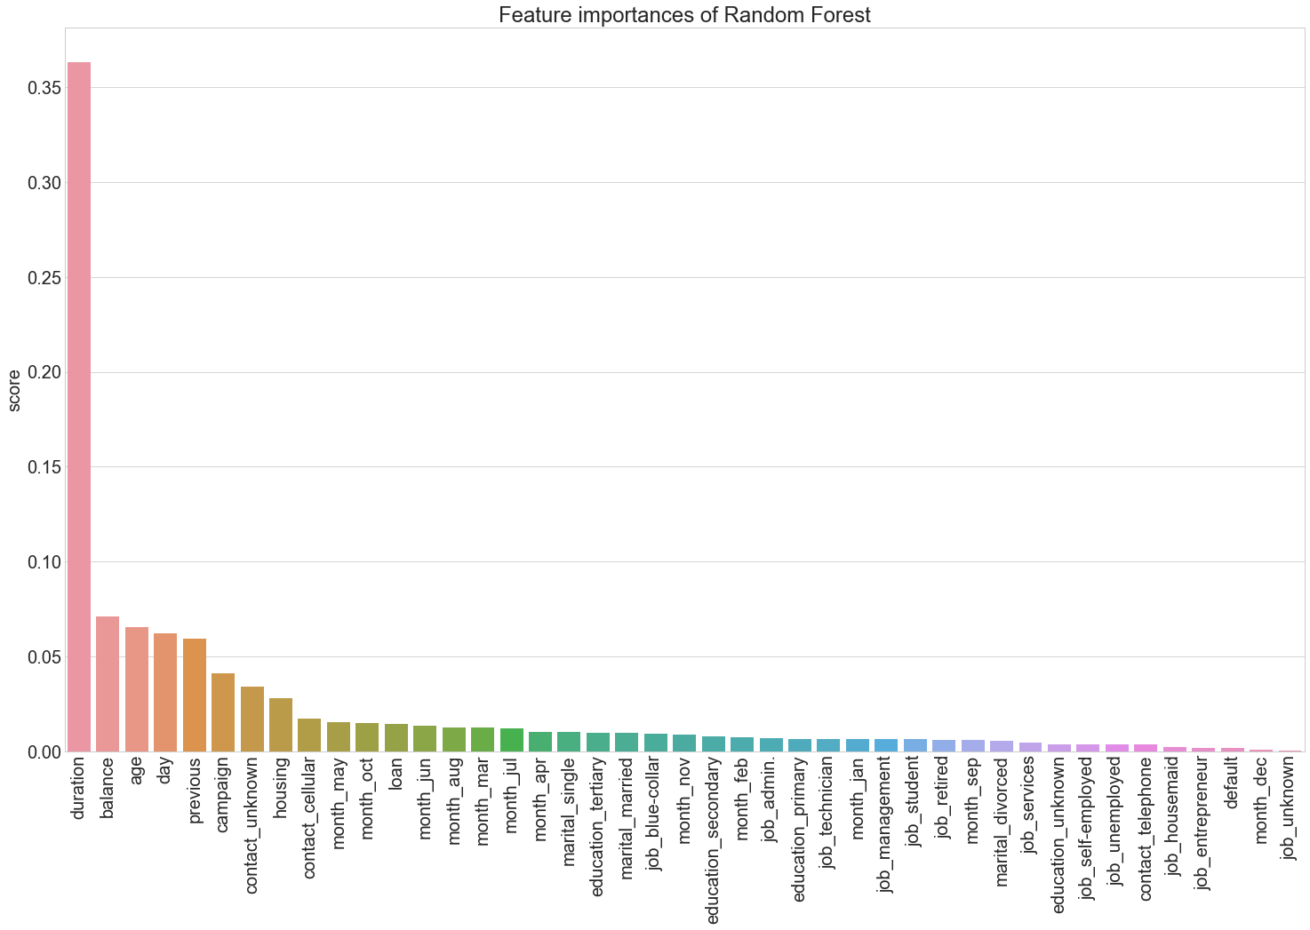

Slide 12
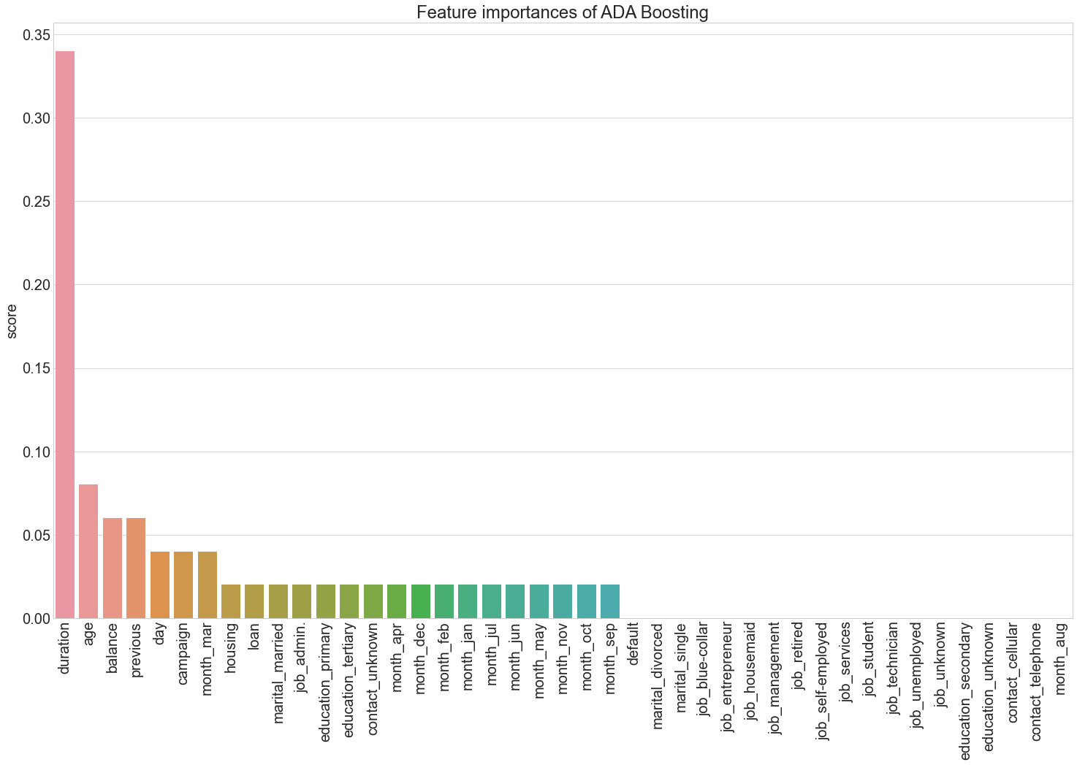

Slide 13
CONCLUSION
Focus on Ages < 30 and Ages > 50.
Put emphasis on segments of clients who do not have regular employment and higher secondary level of education.
Target group with duration of contact around the average line.

Slide 14
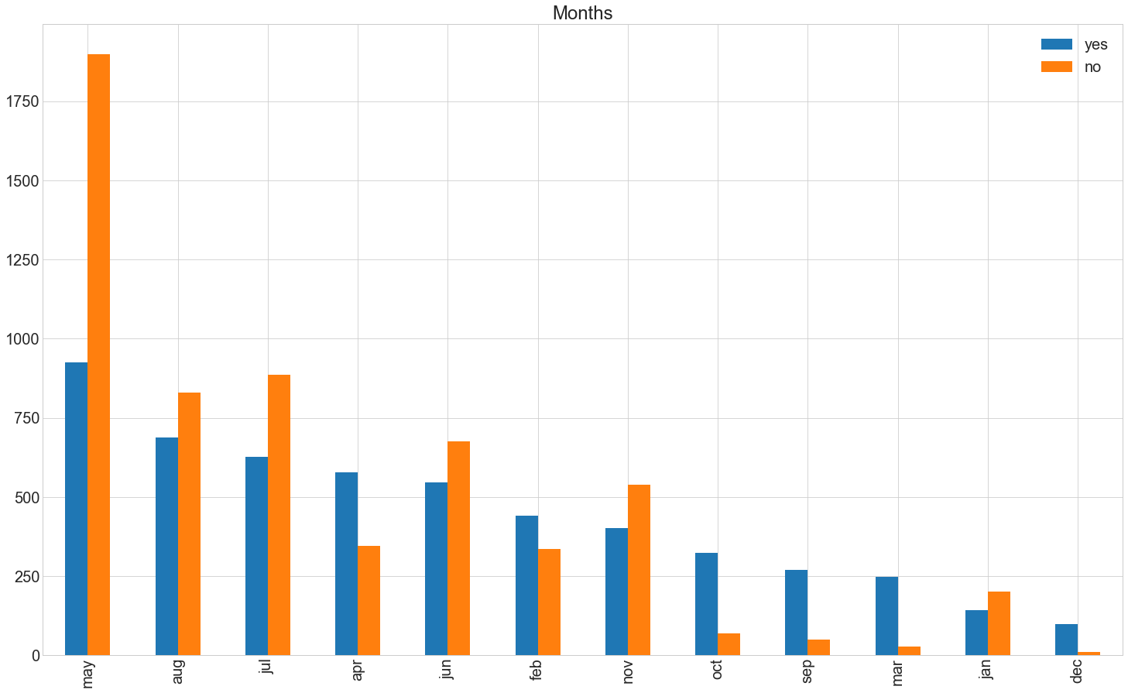

Slide 15
CONCLUSION
Focus on Ages < 30 and Ages > 50.
Focus Marketing on months of February, March, September and October.
Put emphasis on segments of clients who do not have regular employment and higher secondary level of education.
Target group with duration of contact around the average line.

Slide 16
DATASET
https://www.kaggle.com/janiobachmann/bank-marketing-dataset
https://github.com/datasets/openml-datasets/tree/master/data/bank-marketing

