Slide 1
THE GRADES OF CLIMBING ROUTES
Suraaj Shrestha

Slide 2
CONTENTS
Pre-Processing
Regression Model
Testing
Conclusion

Slide 3
ABOUT DATASET
10,927 rows and 16 columns
Stratified Sampling grouped by frequency of sex to 500 samples.
Check for null values and drop irrelevant columns
Columns: grades_mean, grades_first, years_cl, sex, age, height, weight
Retrieved from Kaggle

Slide 4
RESEARCH SCENARIO
Find the best model to predict grades_mean:
Linear Regression
Multiple Regression
Run tests to check significance of the model and inference of the parameters.

Slide 5
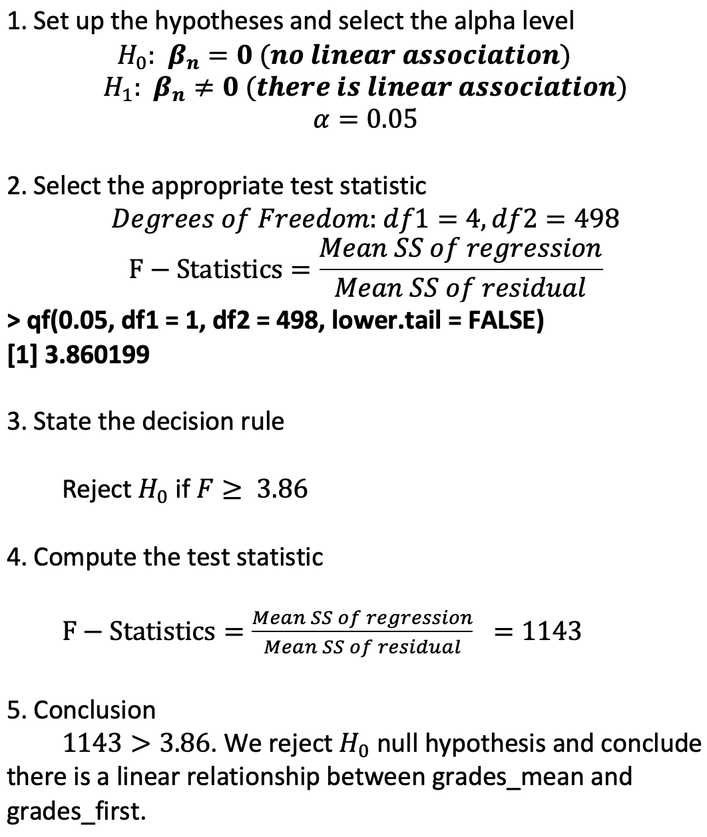
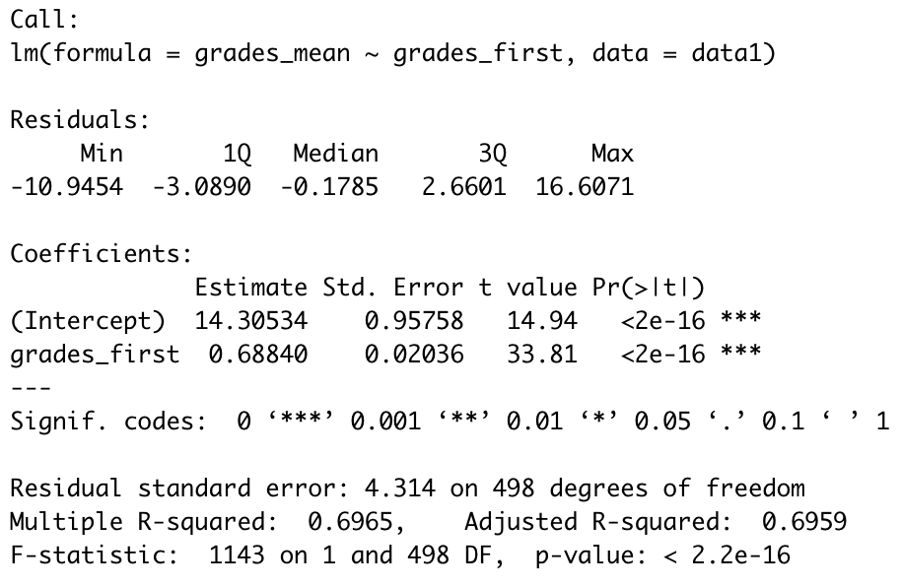
LINEAR REGRESSION
grades_mean ~ grades_first

Slide 6
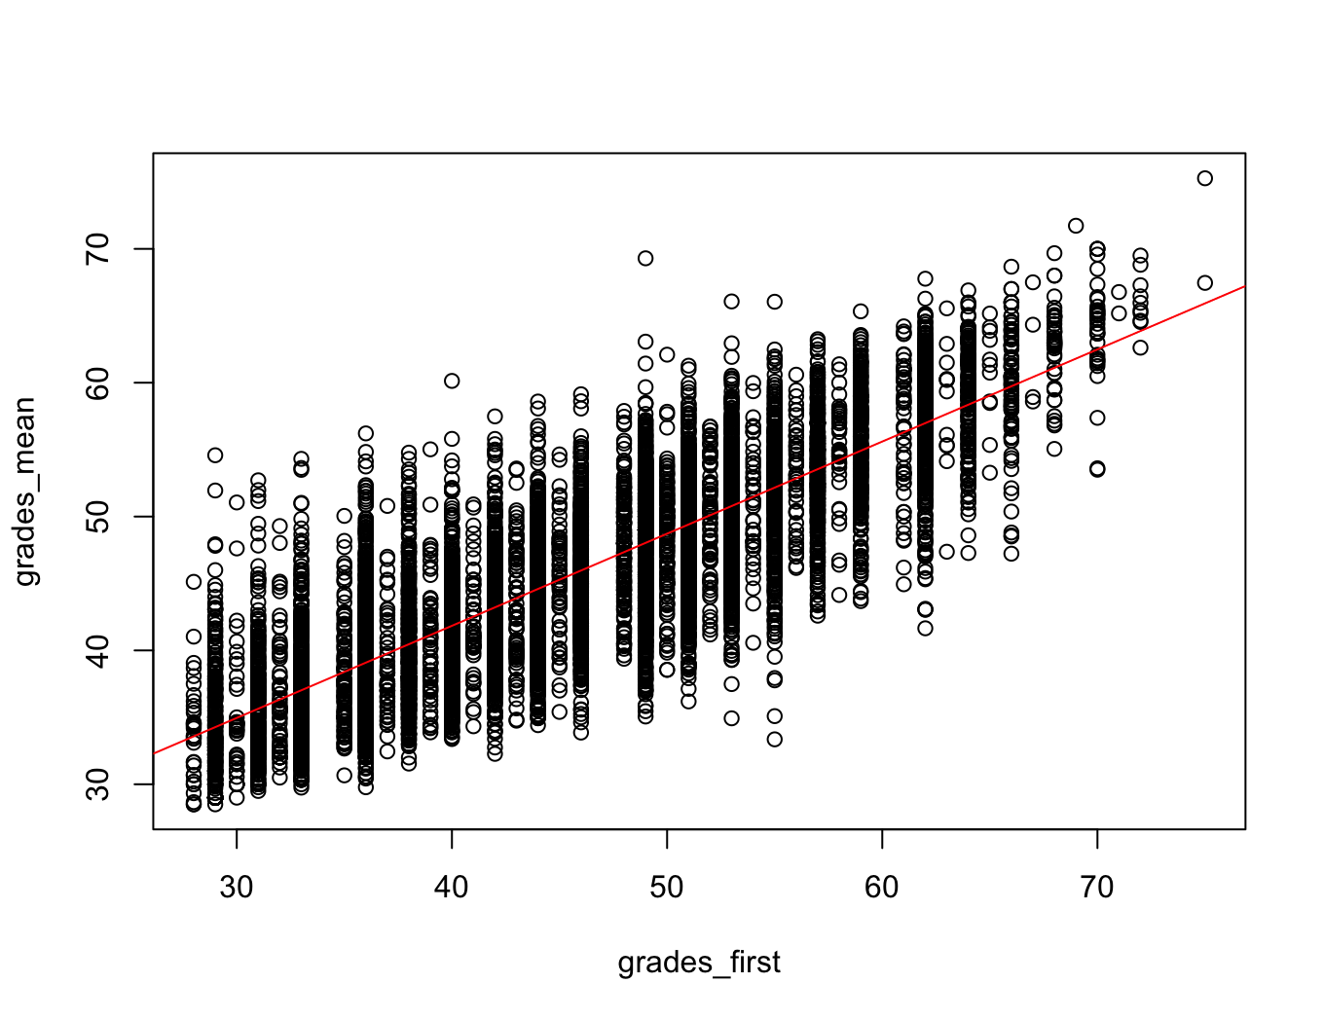
LINEAR REGRESSION

Slide 7
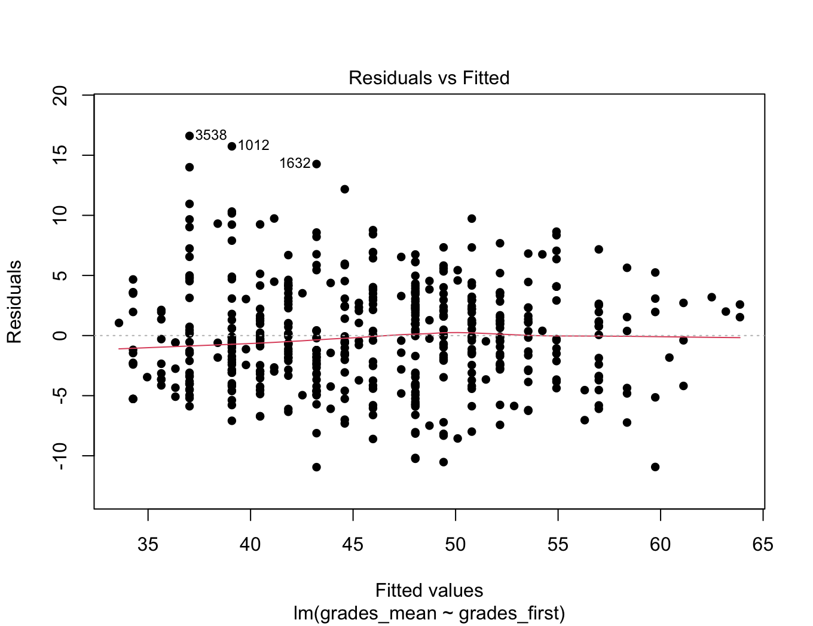
LINEAR REGRESSION

Slide 8
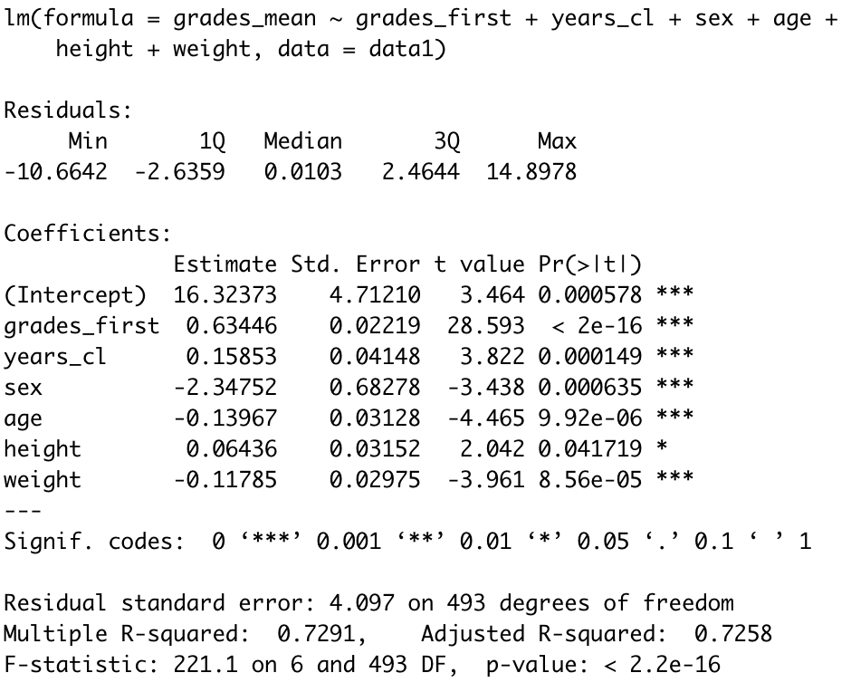
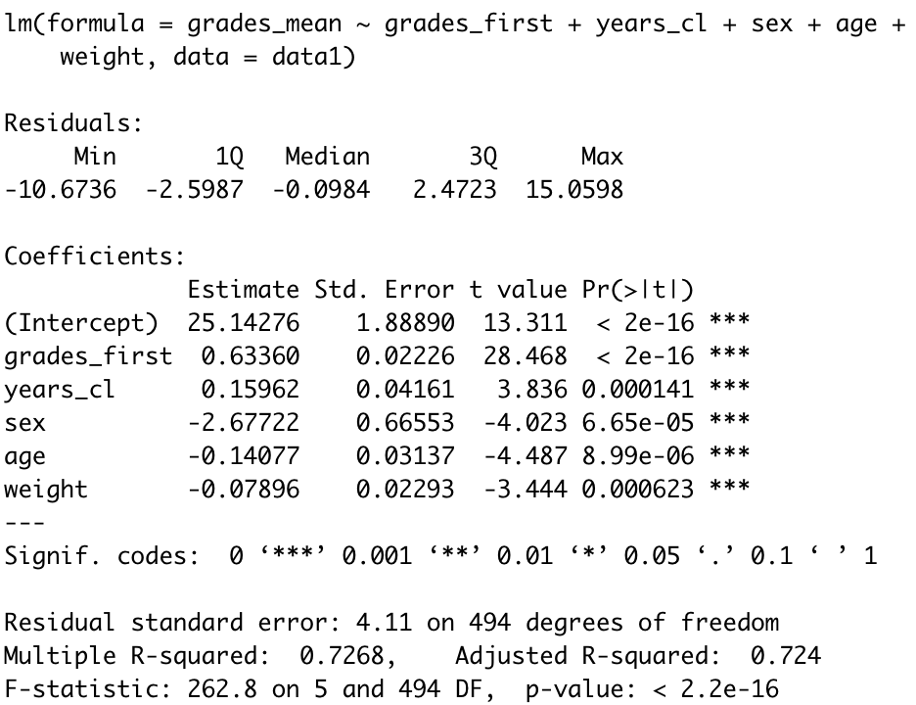
MULTIPLE REGRESSION
grades_mean ~ grades_first + years_cl + sex + age + height + weight
grades_mean ~ grades_first + years_cl + sex + age + weight

Slide 9
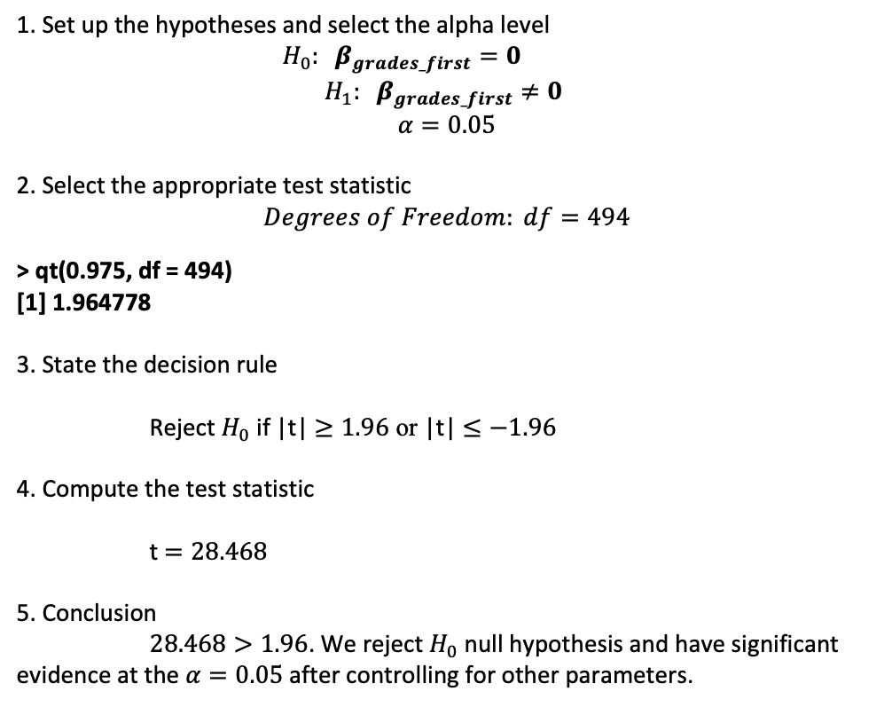
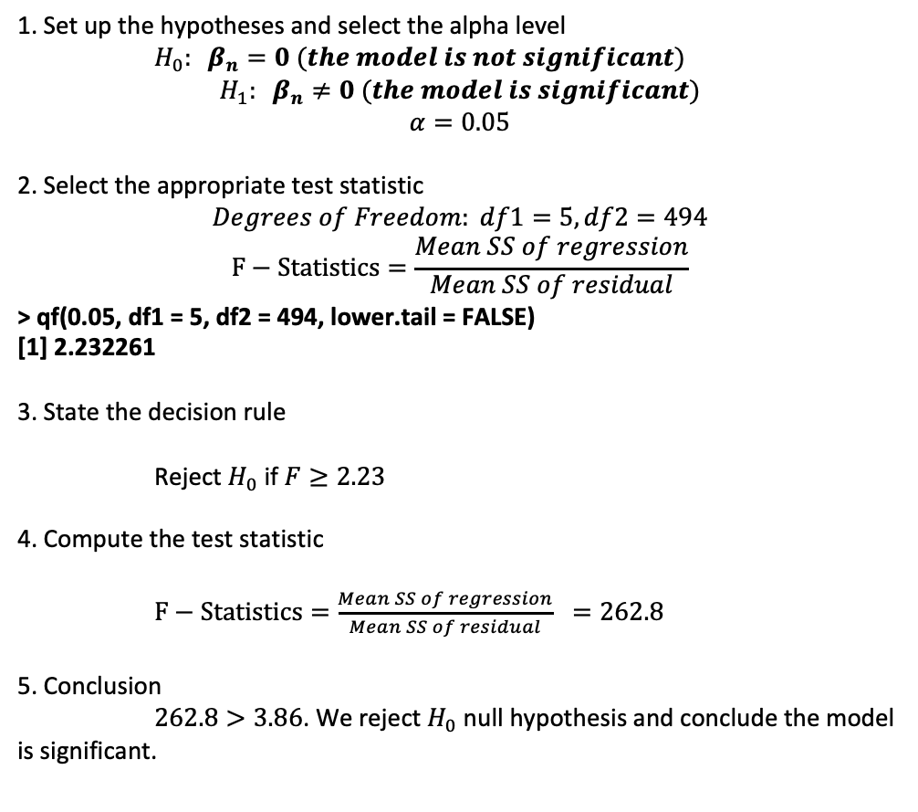
MULTIPLE REGRESSION
1. Set up the hypotheses and select the alpha level
$H_{0}: β_{n}=0 (the model is not significant)$
$$H_{1}: β_{n}≠0 (the model is significant)$$
$$α=0.05$$
2. Select the appropriate test statistic
$$Degrees of Freedom: df1=5, df2=494$$
$$F−Statistics=\frac{Mean SS of regression}{Mean SS of residual}$$
> qf(0.05, df1 = 5, df2 = 494, lower.tail = FALSE)
[1] 2.232261
3. State the decision rule
Reject $H_{0}$ if $F≥2.23$
4. Compute the test statistic
$F−Statistics=\frac{Mean SS of regression}{Mean SS of residual} =262.8$
5. Conclusion
$262.8>3.86$. We reject $H_{0}$ null hypothesis and conclude the model is significant.
1. Set up the hypotheses and select the alpha level
$H_{0}: β_{grades_first}=0$
$$H_{1}: β_{grades_first}≠0$$
$$α=0.05$$
2. Select the appropriate test statistic
$$Degrees of Freedom: df=494$$
> qt(0.975, df = 494)
[1] 1.964778
3. State the decision rule
Reject $H_{0}$ if |t| $≥1.96$ or |t| $≤−1.96$
4. Compute the test statistic
t $=28.468$
5. Conclusion
$28.468>1.96$. We reject $H_{0}$ null hypothesis and have significant evidence at the $α=0.05$ after controlling for other parameters.

Slide 10
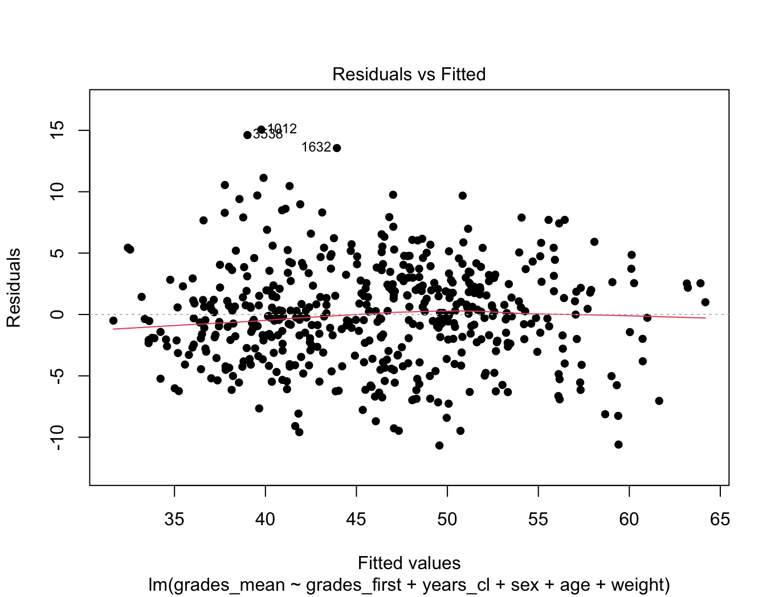
MULTIPLE REGRESSION

Slide 11
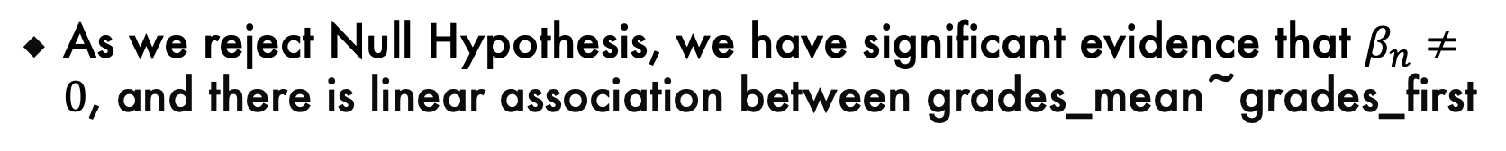
CONCLUSION
As we reject Null Hypothesis, we have significant evidence that $β_{n}≠0$, and there is linear association between grades_mean~grades_first
Suggested model: R-squared = 0.7268
grades_mean ~ grades_first + years_cl + sex + age + weight.
t-test provides significant evidence of contribution of main parameter while other parameters are included in the model.

Slide 12
THANK YOU !

Slide 13
CREDITS
https://www.kaggle.com/datasets/jordizar/climb-dataset
https://googleslides.org/free-templates

