Slide 1

CS688 PROJECT WAV2VEC
SURAAJ SHRESTHA

Slide 2
SPEECH TO TEXT
WAV2VEC2
by Alexei Baevski, Henry Zhou, Abdelrahman Mohamed, Michael Auli.
“Wav2Vec2 is a speech model that accepts a float array corresponding to the raw waveform of the speech signal.”
Transform Audio wav file of Ted Talk
by Marco Tempest on "The magic of truth and lies (and iPods)

Slide 3
Original Text from the Ted Talk Transcript
So the type of magic I like, and I'm a magician, is magic that uses technology to create illusions. So I would like to show you something I've been working on. It's an application that I think will be useful for artists -- multimedia artists in particular. It synchronizes videos across multiple screens of mobile devices. I borrowed these three iPods from people here in the audience to show you what I mean. And I'm going to use them to tell you a little bit about my favorite subject: deception.One of my favorite magicians is Karl Germain. He had this wonderful trick where a rosebush would bloom right in front of your eyes. But it was his production of a butterfly that was the most beautiful. Ladies and gentlemen, the creation of life.
Transformed Wav2Vec and T-5 Grammer Fixer Model Text
So the type of magic I like and a magician is a magic that uses tecnologis to create illusions so I would like to show you something I've been working on it's an application that I think will be useful for artists. Multimediatistint particular, it synthonizes vivid across multiple screens of mobile devises and I-boro-thy-shee eyepots from people here in the audience to show you what I mean and I-gan a use them to tell you a little bit about my favorite subject (deception). Woo of my favorite magicians is Quarrel German, yet this wonderful trait where a rose bush-woul glow right in front of your eyes. What it was Ti's production of a mildly that was the most beautiful ladies, a gentleman bout creation a like.

Slide 4
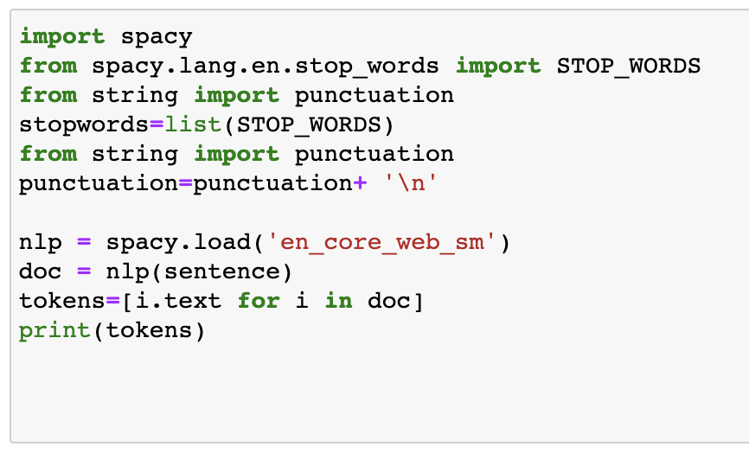

Slide 5
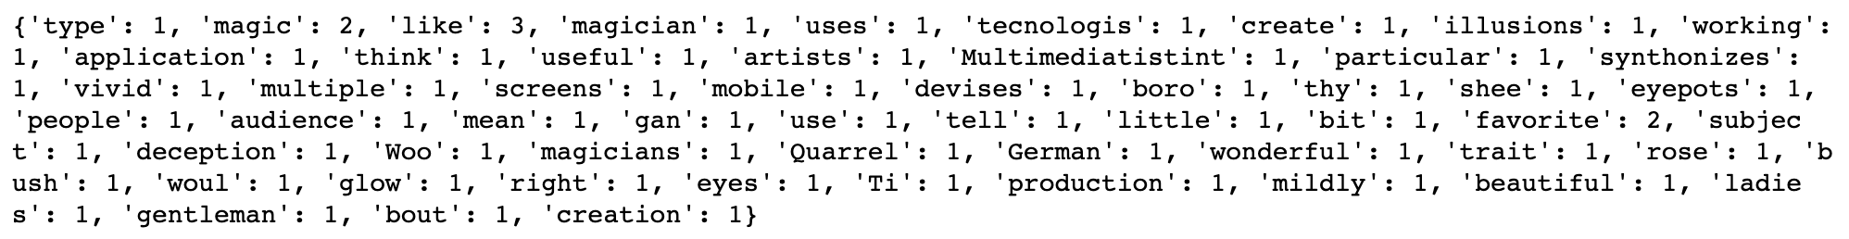
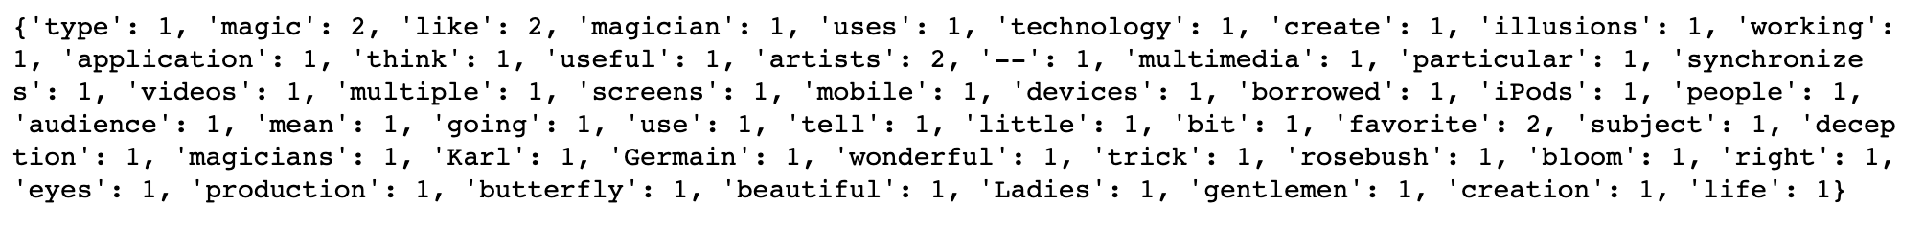
NLP SUMMARY USING SPACY
Wav2Vec word frequency
Original word frequency

Slide 6
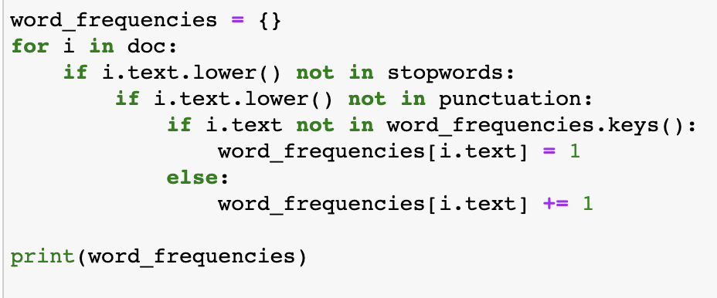
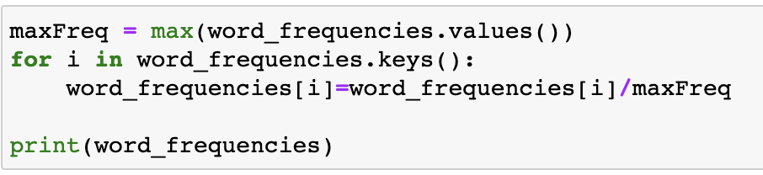

Slide 7
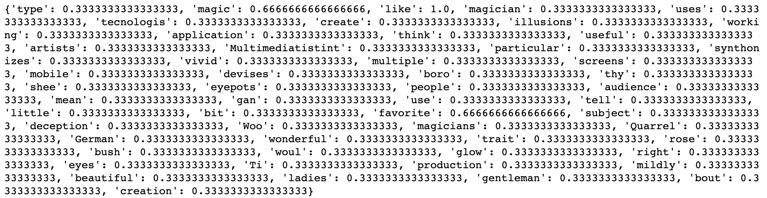
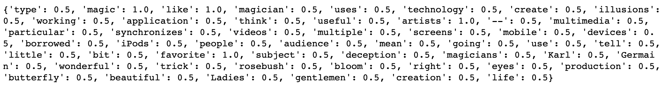
NLP SUMMARY USING SPACY
Normalized Wav2Vec word frequency
Normalized Original word frequency

Slide 8
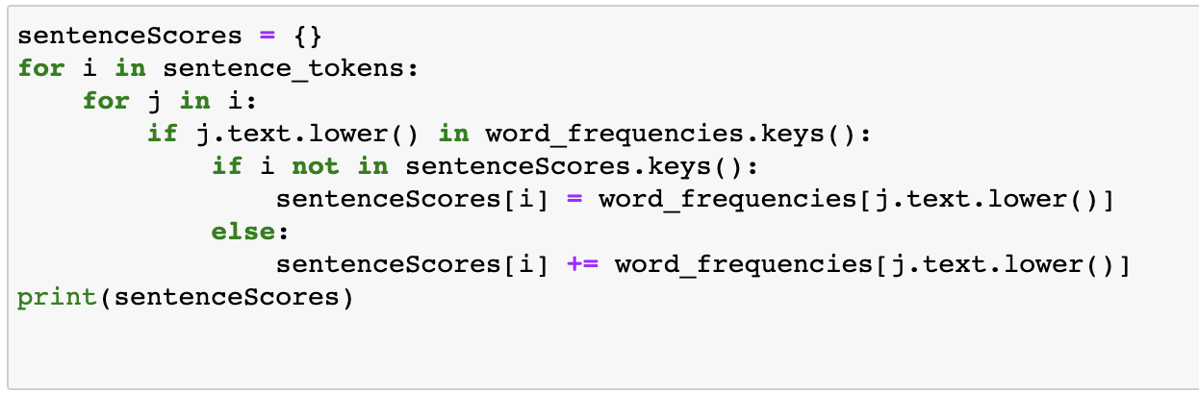

Slide 9
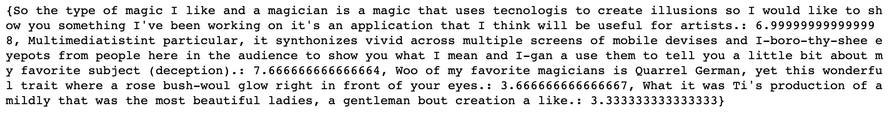
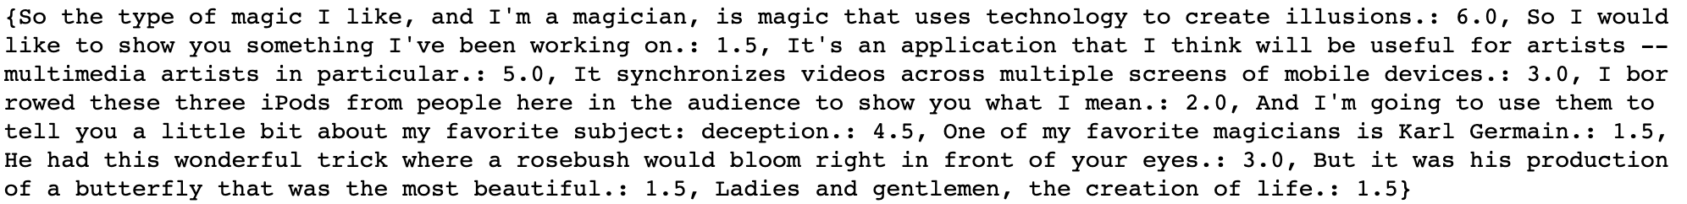
NLP SUMMARY USING SPACY
Wav2Vec text Sentence scores
Original Text Sentence Score

Slide 11
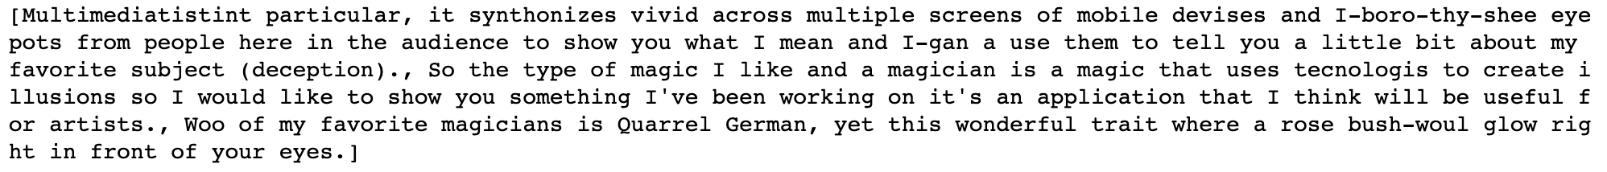
NLP SUMMARY USING SPACY
Summary of Wav2Vec Text
Summary of the original Text

Slide 12
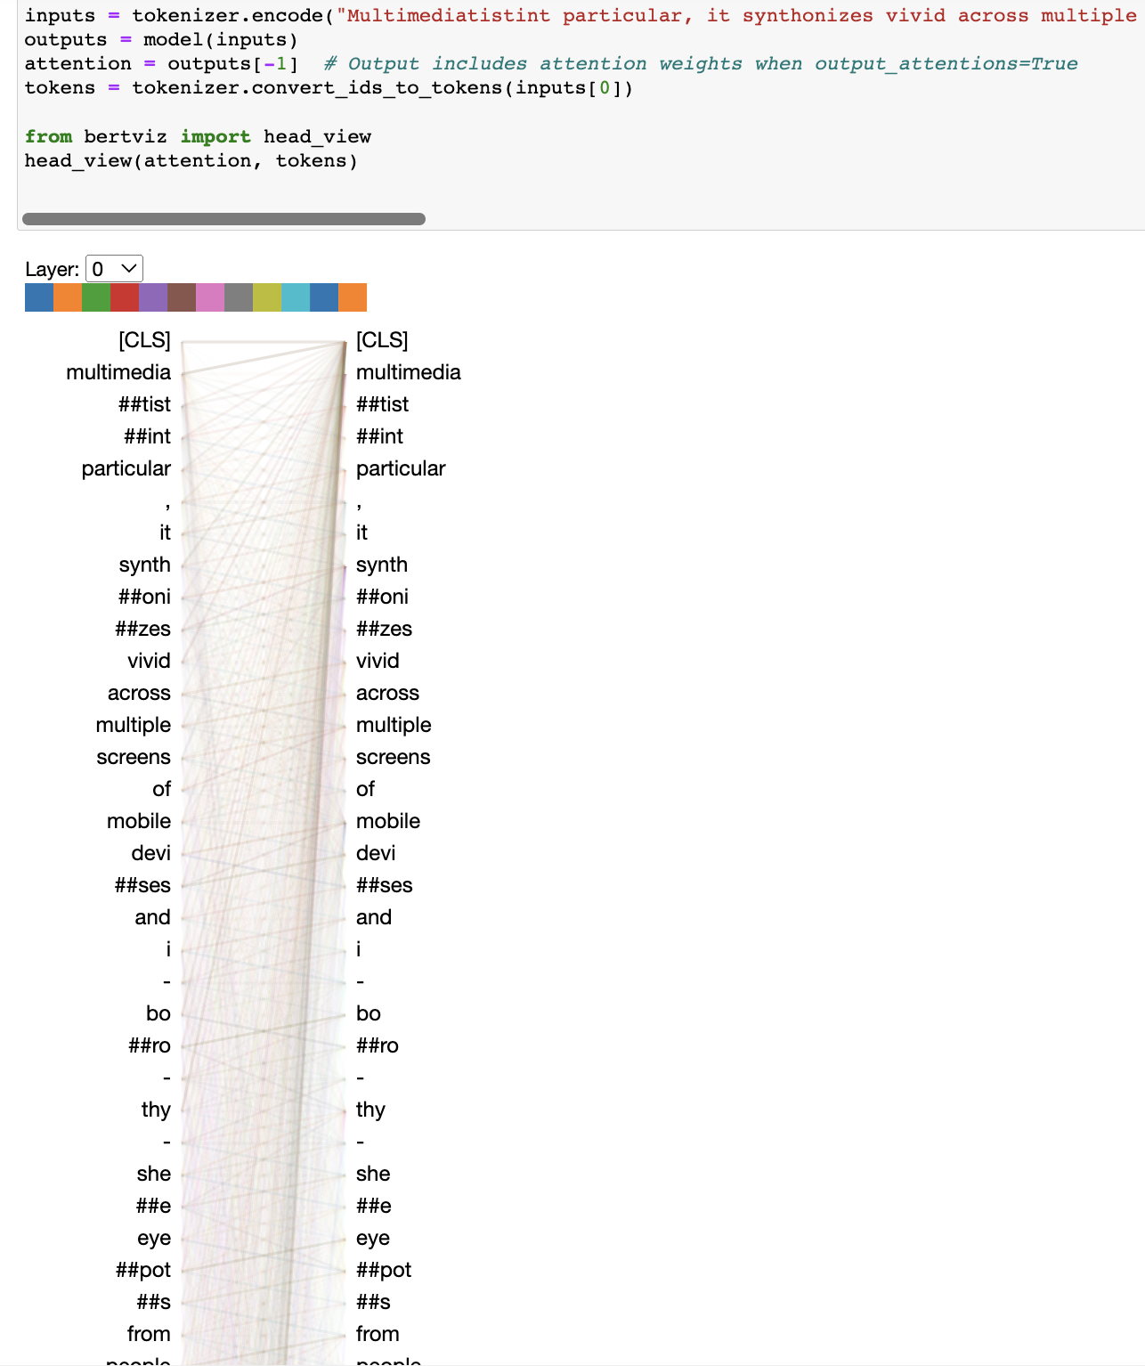
BERT HEAD VIEW for highest scored Sentences

Slide 13
credits
https://huggingface.co/docs/transformers/model_doc/wav2vec2

