Slide 1
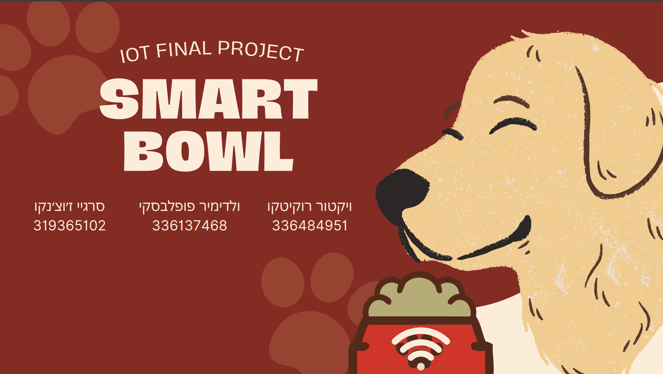
קישור לריפו: https://github.com/srjuchenko/smart-bowl-IoT
לינק לסרטון: https://www.youtube.com/watch?v=S5Sgx67XWTQ

Slide 2
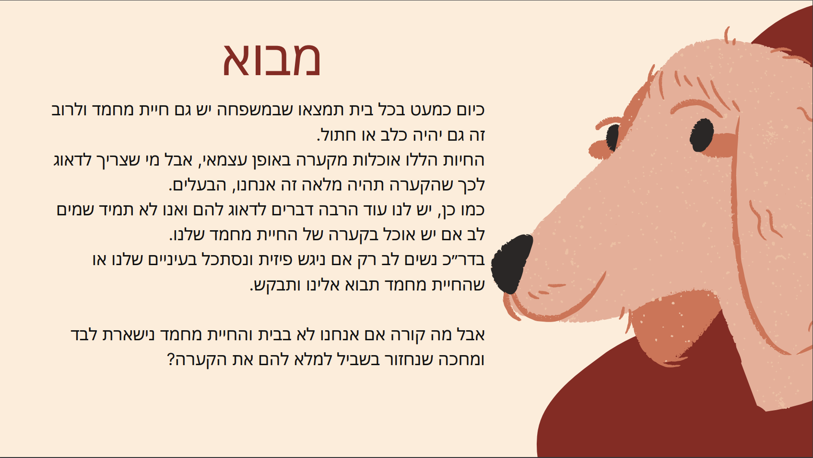

Slide 3
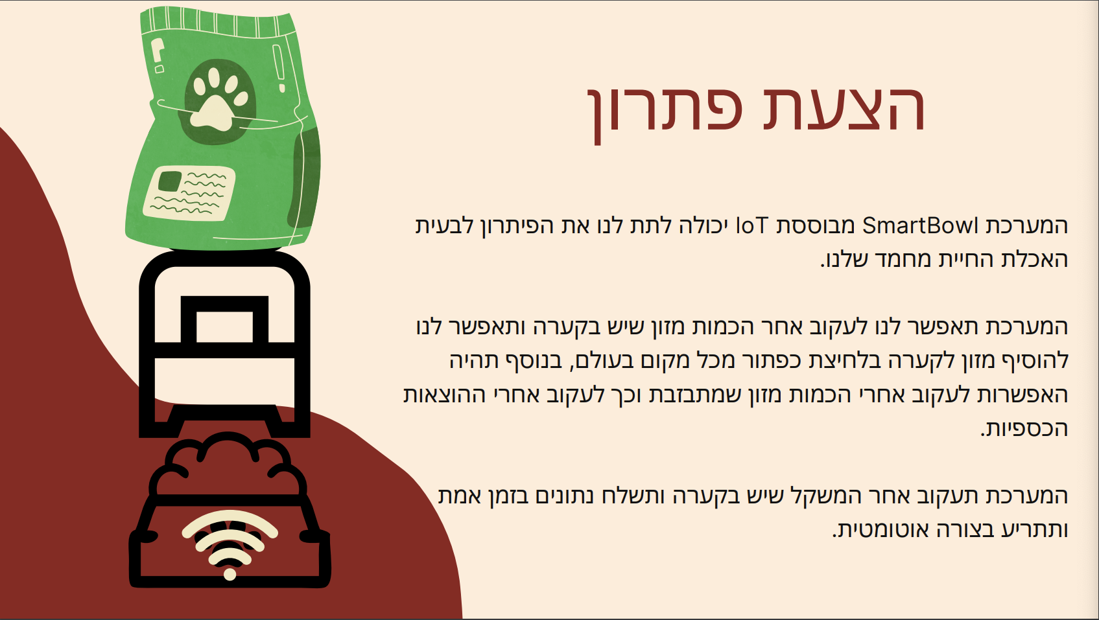

Slide 4


Slide 5
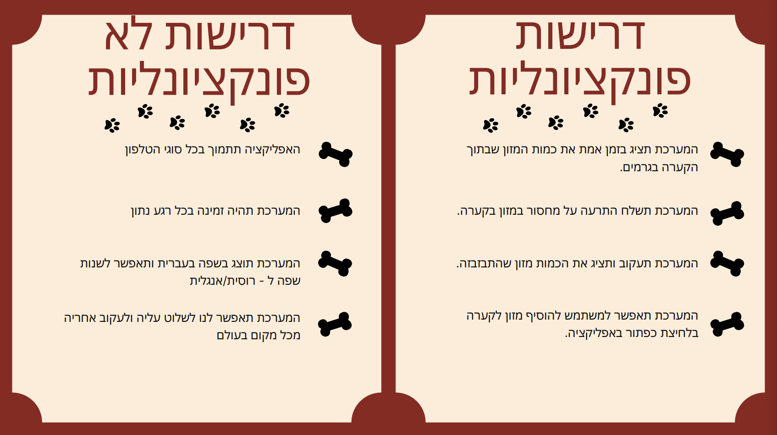

Slide 6
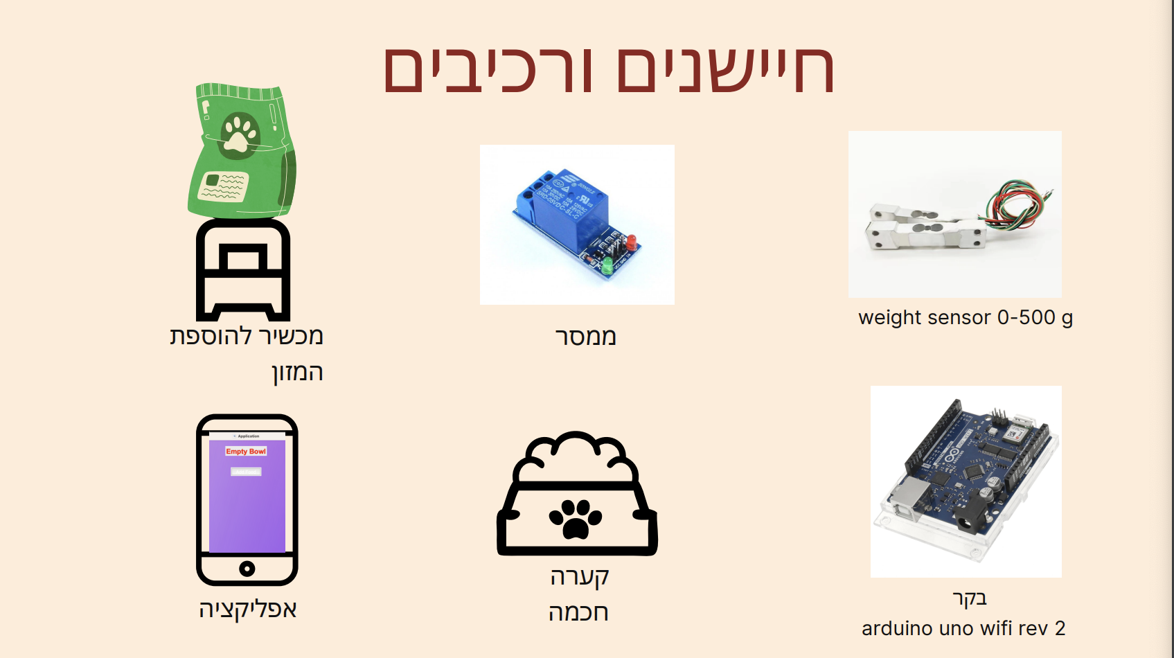

Slide 7
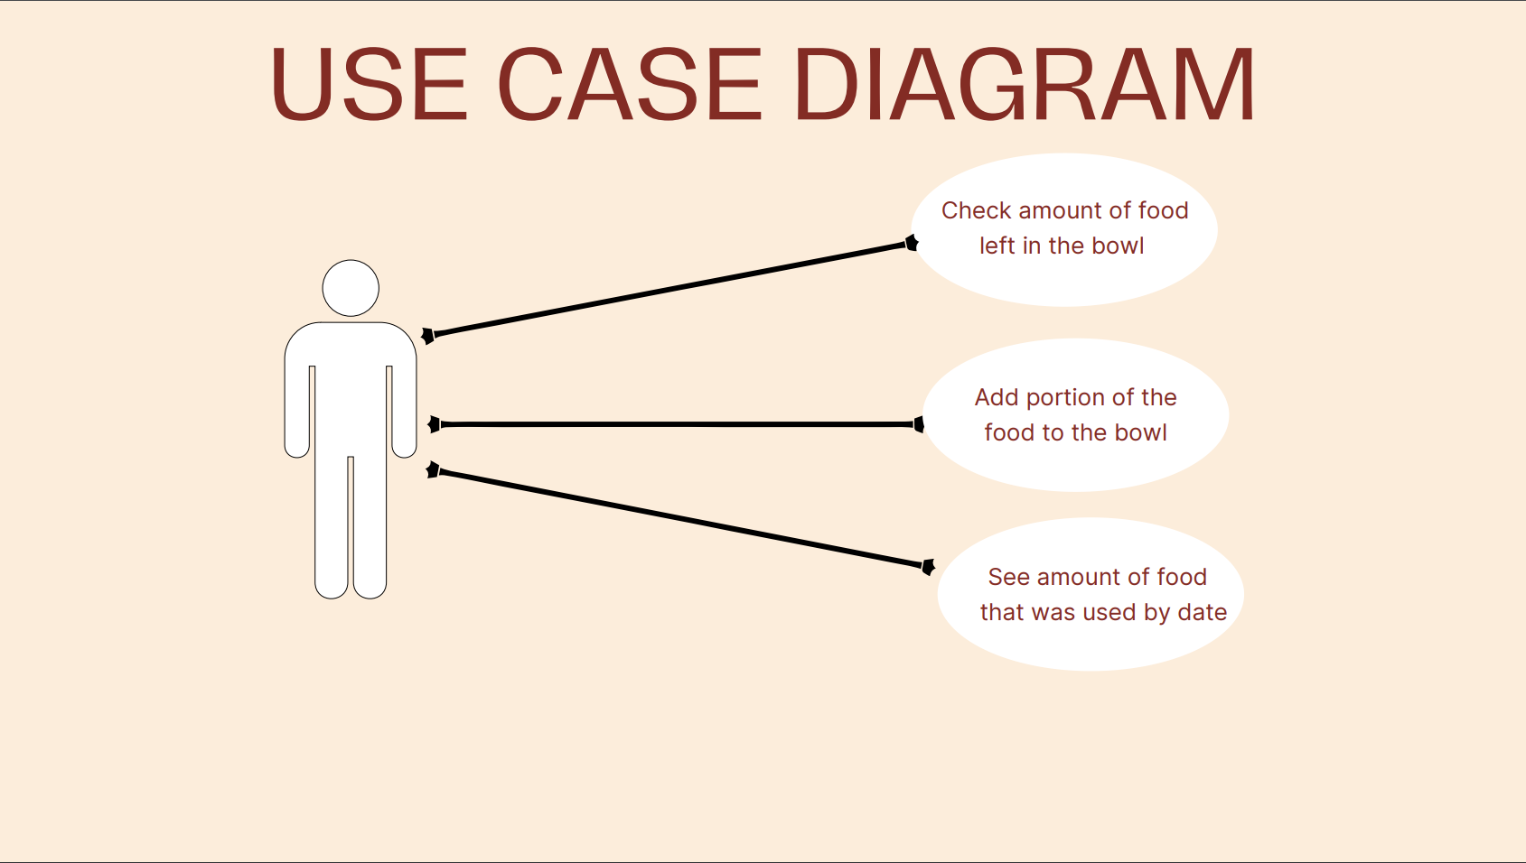

Slide 8
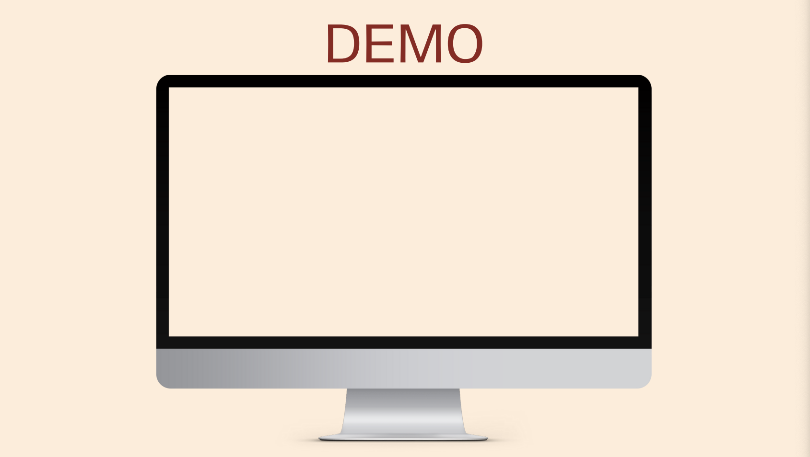

Slide 9
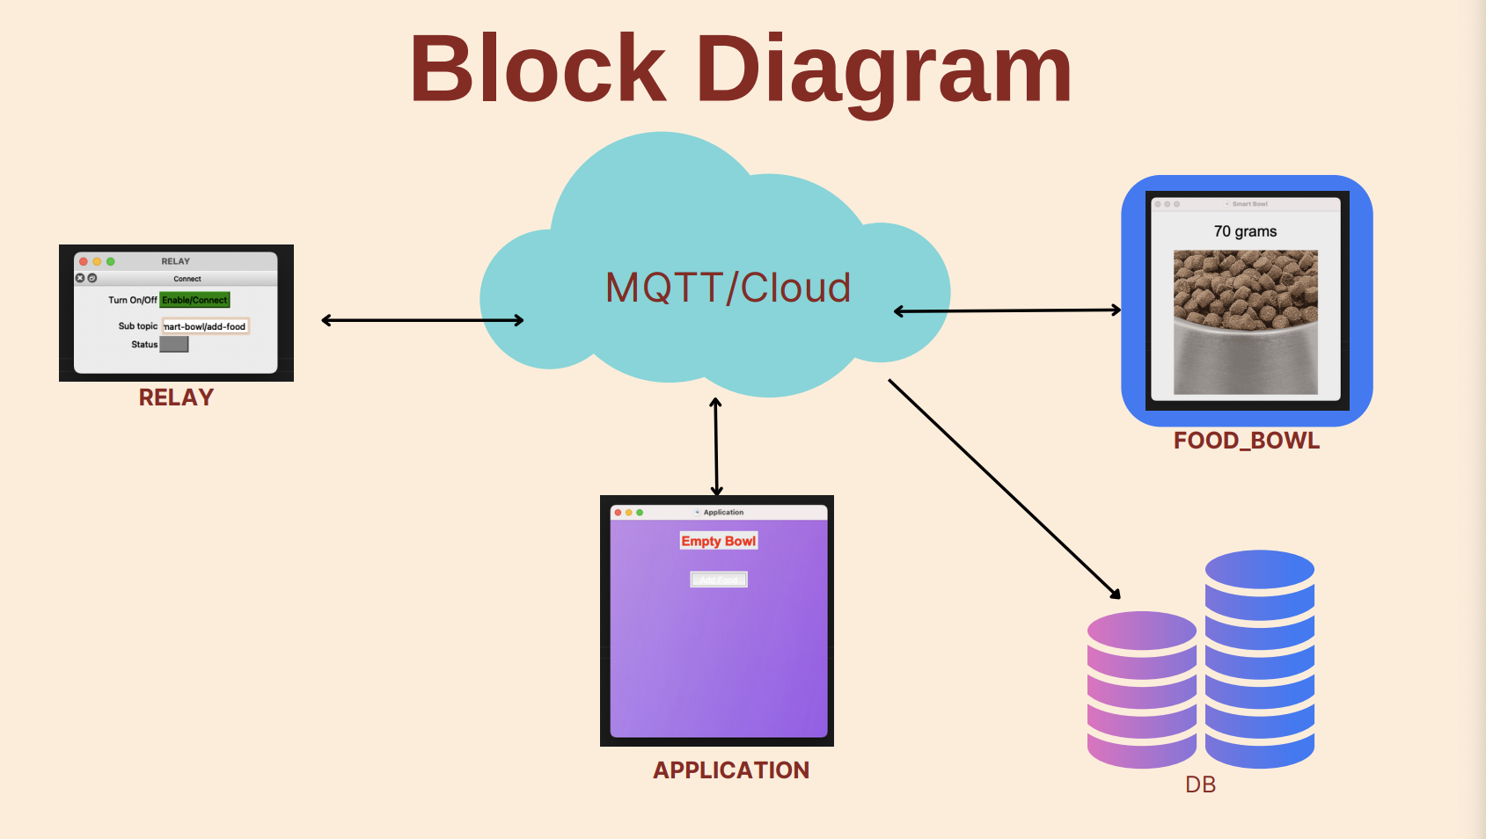

Slide 10
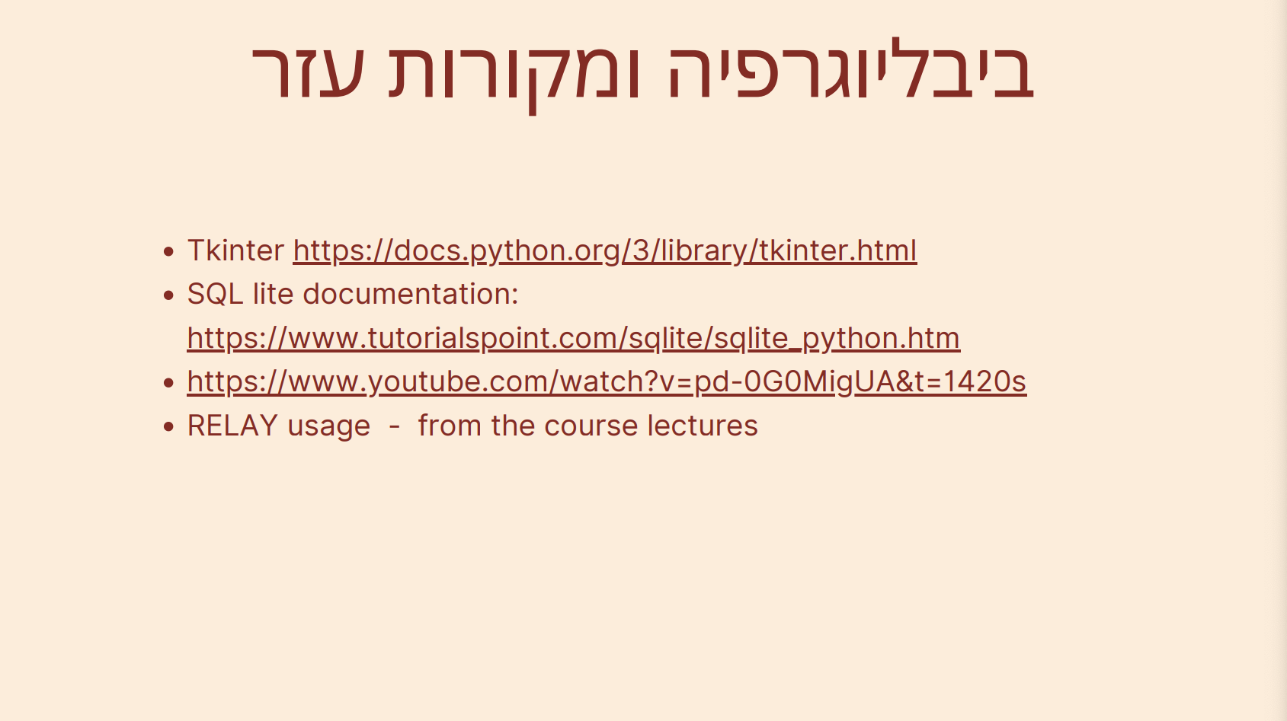
Tkinter: https://docs.python.org/3/library/tkinter.html
SQL lite documentation: https://www.tutorialspoint.com/sqlite/sqlite_python.htm https://www.youtube.com/watch?v=pd-0G0MigUA&t=1420s
RELAY usage - from the course lectures
Tkinter https://docs.python.org/3/library/tkinter.html SQL lite documentation: https://www.tutorialspoint.com/sqlite/sqlite_python.htm https://www.youtube.com/watch?v=pd-0G0MigUA&t=1420s RELAY usage - from the course lectures

Slide 11
