Slide 1


BookMySeat : IIITD Library Seat Booking Application
An android app to book a seat in IIID Library and to know available vacant seats
Submitted by : Team Coffee Bytes
Shristi V Kotaiah, MT22070
Ujjwal Garg, MT22085
Shraman Jain, MT22068
Amey Pawar, MT22010
Shreeyash Khalate, MT22069

Slide 2
Problem Statement
Design an android application for students of IIITD Delhi to provide the facility to book a seat in Library in any study room, for a specific amount of time.
Make it easy, efficient and quick for students to see vacant seats in the library prior to actually visiting it and book seat according to their choice
Tools/Technologies Used:
Android Studio
Language – Java, XML
Database – Firebase
Firebase Cloud Messaging Service

Slide 3
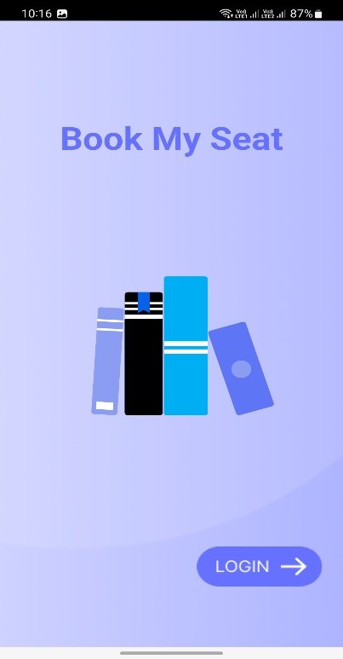
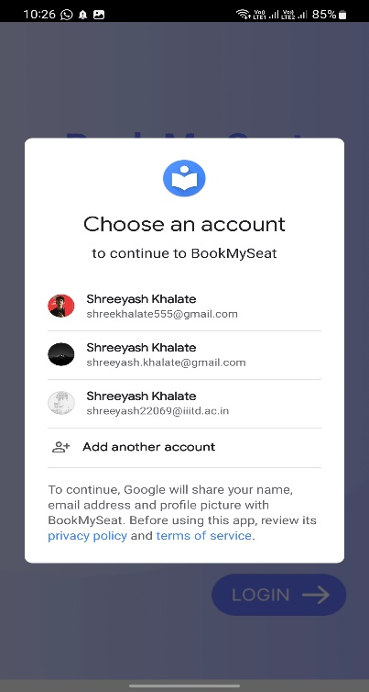
Application Features
Registration and Login
Authentication:
Only IIITD students will be able to register and login with their official mail ID
The profile information including name, IIITD mail and profile photo will be fetched from his/her Google account and incorporated in the app

Slide 4
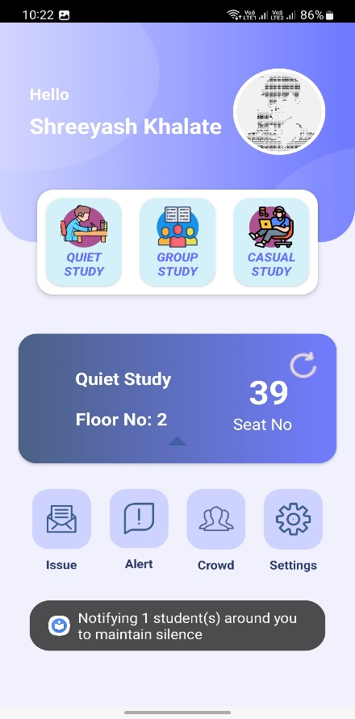
Application Features
2. Home Page
A Home Page where student can navigate to any study room and floor in the library to see the vacant seats and eventually book them.
Students will also have access to other features of the app on the home screen which are discussed ahead.

Slide 5
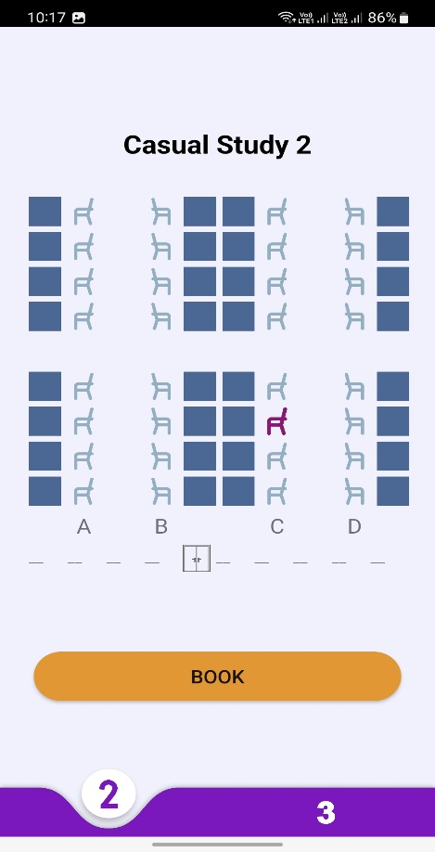
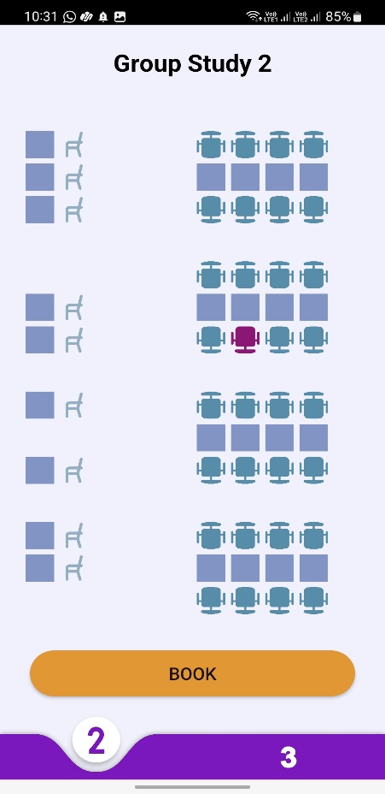
Application Features
3. Room Layouts
Each room having a corresponding layout with selectable seats and setting time/ booking options.
Constraints like students can only book one seat at a time for not more than 5 hours and not less than 1 hour.
Time constraints to validate the booking time slot

Slide 6
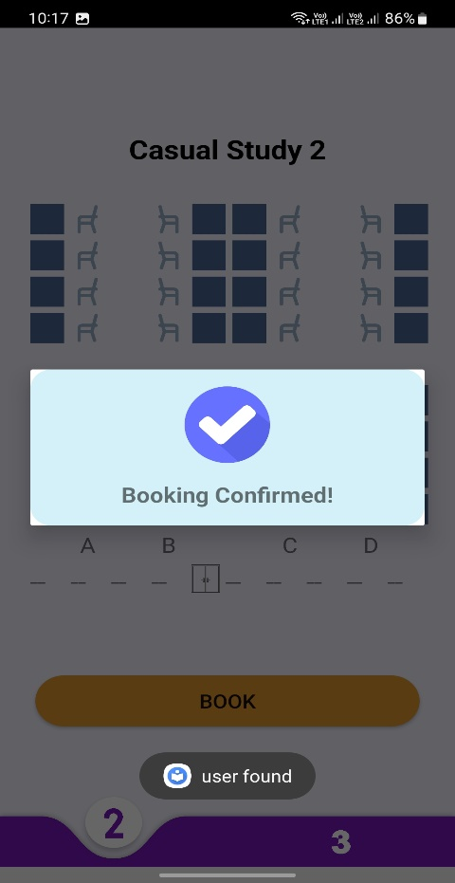
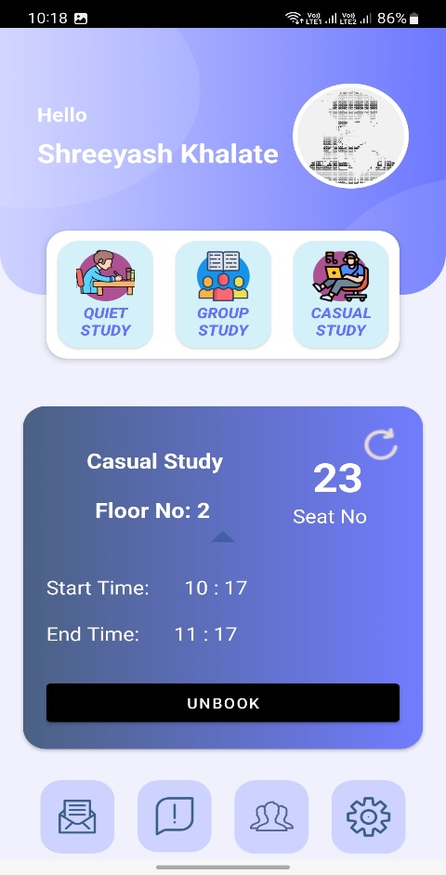
Application Features
4. Booking and Unbooking a seat
A seat number will be assigned to each student after booking a seat.
Students can view their booked seat details in the booking details card on the homepage. This card can be refreshed with a refresh button.
Students can view the time, floor, room and seat number in the details card and can also unbook their seat.

Slide 7
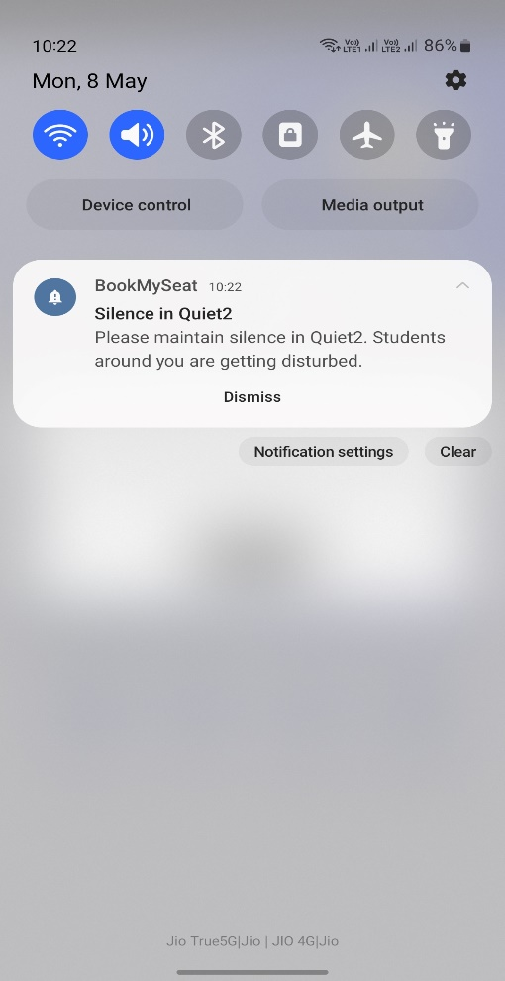
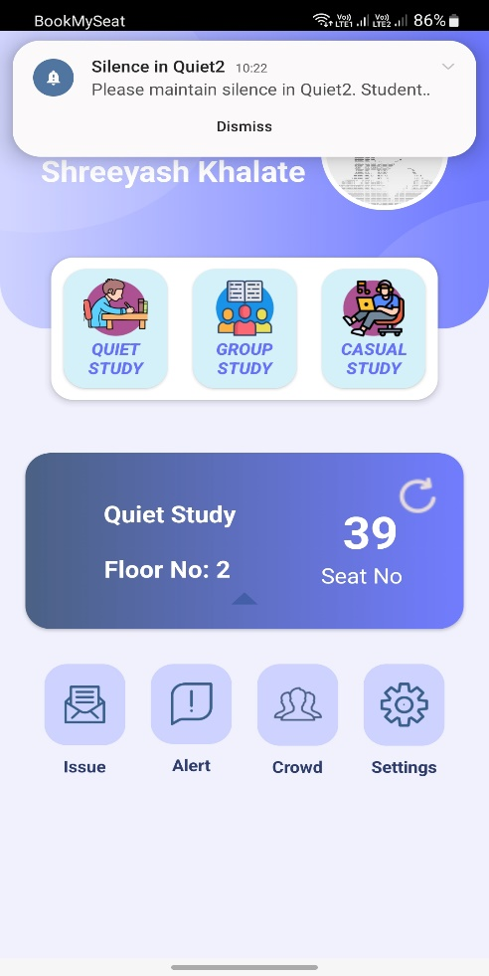
Application Features
5. Alert Students
If you are getting disturbed by other students around you in the library you can send an alert notification to all the devices that are booked in your room at that time
This alert message will notify students in your particular to maintain silence in the library.

Slide 8
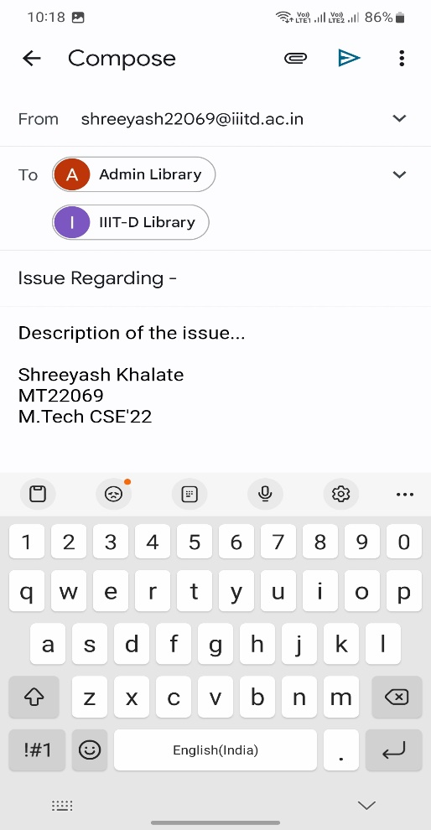
Application Features
6. Report an Issue
A separate functionality on the home page to report an issue or register a complaint directly to the library admin.

Slide 9
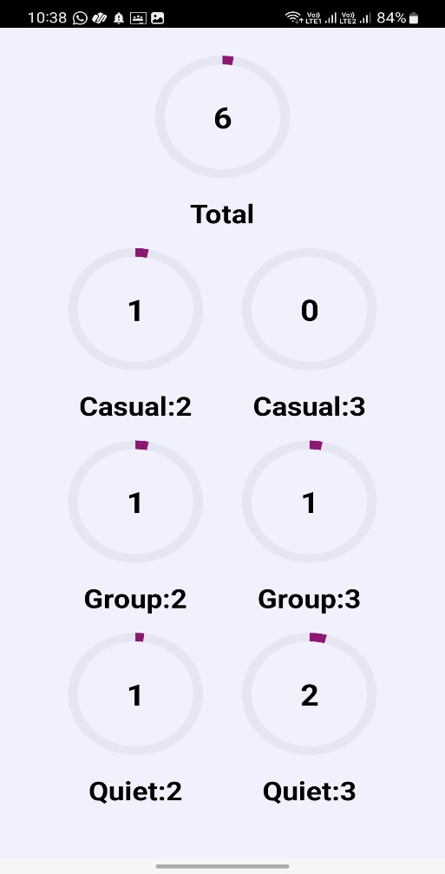
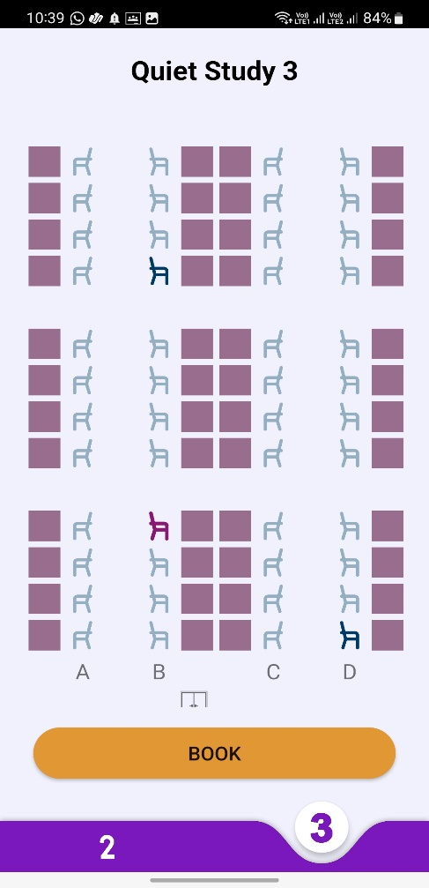
Application Features
7. View Crowd
Students will be able to view number of students currently studying in the library in each room separately.
Students will also be able to see which seats in every room are occupied by navigating to that room layout.

Slide 10
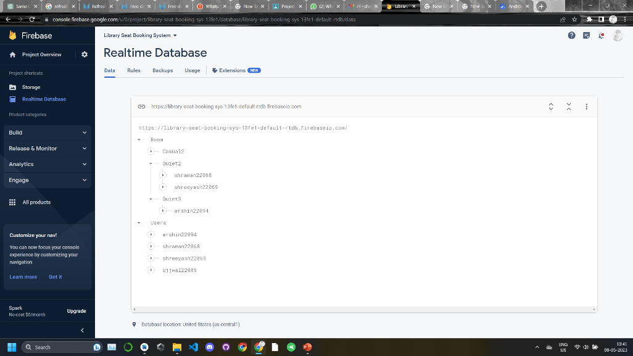
Application Features
8. Realtime Data Updation
Whenever someone books or unbooks a seat, all other student’s UI will get updated immediately.
All the components of the application will get updated simultaneously on any data change in the firebase.

Slide 11
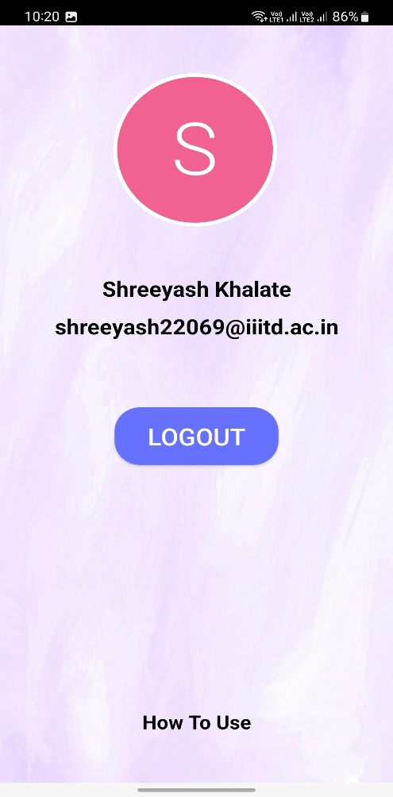
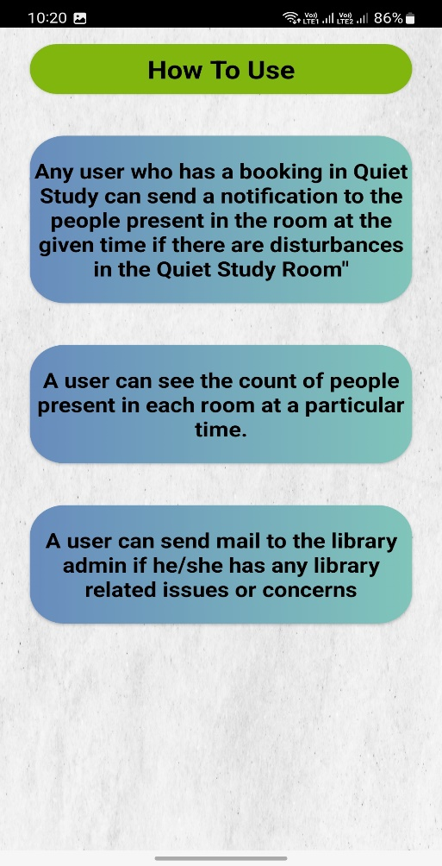
Application Features
9. Settings
Students will be able to log out from their account from settings menu
A How to Use section provided in settings with instructions on specific features of the app.

Slide 12
Conclusion
We were successful in designing an interactive and robust android application with all edge cases covered to enable IIITD students to book a seat in any library study room for a particular period of time.
If a student wants to study in the library then he/she can know the availability of any particular seat in library in the app without actually visiting the library and can also book the available seats prior to visiting the library. The app will be helpful for all IIITD students who usually use library as their primary spot for studying.

Slide 13
THANK YOU!!

