Slide 1
F2 - Claim Check Worthiness (Group 4)
Created By
Akshara Nair
Ayush Agarawal
Janak Kapuriya
Shubham Agrawal

Slide 2
Problem Definition
Given a tweet, predict whether it is worth fact-checking by professional
fact-checkers or not.
This is a binary classification task.
Text
Claim
Not Claim
Check worthy
Not Check worthy

Slide 3
Methodology
Preproccessing
Syntactic Feature Extraction
POS tagging
Syntactic Dependency relation
Contextual Word Embedding
all-MiniLM-L6-v2 model
Feature Encoding
Count based histogram vector
Feature Concatenation
Dimensionality Reduction
PCA
Classification
SVM (weighting on minority class)

Slide 4
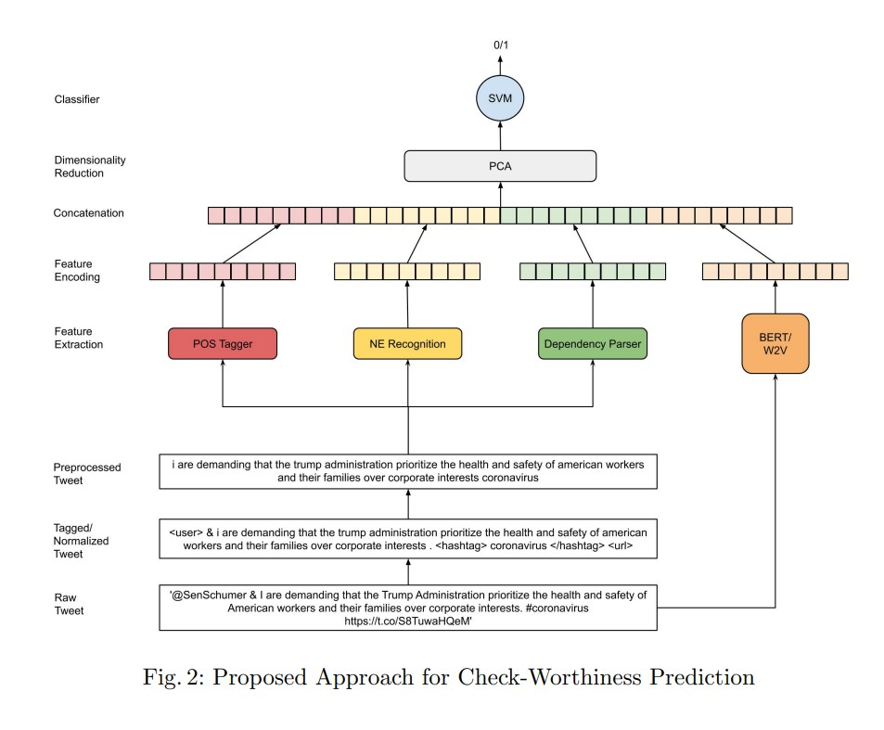
Methodology

Slide 5
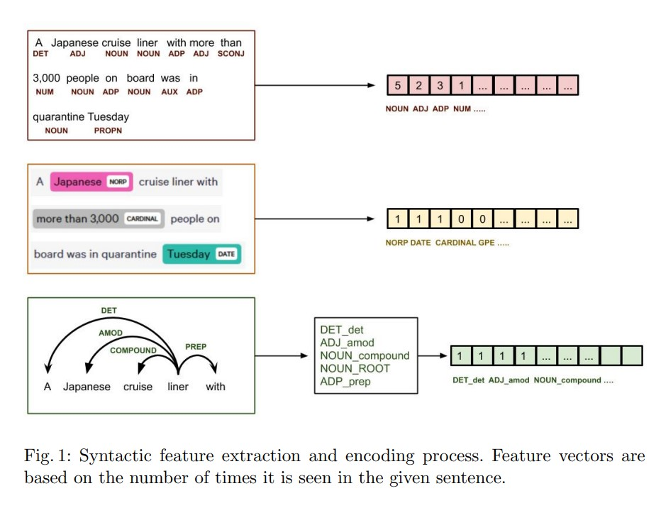
Feature Extraction and Encoding

Slide 6
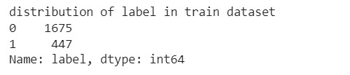
Experiments
Removing stop words in pre-processed text did not add much value to the final results.
Named entity feature extraction did not add much value to the final results.
Unweighted SVM results in lower F1 score because of imbalanced dataset.

Slide 7


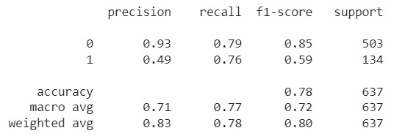
Results
F1 Score
Confusion Matrix
Classification Report

