Slide 1

React Suspense
Suspense is a powerful feature introduced in React 16.6 that allows you to build more performant and user-friendly applications.
by Shivaramakrishna

Slide 2


What is React Suspense?
<Suspense> lets you display a fallback until its children have finished loading.
1
Awaiting Data
2
Better User Experience
3
Declarative Approach
Suspense is like a placeholder that indicates something is still loading. When the data is ready, the placeholder disappears, and the component renders.
Suspense offers a more seamless user experience by preventing the display of blank screens or loading spinners until the data is available.
Suspense provides a declarative approach to handling asynchronous operations. You don't need to manually manage loading states or error handling.

Slide 3
Benefits of using React Suspense
Suspense brings several advantages to React applications, enhancing performance, user experience, and code simplicity.
Improved Performance
Enhanced User Experience
Simplified Code
Suspense can optimize performance by deferring rendering until necessary, reducing unnecessary computations and improving loading times.
Suspense provides a smoother user experience by displaying a placeholder or loading indicator while waiting for content to load.
Suspense simplifies the management of asynchronous operations, eliminating the need for complex loading state management or error handling.

Slide 4





Handling data fetching with Suspense
Suspense simplifies the process of fetching data and displaying it in your components.
1. Suspense Boundaries
Wrap your component with a Suspense to handle loading states.
2. Data Fetching
Use a data fetching function that returns a Promise or a React.lazy component.
3. Rendering
Suspense displays a placeholder until the data is available, and then renders the component with the fetched data.

Slide 5


Implementing Suspense in your application
Integrating Suspense into your React application is straightforward. You'll need to install the necessary packages and wrap your components with Suspense boundaries.
1
1. Install Dependencies
Install the necessary dependencies for data fetching and code splitting. For example, use `react-query` for data fetching and `react-router-dom` for routing.
2
2. Create Suspense Boundaries
Wrap components that need to wait for data or resources with the `` component.
3
3. Fetch Data
Use data fetching libraries like `react-query` to fetch data asynchronously. Then, you can use Suspense to handle the loading state.

Slide 6
Displaying a fallback while content is loading:
You can wrap any part of your application with a Suspense boundary:
<Suspense fallback={<Loading />}>
<SomeComponent />
</Suspense>
React will display your loading fallback until all the code and data needed by the children has been loaded.

Slide 7

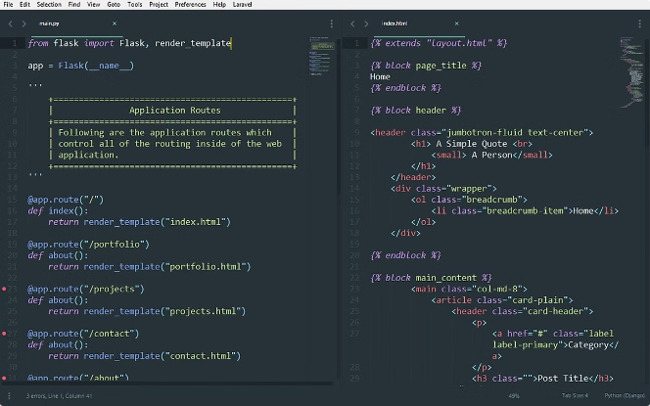
Usage
Displaying a fallback while content is loading
Revealing content together at once
Showing stale content while fresh content is loading (Eg: Searching)
Indicating that a Transition is happening
Providing a fallback for server errors and client-only content

Slide 8


Conclusion
Suspense is a valuable addition to the React ecosystem, offering a more declarative and user-friendly way to handle asynchronous operations.
1
Simplifies Development
2
Enhances User Experience
Suspense streamlines the development process by providing a more declarative and intuitive way to handle asynchronous operations.
Suspense contributes to a smoother and more engaging user experience by eliminating unnecessary loading spinners and delays.
3
Future Potential
The future of Suspense looks promising, with further enhancements and potential integrations for improved performance and user experience.

