Slide 1
hTML - Tables

Slide 2
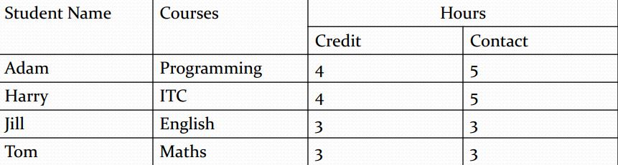
Why tables in html?
Used for tabular data.
Allows you to quickly and easily look up values.
Information is easily interpreted by making visual associations between row and column headers.

Slide 3
Introduction
Tables are very useful to arrange in HTML and they are used very frequently by almost all web developers.
Rows and columns.
<table> tag.

Slide 4
Defining a table structure
The first step to creating a table is to specify the table structure:
the number of rows and columns
the location of column headings
Once the table structure is in place, you can start entering data into the table.

Slide 5
Usage of TABLE TAGS
Tables are defined with the <table> tag.
A table is divided into rows (using <tr>), and each row is divided into data cells (using <td>).
Letters td stand for "table data“. Text in a td element is regular and left-aligned.
Text in a th element is bold and centered.

Slide 6
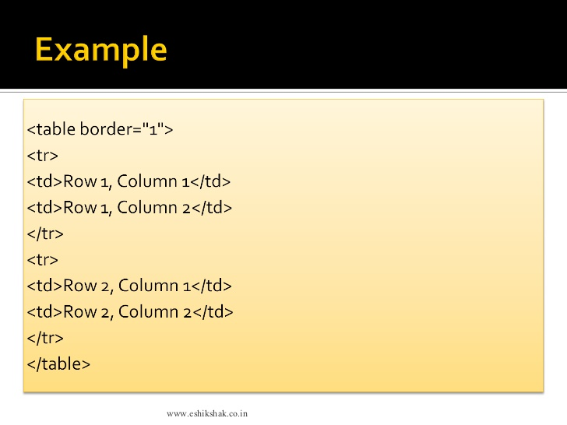

Slide 7
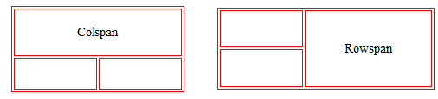
Table formatting
Cell spanning
Table cell can span across more than one column or row.
Types of cell spanning:
Row spanning
Column spanning

Slide 8
Tables background
Using bgcolor attribute:
You can set background color for whole table or just for one cell.
Using background attribute:
You can set background image for whole table or just for one cell.

Slide 9
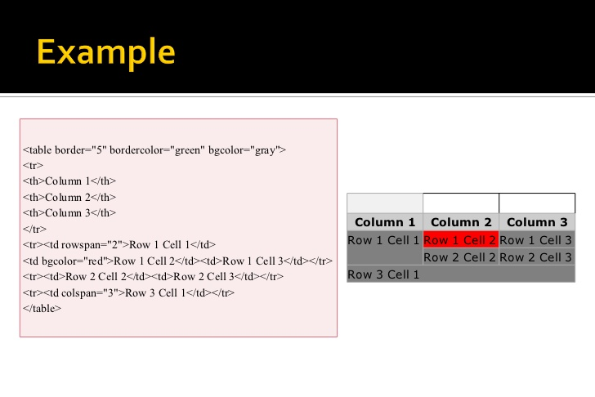

Slide 10
Thank you!!!

