Slide 1


Predicting the Car Price Using Machine Learning Models
Revolutionizing the Automotive Marketplace through Predictive Analytics
Group G :Members
Suryawanshi, Shivani Suresh
Korrapati, Siva Tarun Red
Kalaparthy, Shyam Rishi Kashyap Sai
Mantha, Sai Anirudh

Slide 2

Agenda
Business Problem
Motivation
Past Approaches in the Industry
Our Approach: Data and Models
Results
Conclusion
Recommendations

Slide 3
Business Problems
What factors most significantly influence the price of used cars? Does the brand influence the cost of the car ?
Which body style of the car is most popular, and how does the body style affect the price?
How does the fuel type of a car affect its popularity and price?

Slide 4
Motivation
Transparency: Accurate price predictions empower buyers with transparent and fair market values, fostering trust and confidence in their purchase decisions.
Maximized Revenue: Sellers can avoid underpricing, maximizing their revenue, and preventing potential losses, ensuring fair deals for both parties.
Competitive Edge: Accurate pricing provides sellers a competitive advantage, attracting buyers and establishing a reputation for honesty and reliability.
Stable Market: Predictive pricing prevents drastic fluctuations, ensuring market stability, predictability, and better financial planning for both buyers and sellers.

Slide 5

Objective
Develop a machine learning model that predicts the selling price of used automobiles based on a variety of factors.
The model should give reliable and regular pricing projections for various automobile models, assisting the company in setting competitive rates and improving customer satisfaction.

Slide 6

Past Approaches in the Industry
1. Overview of Traditional Methods:
Traditional methods, including market research and expert opinions, rely on subjective assessments and historical data. Market research involves surveying potential buyers, while expert opinions often lack scalability and might not reflect real-time market dynamics.
2. Limitations of Past Approaches:
Traditional methods are limited by their dependency on human judgment, often leading to biases and inaccuracies. Additionally, these methods struggle to adapt to rapid market changes, hindering their effectiveness in providing accurate and up-to-date pricing insights.
3. Transition to Data-Driven Solutions:
Embracing data-driven solutions leverages advanced algorithms and real-time data analysis, ensuring objective, precise, and adaptive pricing strategies. Machine learning models can process vast datasets, capturing intricate market patterns, leading to more accurate and responsive pricing decisions.

Slide 7
Our Approach: Data and Models
Dataset Overview
This dataset appears to contain various features related to car specifications, which can be used for analysis and modeling, especially for tasks related to car pricing prediction or market analysis.
Data Source – http://bit.ly/datasetscardatacsv

Slide 8

Features of the dataset
This dataset includes car specifications such as car_ID , symbolling, CarName, fueltype, aspiration, doornumber, carbody, drivewheel, enginelocation, wheelbase, carlength, carwidth, carheight, curbweight, enginetype, cylindernumber, enginesize, fuelsystem, boreratio, stroke, compressionratio, horsepower, peakrpm, citympg, highwaympg, price.

Slide 9

Model Selection And Evaluation
Models Chosen for Evaluation
1. Random Forest Regressor
Robustness: Effectively manages outliers and non-linear data.
Feature Importance: Identifies the most influential features in predicting car prices, providing valuable insights.
Generalization: Due to its ensemble nature, it's less prone to overfitting, ensuring a model that generalizes well to new data.
2. Gradient Boosting Regressor
Sequential Learning: Utilizes boosting to create a strong model by combining multiple weak models sequentially.
Flexibility: Efficiently handles a mixture of data types, including categorical and numerical features.
Regularization: Contains built-in regularization hyperparameters to prevent overfitting, ensuring a more robust model.

Slide 10

Why Other Models Were Not Chosen
Linear Regression:
Might struggle with complex, non-linear relationships between features and the target variable.
Support Vector Machines (Regression):
Can be less effective with many features and might require extensive hyperparameter tuning.

Slide 11

Results
Random Forest Regressor:
R-squared Score: 0.915
Indicates that 91.5% of the variance in the car prices is captured by the model.
Root Mean Squared Error (RMSE): 3305.46
Represents the average deviation of the model predictions from the actual prices, measured in dollars.
Gradient Boosting Regressor:
R-squared Score: 0.629
Indicates that 62.9% of the variance in the car prices is captured by the model.
Root Mean Squared Error (RMSE): 6895.12
Represents the average deviation of the model predictions from the actual prices, measured in dollars.

Slide 12
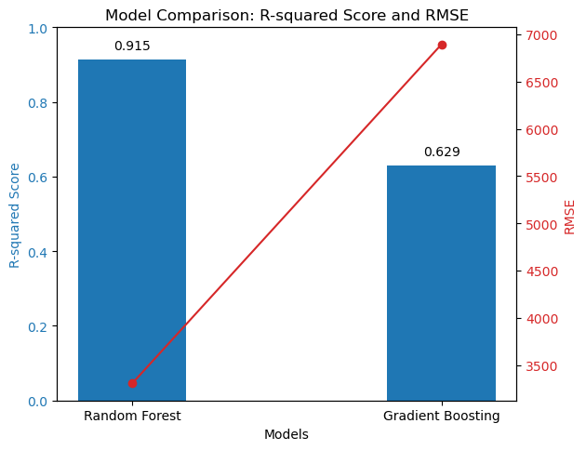

Slide 13

Conclusion
The Random Forest Regressor significantly outperforms the Gradient Boosting Regressor in this case, showing a higher R-squared score and a lower RMSE.
This suggests that the Random Forest model is more suitable and reliable for predicting car prices in this specific dataset, providing a balance between bias and variance.
Through examples and analysis, we've gained insights into market preferences and pricing strategies in the car market. Including more comprehensive data and features like model, mileage would further enhance the depth and applicability of the analysis.

Slide 14

Recommendations
Consider Time Factors: Account for temporal trends, as car prices fluctuate based on seasons, economic conditions, and new model releases.
1
Regional Pricing Variations: Incorporate regional pricing disparities, considering factors like demand, supply, and economic differences.
2
User-Friendly Interface: Develop an intuitive interface for users, allowing them to input car details and receive price estimates effortlessly.
3
Regular Model Evaluation: Continuously monitor model performance and recalibrate as needed, especially when new data becomes available.
4
Consult Automotive Experts: Collaborate with professionals who have in-depth knowledge of the automotive industry to validate model predictions and enhance domain expertise.
5
Collect User Feedback: Gather feedback from users to identify pain points and areas of improvement, guiding iterative model enhancements.

