Slide 1

Enhancing Promotion Placement for Optimal Viewer Engagement
Data-Driven Insights for MBC Group
Presented by: Stephanie KHABBAZ
Presented to: MBC Group – Research Insights & Media Analytics
12/05/2024

Slide 2
PRESENTATION ROADMAP
Today’s journey through data-driven decision making
1. Strategic Context: Setting the stage and defining our objectives
2. Challenges & Opportunities: Identifying key areas for improvement
3. Analytical Framework: Overview of the data and methodologies employed
4. Strategic Insights: Key findings and their implications for business strategy
5. Recommendations & Impact: Proposed actions and their expected benefits
6. Discussion: Opportunity for questions and strategic alignment

Slide 3

STRATEGIC CONTEXT
Setting the Stage for Data-Driven Strategy
Driving Change Through Data: Refine promo placement strategies, leveraging detailed viewer data to enhance engagement and maximize advertising revenue.
Aligning Goals: This initiative aligns with our strategic goal to not only maintain but expand our market leadership through innovation.

Slide 4

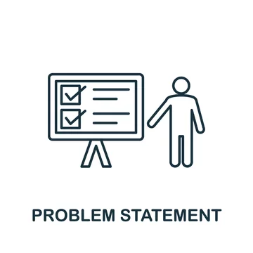

CHALLENGES & OPPORTUNITIES
Navigating Through Challenges to Capture Strategic Opportunities
Current Limitations
Existing promo strategies are not fully
exploiting the available viewer data
Missed opportunities in targeted
engagement.
Window of Opportunity
Significant potential to optimize
promo placements Enhancing both viewer
satisfaction and ad performance.

Slide 5
FOUNDATION OF OUR ANALYSIS: KEY DATASETS
Understanding Our Data: Key Datasets Overview
Schedules Information
Promotions Information
Tracks promotional slots across different segments with their respective total airtime threshold and average reach.
Crucial for understanding how promos are distributed throughout our programming.
Details on individual promos, including target audience promo priority and promo duration.
Essential for tailoring our promotional efforts to maximize viewer engagement.

Slide 6
LAYING THE GROUNDWORK: DATA EXPLORATION, PREPARATION & MANIPULATION
Comprehensive data cleaning to ensure accuracy and reliability of analysis
Handling POTENTIAL missing values, correcting errors, standardizing data type formats AND DATA ENCODING
Preparing data for insightful analysis and optimization

Slide 7

ENHANCING DATA WITH STRATEGIC ATTRIBUTES
Creating Useful Attributes:
Developed new data attributes such as day_ of_week and start_hour to better understand viewer habits
Value Added:
Allow us to analyze viewing patterns more precisely, identifying peak times for targeted promo placements
Application:
Utilized in our time-based analysis to strategically align promo slots with audience availability and for future additional insights

Slide 8
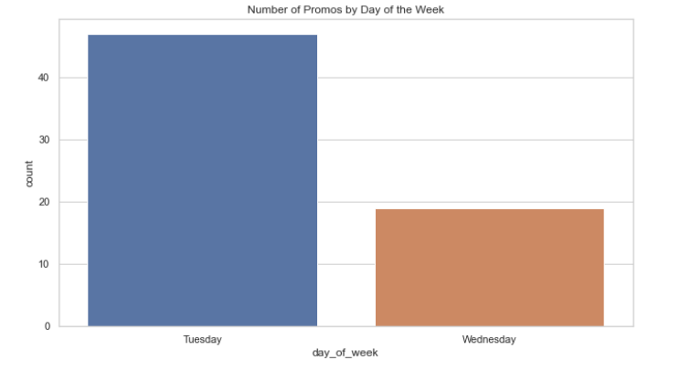
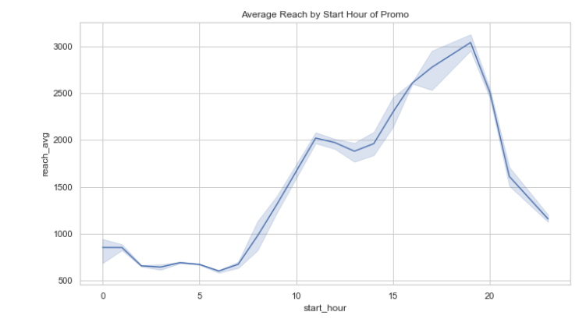
VISUAL INSIGHTS: TIME-BASED DATA ANALYSIS
If we were to consider that promos will be placed across all TV slots
Analysis of number of promos across day of the week
Identifying peak viewing hours critical for optimal promo placement

Slide 9
OUR OPTIMIZATION PROBLEM
Optimizing for Impact: A Strategic Approach
Optimization Goals: Ensure maximum reach for high-priority promos, respect airtime limits, and align promos with audience demographics.
Approach Used: Implemented a Greedy/Heuristic algorithm, starting with simpler rules and progressively incorporating complex constraints to refine promo placement.
Added Value: This approach allows for iterative refinement and optimal resource allocation, enhancing the effectiveness of our promotional strategy.

Slide 10
EFFICIENT OPTIMIZATION STRATEGY
Efficient Strategy: Breaking Down Complex Problems
Starting Simple: Begin with less restrictive constraints to understand core interactions and potential improvements.
1
Adding Complexity: Gradually introduce more specific constraints to refine effectiveness and precision of promo placements.
2

Slide 11

APPLYING FIRST CONSTRAINT
First Constraint: Demographic Alignment
Ensures promos match the demographic profile of the time slot.
Increases relevance and engagement by targeting appropriate viewer segments.

Slide 12
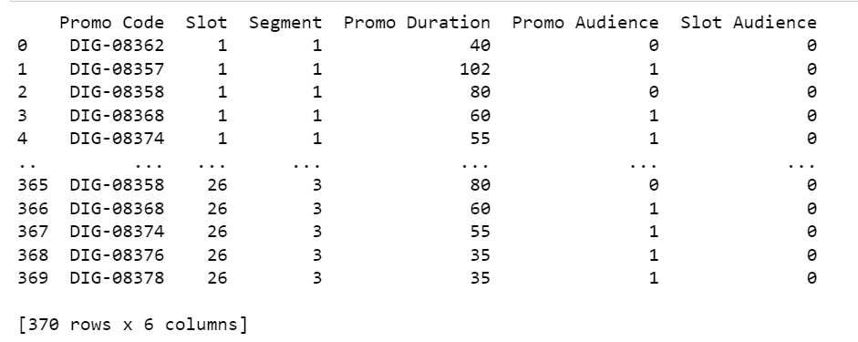
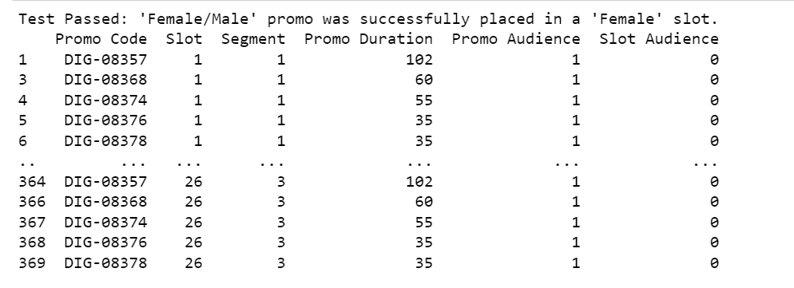
APPLYING FIRST CONSTRAINT
First Constraint: Demographic Alignment
Ensures promos match the demographic profile of the time slot.
Increases relevance and engagement by targeting appropriate viewer segments.

Slide 13
APPLYING SECOND CONSTRAINT
Second Constraint: Priority-Based Placement
Prioritizes high-reach slots for high-priority promos.
Ensures that promotional impact aligns with strategic business priorities.

Slide 14
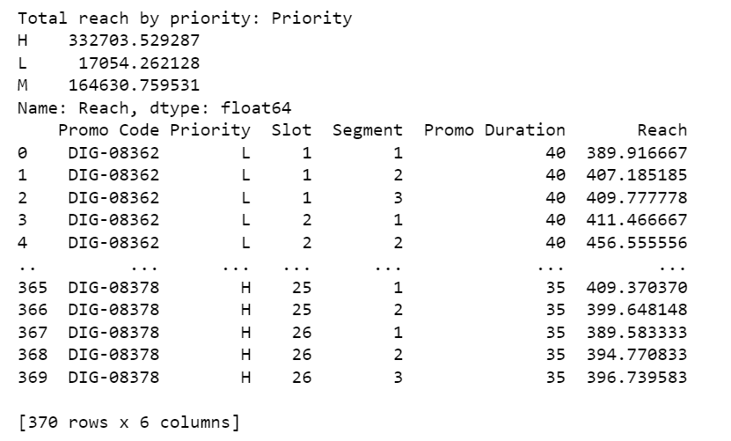
APPLYING SECOND CONSTRAINT
Second Constraint: Priority-Based Placement
Prioritizes high-reach slots for high-priority promos.
Ensures that promotional impact aligns with strategic business priorities.

Slide 15
APPLYING THIRD CONSTRAINT
Third Constraint: Airtime Optimization
Ensures the total promo duration does not exceed available slot airtime.
Incorporates dynamic reallocation to maximize high-priority promo placements.

Slide 16
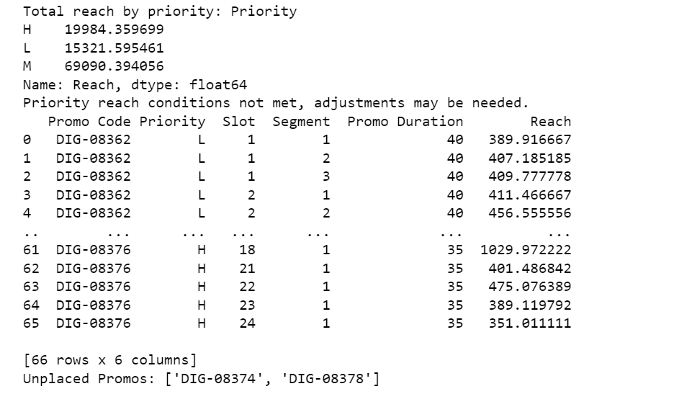

APPLYING THIRD CONSTRAINT
Third Constraint: Airtime Optimization
Ensures the total promo duration does not exceed available slot airtime.
Incorporates dynamic reallocation to maximize high-priority promo placements.

Slide 17
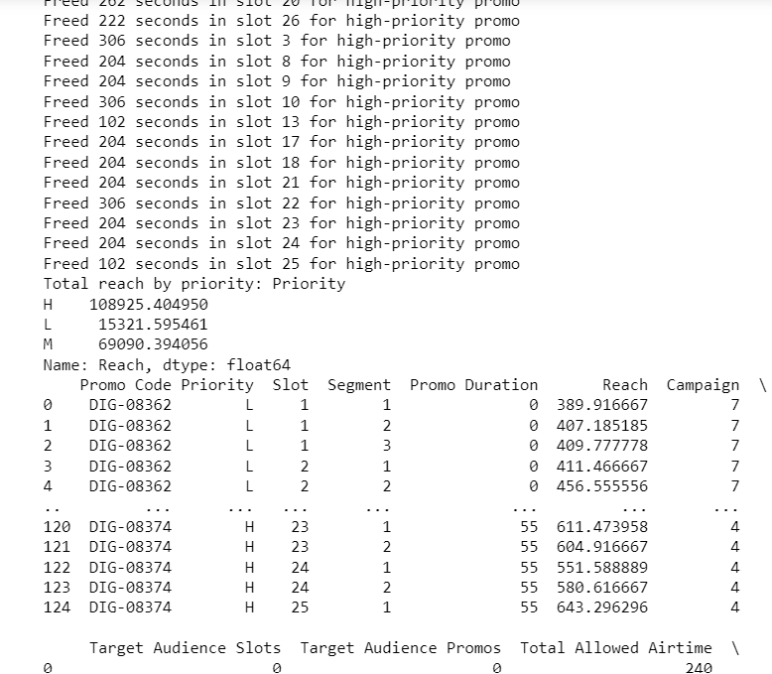
APPLYING THIRD CONSTRAINT
Third Constraint: Airtime Optimization
Ensures the total promo duration does not exceed available slot airtime.
Incorporates dynamic airtime reallocation to maximize high-priority promo placements.

Slide 18

CONCLUSION AND OPTIMIZED PLAN RESULT
Optimization Conclusion: Strategic Enhancements Achieved
Targeted Audience Engagement: Optimized promo placements by precisely matching promos to slots based on specific demographic needs, increasing the likelihood of reaching the intended audience.
Priority and Reach Optimization: Implemented a priority handling mechanism ensuring that high-priority promos are placed in slots with the highest potential reach, enhancing the impact of key promotional campaigns.
Efficient Airtime Utilization: Advanced airtime management techniques were applied to ensure promos do not exceed the time limits of their slots, with priority-based reallocation allowing for optimal use of available airtime.
Adaptive Strategy Implementation: Our iterative optimization process adapted to initial outcomes by introducing more stringent constraints, progressively refining our strategy to better align with dynamic viewer behaviors and operational constraints.

Slide 19

FUTURE PERSPECTIVES AND RECOMMENDATIONS
Looking Ahead: Further Enhancements and Technologies
Potential use of advanced optimization tools like Gurobi for linear programming.
Exploring additional data sources and real-time analytics for dynamic promo scheduling.
Continual refinement of promo placement strategies to adapt to changing viewer behaviors.
For more details on the project, check my [Promo Optimization Case Study]
(https://github.com/srk96/mbc-promo-optimization.git) on GitHub

Slide 20

THANK YOU FOR YOUR ATTENTION!
Any questions?

