Slide 1
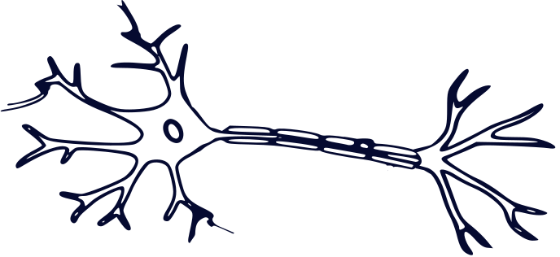


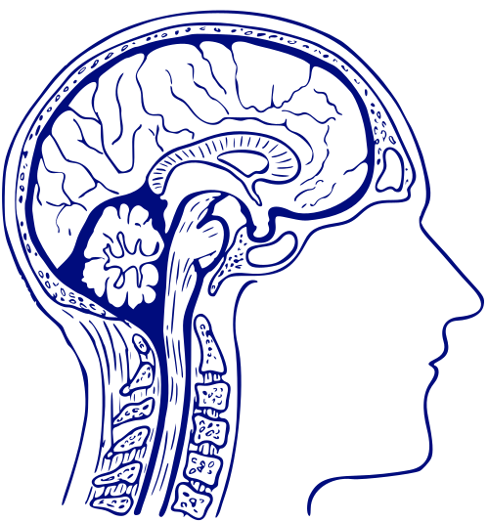
THE HYBRID DEEP LEARNING MODEL FOR IDENTIFICATION OF ATTENTION-DEFICIT / HYPERACTVITY DISORDER
ADHD classification from EEG signals is challenging because EEG contains complex temporal, spatial and frequency-domain information.
GROUP ID: 1605
Team Members:
1.S. R. Karthikeya - 245524733184
2.Keerthi - 245524733173
3.Amuktha - 245524748118
4.Ambika - 245524733134
5.Grithika - 245524733214
Mentor: Dr.M.Deepika

Slide 2
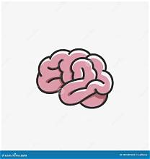
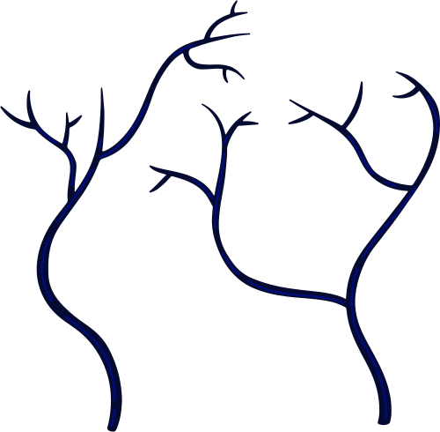
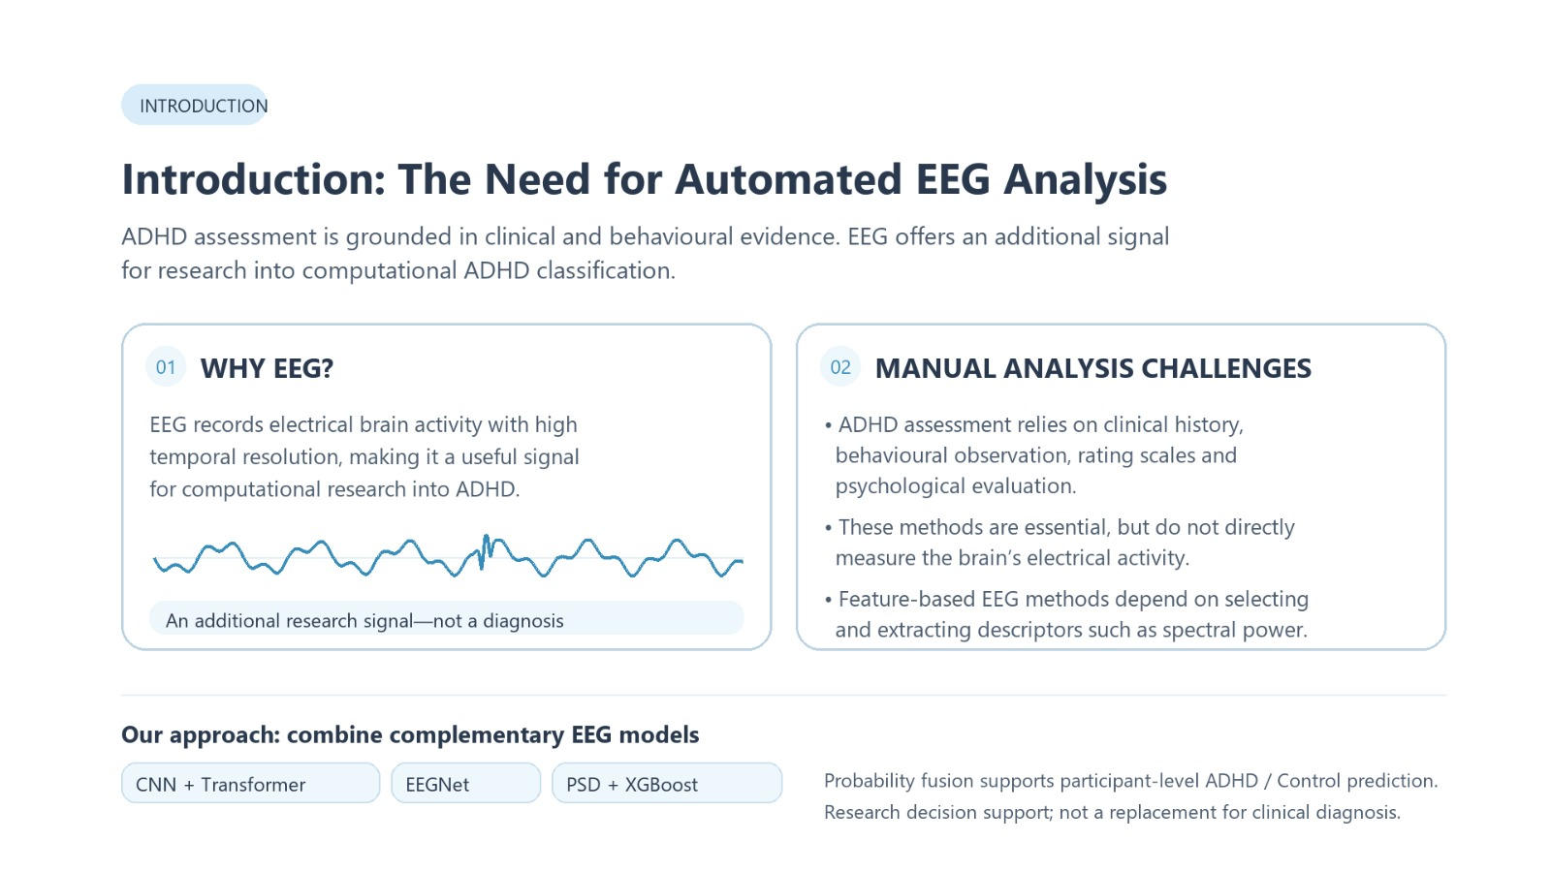
INTRODUCTION

Slide 3

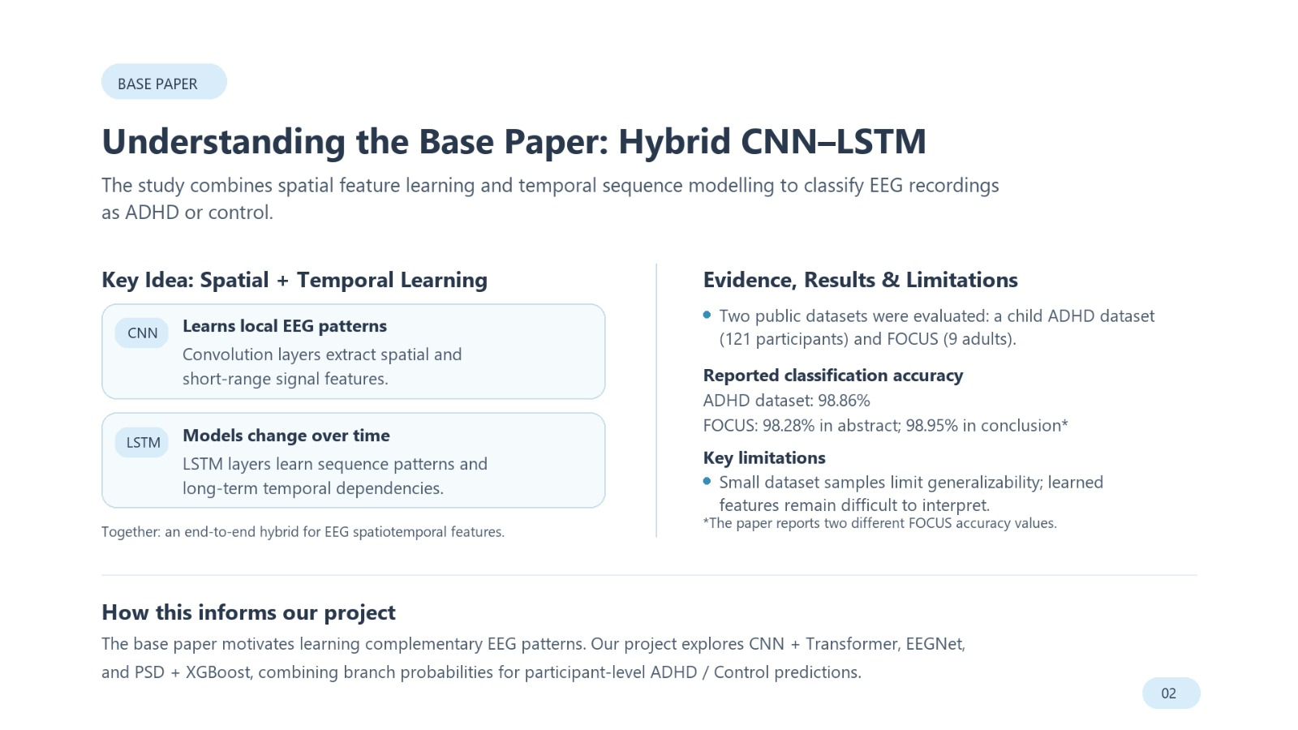

Slide 4
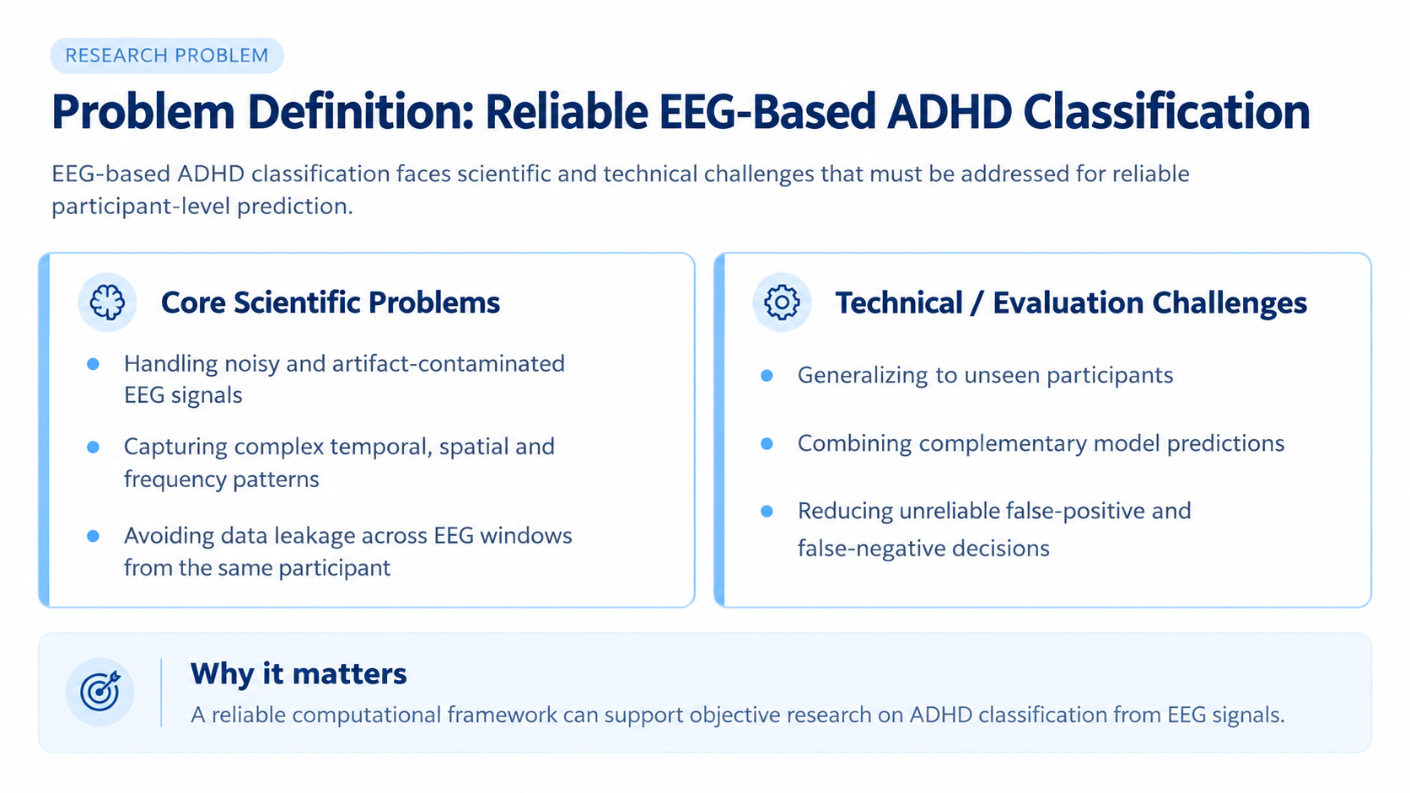
Problem Definition

Slide 5

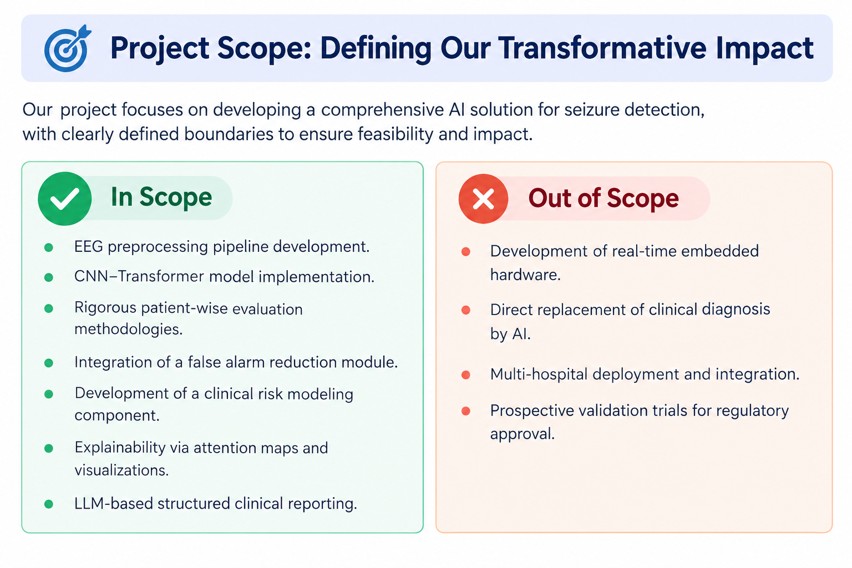
PROJECT SCOPE

Slide 6

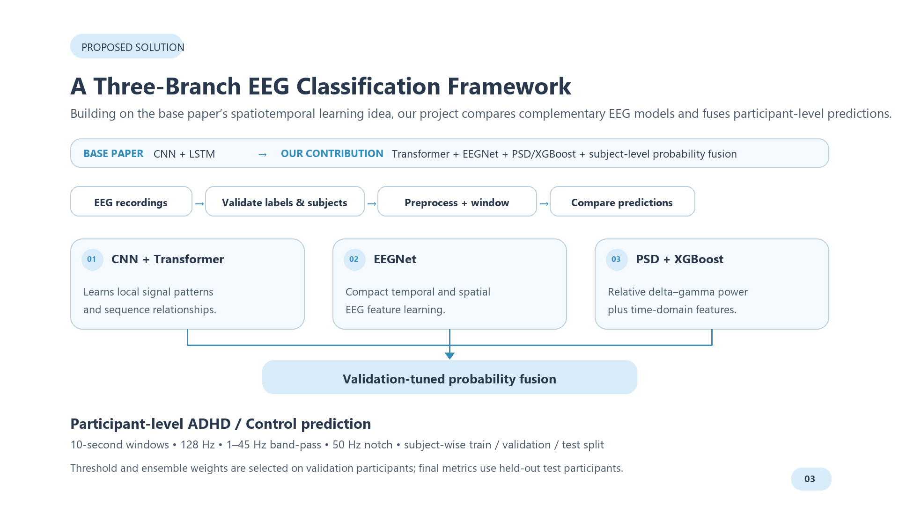
PROPOSED SOLUTION

Slide 7

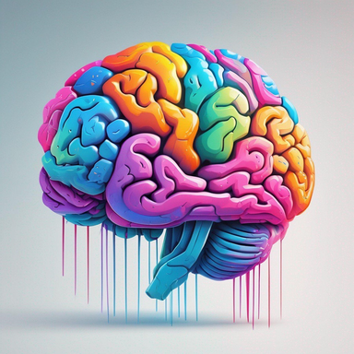
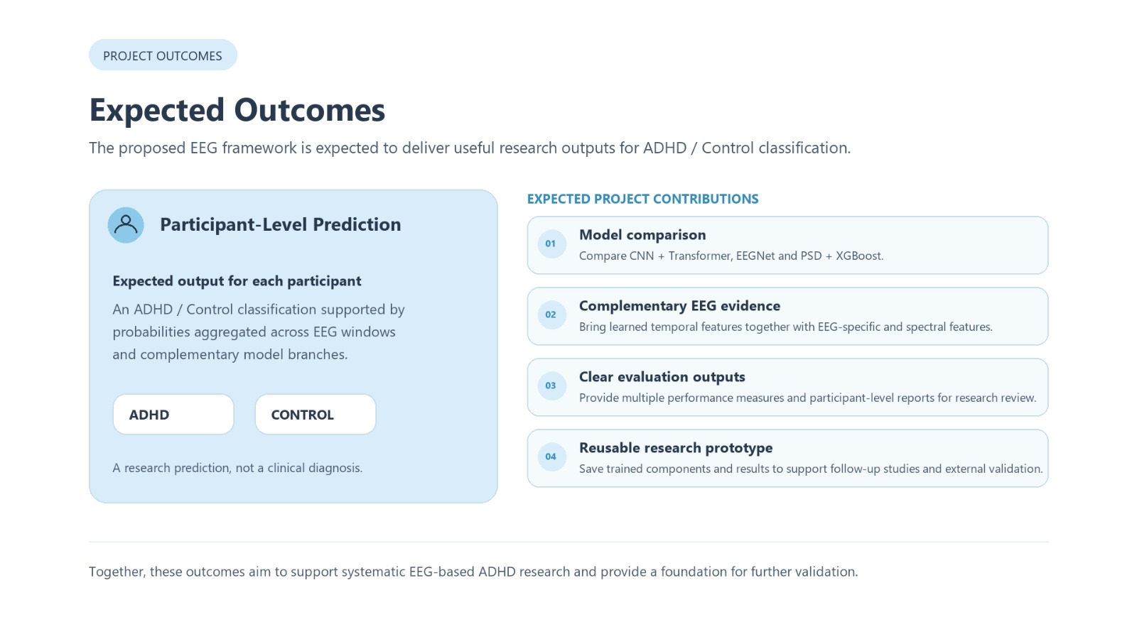
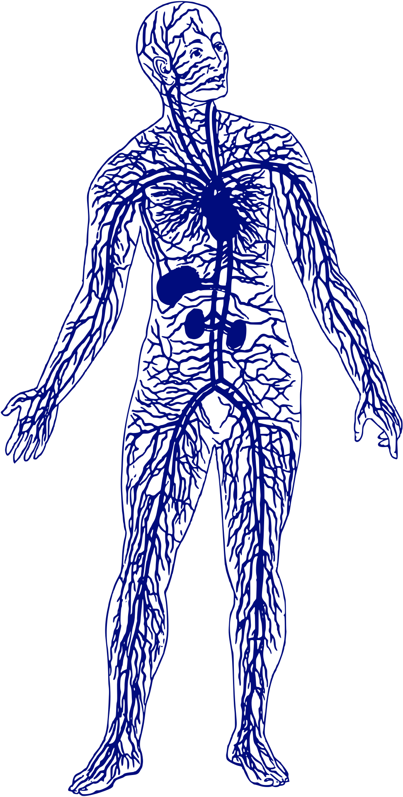
  Clinical Manifestations

Slide 8
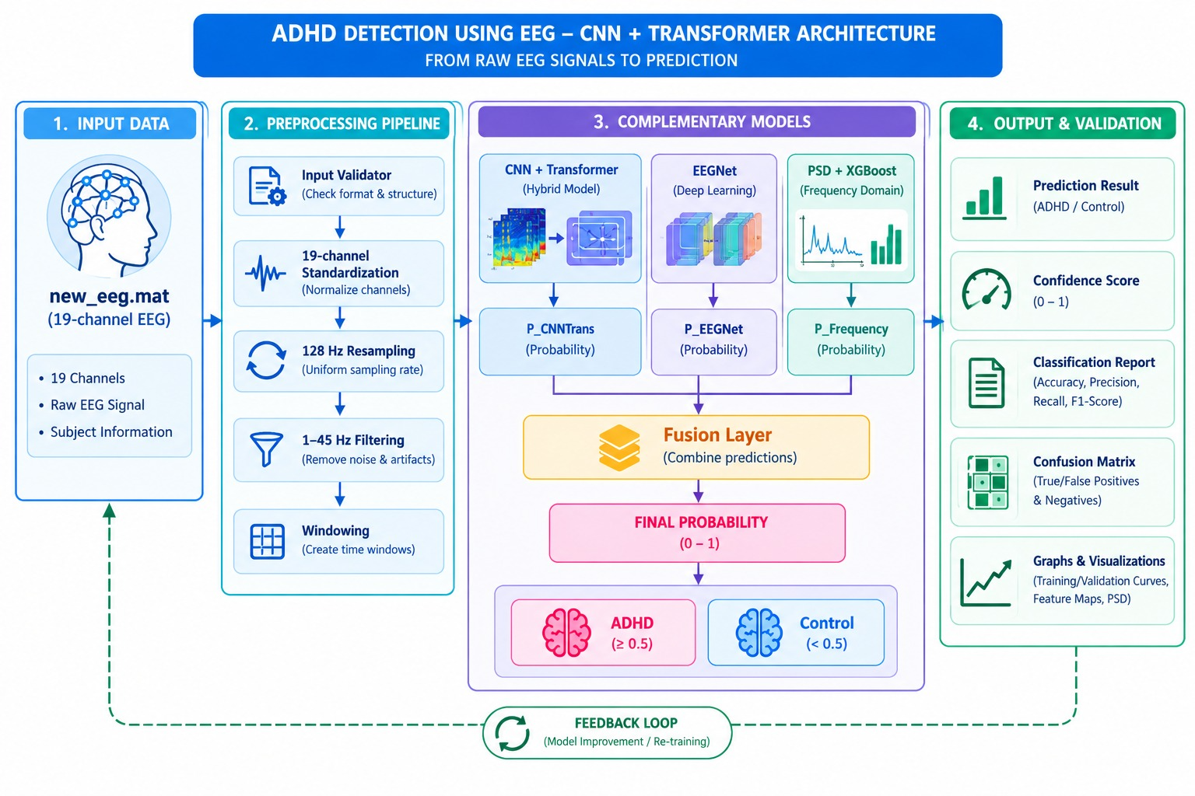
ARCHITECTURE DIAGRAM

Slide 9
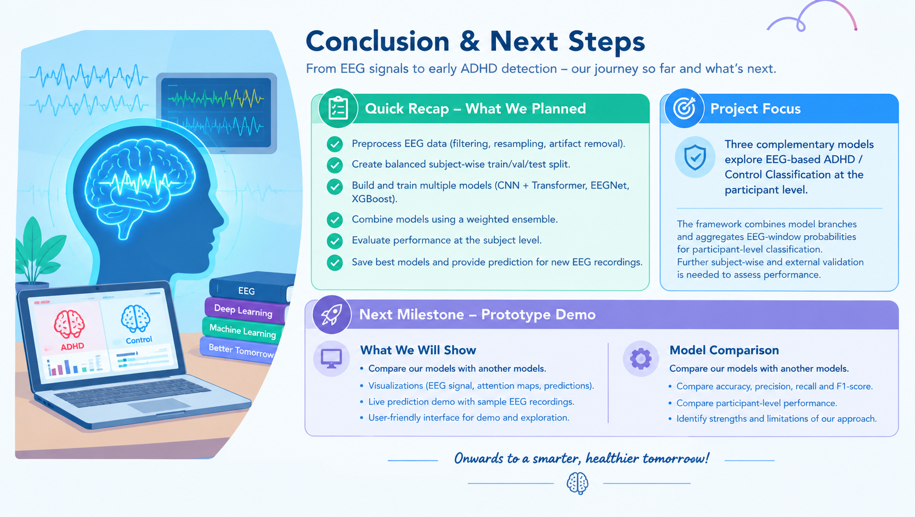

Slide 10
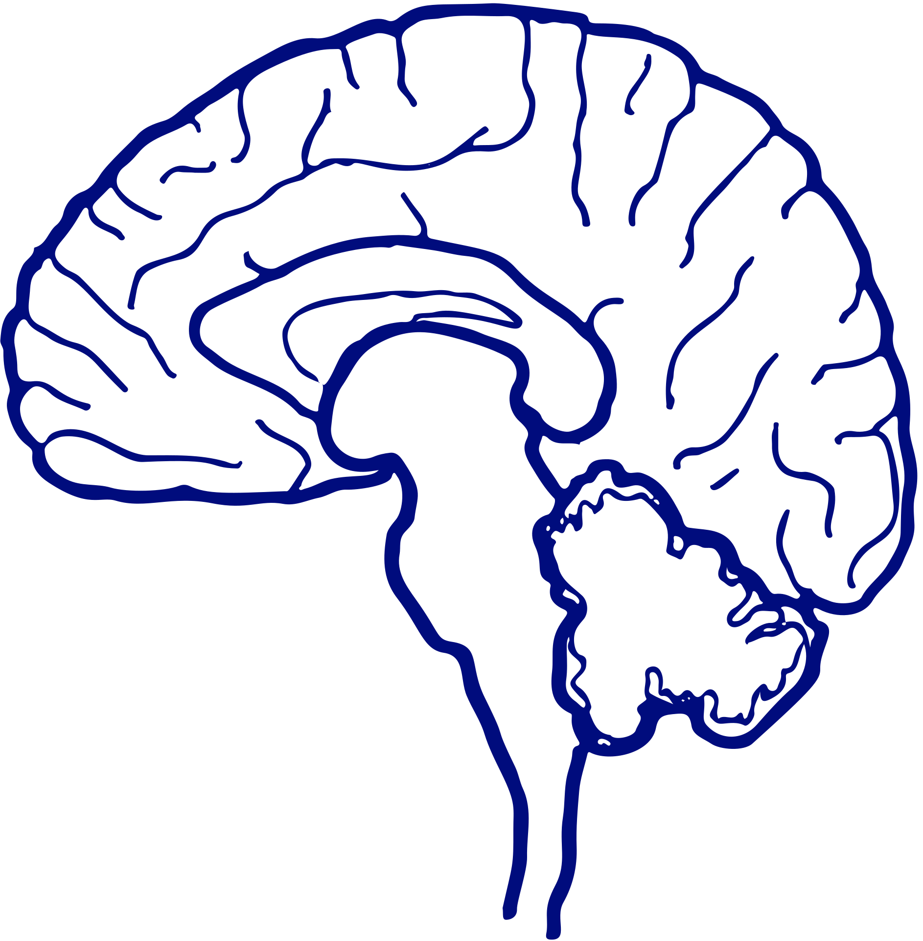
Thank You

