Slide 1
Manzarah (Sight)
Shah Rukh Khan

Slide 2
Not a simple caption generation project An assistant to guide the visually impaired
A hybrid model approach.
(I don’t know what else to call it)

Slide 3
What It Is..?
Images
CNN VGG16
Inception
Features
Generate Caption
Image DataBase
Image Captions
LSTM
Sequence
Processor

Slide 4
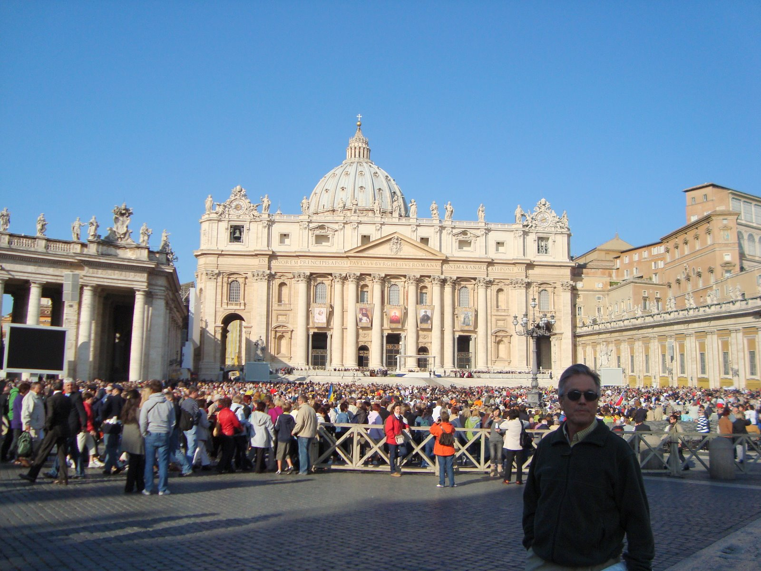
Example Image

Slide 5
man in red shirt is standing on the street
two children are playing on the beach
two children are playing on the grass
man in black shirt and jeans is standing in front of building

Slide 6
?
man in red shirt is standing on the street
two children are playing on the beach
?
two children are playing on the grass
man in black shirt and jeans is standing in front of building

Slide 7
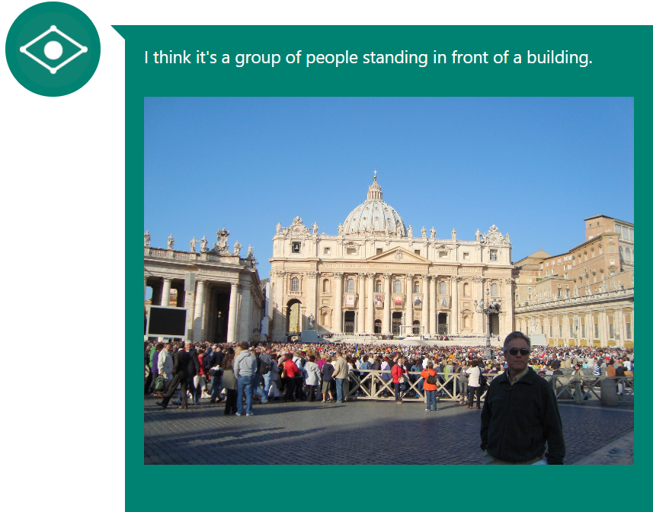
Microsoft CaptionBot begs to differ

Slide 8
Introduction
Human memory works different than AI
Machines need AI to make a decision
For AI to be successful every time, it needs database of images and decision trees.
Even if we are able to get the complete data, computational power limits machines to process the complete data.
Thus Deep Learning using CNN and LSTM to extract features from a small database and apply that to a picture then use LSTM.

Slide 9
Model Objectives
A Hybrid multi-model approach.
As shown initially, our project will use two models.
A VGG16 layer and Inception Model, to see if Hybrid approach can generate better results then separate models.
Develop a neural network
Check Accuracy by validation of the generated caption

Slide 10
Related Work
Generating Captions:
Free lancers and open source coding has made abundant contributions.
Google’s AI, show and tell model
Microsoft CaptionBot
Take picture, upload and get a caption for it. Mission is:
Train model
Generate caption
Validate it using MS CaptionBot

Slide 11
MODEL
Input: Image.
Output: Image with Caption
This will be further improved by using Microsoft’s CaptionBot’s Caption and comparing to that.
How It works:
First two models are trained, 1 on VGG16 layer and another on Inception.
The Image dataset is fed to them both with captions.
Features and Tokenizers are created and later these are leveraged to generate captions for totally unseen pictures.

Slide 12
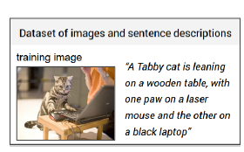
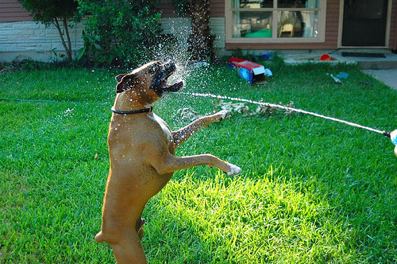
How it works :
“A brown Dog playing with water in garden”

Slide 13
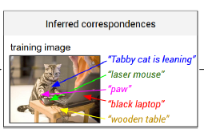
Continued :
Brown Dog
Green Grass
Garden
Water
Playing

Slide 14
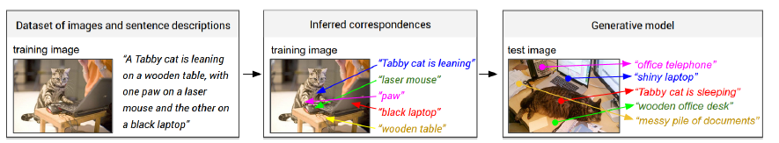
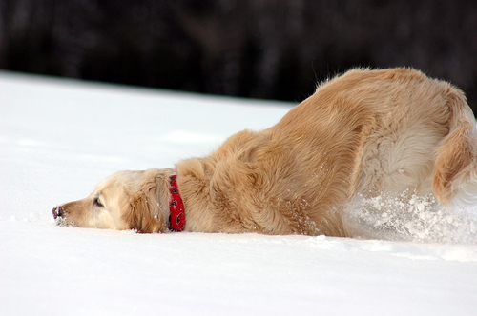
Continued :
“A brown Dog playing with water in garden”
Brown Dog
Green Grass
Garden
Water
Playing
Brown Dog
Snow
Red Clothes
Playing

Slide 15
This Project’s RNN:
Input is set of images and their textual descriptions.
The key challenge is in creating a 3rd Model that can intelligently identify which of the two models is generating a better caption. Or if the two generated captions can merged to better describe the picture
So we will not be taking output of VGG16 or Inception but of a 3rd model that will predict on top of those two.

Slide 16
Experiments:
Data sets:
Flickr8K(Complete)
Data Preprocessing:
Convert all the sentence to lower case
Discard non-alphanumeric characters.

Slide 17
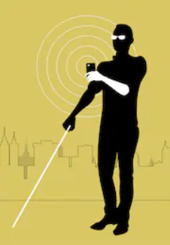
How is my project different?
I talked about an Assistant and not a caption generator
It will be a sight for the visually impaired!
There will be a Voice to text conversion and then that Caption generated from the Voice will be used to find the best fit response.
Two separate models into 3rd Model.
Yup, Your keys are on the table by the door!
Click
Hey Manzarah, can you tell me wheather my car keys are around me?
Click
Click
Click
Click
Click
Sure! Take some pictures in all directions and I will tell you if there are somewhere around you!

Slide 18
Conclusions
A Couple of tutorials online!
The Potential!
Initially: Will be creating a basic caption generation model!
Finally: Will embed the Voice to Text and then turn it into an assistant to better help the impaired!

