Slide 1
Oracle Query VBA Tool (OQVT)
srkjain@gmail.com

Slide 2
INTRODUCTION
Oracle Query VBA Tool (OQVT) is Microsoft Excel (VBA) based solution to fetch data from oracle database. It allows fetching data from multiple schemas (users) of same or different oracle database at just click on a button.
It highly configurable and very user friendly for specially Non-IT user
It designed to support any number of schemas and any number of queries

Slide 3
KEY BENEFITS
  Write sql queries once and execute any time. No need to write same query again and again.
  Easier for non-technical user to get the data from database without knowing underlying tables or sql syntax
  Categorized the multiple queries to run all at once
  Gets data from multiple schemas (users). For example it can fetch some parameter value from the production and all test environment in single click without requiring user to connect to each environment

Slide 4
KEY BENEFITS
  Queries can be parameterized to get the input at run time. (For example, Query can ask user to input the client number which will in used in where clause to get only client related information)
  Data will be fetch in Excel sheet so you can use all excel feature to filter and see the information.

Slide 5
SOFTWARE REQUIRED
1) Oracle Client 10g and above
2) MS Excel 2000 and above
3) Windows XP and Above Machine

Slide 6
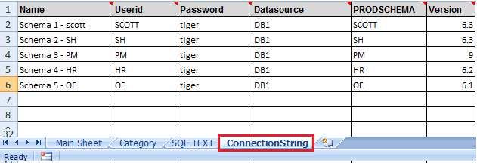
OQVT IN ACTION
  Created 5 schemas and put the details in ConnectionString Sheet
You don’t have to give the password in ConnectionString , On Run time , Tool will prompt for password. This is a good security practice in case you forget to delete the password and someone got the access to worksheet

Slide 7
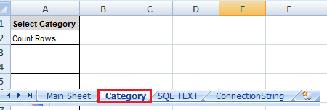
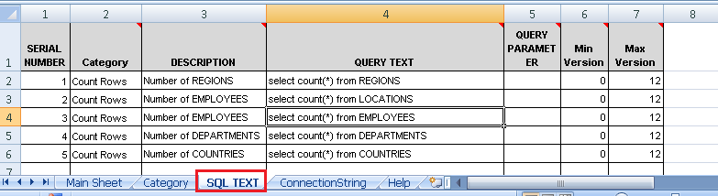
CATEGORY AND SQL QUERY
Create a Category in “Category” Sheet
Put the SQL Queries in “SQL TEXT” Sheet and give Description and Category

Slide 8
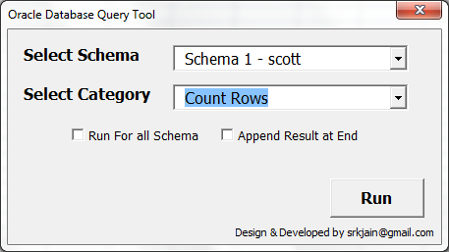
OQVT IN ACTION
Press Ctrl+W to Run Tool, Below form will be opened
Select Schema Name, Category and Press Run button to execute queries
Note: Select “Run for all schema” to execute queries for all schemas maintained in “ConnectionString” Sheet

Slide 9
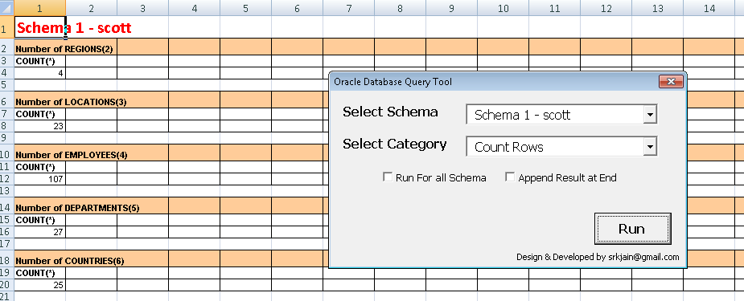
OUTPUT
All queries in category “Count rows” executed in “schema 1 – scott” and output is fetch in Excel

Slide 10
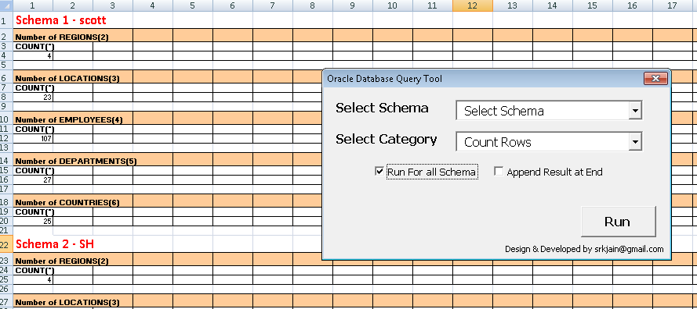
RUN FOR ALL SCHEMAS
  Select “Run for all schema” checkbox and data will be fetched from all schema and result will be place one after another

Slide 11
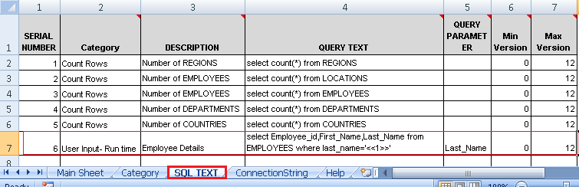
USER INPUT AT RUN TIME
Create a category to fetch Employee details , Last_Name will be input by user at Run time.
“Query Text” will have place holder <<1>> for last_name mentioned in “Query Parameter” Column
If there are multiple parameter then place holder will be like <<1>> <<2>> <<3>> ..<<n>> and Query parameter will have name of parameters Param1,param2…paramN

Slide 12
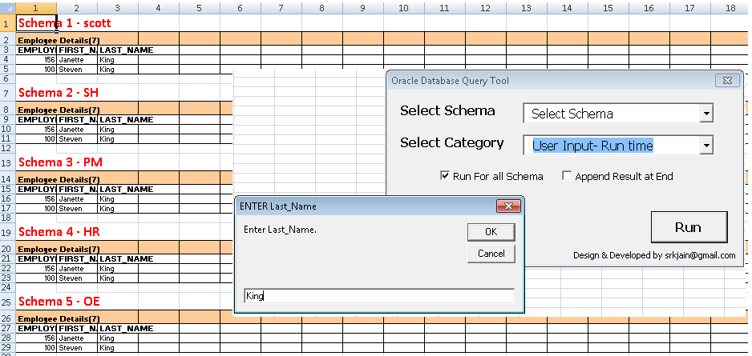
USER INPUT RUN TIME - OUTPUT
OQVT will ask for Last_Name at Run time and will fetch all employee whose last_nae is King

Slide 13
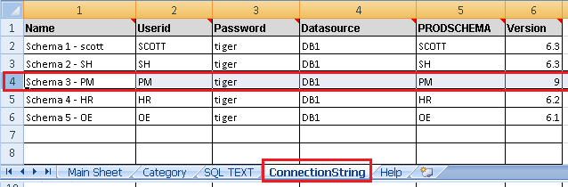
VERSION TEST
Employee Table is added with Birthdate Column in Version 7 and above but older version does not have this column
Schema 3 – PM is on higher version 9 and has new column Birthdate.
But all other schemas does not Birthdate column in their Employee as they are on version 6

Slide 14
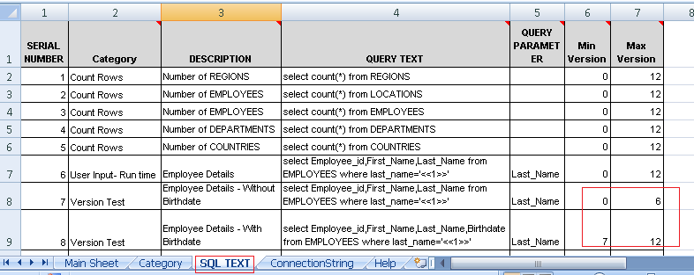
VERSION TEST
There two queries with Min version and Max Version. So all schema with version upto 6 query7 will be fired and for version 7 and above Query8 will be fired

Slide 15
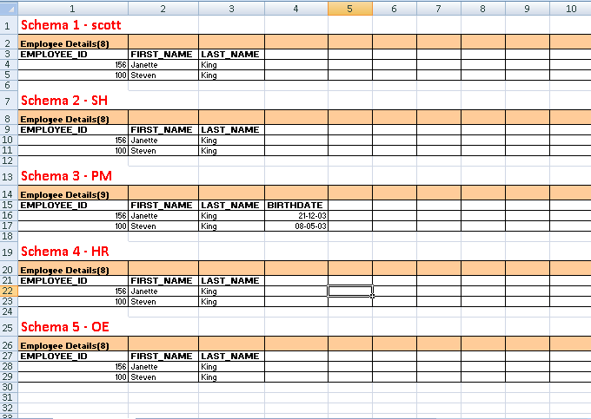
VERSION TEST -OUTPUT
Only Schema 3 –PM has the Birthdate

Slide 16
QUERY FROM READ ONLY SCHEMA
In a Production Environment , keeping security and integrity in mind , DBA will create read only schema and give access to only that schema to user .
User access the actual production tables/views by prefixing production schema name
For Example:
If a HR_READONLY has read only access to HR schema on table Employees
Select * from hr.Employees;

Slide 17
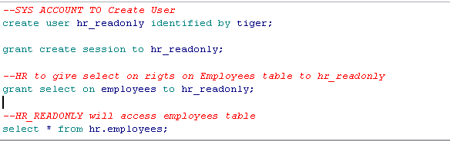
QUERY FROM READ ONLY SCHEMA
Lets Create a read-only user and test to demonstrate how this utility will work

Slide 18
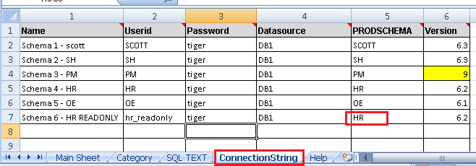
QUERY FROM READ ONLY SCHEMA
Add HR_READONLY schema to ConnectionString Sheet .
Note: ProdSchema will have actual Production Schema Name in this example “HR”

Slide 19
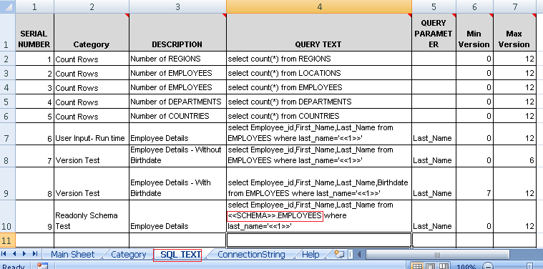
QUERY FROM READ ONLY SCHEMA
Note <<SCHEMA>>.EMPLOYEES, On Run time tool will convert this to HR.EMPLOYEES and Fire the query From HR_READONLY Schema

Slide 20
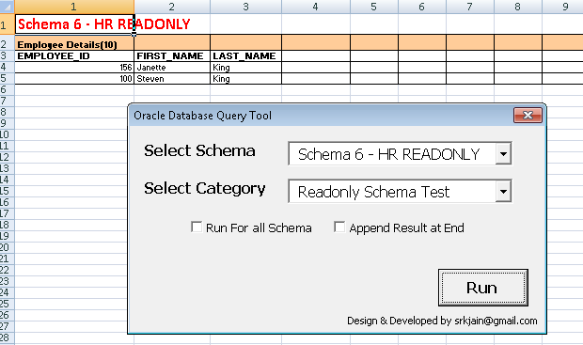
OUTPUT – READ ONLY SCHEMA

Slide 21
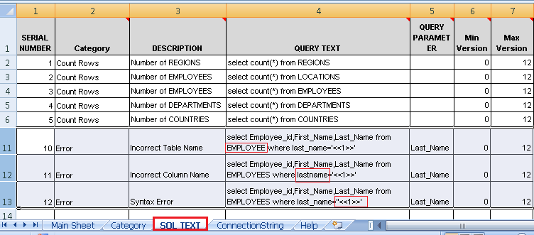
ERROR HANDLING
In case there is any error in sql , Tool will print the exact error so that you can fix it
Below are few Examples

Slide 22
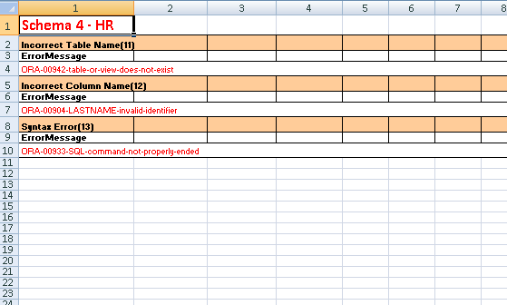
OUTPUT – ERROR HANDLING

Slide 23
THANK YOU
I hope you like this tool and excited to use this.
If you have any queries and suggestion please mail me at srkjain@gmail.com
Visit website www.oqvt.in for more details

