Slide 1
CAPSTONE PROJECT:
APPVERSE AI
Name: Srikant Govind Sharma
Organisation: WIPRO

Slide 2
INTRODUCTION:
AppVerse is a secure, full-stack application marketplace built with React and Spring Boot that seamlessly connects software creators with users. It empowers users to easily discover and dynamically review apps, while equipping developers with a real-time analytics dashboard to track live downloads and revenue. To ensure market success, the platform uniquely integrates Google Gemini AI to deliver predictive six-month download forecasts directly to creators.

Slide 3
Backend Technologies:
Core Framework: Java Spring Boot
Database: MySQL
ORM (Object-Relational Mapping): Spring Data JPA / Hibernate
Security: Spring Security with JWT (JSON Web Tokens)
Unit Testing: JUnit 5 & Mockito
Build Tool: Maven
Frontend Technologies:
Core Framework: React.js (built with Vite)
Styling: Tailwind CSS
Routing: React Router DOM
Data Visualization: Recharts (for the developer analytics dashboard)
API Communication: Axios

Slide 4
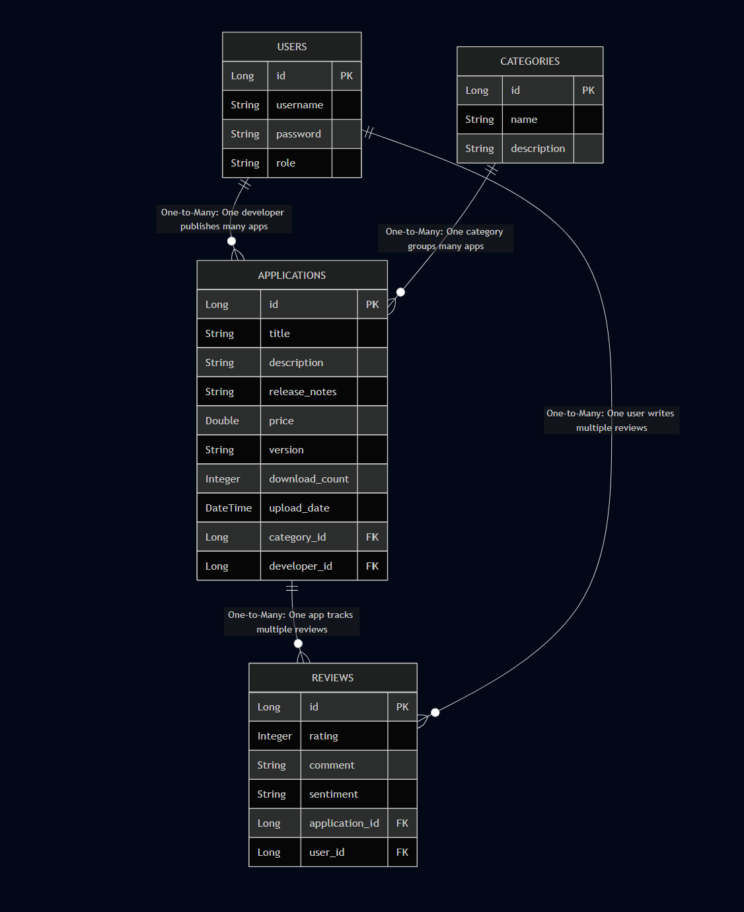
Entity Relationship Diagram

Slide 5
ROLES
USER:
View Details of App
Get Similar App Recommendations
Search App By Category
Search App By App Name
Ask AI Engine For App Recommendations And Details
DEVELOPER:
Ability To Add New Apps
Ability To Update Apps And Push Updates
Average User Reviews
Total Downloads Per App
Revenue Insights
Future 6 month App Performance Projection
ADMIN:
Work as a moderator and remove user and apps
Perform spam detection and user sentiment analysis
Manage apps in the marketplace
Contains all Features of Developer and User

Slide 6
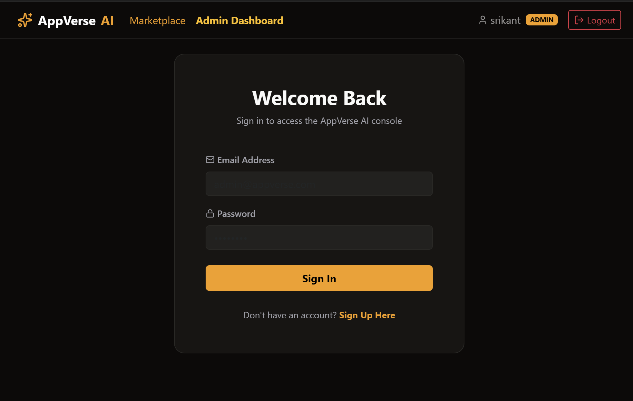
Login Page:

Slide 7
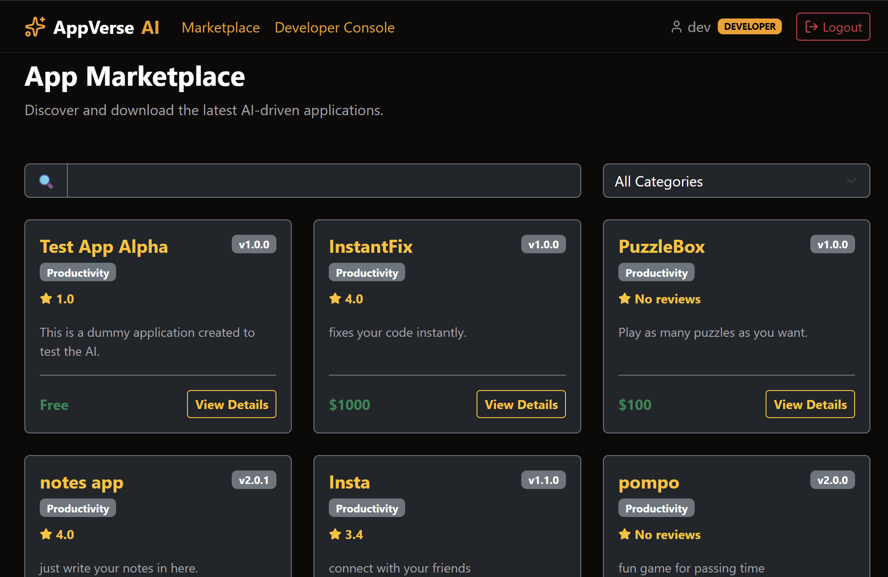
App Marketplace:

Slide 8
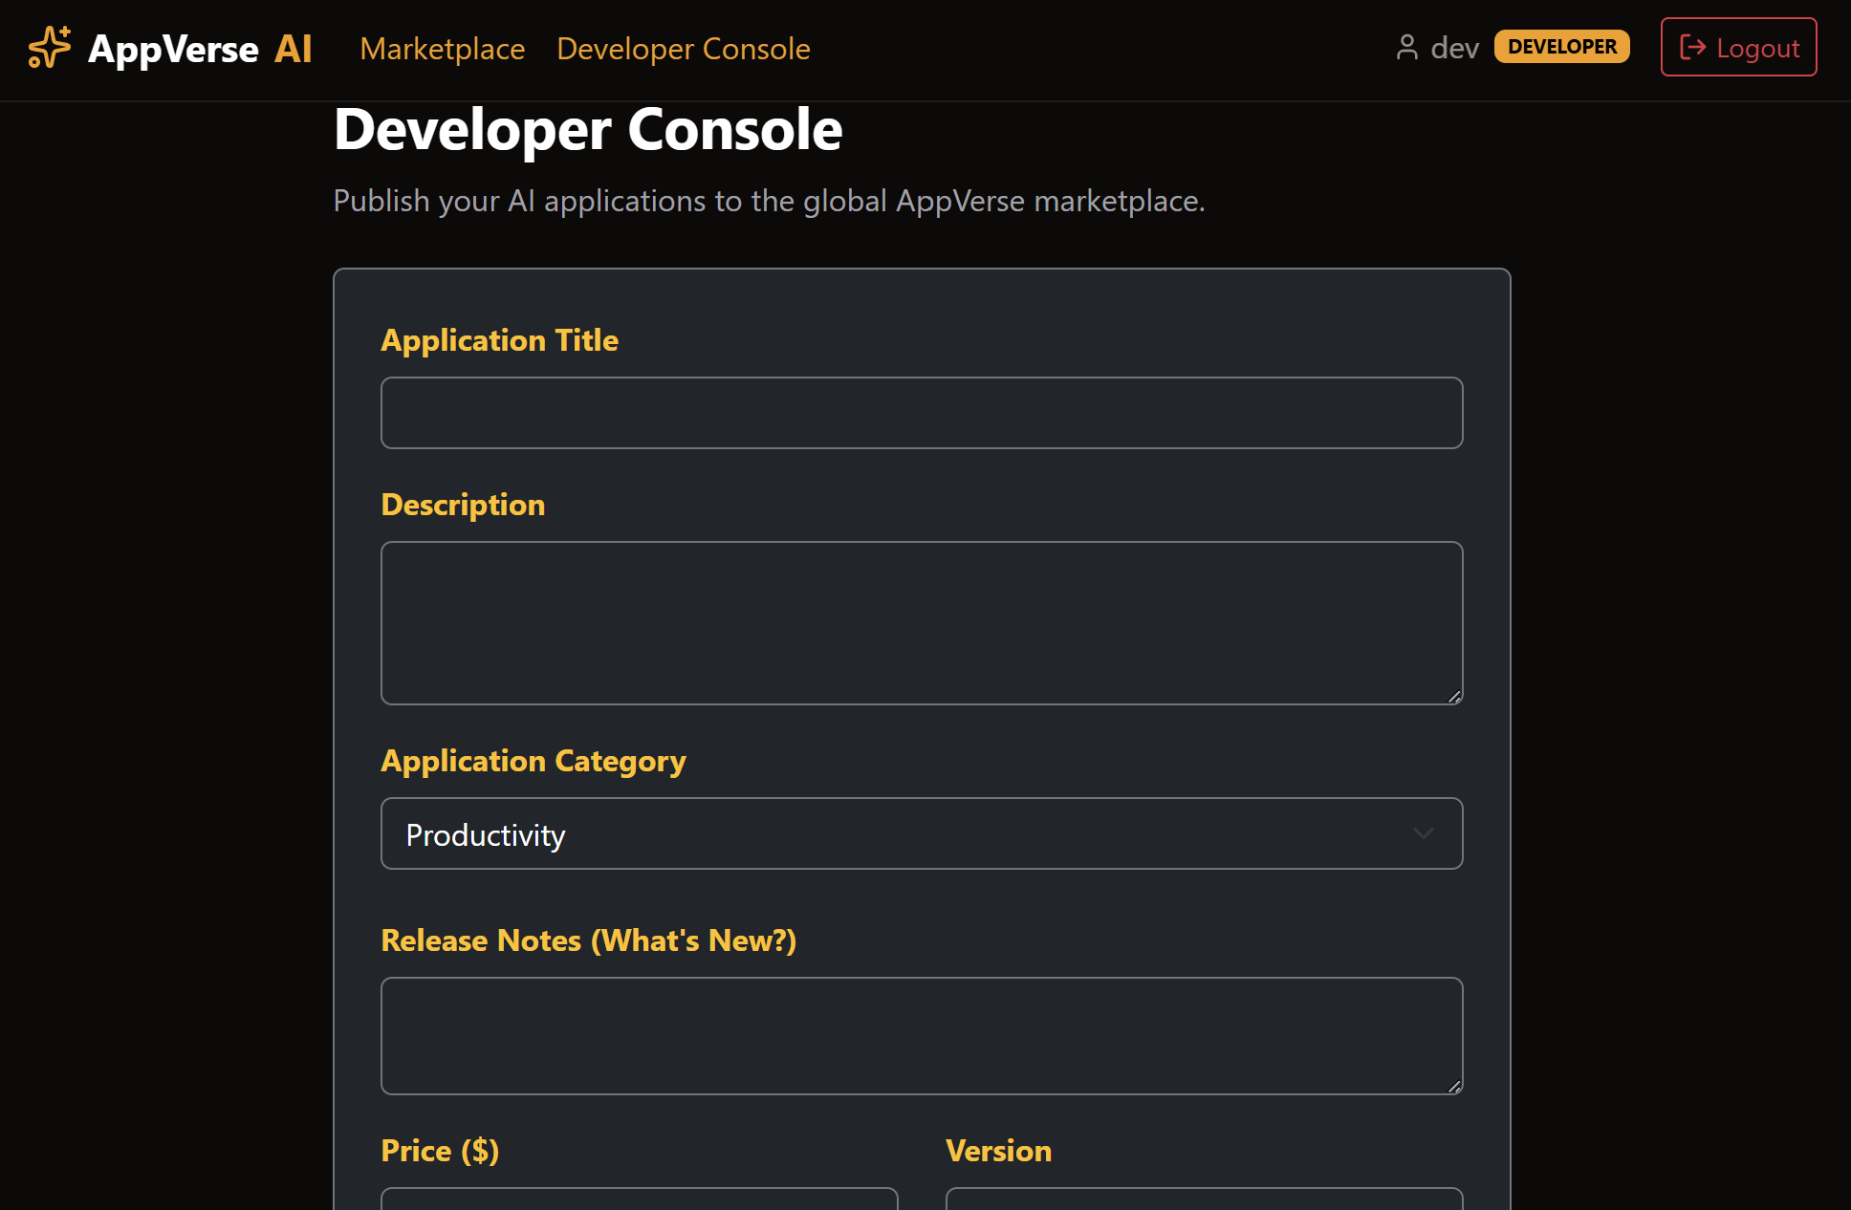
Developer Console:

Slide 9
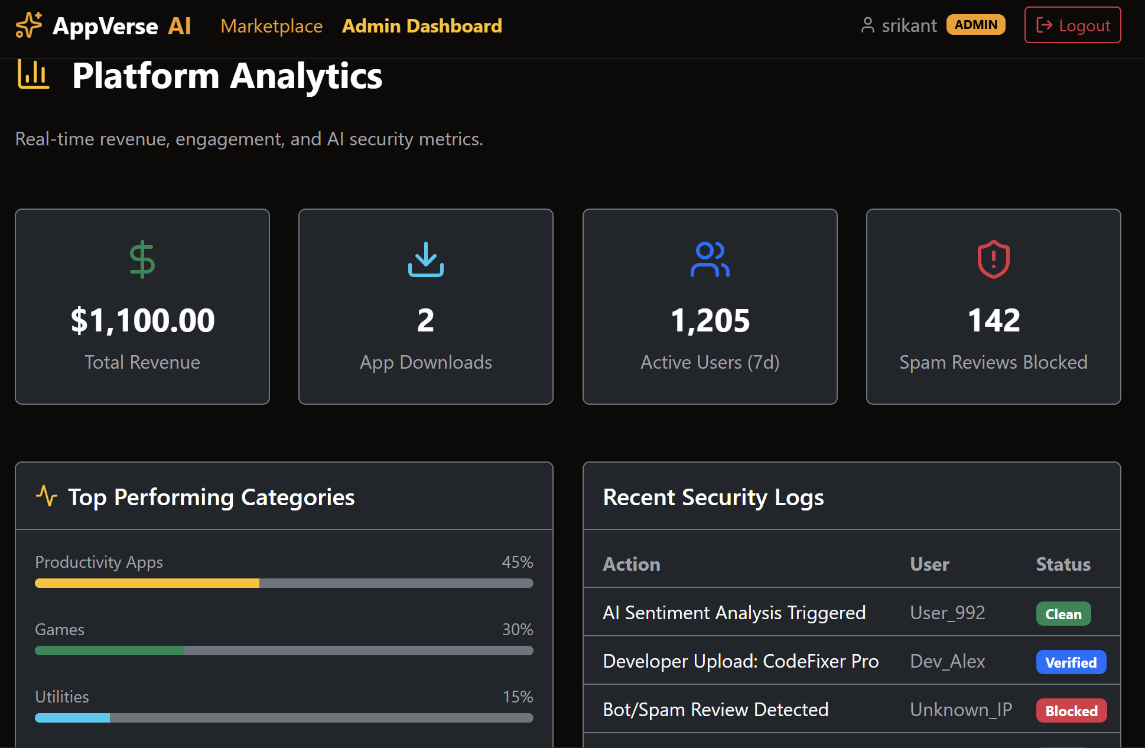
Admin Console:

Slide 10
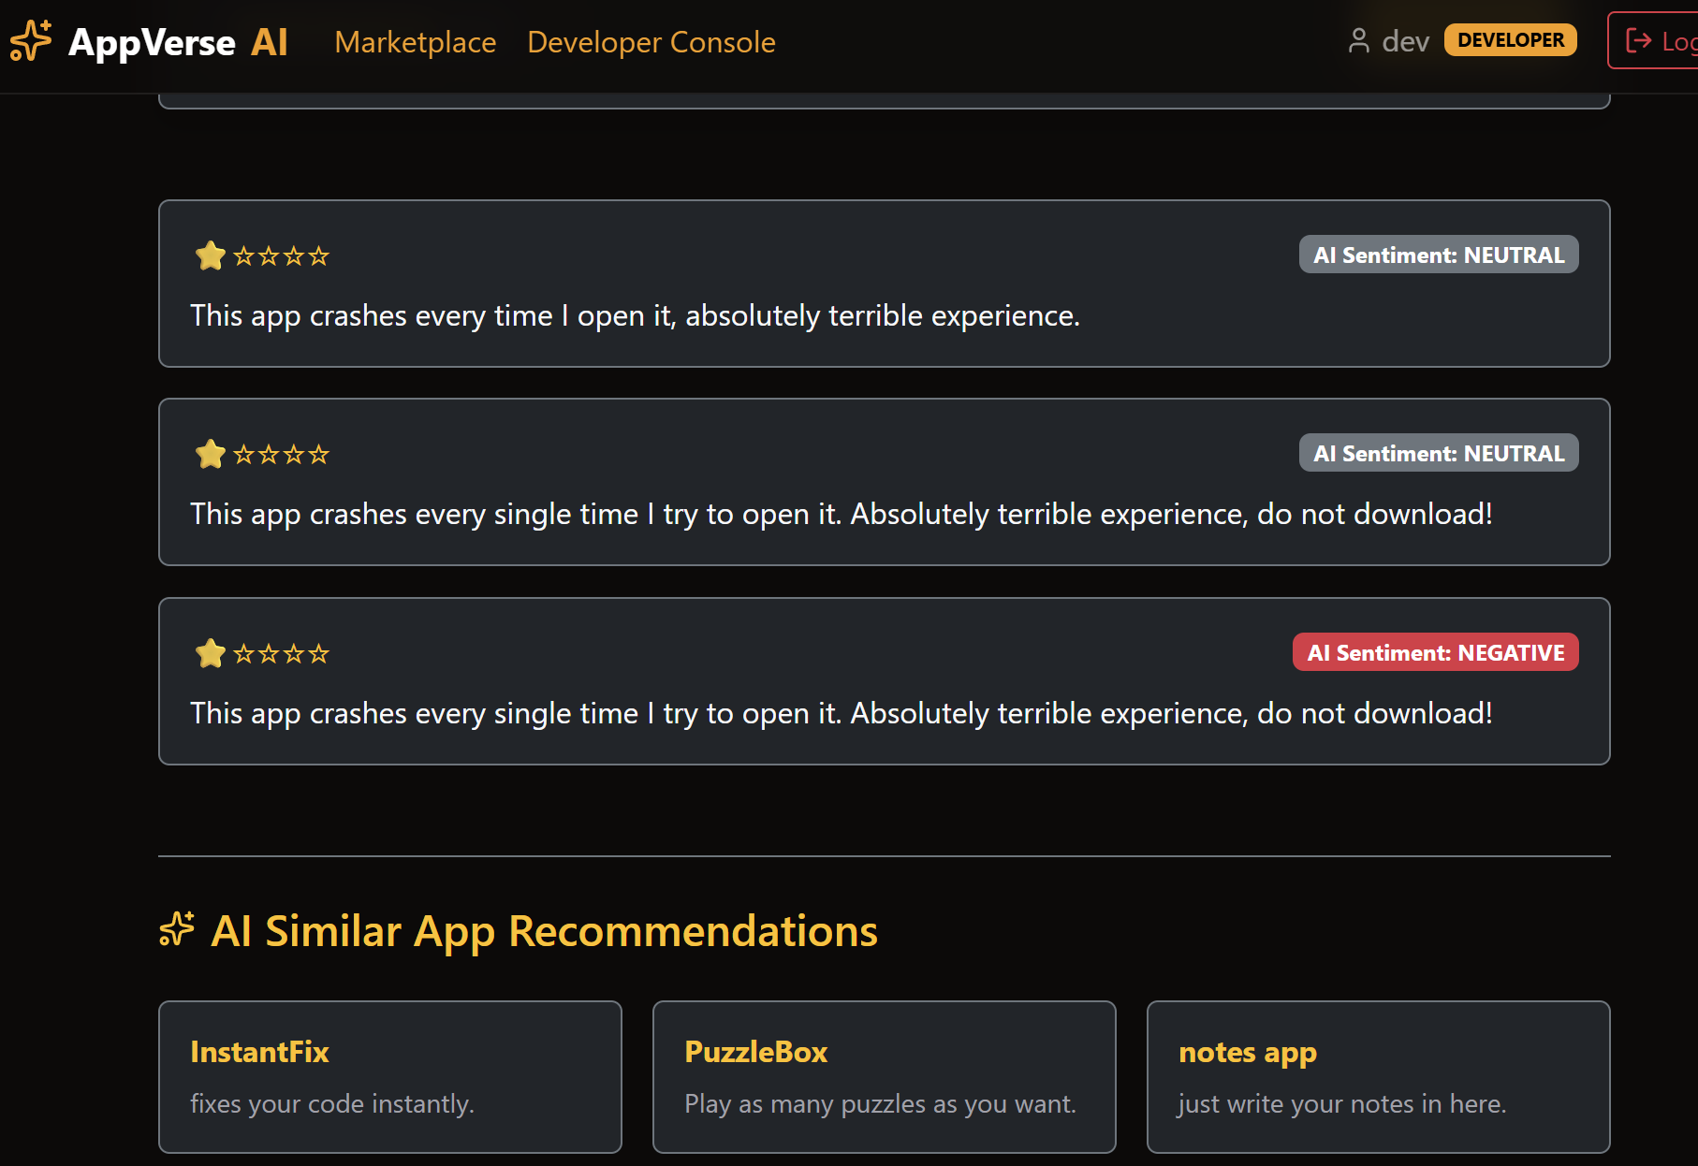
Sentiement Analysis Of User Reviews:

Slide 11
Conclusion:
The development of AppVerse successfully demonstrates the implementation of a modern, highly scalable full-stack web application. By combining the reactive performance of React.js with the robust, secure architecture of Java Spring Boot, the project successfully bridged the gap between software creators and end-users.
Future Scope:
Payment Gateway Integration: Integrating UPI or Razorpay to process actual transactions for paid applications.
Cloud Storage for App Binaries: Migrating from basic data storage to integrating AWS S3 for uploading and downloading actual .apk or .exe application files.
Advanced AI Review Moderation: Using the Gemini API to automatically flag and filter toxic or spam reviews before they are posted to the public marketplace.
Social Features: Allowing users to follow their favorite developers and receive email notifications when a new app version is released.

Slide 12
Thank You

