Slide 1
Cmpe 462 Machine Learning
Class Project
Serkan Özel
İsmail Levent Baş

Slide 2
What is it?
We liked the idea behind the neural networks and wanted to implement it, experience and deal with problems that occur.
Therefore, we used Keras to build an animal classifier
Building it from scratch was important to learn.

Slide 3
What do we try to achieve?
Our dataset is online http://www.csc.kth.se/~heydarma/Datasets.html
K-th animals
A dataset from a KTH Royal University in Stockholm, Sweden.
It is a challenging dataset with 19 different animals.
We want to discriminate the animals in the test set with more than 80 percent success rate.

Slide 4
Some properties of our dataset
Not all 19 animal classes have same number of images.
All images can be of different size, typically near 500x500.

Slide 5
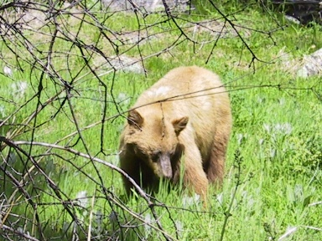
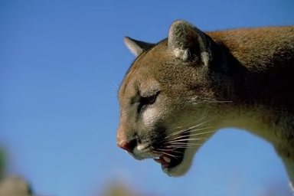
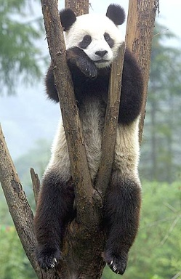
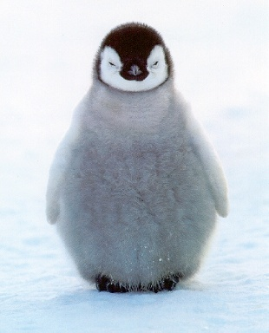
Some samples from our dataset
Bears
Cougars(Puma)
Pandas
Penguins

Slide 6
What do we first ? How to handle the data?

