Slide 1

Loan prediction
Ramesh Kumar Surapuredy (U00831213)
Contact email: rsrprddy@memphis.edu
AND
Hemanth Venumbaka (U00870132)
Contact email: hvnmbaka@memphis.edu

Slide 2

Introduction:
The major aim of this project is to predict which of the customers will have their loan paid or not.
we are developing loan prediction system using machine learning, so the system automatically selects the eligible candidates.
we are predicting the loan data by using some machine learning algorithms like Decision Tree, Logistic Regression, Random Forest, XGBoost.

Slide 3
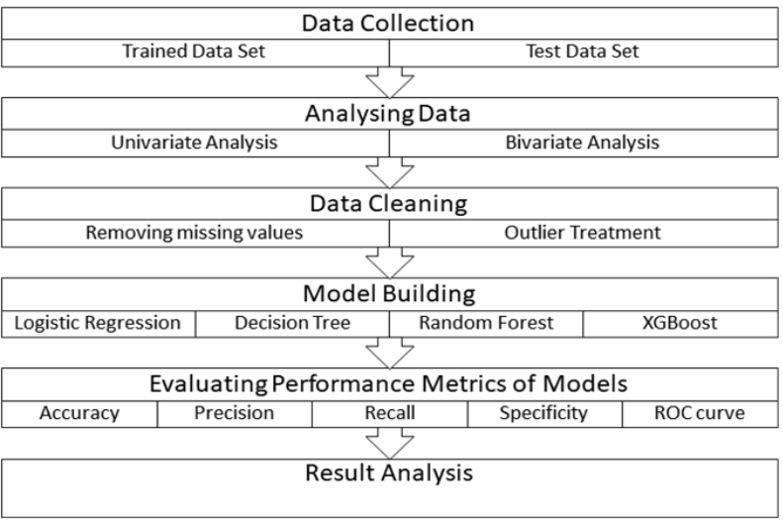

Slide 4
Logistic Regression
This is a classification algorithm which uses a logistic function to predict binary outcome (True/False, 0/1, Yes/No) given an independent variable. The aim of this model is to find a relationship between features and probability of particular outcome. The logistic function used is a logit function which is a log of odds in the favor of the event. Logit function develops a s-shaped curve with the probability estimate similar to a step function
Decision Trees
This is a supervised machine learning algorithm mostly used for classification problems. All features should be discretized in this model, so that the population can be split into two or more homogeneous sets or subsets. This model uses a different algorithm to split a node into two or more sub-nodes. With the creation of more sub-nodes, homogeneity and purity of the nodes increases with respect to the dependent variable.

Slide 5
Random Forest
This is a tree based ensemble model which helps in improving the accuracy of the model . It combines a large number of Decision trees to build a powerful predicting model. It takes a random sample of rows and features of each individual tree to prepare a decision tree model. Final prediction class is either the mode of all the predictors or the mean of all the predictors.
XGBoost
This algorithm only works with the quantitative variable. It is a gradient boosting algorithm which forms strong rules for the model by boosting weak learners to a strong learner. It is a fast and efficient algorithm which recently dominated machine learning because of its high performance and speed.

Slide 6
What datasets are used for experiments? What are the features (e.g., statistics) of the dataset? Is any pre-processing required?
Understanding the Dataset
The machine learning model is trained using the training data set. Every new applicant details filled at the time of application form acts as a test data set. On the basis of the training data sets, the model will predict whether a loan would be approved or not. We have 13 features in total out of which we have 12 independent variables and 1 dependent variable i.e. Loan_Status in train dataset and 12 independent variables in test dataset. The Loan_ID, Gender, Married, Dependents, Education, Self_Employed, Property_Area, Loan_Status are all categorical data.

Slide 7
Features of a Dataset:
There are 614 rows and 13 columns. 12 independent variable and target variable: (614, 13)
The Datatypes of features are as :
Loan_ID -object
Gender -object
Married -object
Dependents -object
Education -object
Self_Employed -object
ApplicantIncome -int64
CoapplicantIncome -float64
LoanAmount -float64
Loan_Amount_Term -float64
Credit_History -float64
Property_Area -object
Loan_Status -object

Slide 8

What is the problem? Why is it important? How hard is it?
The most challenging task is to finding the right features that influence the target feature.
Finding the features that influencing the target feature is important because it gives the meaningful insights of the data.
To find these features there will be lot of exploratory analysis and have to use right feature engineering technique.

Slide 9

What are the solutions you implement/propose? Are there any assumptions?
By looking at the columns description we can make many assumptions like
The one whose salary is more can have a greater chance of loan approval.
The one who is graduate has a better chance of loan approval
Married people would have a upper hand than unmarried people for loan approval .
The applicant who has less number of dependents have a high probability for loan approval.
The lesser the loan amount the higher the chance for getting loan.
By using EDA and Feature Engineering techniques, we came to tackle the challenges.

Slide 10
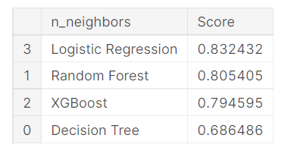
What are the preliminary results? What conclusion can be drawn from your observation?
We constructed models taking different variables into account and found through odds ratio that credit credit history is creating the most impact on loan giving decision
Finally, we got a model with coapplicant income and credit history as independent variable with highest accuracy.
We tested the data and got the accuracy of 83 %.
Among all the models Logistic Regression gives maximum accuracy.

Slide 11
References:
https://ijirt.org/master/publishedpaper/IJIRT151769_PAPER.pdf
https://www.kaggle.com/code/atchayvarma/loan-prediction-ml-project/data

Slide 12
THANK YOU

