Slide 1
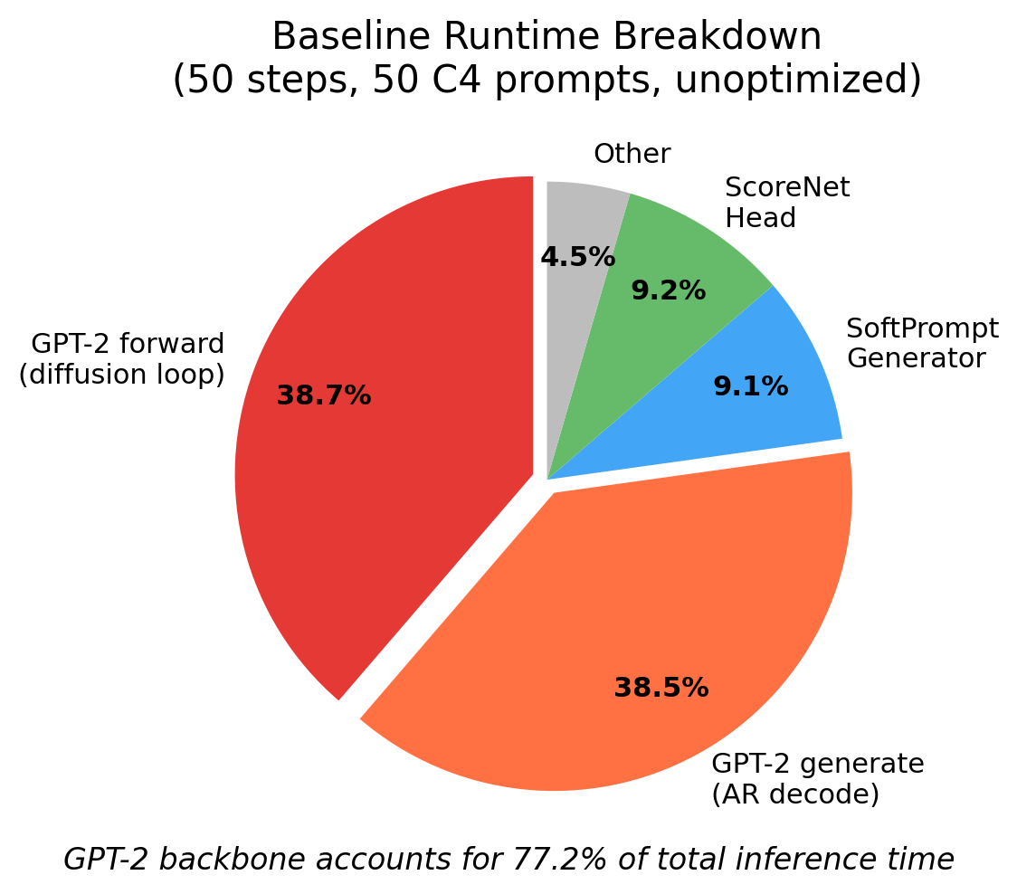
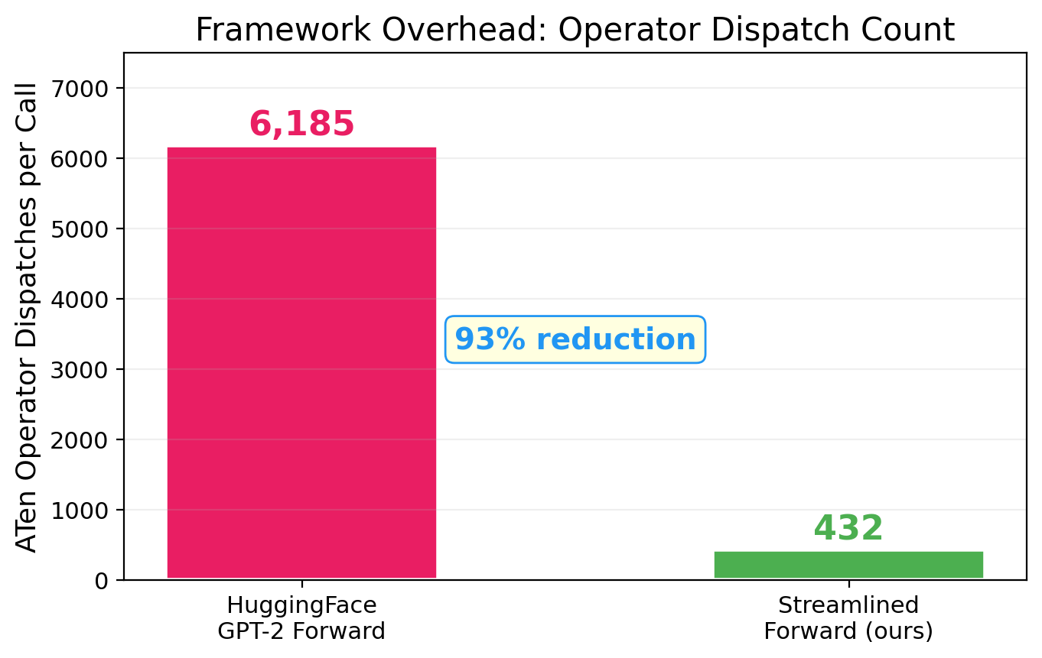
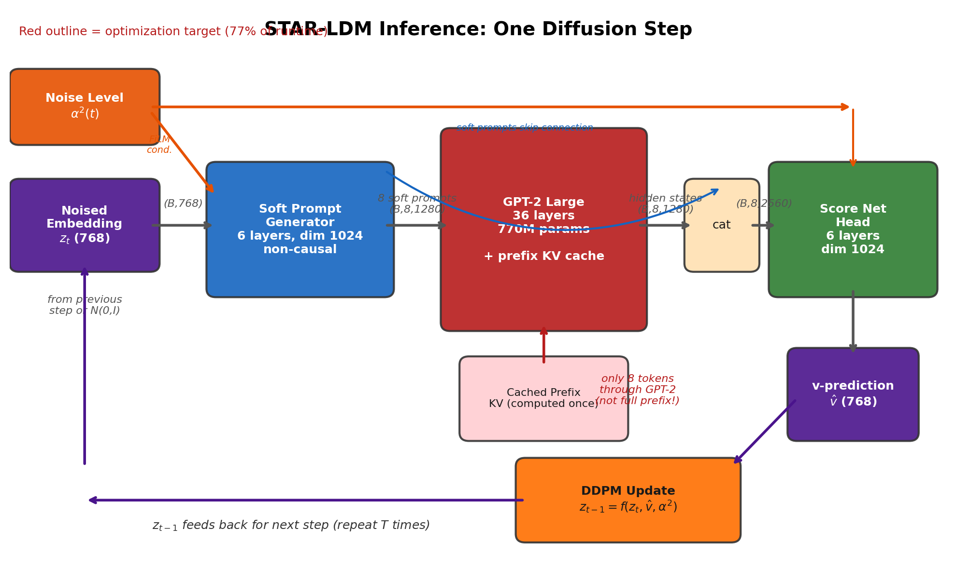
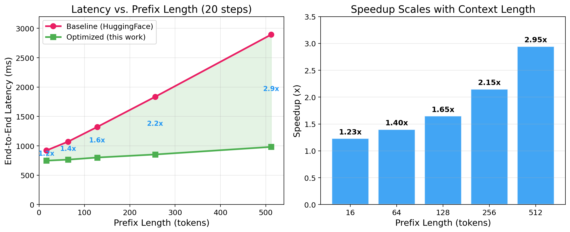
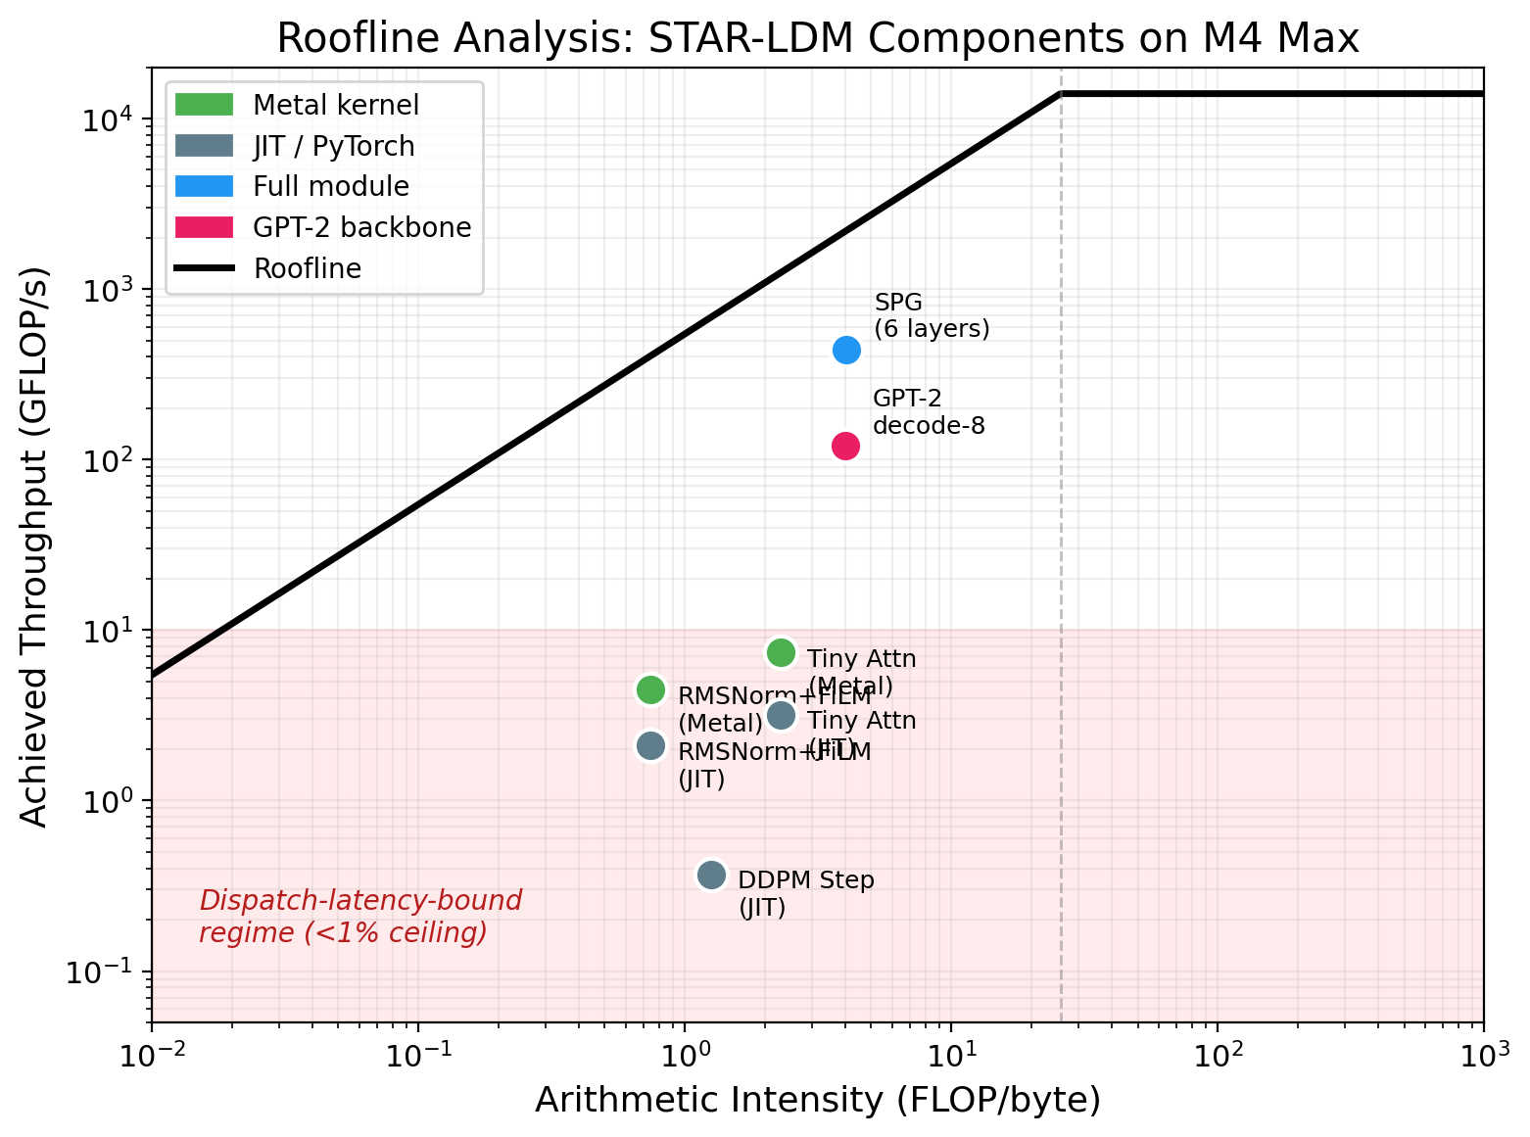
Inference Optimization for Hybrid Diffusion-Autoregressive Language Models: Profiling, Fusion, and Framework Overhead
STAR-LDM (COLM 2025)
Lovelace, Belardi, Zalouk, Polavaram,
Kundurthy, Weinberger
Apple M4 Max | 128 GB | Metal GPU
Srivatsa Kundurthy | Cornell University | CS 5220: Applied High-Performance and Parallel Computing | Spring 2026
1. STAR-LDM: Hybrid Diffusion + Autoregressive
STAR-LDM combines 50-step latent diffusion planning with GPT-2 Large autoregressive decoding, achieving dramatically better text quality:
Model Params MAUVE ↑
GPT-2 Large 770M 85.2
GPT-2 XL 1.5B 86.6
STAR-LDM 956M 94.6 (+8 points)
The Stop → Think → AutoRegress Pipeline
1. STOP: Encode prefix through GPT-2, cache KV projections.
2. THINK: 50-step diffusion loop. Each step:
z_t (768d) → SPG (6 layers) → 8 soft prompts (1280d)
→ GPT-2 Large (36 layers, 770M) → hidden states
→ ScoreNet (6 layers) → v-prediction → DDPM update → z_{t-1}
3. AUTOREGRESS: Final soft prompts condition GPT-2 for token generation.
The Problem
Each step invokes the full 770M-param GPT-2 backbone. At 50 steps, STAR-LDM is 2.3x slower than GPT-2 Large. The authors note their implementation is "not optimized for inference speed."
2. Profiling: Where Does Time Go?
3. Optimizations
A. Streamlined GPT-2 Forward
Replace HuggingFace GPT2LMHeadModel.forward() with 40 lines of PyTorch performing only essential ops. Eliminates mask construction, cache management, tensor format conversions.
6,185 → 432 dispatches | 3.6x faster per-call
B. KV-Cache with Pre-Allocated Buffers
Compute prefix KV once, reuse across all 50 steps. Pre-allocate contiguous buffers — eliminates 1,800 tensor allocations per generation.
Per-step cost: O(1) vs O(prefix_len)
C. Metal Compute Shaders (1,700 lines)
6 custom Apple Metal GPU kernels:
✓ RMSNorm+FiLM: 3→1 dispatch, 1.69x
✓ Tiny Attention: register-resident 8×8, 2.39x
✗ DDPM Step: dispatch > compute, 0.35x
✗ Fused FFN: can't beat Apple BLAS, 0.01x
✗ Decode-N Attn: wins only at KV<40
✗ Spec Verify: dispatch overhead, 0.13x
2 of 6 kernels deliver speedups.
5. Future Work (for Final Report)
A. Cross-Platform CUDA Comparison
Run identical benchmarks on NVIDIA A100. Test whether framework overhead is MPS-specific or general. Does torch.compile with CUDA Graphs succeed where MPS failed?
B. Quality Validation
Generate 5,000 C4 continuations with both pipelines. Compute MAUVE and perplexity to verify optimizations preserve output quality. Critical: our fast forward drops causal masking on the 8 soft prompts.
C. Model Scheduling
Profile v-prediction error at each noise level. At early/late steps, GPT-2 may add minimal value — replace with cheap SPG+ScoreNet-only path (~3ms vs ~12ms/step). Training-free, potential 30–40% further speedup.
D. Consistency Distillation (Stretch)
Train student score network to map z_t → z_0 in 1–4 steps (LCM-style). STAR-LDM's 768-dim space is smoother than pixel space — few-step distillation should be effective.
At 4 steps: ~550ms total (faster than GPT-2 Large)
50 C4 prompts, M4 Max, 50 steps, unoptimized.
GPT-2 = 77.2% of total inference time.
The Real Bottleneck: Framework Overhead
Architecture: One Diffusion Step
4. Results: Prefix Length Scaling
6,185 ATen dispatches per call — only 432 (7%) compute.
The rest: mask creation, cache management, tensor reshaping. At ~3.4μs each, dispatch overhead alone = ~21ms/call.
Key Takeaway
The primary bottleneck in hybrid diffusion-AR inference is framework dispatch overhead, not GPU kernel performance.
HuggingFace issues 14x more operator dispatches than needed. A 40-line PyTorch rewrite gives a larger speedup (3.6x on 70% of pipeline) than six custom Metal GPU kernels combined.
Roofline analysis reveals a dispatch-latency-bound regime where micro-transformer ops achieve <1% of hardware ceiling — a third regime beyond compute-bound and memory-bound.
Negative results: Picard parallel diffusion (convergence too slow), torch.compile on MPS (2–3x slower), fused FFN kernel (127x slower than BLAS).
References
Lovelace et al., COLM 2025 • Dao et al., NeurIPS 2022 • Aminabadi et al., SC 2022 • Williams et al., CACM 2009 • Yuan et al., 2024 • Ansel et al., ASPLOS 2024
Roofline: Dispatch-Latency-Bound
Prefix Baseline Optimized Speedup
16 921 ms 748 ms 1.23x
64 1,072 ms 765 ms 1.40x
128 1,321 ms 801 ms 1.65x
256 1,835 ms 853 ms 2.15x
512 2,894 ms 982 ms 2.95x
100-Prompt Evaluation (20 steps, prefixes 5–200 tok):
Baseline: 1,590 ms (std 279) → Optimized: 1,379 ms (std 50)
1.15x speedup, 5.6x lower variance
Micro-transformer ops: <1% of roofline ceiling. Not compute-bound, not memory-bound — dispatch-latency-bound.
Code: 1,700 lines Metal/Obj-C++ (6 GPU kernels) + optimized PyTorch pipeline | Eval: 100 prompts, 4 prefix-length buckets
CS 5220: Applied High-Performance and Parallel Computing | Prof. Giulia Guidi | Cornell University | Spring 2026

