Slide 1
Orion flavors - Wireframes
January 23 2021

Slide 2
Background
Orion Flavors is a hypothetical restaurant for which a brand site is being built.
This brand site features the following:
Responsive web design to suite desktops, tablets and mobile devices
Online orders for take away
Promote featured dishes from the restaurant
Content slots for digital marketing

Slide 3
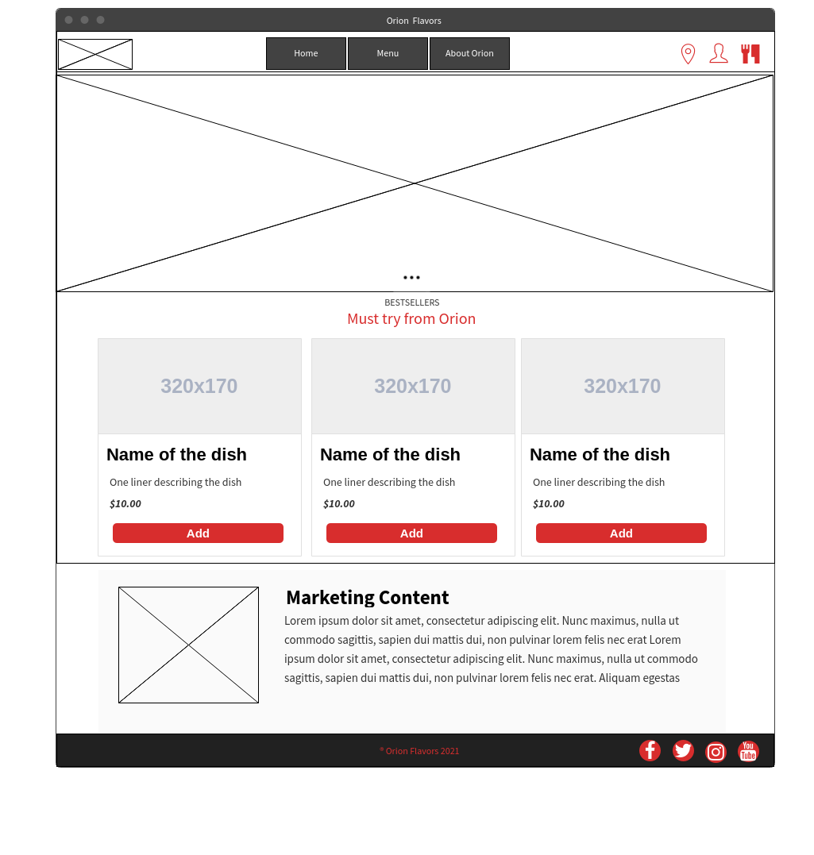
Home Page

Slide 4
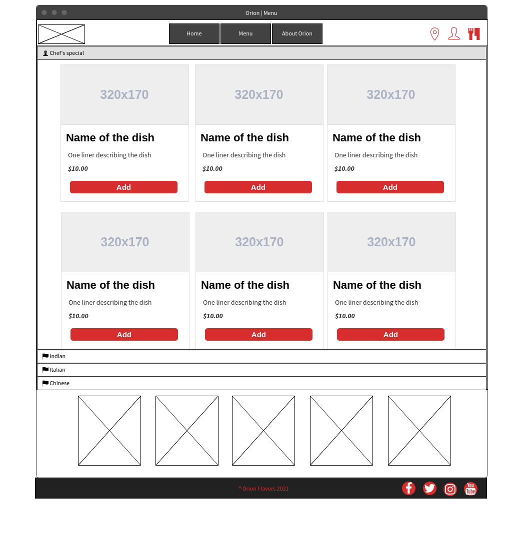
Menu

Slide 5
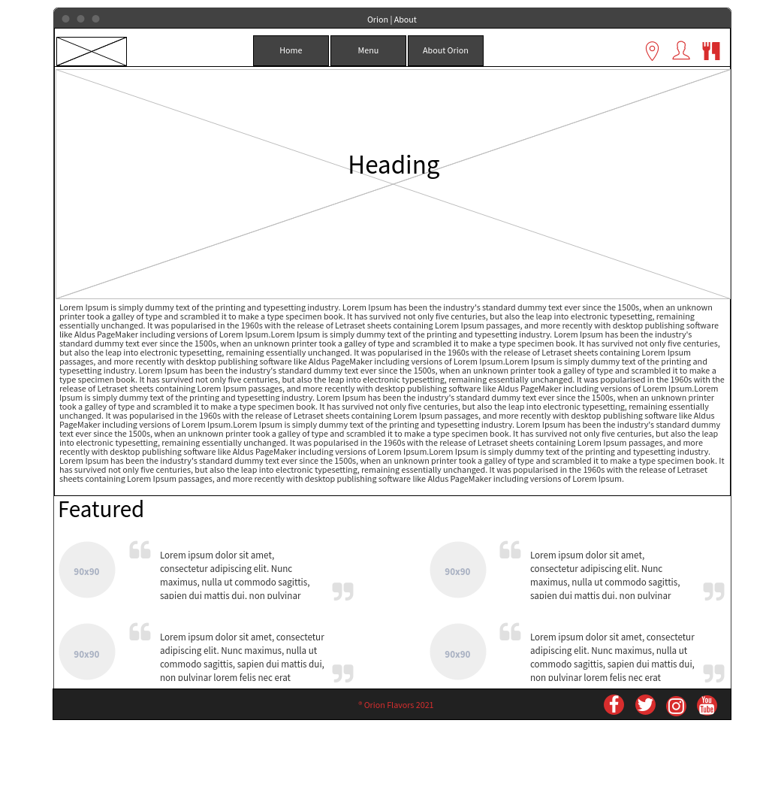
About Orion

Slide 6
Thank you

