Slide 1
SPARKATHON 2025
Tech Warriors
TITLE PAGE
Problem Statement ID – PEC0019
Problem Statement Title- SMART BMI INDICATOR FOR HEALTH SENSOR
PS Category- Hardware
Team Name – TECH WARRIORS

Slide 2
SMART BMI MANAGEMENT
Tech Warriors
Proposed Solution
Detailed explanation of the proposed solution
Our project, BioFit Smart BMI Tracker, addresses the inefficiencies in traditional BMI measurement, which rely on manual input and are prone to errors.
AI-enhanced load cells for precise weight measurement.
Ultrasonic, infrared, and LiDAR sensor fusion for accurate height detection.
Real-time BMI calculation with AI-driven error correction.
Machine learning analysis for BMI trend tracking and health risk prediction.
IoT integration for seamless syncing with fitness apps and smartwatches.
AI-powered personalized health recommendations for diet and exercise.
User-friendly LCD and mobile app interface with voice feedback.
Innovation and uniqueness of the solution
How it addresses the problem:
Eliminates manual errors with weight sensors and LiDAR-ultrasonic height measurement.
Real-time BMI calculation with AI-driven accuracy correction.
Machine learning predicts health risks from BMI trends.
IoT integration syncs with fitness apps and smartwatches.
LCD and mobile app display for easy tracking
Innovation and uniqueness of the solution:
AI-Enhanced Accuracy – Uses load cells & LiDAR-ultrasonic fusion for precise weight and height measurement.
Real-Time BMI & Trend Analysis – AI-driven error correction and health risk prediction.
IoT & Smartwatch Sync – Seamless fitness app integration for continuous monitoring.
Voice-Assisted Interface – LCD & mobile app with AI-driven insights

Slide 3
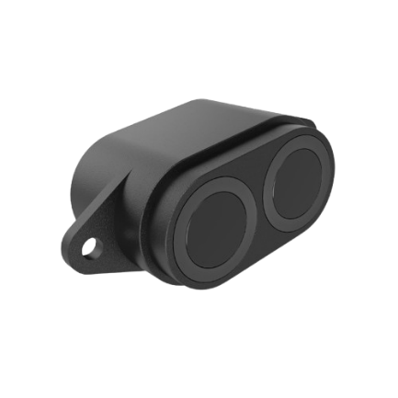



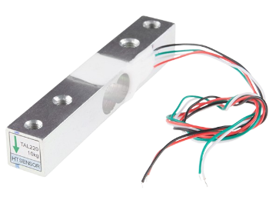



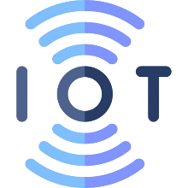
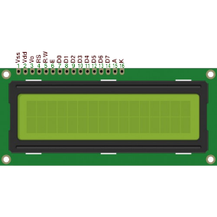
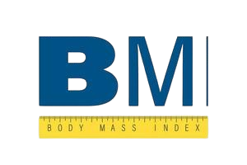
TECHNICAL APPROACH
Tech Warriors
Your Team Name
Weight Measurement
Height Management
Real time BMI Calculation
User
IOT Sync
Health Risk Prediction
BMI Categorization
Data Display

Slide 4
FEASIBILITY AND VIABILITY
Tech Warriors
Your Team Name
Technical Feasibility:-
Sensor Accuracy – AI-enhanced load cells & LiDAR-ultrasonic fusion provide high precision. IoT & Cloud Integration – Wi-Fi, Bluetooth, and MQTT ensure real-time data sync. AI & Machine Learning – Edge computing (TensorFlow Lite, Edge Impulse) enables on-device analysis. Data Security – Blockchain encryption ensures privacy and integrity.
2. Market Feasibility:-
Growing Health Awareness – Increased demand for smart health monitoring solutions .Fitness Tech Adoption – Users prefer wearable and connected fitness devices .Integration with Smart Devices – Compatible with fitness apps & smartwatches, improving user adoption.

Slide 5
IMPACT AND BENEFITS
Tech Warriors
Your Team Name
Social Benefits:-
Promotes Preventive Healthcare – Early detection of obesity, undernutrition, & health risks. Encourages Healthy Lifestyle – Personalized fitness & diet recommendations. Increases Accessibility – Makes BMI tracking easy & automated, reducing manual errors.
2. Economic Benefits:-
Reduces Healthcare Costs – Early monitoring helps prevent expensive chronic illnesses . Boosts the Fitness Tech Industry – Drives growth in IoT-based health solutions. Improves Workplace Productivity – Healthier employees result in fewer sick days & higher efficiency.
3. Environmental Benefits:- Reduces Paper Usage – Digital records eliminate the need for manual health logs. Energy-Efficient Design – Low-power IoT components reduce energy consumption. Promotes Sustainable Health Practices – Encourages preventive care over excessive medical treatments.

Slide 6
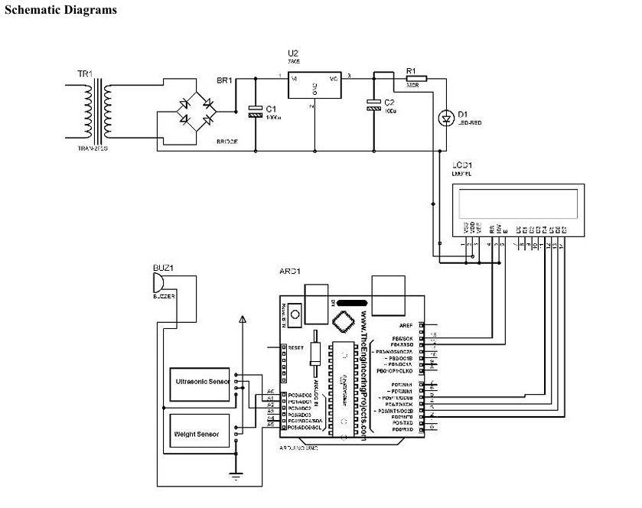
BLOCK DIAGRAM :-
Tech Warriors

Slide 7
REFERANCE :-
- References ➢ Rajeswari P. (2014). Glimpse on Body Mass Index. Volume 3, Issue 4, 2014.
Retrieved from International Journal of Medical and Applied Science. Website: www.earthjournals.org ➢ Sun,J.(2007).
The History of BMI. Retrieved from: http://www.epsport.idv.tw/blog ➢ BodyMassIndex.Wikipedia. Retrieved from: https://en.wikipedia.org/wiki/Body_mass_index ➢ Dinsdale, B. (2011).
A Simple Guide in Classifying Body Mass Index in Children. Changing Lifestyle, 2nd Ed., Pg. 169-170. ➢ Body Mass Index: Advantages and Disadvantages.
Retrieved from: http://www.livestrong.com/article/40808-body-mass-index advantages ➢ Lustig,J. (2011).
Wellness and Fitness of a Child. Wellness and Fitness, 3rd Edition, Pg. 165-167. ➢ O’Brien(1995). ABC of Hypertension, BMJ Publishing Group, London, Pg. 1-34. ➢ Bray,J.,&Gray, S. (1988).
Gain Weight. Western Journal of Medicine, Vol. 2, No. 1, May 1998. ➢ Harper,F. (2012). BMI Calculator with LCD Display, Version 2, No. 3, October 2012. ➢
Clark,S. (2014). Nutrient Prices and Other Socio-Economic and Health Determinants of the Body Mass Index of Canadians, Vol. 20, No. 3, August 2014

