Slide 1
SPARKATHON 2025
TITLE PAGE
Problem Statement ID –PEC0017
Problem Statement Title-SOLAR POWERED SMART MOBILE CHARGER
PS Category- Hardware
Team Name:NEXON

Slide 2
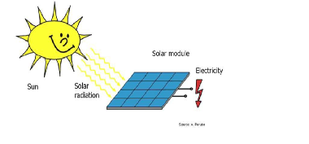
SOLAR POWERED SMART MOBILE CHARGER
Proposed Solution:
Our solution:
We propose a Solar-Powered Smart Mobile Charger that integrates solar energy harvesting, power management, and smart monitoring to provide an efficient, portable, and user-friendly charging solution.
The key features in solar powered smart mobile charger are:
Solar-Powered Charging System: High-efficiency solar panel to convert sunlight into electricalenergy .
Smart Charging & Power Management Fast-charging support (QC 3.0, PD - Power Delivery) for various mobile devices
IoT-Based Smart Features: Mobile App & IoT Dashboard for real-time monitoring of charge levels, solar efficiency, and usage statistics
Sustainability & Portability: Eco-friendly materials with a foldable, compact, and lightweight design

Slide 3
TECHNICAL APPROACH:
NEXON
Solar Panel & Battery: The solar panel converts sunlight into electrical energy, which is stored in a 7.4W battery for continuous power supply.
Buck-Boost Converter & Power Module: The buck-boost converter regulates voltage to ensure a stable output, while the power module manages power distribution to connected devices.
Two-Way Switch:Diode & LED: The two-way switch allows selection between solar and battery power.
Diode & LED :The diode ensures unidirectional current flow (preventing backflow), and the LED acts as an indicator for power status.
Wiring:wires provide electrical connectivity between all components, ensuring efficient power transfer with minimal loss.

Slide 4
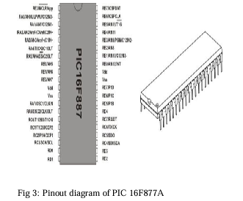
FEASIBILITY AND VIABILITY
NEXON
Technical Feasibility:
Performance Reliability: The buck-boost converter ensures stable voltage, while the diode prevents backflow, ensuring safe operation.
Scalability: Can be enhanced with larger batteries or higher-efficiency solar panels for better performance.
Operational Feasibility :
User-Friendly: Simple switching mechanism and LED indicators make it easy to use.
Portability: Lightweight and compact, making it ideal for travel and outdoor use.
Economic Feasibility:
Affordable Components: The project uses cost-effective components, making it budget-friendly.
Low Operational Cost: Once installed, there are minimal costs as solar energy is free.

Slide 5
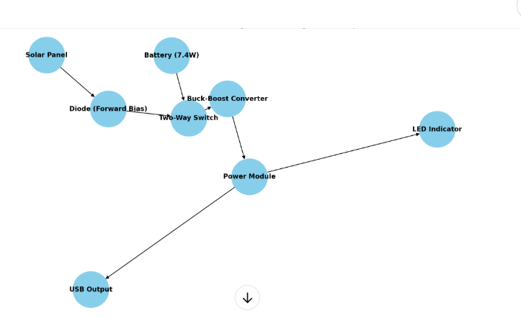
IMPACT AND BENEFITS
NEXON
Environmental Impact :
Reduces Carbon Footprint: Uses renewable solar energy, reducing dependency on fossil fuels.
Minimizes E-Waste: Extends battery life and reduces the need for disposable chargers and power banks.
Social Impact :
Empowers Rural Areas: Provides power in remote locations with limited electricity access.
Cost-Effective Solution :
Requires minimal maintenance.
Reliable & Portable :
Lightweight and compact, making it easy to carry.
Energy Independence :
Charges devices anywhere, without relying on grid electricity.
Useful for outdoor enthusiasts, travelers, and campers.

Slide 6
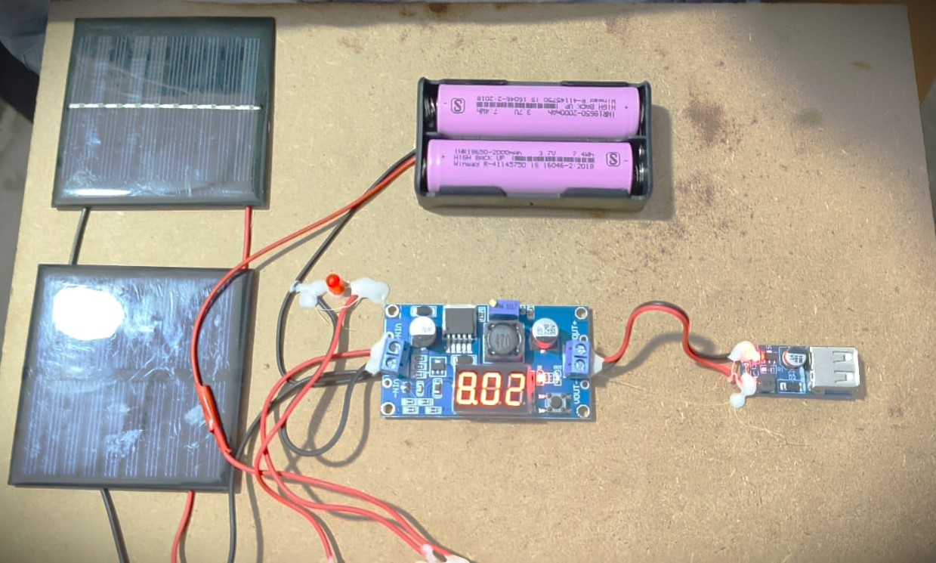
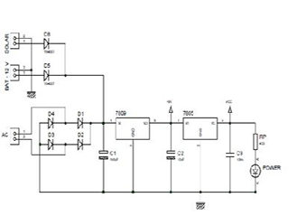
RESEARCH AND REFERENCES
NEXON
[1] T. Voigt, H. Ritter,and J. Schiller, “Utilizing solar power in wireless sensor networks”, Proc. IEEE Conference on Local Computer Networks, 2003.
[2] Ferro Solutions. “VEH-360: Evaluation Power System Specifications.”
[3] C. Park and P. Chou , “Power utility maximization for multiple-supply systems by a load-matching switch”, Proc. ACM/IEEE International Symposium on Losw Power Electronics and Design, pp. 168–173, 2004.
[4] Esram, T. a. (2007). Comparison of Photovoltaic Array Maximum Power Point Tracking Techniques. IEEE Transactinos on Energy Conversion , 22 (2), 439-449.
[5] www.edutalks.org

