Slide 1

SPARKATHON 2025
24-03-2025/25-03-2025
PANIMALAR ENGINEERING COLLEGE ELECTRICAL AND ELECTRONICS ENGINEERING
Problem Statement ID - PEC OO16
Problem Statement Title - Automated Programmable Bell Ringing System for Educational Institutes
PS Category - Hardware
Team Name - AURA

Slide 2
AURA
Title-Automated Programmable Bell Ringing System for Educational Institutes
Proposed Solution: Our Smart Solution for Modern Educational Institutes to make a “Automated Programmable Bell Ringing System ”. for a” Traditional bell systems are manual that’s makes a prone to errors , human malfunctions lack
flexibility” and so on but our project will rectify all the problems to make our own innovations and with help of ai to make
this project more effective and flexibly to use anyone to operate easily and rang the bell at proper provided time duration via the mobile application like website owned by our collage management to access only selected adminstators to make edit this time otherwise this will keep its already provided commands .
INNOVATIVE IDEAS : we used in this both hardware and as well as software tools to make this project more efficiency to operate a users
Hardware Components like ESP32 module , RTC , BUZZERS , Relay module , LED display , power backup, Software tools like Firebase , {HTML ,CSS, React JS ,node JS} (or) FLASK , real time tracking , IOT .
We have to implement our contribute to improve this project we included user friendly interface ,integrate the LED display , effective web dashboard , it supports different schedule(holidays, Exams, Events), RTC , Manual override , Power backup ,IOT integration for remote access via the web ,sound coustomization while ranging the bell, emergency button to ring the bell because any malfunctions are done in the circuits , Voice Alerts Instead of Traditional Bells
Addresses the problem : "Automation eliminates human error," "Customizable schedules for flexibility," "IoT integration for remote control," and "RTC for reliable timekeeping" to address the problem effectively. "Never miss a bell again— even during power outages, our RTC keeps operations running smoothly."

Slide 3








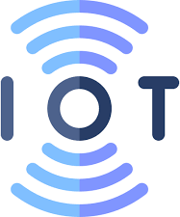



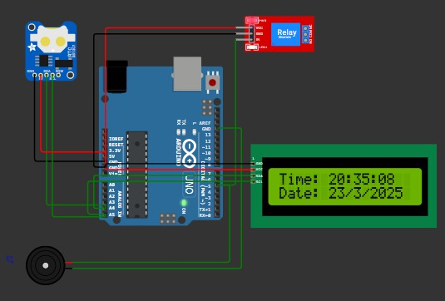



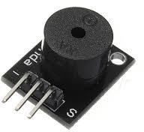
AURA TECHNOLOGICAL STACKS, FLOW CHART AND METHODOLOGY
Web page
Data storage
Power backup
buzzer
Hardware and software are used :
ESP32 :handles schedule processing and web communication DS3231 RTC Module : Real-Time Clock to maintain accurate bell schedules
Buzzers ,battery backup , oled display
Flask or (HTML , CSS , java script ) : Backend for handling web requests and schedules
Firebase: Database for storing bell schedules
Matlab: to simulate the hardware to check the connections.
1️⃣ Problem: Manual errors, rigid scheduling
2️⃣ Solution: ESP32 + Flask for automation & remote control
3️⃣ Implementation: RTC-based scheduling, relay control, web UI
4️⃣ Testing: Wokwi simulation, API validation
5️⃣ Future Enhancements: Cloud hosting, AI-based adaptive schedules
Efficient, accurate, and smart bell management system!

Slide 4
AUTOMATED PROGRAMMABLE BELL RINGING SYSTEM SIMULATED OUTPUT

Slide 5
FEASIBILITY AND VIABILITY
AURA
FEASIBILITY | CHALLENGES | SOLUTIONS
Cost-effective components | Network issues may affect remote access | Offline fallback with onboard schedule memory
Modular design for easy installation | User interface needs to be intuitive | Testing with non-tech users for UI validation
Easily scalable across institutions | Power Outages Disrupting Bell Functionality | Integrate a rechargeable battery

Slide 6
AURA
IMPACTS | BENEFITS
Accurate class timing = better discipline | Social: Reduces manual labor dependency
Less admin workload | Economic: Saves resources over time
Boosts digital infrastructure of institutions | Environmental: Minimizes paper-based scheduling

Slide 7
RESEARCH AND REFERENCES
AURA
https://matjournals.net/engineering/index.php/JoMMR/artic le/view/867?utm_source=chatgpt.com
https://www.researchgate.net/publication/313838082_Desig n_of_Microcontroller- Based_Automatic_School_Bell?utm_source=chatgpt.com

