Slide 1
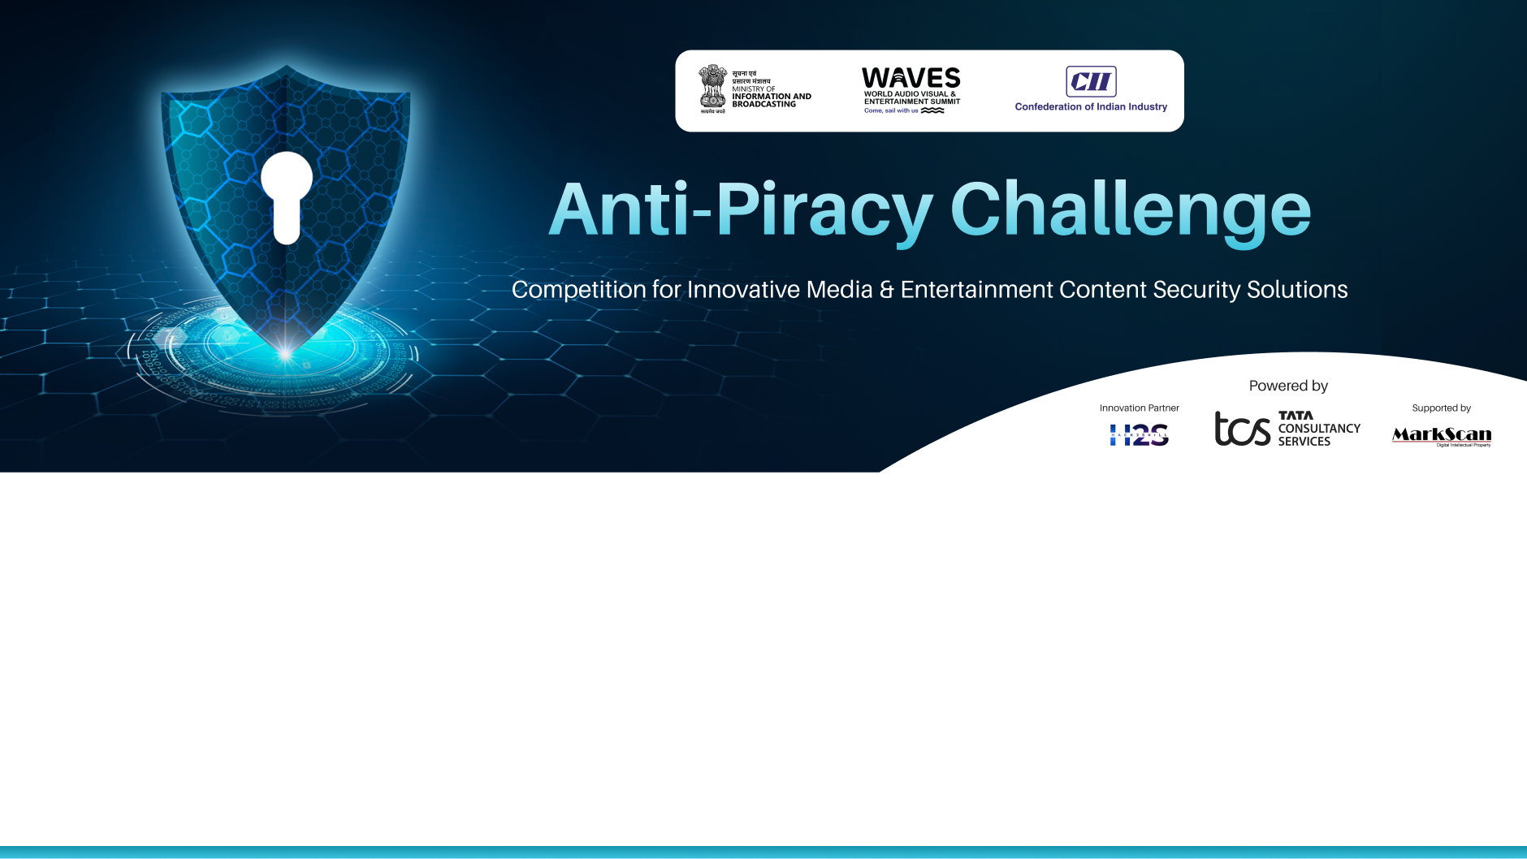
Team Name: AntiPiracyGuard
Email: santhoshpakkiri550@gmail.com
Participant Name: Santhosh P
Vimal Sridhar K
Parthasarathy M
Aravind R
Shanthosh K
Phone number: +918015696321

Slide 2
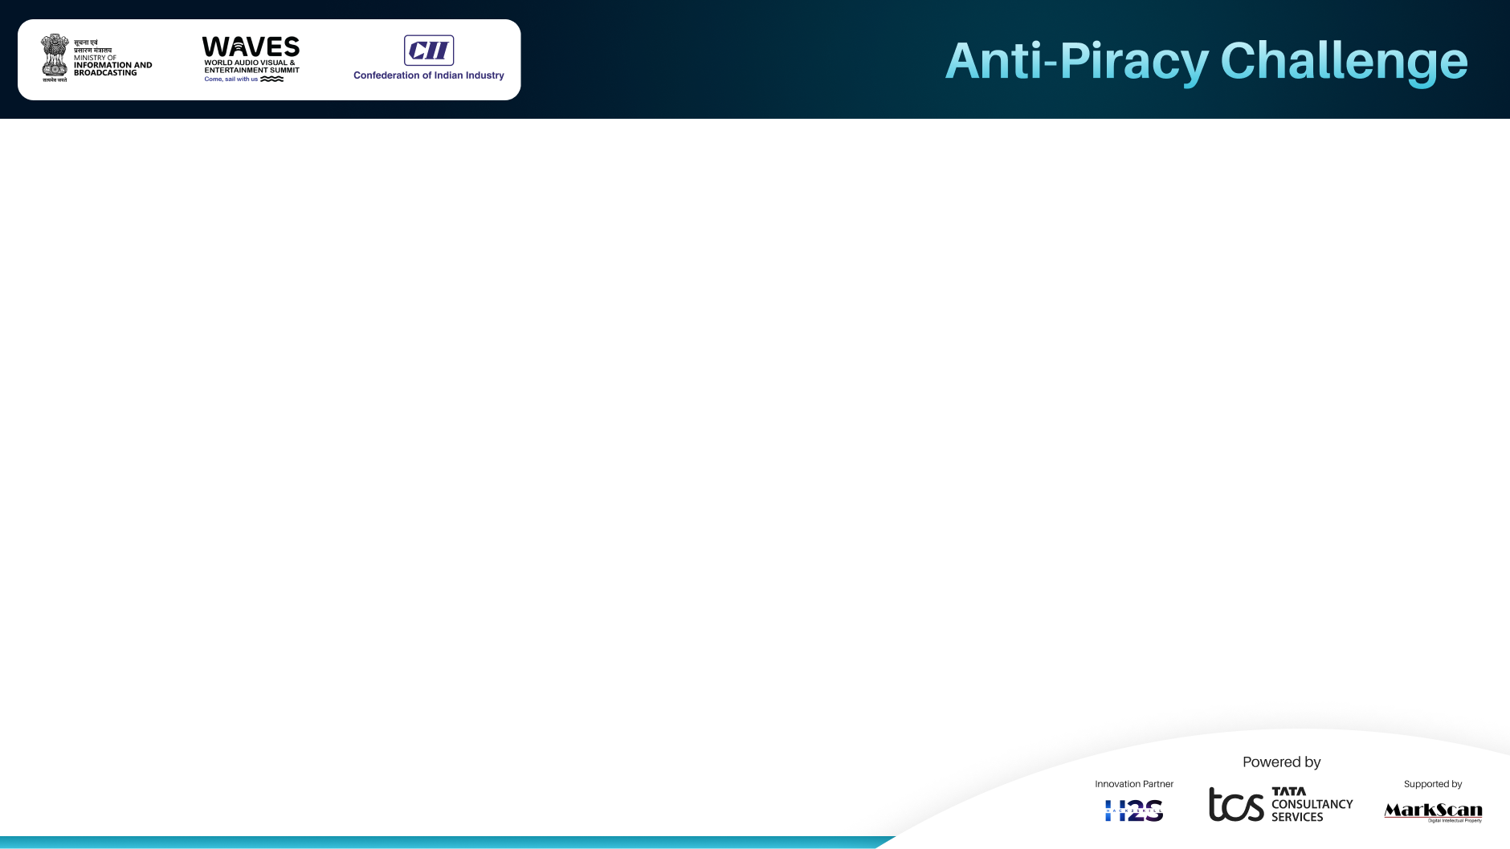
Executive Summary:
AI Audio Fingerprinting Detects pirated music even if altered (pitch, noise, tempo) using unique song fingerprints.
Real-Time Monitoring & Automation Scans YouTube, TikTok, Instagram, Telegram 24/7 and triggers DMCA takedowns or ad revenue diversion.
Protects Artists & Labels Restores control over content and recovers lost revenue through instant enforcement.
Key Aims & Contributions:
🎯 1. Eradicate Music Piracy: AI-based audio fingerprinting identifies and removes illegal copies (even altered ones) before they go viral.
⚙️ 2. Automate Copyright Protection: AI flags violations and enforces rights via DMCA takedowns or monetization redirection.
💰 3. Ensure Fair Compensation for Artists: Turn piracy into revenue: Claim ad earnings or licensing fees from unauthorized usage.
🛑 4. Block AI-Generated Deepfakes: Detect and block cloned voices or AI-generated tracks to protect artist identity.
🌍 5. Scalable Industry Standard: Ready for Spotify, YouTube, Apple Music — designed to set a universal anti-piracy benchmark.

Slide 3
Problem Statement:
Music Piracy & Revenue Loss:
The music industry faces billions in losses due to piracy and unauthorized distribution. Key issues include:
Illegal Downloads & Streaming – Songs are shared on torrent sites, illegal platforms, and Telegram, causing financial losses.
Unlicensed Use in Videos – Music is used on TikTok, YouTube, and ads without proper licensing, denying artists fair compensation.
AI-Generated Deepfake Songs – AI clones artist voices, creating fake songs that mislead audiences and harm reputations.
Ineffective Copyright Protection – Manual complaint-based systems fail to detect and remove illegal content swiftly.
Loss of Monetization – Unauthorized uploads and monetization divert revenue from rightful owners.
With $2.7 billion lost annually, an AI-driven, automated solution is essential to detect, track, and enforce copyright protection in real-time.

Slide 4
Proposed Solution
Technology Overview:
AI-powered audio fingerprinting for piracy detection.
Real-time scanning (YouTube, TikTok, Instagram, Telegram).
Blockchain-backed copyright for ownership protection.
Key Features:
🔍 AI Detection Detects altered tracks (pitch, tempo)
⚡ Real-Time Scan Monitors YouTube, TikTok, Telegram
⛓️ Blockchain Proof Immutable copyright records
Innovation & Impact:
Beyond Watermarking Detects altered tracks (pitch, speed, remixes) for stronger piracy protection.
AI-Powered Automation Zero manual effort: Instant detection, takedowns, and revenue recovery.
Industry-Wide Adoption Works with Spotify, YouTube, Apple Music to set a universal anti-piracy standard.

Slide 5
Implementation Plan
Development Timeline & Key Milestones
Finalize Scope & Requirements
System Design & Prototype
Develop Core Features & Test
Deploy & Train Users
System Testing & Bug Fixes
Resources & Technologies Required
📊 Data Sources: OpenSLR, GTZAN, FMA, YouTube, Spotify APIs
🤖 AI/ML Tools (Audio fingerprinting & deepfake detection): TensorFlow, PyTorch
⛓️ Blockchain (Copyright protection): Ethereum, Hyperledger
🌐 Backend & APIs(Real-time monitoring): Node.js, Django
🖥️ Frontend(Rights management dashboard): React.js, Next.js
☁️ Infrastructure(AI hosting & scalability): AWS, GCP
🔒 Security & Compliance: SSL, OAuth 2.0 & DMCA enforcement

Slide 6
Impact Assessment
Scalability and Relevance:
Cloud-Based AI | API-Driven System | Adaptive AI Models
Scalable deployment on AWS/GCP | Easy integration with streaming platforms | Learns new piracy techniques like deepfakes
Processes millions of scans | Works with emerging media | Evolves to detect emerging threats
Industry Outcomes & Benefits:
For Artists & Labels
Real-time piracy detection & revenue recovery.
Ownership verification via blockchain.
For Streaming Platforms
Enforces copyright compliance & minimizes piracy losses.
Builds trust with users and creators.
For Legal Enforcement
AI-powered takedowns & open blockchain records.
Swift legal action with reduced manual effort.

Slide 7
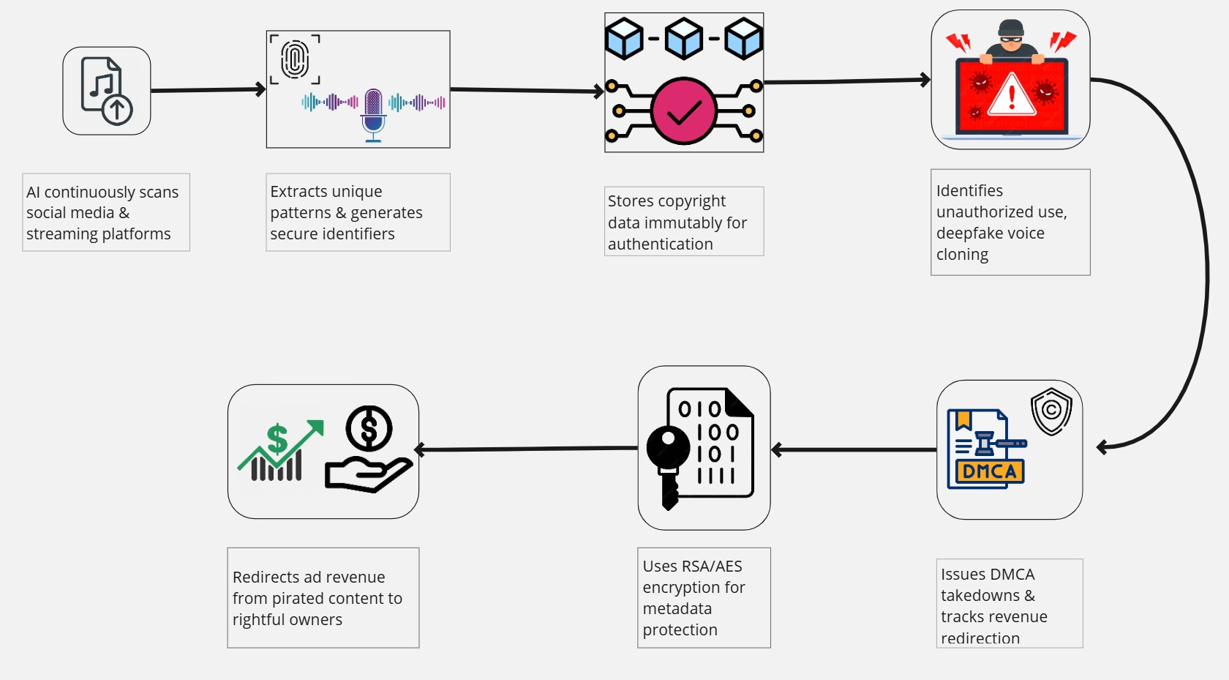
Flowchart

Slide 8
Team Profile
Team Name: AntiPiracyGuard
Team Members:
Members Name: | Role:
Santhosh P | AI/ML Developer
Vimal Sridhar K | Blockchain Developer
Parthasarathy M | Backend Developer
Aravind R | Frontend Developer
Shanthosh K | Full Stack Developer

Slide 9
