Slide 1

Team Name: Team NPC
Email:pecec516@gmail.com
Participant Name: Hitesh Kumar S & Priyadharsan S
Phone number: +91-7395844483

Slide 2
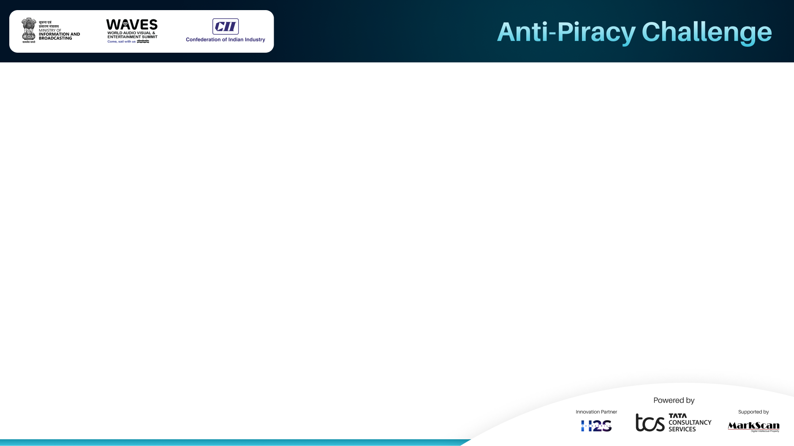
Executive Summary :
APK modding threatens Android app security, intellectual property, and user safety. Current solutions like static checks and server-side verification are easily bypassed. To combat this, we propose a comprehensive anti-modding framework combining blockchain technology , advanced integrity checks , and dynamic server-side verification .
New Stacks :
Tamper Detection : Dynamic, obfuscated checks to detect unauthorized modifications.
Secure Key Management : Hardware-backed storage and key rotation to protect cryptographic keys.
Blockchain Integration : Immutable record of app integrity hashes to prevent tampering.
Adaptive Server-Side Response : Multi-factor authentication and real-time threat mitigation.
This solution raises the complexity and cost of modding, protecting developers' assets and users from malicious apps. It is scalable across industries like gaming, fintech, and healthcare, offering a new standard for app security .

Slide 3
Problem Statement :
Problem Statement
APK modding has become a widespread issue, enabling attackers to bypass weak security measures like static integrity checks and server-side verification. These vulnerabilities allow unauthorized modifications, reverse engineering, and redistribution of tampered apps.
Specific Anti-Piracy Issue Addressed
The core issue is unauthorized app modifications : Attackers exploit weak security to alter app functionality, steal intellectual property, and distribute pirated or malicious versions. This not only harms users (via malware and fraud) but also undermines developers through revenue loss and reputational damage.

Slide 4
Proposed Solution :
Revolutionizing APK Security
A ground breaking solution that integrates Blockchain, dynamic integrity checks, and adaptive server-side verification to effectively fight modding attacks.
Why It's Unique Immutable Blockchain Anchoring securely anchors application integrity hashes on a blockchain for tamper-evident verification. Dynamic Obfuscation & Anti-Tampering : Runtime detection of modifications through dynamic obfuscation.
Adaptive Threat Response : Smart system to respond adaptively to identified attacks.
Key Features: In-device protections include root detection, anti-debugging measures, and hardware-backed key storage. Blockchain integration : It keeps cloned or tampered APKs at bay by using device fingerprinting. Secure Server-Side Checks : Multi-factor authentication and anomaly detection for robust defence.
Impact Makes modding expensive and impractical for attackers. Safeguards developers' IP and revenue while providing user safety.

Slide 5
Implementation Plan :
Development Timeline & Key Milestones :
Phase 1: Research & Design (Month 1-2)
Goal : Define scalable architecture and cost-effective blockchain integration.
Outcome : Blueprint for a modular, future-proof solution.
Phase 2: Core Development (Month 3-5)
Goal : Build MVP with tamper-proof verification and AI-driven obfuscation.
Outcome : Functional prototype ready for pilot testing.
Phase 3: Testing & Optimization (Month 6-7)
Goal : Validate security and performance under real-world conditions.
Outcome : Optimized solution with minimal latency and high reliability.
Phase 4: Deployment & Scaling (Month 8+)
Goal : Launch pilot with select APKs and gather user feedback.
Outcome : Ready-to-market product with proven ROI.
Resources & Technologies :
Required Tools : Cost-efficient Blockchain (e.g., Hyperledger), TensorFlow Lite for lightweight AI, and Android Studio.
Business Value ROI : Reduces revenue loss from modding by 90% and increases user trust.
Scalability : Modular design allows easy integration into existing apps.
Market Edge : Positions developers as leaders in app security and innovation.

Slide 6
Impact Assessment :
Scalability and Applicability
Cross-Industry Adoption: Framework applicable to gaming, fintech, e-commerce, and healthcare apps.
Device Compatibility: Works on all Android devices, with enhanced security for hardware-backed key storage (e.g., Google Pixel, Samsung Knox).
Blockchain Flexibility: Compatible with public/private blockchains, ensuring scalability for small-to-large enterprises.
Dynamic Adaptation: Modular design allows integration into existing apps without major overhauls.
Expected Outcomes
Robust Anti Modding : Prevents APK tampering through advanced obfuscation, root detection, and blockchain-anchored integrity checks.
Immutable Audit Trail: Blockchain ensures tamper-proof verification of app integrity, deterring sophisticated attacks.
Enhanced Security Standards: Establishes a new benchmark for app protection, safeguarding intellectual property and user data.
Benefits for the Industry
Cost Savings: Reduces financial losses from piracy, cheating, and fraud.
User Trust: Protects users from malicious modified apps, improving brand reputation.
Competitive Edge: Empowers developers with cutting-edge security, fostering innovation in secure app development.
Future-Proofing: Adaptable to emerging threats with dynamic server-side responses and AI-driven updates.
Key Takeaway: A game-changing solution that combines blockchain, advanced integrity checks, and adaptive security to revolutionize app protection and set new industry standards.

Slide 7
Team Profile
Member 1 :
Name : Priyadharsan S
Role : Lead Developer / Solution Architect
Expertise :
Android app development and reverse engineering defense mechanisms.
Blockchain integration and cryptographic security protocols.
Proficient in Java, Kotlin, and smart contract development.
Member 2 :
Name : Hitesh Kumar S
Role : Security Specialist / Backend Engineer
Expertise :
Server-side security, multi-factor authentication, and adaptive response systems.
Key management strategies and hardware-backed security solutions.
Experienced in Python, AIML, Node.js, and cloud infrastructure

Slide 8
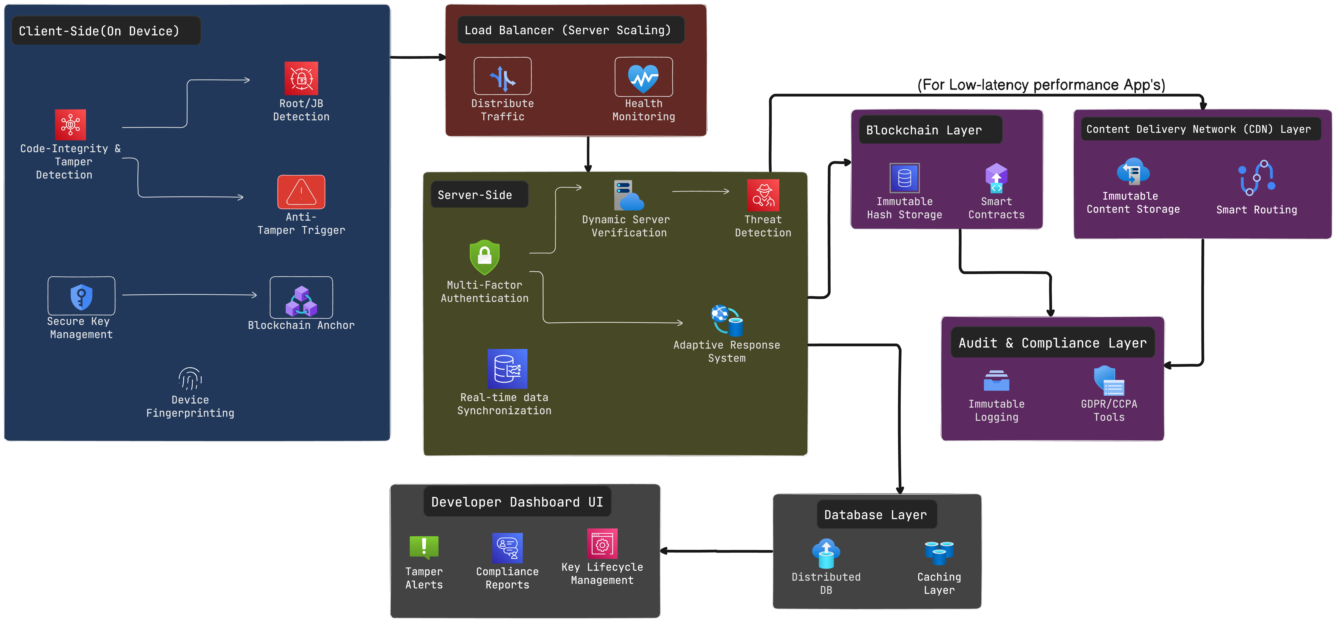
System Architecture Diagram

Slide 9


