Slide 1
b10110 Retrospective Planning
ENGR xD52
Eric VanWyk
Fall 2014

Slide 2
Today
Reminder: Final Projects
Mp3 Checkin
An Olin Tradition
Focused review of material to date

Slide 3
Initial Project Proposal
Project Name
Team Members
1-3 paragraphs description of project
Red / Yellow / Green Feature sets
2 potential things that can go wrong, with mitigations
What are your two next steps?
1-2 Pages Total
Due Wednesday after Turkeys Get Ate

Slide 4
MP3 Checkin
Work Plan updates were very sparse!
We use these
Confusion Points:
Deliverable 4: Millions of Instructions Per Second
Memory Map
Ending Execution

Slide 5
Ending Execution
EXTREMELY rare to actually end execution
OS regains control in typical scenario
Exceptions:
This Lab
Error situations
Interruptible Waits

Slide 6
Ending Execution: Ignore It
main:
#do stuff
j end
other_functions:
#more stuff
end:

Slide 7
Ending Execution: Fall off the End
main:
#do stuff
j end
other_functions:
#more stuff
end:
MARs:
-- program is finished running (dropped off bottom) --

Slide 8
Ending Execution: Fall off the End
main:
#do stuff
j end
other_functions:
#more stuff
end:
MARs:
-- program is finished running (dropped off bottom) --
ModelSim:
Executes the rest of memory like it was code

Slide 9
Ending Execution: Jump Trap
main:
#do stuff
j end
other_functions:
#more stuff
end:
j end
MARs:
Runs forever
ModelSim:
Doesn’t Execute the rest of memory like it was code

Slide 10
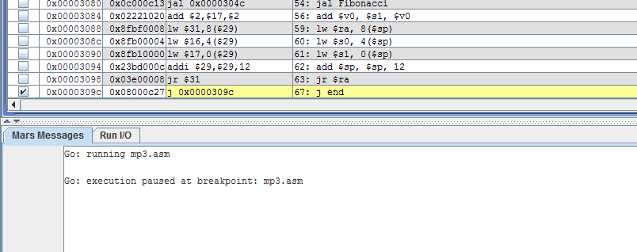
MARS Breakpoints

Slide 11
Ending Execution: Syscall 10
main:
#do stuff
#end
li $v0, 10
syscall
other_functions:
#more stuff
MARs:
-- program is finished running --
ModelSim:
No idea what Syscall is

Slide 12
Ending Execution: Syscall 10
main:
#do stuff
#end
li $v0, 10
syscall
other_functions:
#more stuff
MARs:
-- program is finished running --
ModelSim:
No idea what Syscall is
WHY $v0?!?!?!? BFYTW

Slide 13
Ending Execution: $stop
If you’d like, use $stop to make debugging easier
Not required
Maybe $stop when the decoder sees syscall?
FANCY SCHMANCY

Slide 14
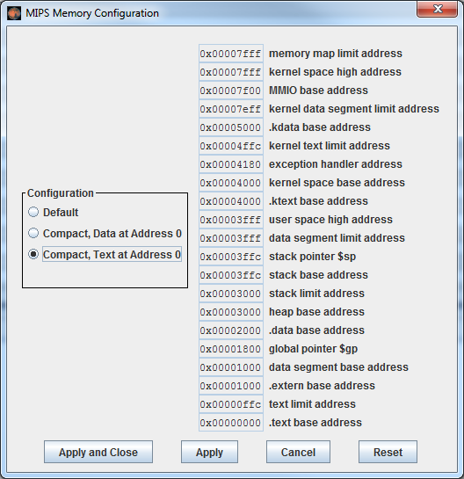
Memory Map

Slide 15
Memory Map
Defines how data memory is split up and used
We care about:
Stack pointer
Program Counter
Memory Size(s)
Memory Location(s)

Slide 16
Memory Map: Stack Pointer
Initialize in your own code explicitly
li $sp 0x3ffc
Starts at top of data
0x3ffc
=0x4000-4 (word size)
Ends at 0x3000
Hopefully

Slide 17
Memory Map: Program Counter
Initialize in Verilog
Initial pc=0
“Text” means code
Starts at 0
Ends at 0x1000 (-4)

Slide 18
Memory Map: Size
Compact is 0x4000
Highest of:
User Space
Stack
Heap
Data
Text

Slide 19
Memory Map: Size
Compact is 0x4000
BYTES
16kB

Slide 20
An Olin Tradition
We are hopping in the way-back machine
To a simpler time
To a time of innocence and confusion
Welcome to 2004

Slide 21
Retrospective
Deep look back in to the course
For personal review
For the good of the next class
Generate two distinct deliverables
Outline of Main Ideas for review
Hindsight tweaks to the course flow

Slide 22
Organization
In teams, select specific lecture(s)
Organize at: http://goo.gl/HKwjft
First pass:
Clean slides for errors
Put answers to prompts in the “notes” section
Or as duplicate slides at the end of the deck
Put comments on effectiveness in the “notes”
Example: [Eric ‘07] – Confused by XYZ, perhaps try __?
comparch14@gmail.com [Retrospective] Deck Title

Slide 23
Second Pass
Create an outline for lessons learned
Collaboratively: http://goo.gl/HKwjft
Include:
Main ideas
Vocabulary
Reference links
Suggestion: Do this in a separate doc to avoid edit-time conflicts of 25 people

Slide 24
Third Pass
Prepare a 5 minute wrap-up lecture
Speech & Whiteboard, PPT not necessary
Intended Audience:
Took CompArch 5 years ago
Just got a new job that uses Topic X
Needs to bone up real fast
These will happen Thursday

Slide 25
Thursday
Recreate board work for first 30 minutes
Take photos of results
Take notes of what makes sense now that didn’t before
Give prepared lightning lectures

Slide 26
By Monday
Read http://www.emulators.com/docs/pentium_1.htm
Skim / skip the assembly
Take with a grain of Salt
Just that page, don’t continue to part 2
Is the Pentium 4 really that bad?
What happened in the 14 years in between?
Did Intel learn from its mistakes?
Were they actual mistakes?
What more do you want to know?
We will discuss in class.

