Slide 1
Designing A Highly Available Service

Slide 2
Agenda
Create an application and design that will insert a timestamp into a database following a curl request.
The design should consist of at least a single web-application and a single database.

Slide 3
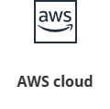


Technologies Used
AWS
Terraform
Azure DevOps

Slide 4
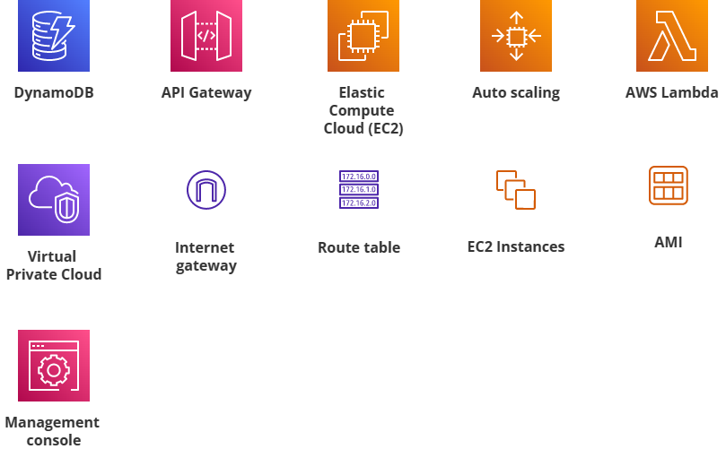
AWS Services Used
EC2 instance
DynamoDB
Lambda Function
API Gateway
Load Balancer
To make system highly available.
Auto-Scaling
To make system scalable.

Slide 5
System Architecture

Slide 6
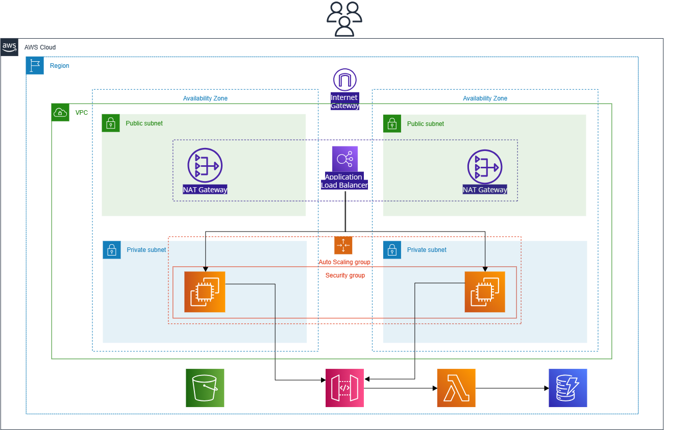

Slide 7
Thank You.

