Slide 1

Luke DeRuyter ilukester@anzhelka.com
Cody Lewis srlm@anzhelka.com

Slide 2
The Problem:
It's difficult to film extreme sports
  Mountain biking
  Snowboarding/skiing
  Cross country running
  White water rafting

Slide 3
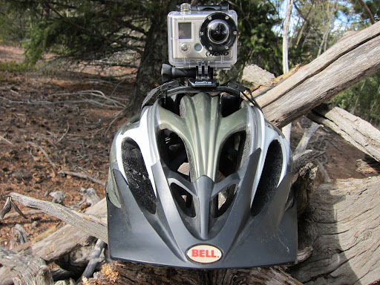
Helmet mounted GoPro Camera

Slide 4
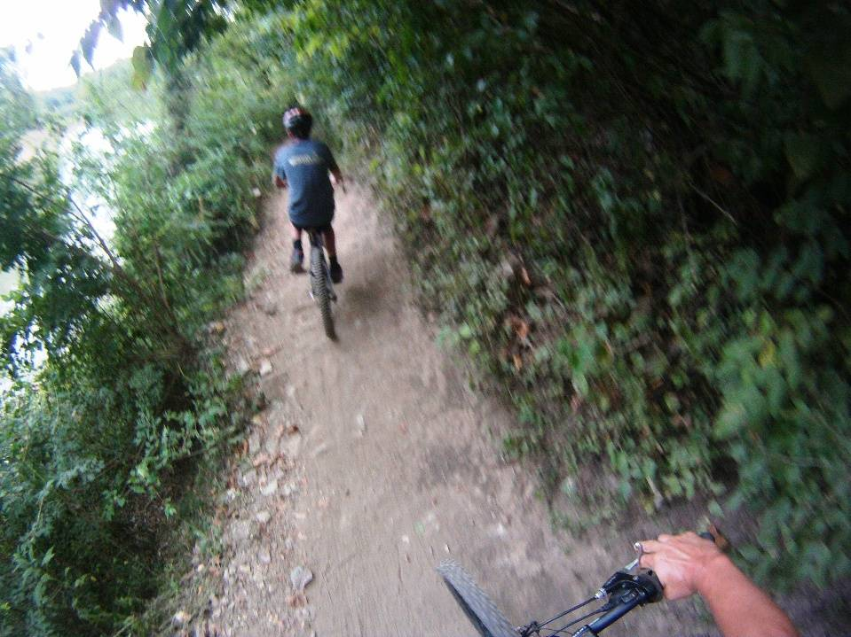
Poor focus, blurriness, and distortion

Slide 5
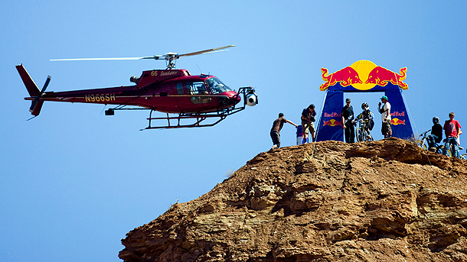
Traditional Options
Helmet cameras get boring fast
Cameramen along the path are no good
A vehicle might work...
  But is expensive

Slide 6
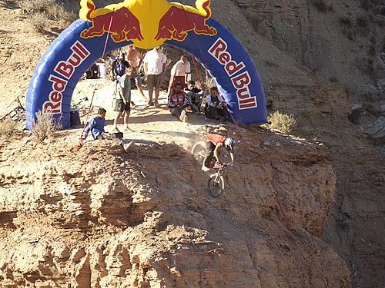
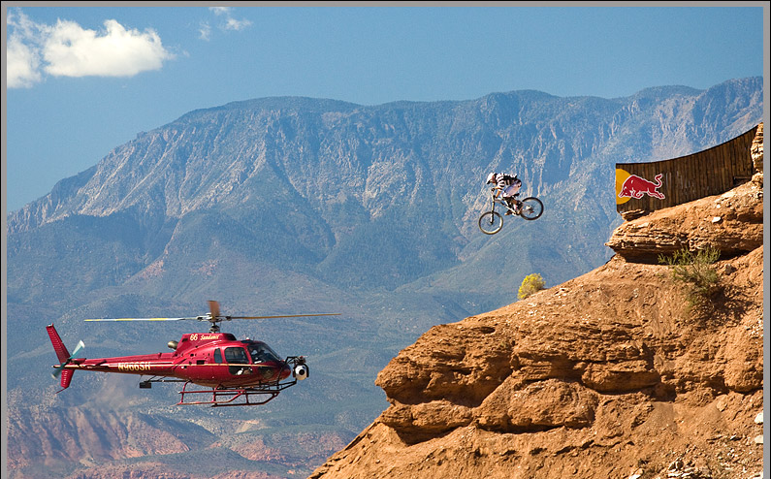

Slide 7
Quadrotor Advantages
A quadrotor can
  Fly closer to the athelete
  Operate at lower costs
  Be more portable and available
  Carry large payloads

Slide 8
Goal
Create a fully programmable aerial quadrotor that is autonomous, stable, and controllable

Slide 9
Ancilliary Goals
Create stable quadrotor platform
Use Parallax P8X32A for low level control
Be completely open source, from hardware to software
Have extensive and up to date documentation on all aspects

Slide 10
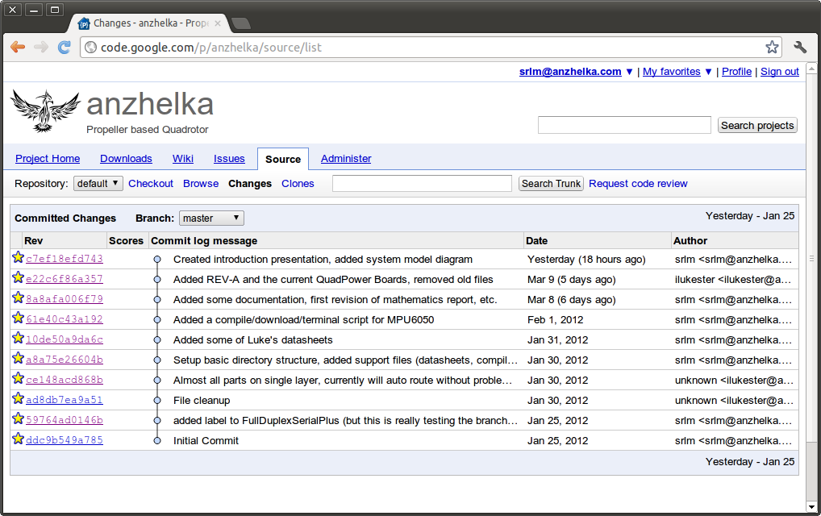
Open Online Repository

Slide 11
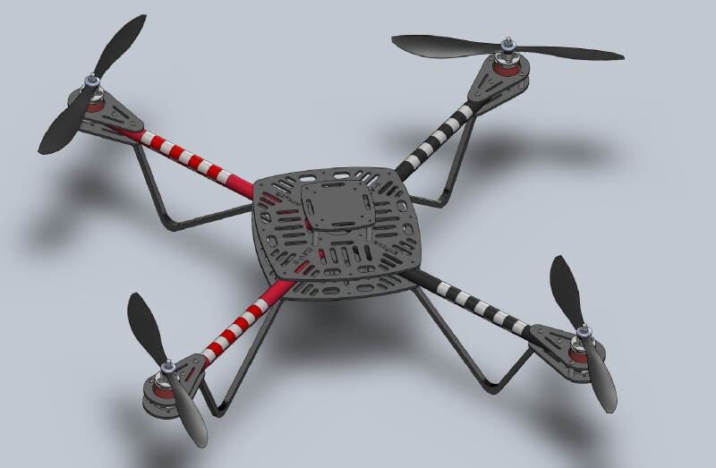
Open Hardware
Parallax Elev-8

Slide 12
Open Costs
Supplier | Name | Unit | Qty | Total
Parallax | Altimeter | $29.99 | 1 | $29.99
Parallax | Protoboard USB | $29.99 | 1 | $29.99
Parallax | Propeller Chip QFP | $7.99 | 1 | $7.99
Parallax | 64KB EEPROM | $1.99 | 1 | $1.99
Parallax | 5 MHz Crystal | $1.10 | 1 | $1.10
Sparkfun | Radio Modem UM96 | $44.95 | 2 | $89.90
Hobby King | 450 Outrunner Motor - Trinigy | $14.04 | 4 | $56.16
Hobby King | 30A ESC | $5.99 | 4 | $23.96
Hobby King | 3S 30C 1000mAh Battery | $8.99 | 1 | $8.99
Hobby King | 3S 30C 8000mAh Battery | $44.11 | 1 | $44.11
Hobby King | Deans XT Plugs (10 pairs) | $3.08 | 2 | $6.16
Hobby King | 12 AWG 1 meter wire BLACK | $2.49 | 3 | $7.47
Hobby King | 12 AWG 1 meter wire RED | $2.49 | 3 | $7.47
!McMaster-Carr | 5/8" Aluminum Tubing 6' | $16.38 | 1 | $16.38
!McMaster-Carr | 3/32" Delrin 24"x48" | $70.67 | 1 | $70.67
!McMaster-Carr | 1/4" Delrin 12"x12" | $27.87 | 1 | $27.87
!McMaster-Carr | 4-40 5/8" Standoff | $0.46 | 12 | $5.52
Amazon | Optima 7 RC Receiver | $58.04 | 1 | $58.04
DIY Drones | Propellers 10x4.5 1 push 1 pull | $6.00 | 2 | $12.00
Pololu | CHR-UM6-LT IMU Sensor | $149.99 | 1 | $149.99
$655.75 per quadrotor

Slide 13
Specific Technical Goals
Maintain pitch/roll/yaw to desired angle
Traverse to desired position
Carry a payload of small video camera
Be able to yaw/tilt payload

Slide 14
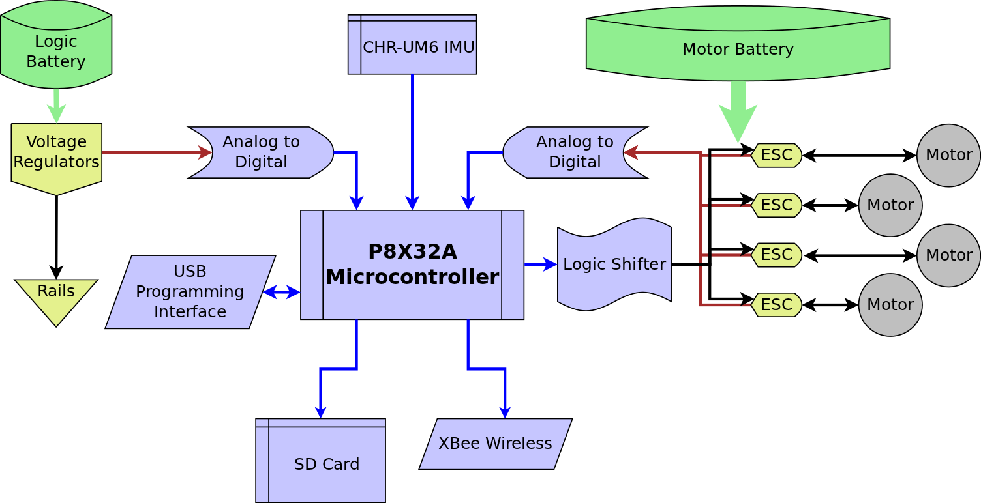
System Architecture

Slide 15
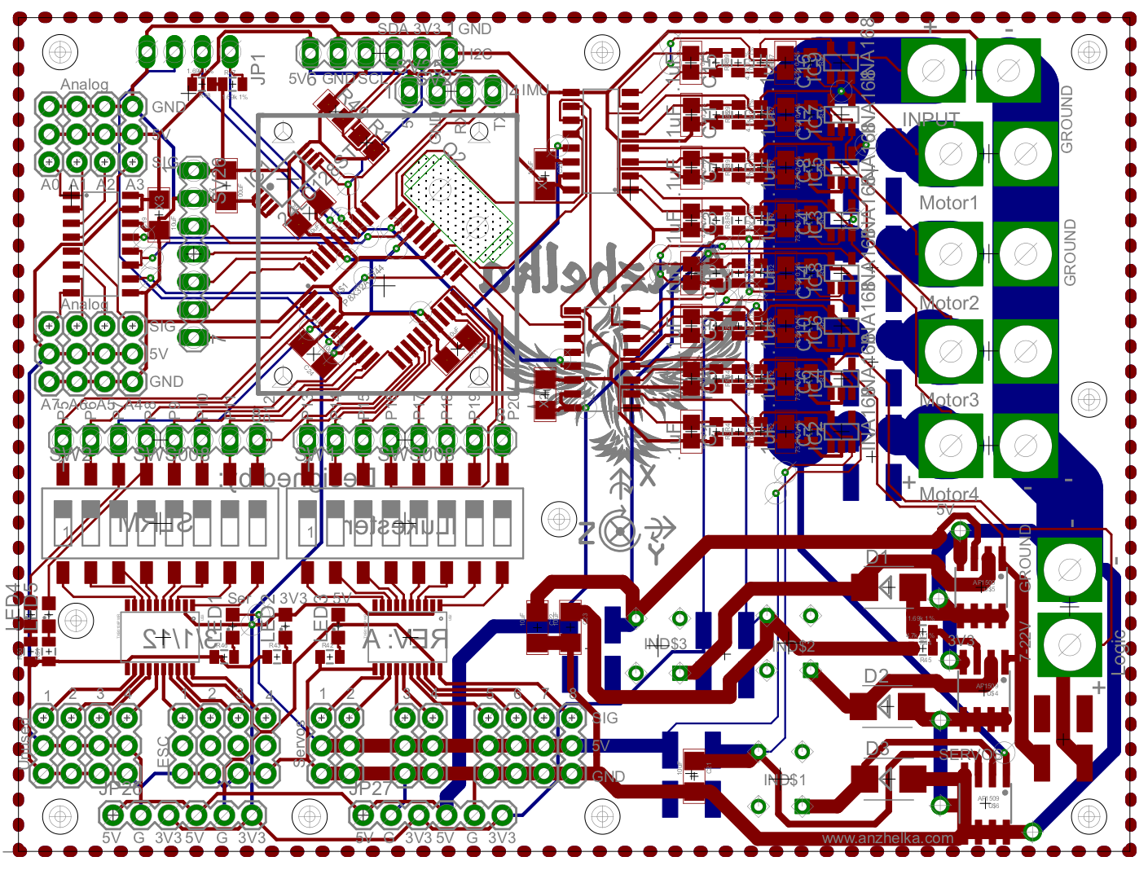
Rev A PCB

Slide 16
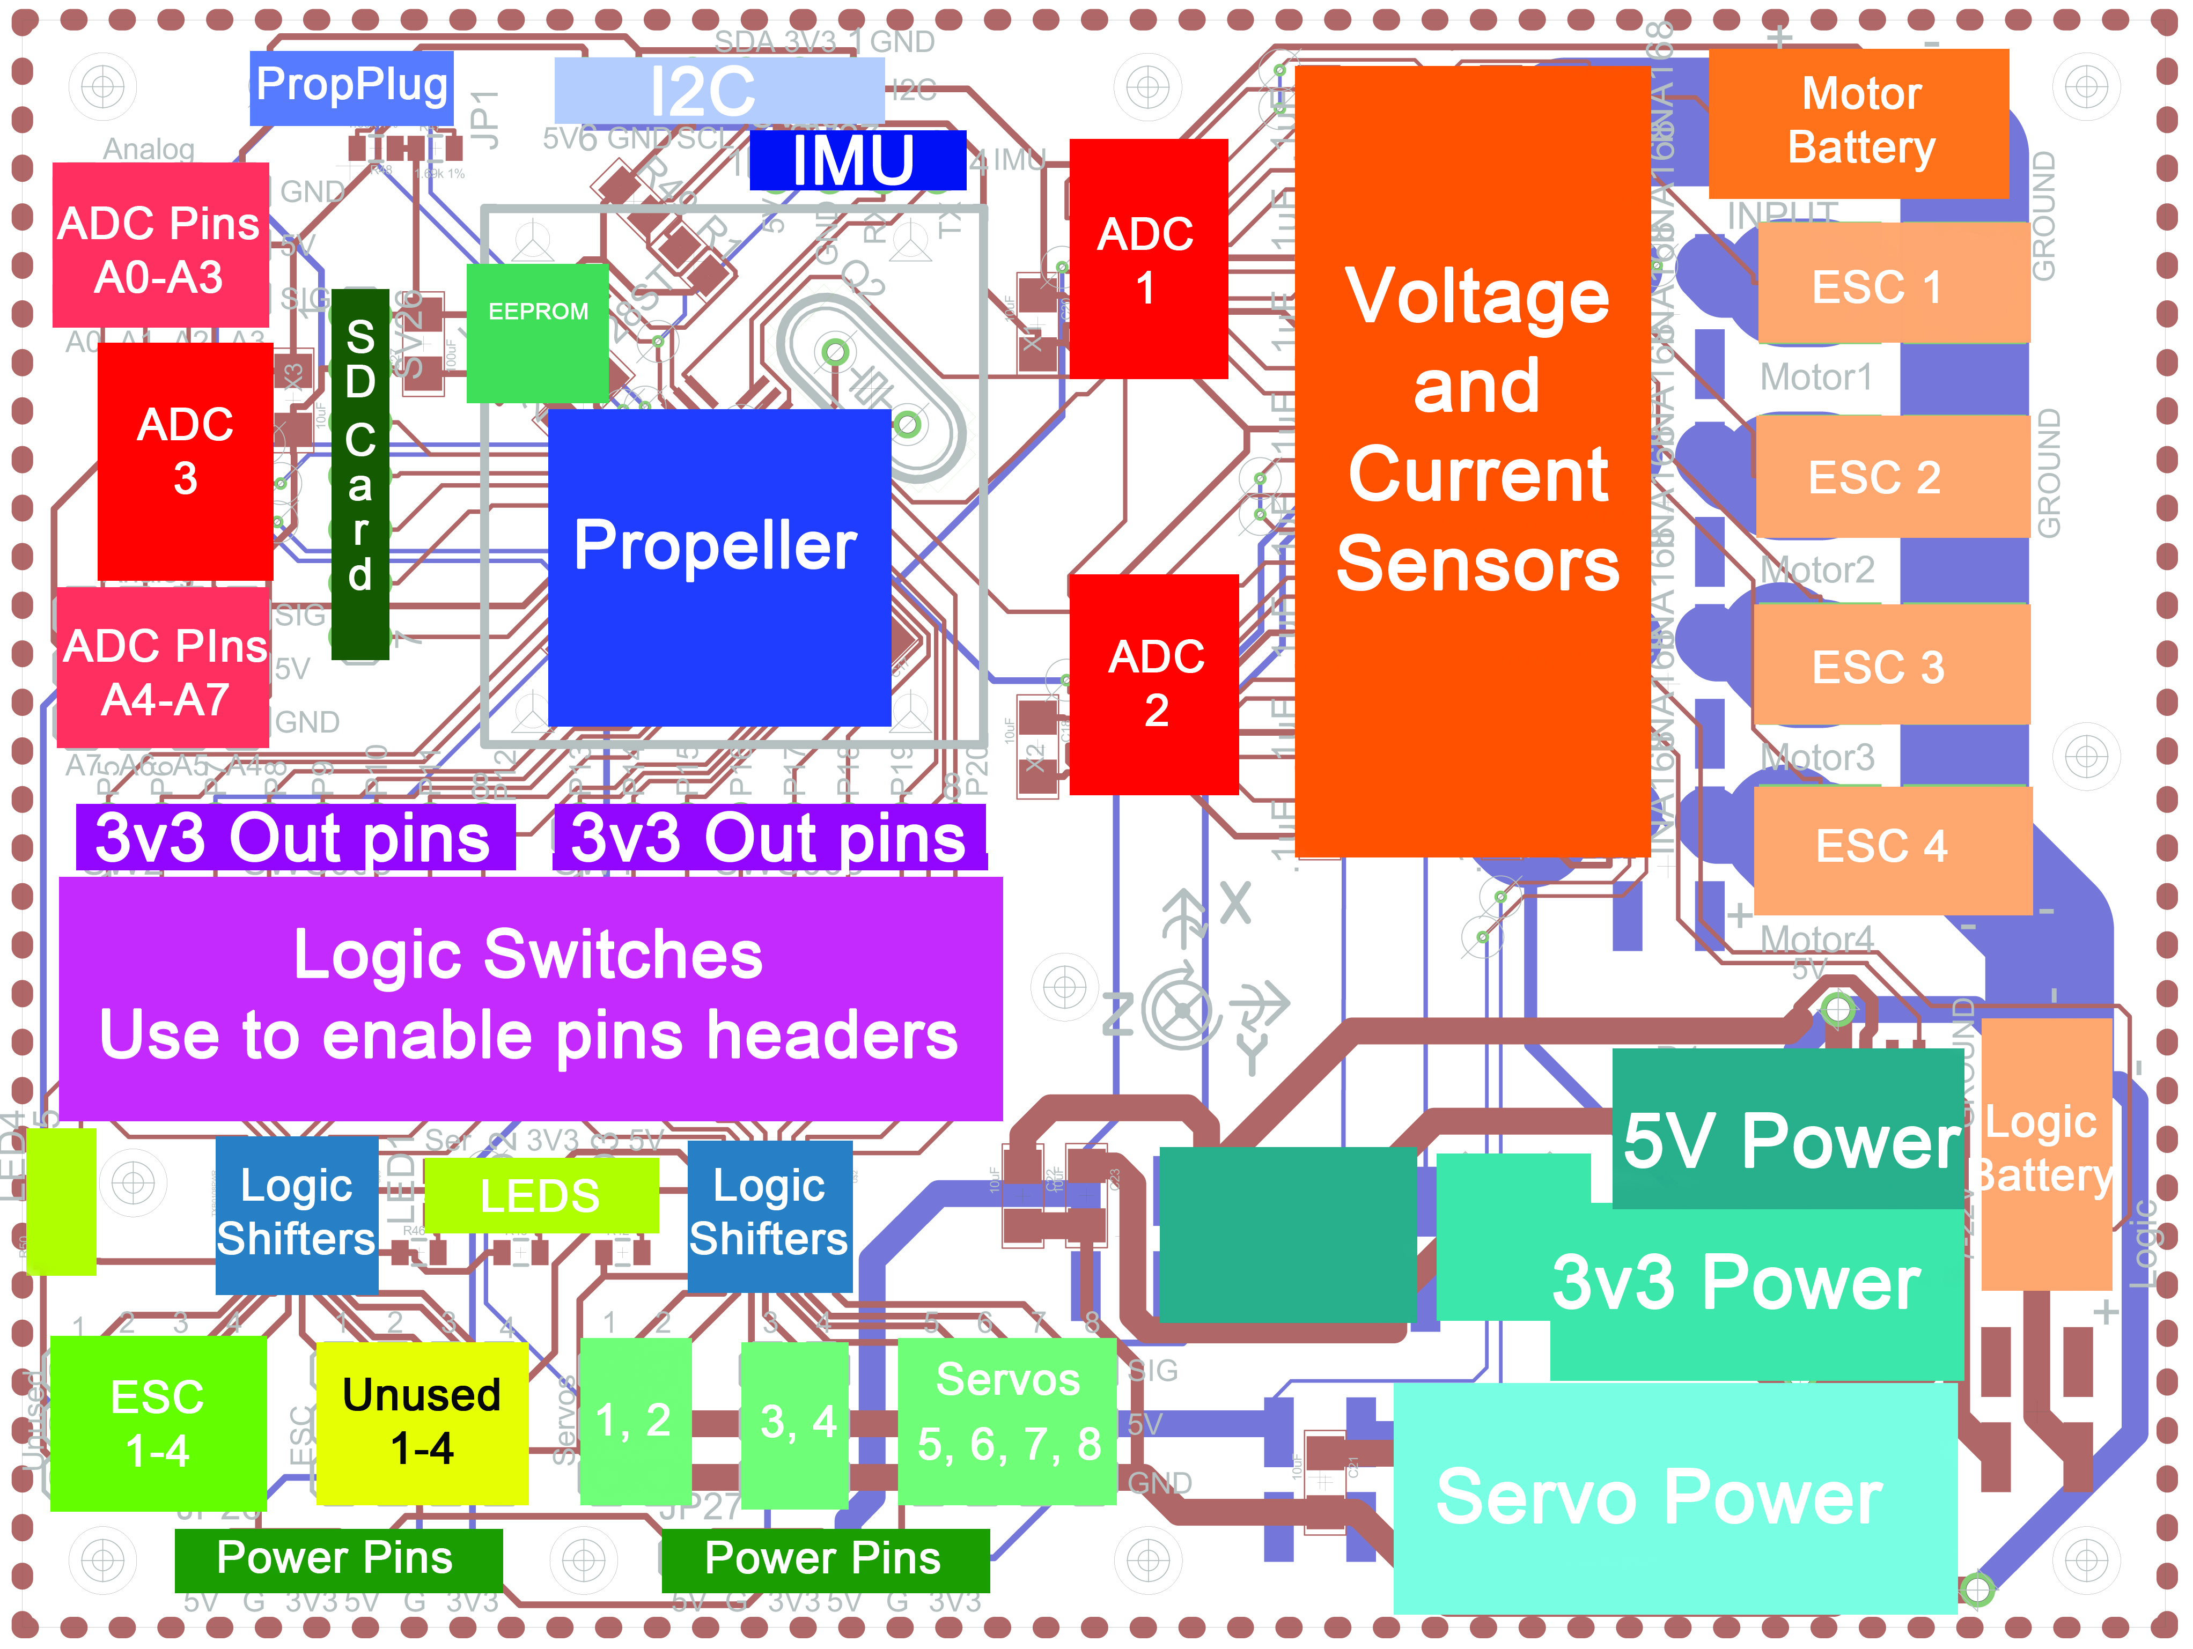
Rev A Overlay

Slide 17
Features
Propeller Multicore Processor
Buck regulators for 5v (x2) and 3.3v
Level shifting for up to 24 I/O lines
Voltage and current sensing for
  Motors, 5v and 3.3v rails
8 free analog channels
Mounting accommodations for
  SD card, IMU, Quickstart, BoE formfactor
Servo and I/O 3 wire headers (WRB)

Slide 18
Tasks
http://www.jasondavies.com/wordcloud/#
Test~Motors
Test~Motors
Design~PCB
Design~PCB
Populate~PCB
Populate~PCB
Select~Frame
Select~Frame
Build~Frame
Build~Frame
Research~Control~Algorithms
Select~Hardware
Select~Hardware
Write~Drivers
Write~Drivers
Code~Algorithm
Develop~Motor~Test~Stand
Create~Project~Management
Document~Project
Document~Project
Anzhelka
Anzhelka
Anzhelka
Anzhelka
Anzhelka

Slide 19
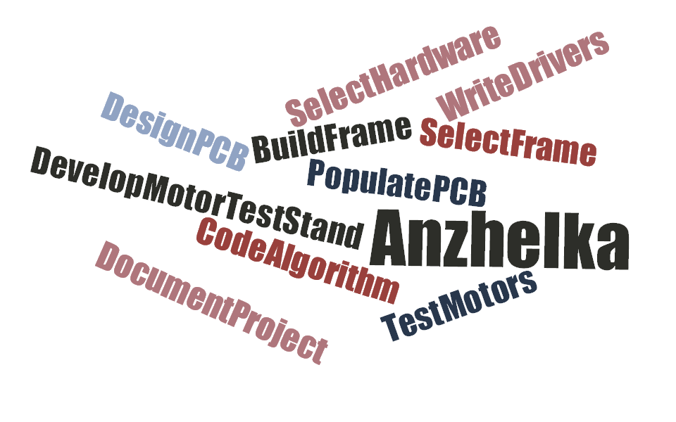
Tasks
Joint effort on all tasks
No arbitrary division of labor

Slide 20
Design Considerations
Realistic constraints
Industry Standards
Time/Skills
Cost effectiveness
Resources

Slide 21
Testing
Motor thrust/torque
Attitude Measurement
Attitude Error
Roll/Pitch
Yaw
Altitude

Slide 22
Technical Challenges
Quadrotors have a hard realtime computational requirement
High current motors require special precautions
System-wide part compatibility and interfacing
Being able to stop a out of control flying object

Slide 23
Summary of progress
Designed control loops for autonomous Hover
Designed main control board (Rev A)
Developed motor test stand and roll pitch test stand
Designed and implemented project management
Designed Custom Terminal

Slide 24
Anzhelka Serial Protocol
Two way communication to the Propeller
A standardized serial communication
$ADXXX - Anzhelka Data
$ACXXX - Anzhelka Command
Over 20 Data Strings Available

Slide 25
Anzhelka Terminal
Graph up to 4 Data Variables at a time
Send variables to the Propeller for tunning
Emergency Stop
Written in Python
  Cross Platform (Windows, Linux)

Slide 26
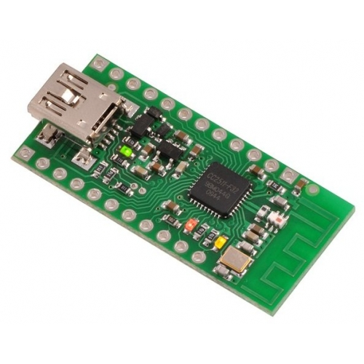
Wireless
Wireless Programming
Wireless Data Transmission

Slide 27
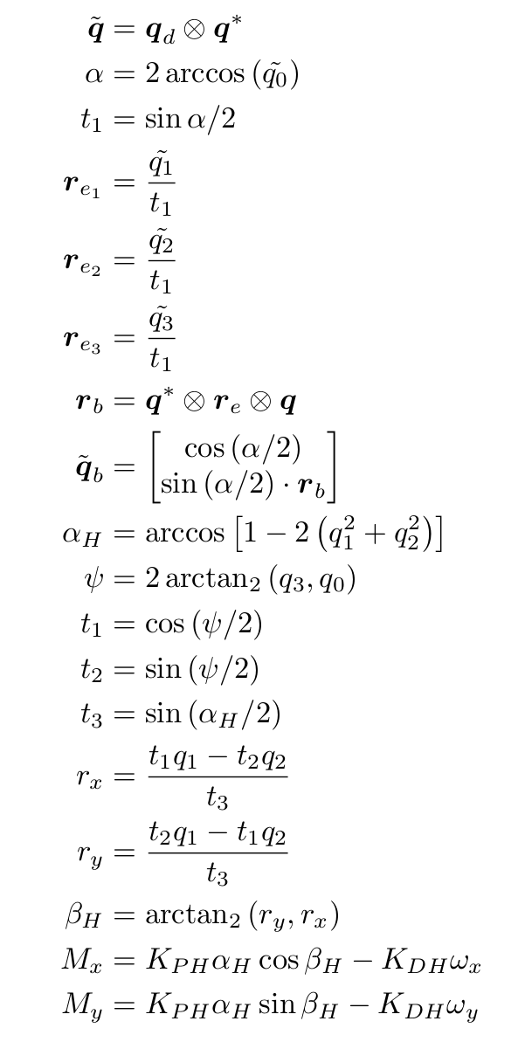
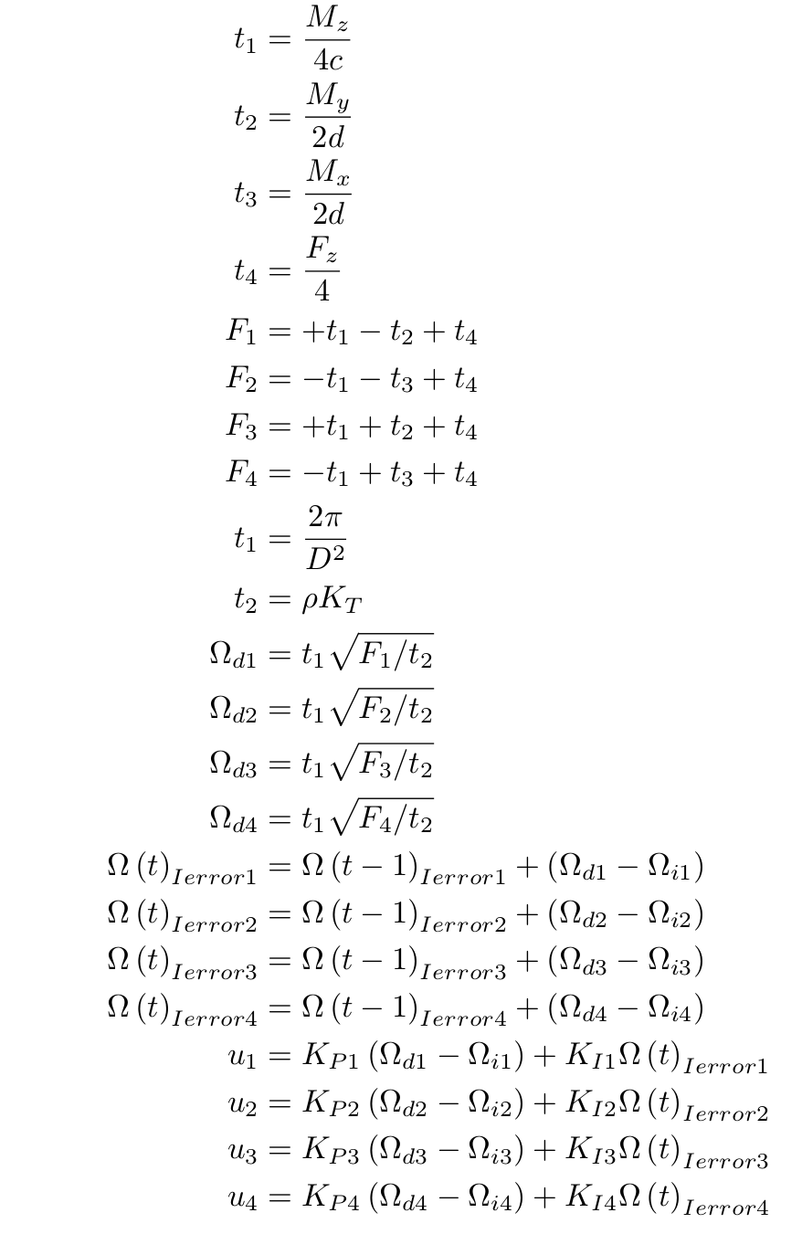
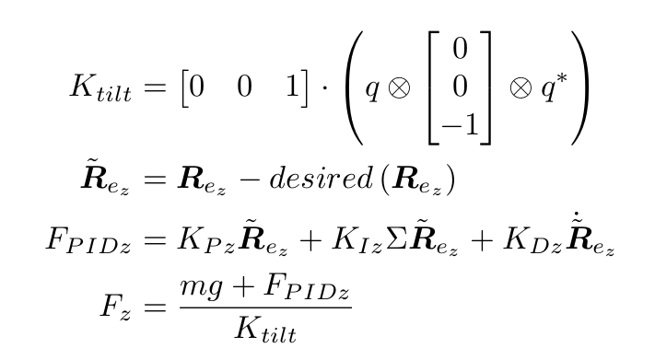
Quadrotor Mathematics

Slide 28
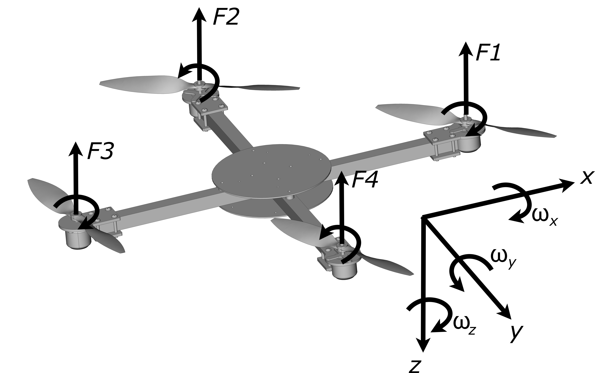
Body Reference

Slide 29
Quaternion Mathematics
Avoid gimbal lock
Smaller memory requirements (4 floats)
More efficient mathematical operations
Smooth interpolation between orientations.
No trigonometric functions for orientation updates

Slide 30
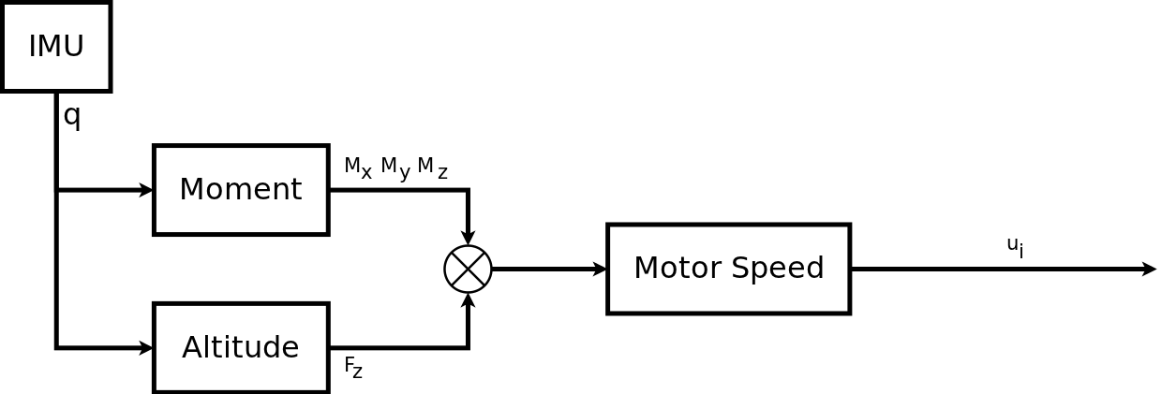
Control Loop Flow
Executed at a hard 50Hz

Slide 31
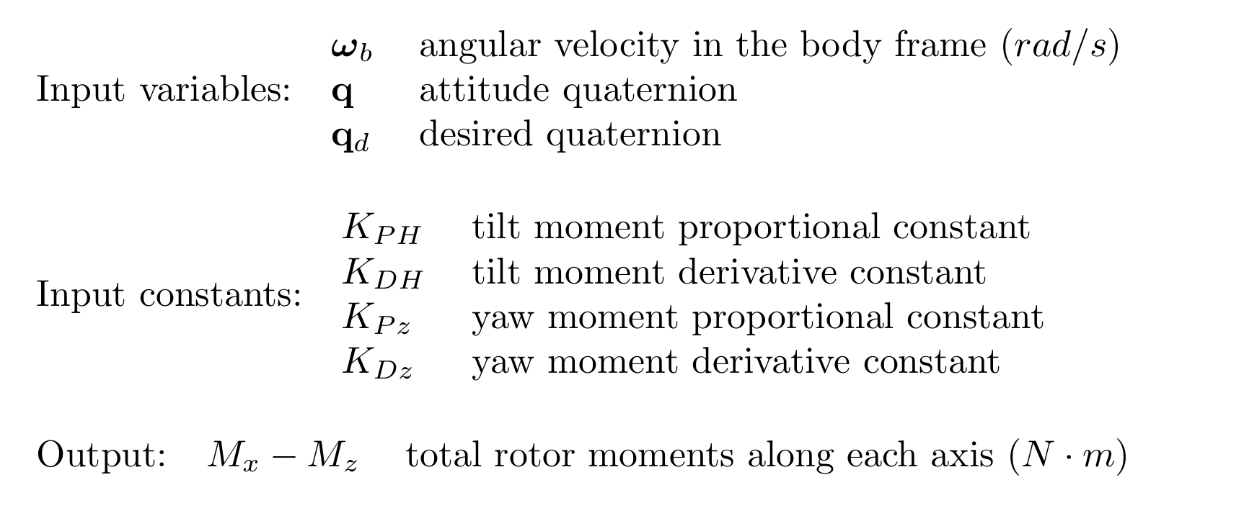
Block: Moment

Slide 32
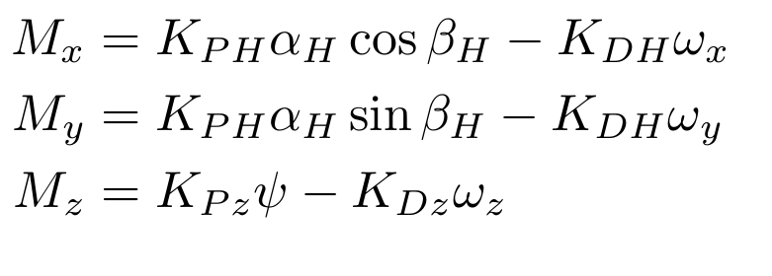
Moment PID

Slide 33
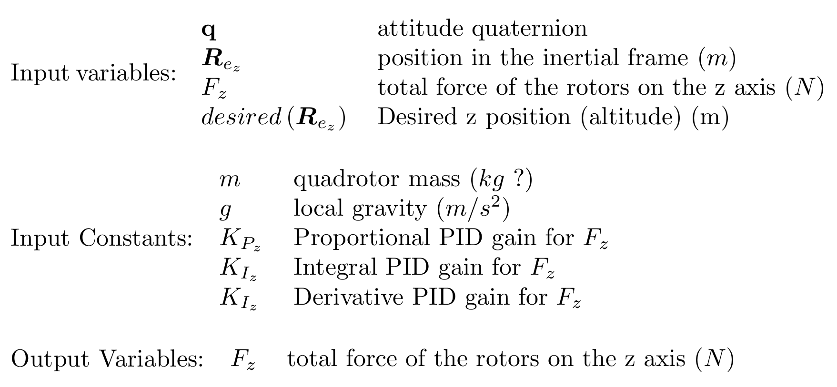
Block Altitude

Slide 34
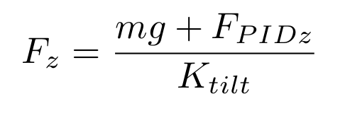
Motor PID
Maps to the total thrust required
Adjusts for mass of vehicle
Adjusts for the tilt of the system

Slide 35
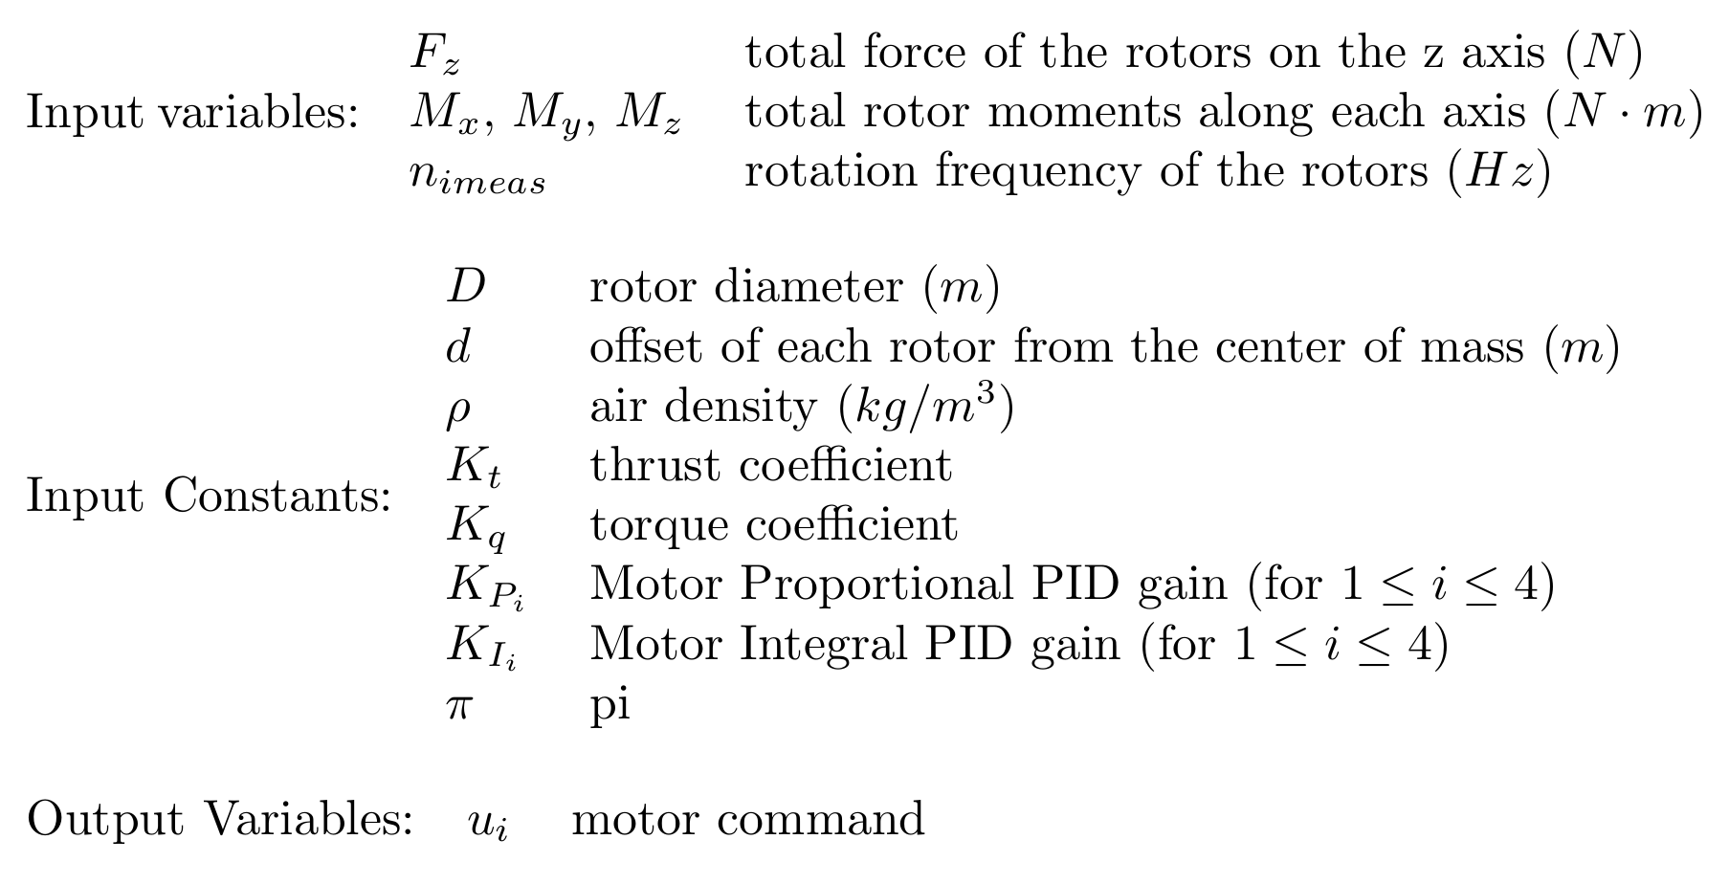
Block: Motor

Slide 36
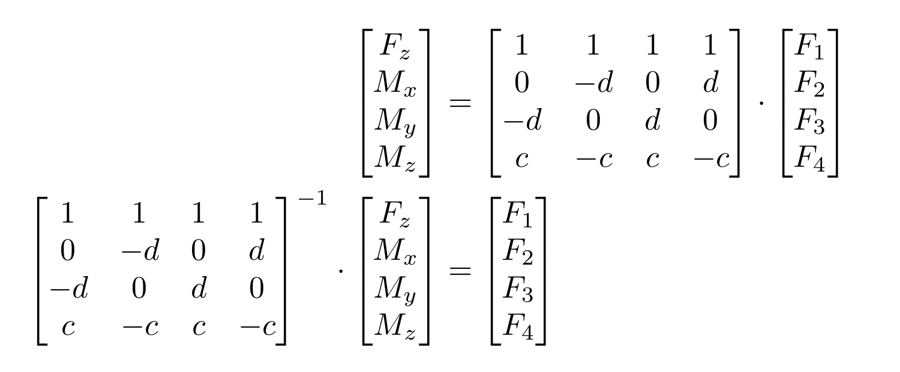
Control Matrix
Rewritten twice to solve for two variables
Main control equation of quadrotor attitude

Slide 37
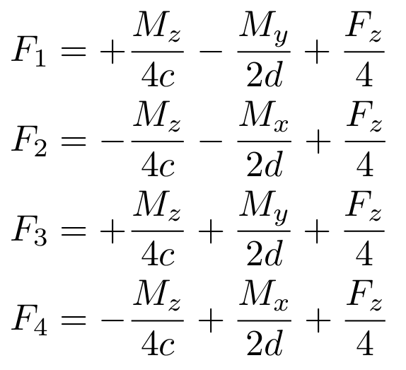
Control Matrix Simplified
Previous matrix multiplied out
Relation between signs and motor rotation direction

Slide 38
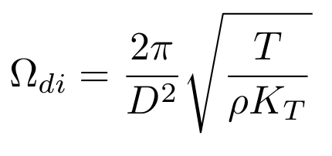
Force to Rotational Speed
Converts desired thrust T to motor speed
Note the effect of the square root

Slide 39
Quadrotor Dynamics
Dynamics – Study of cause of motion
Kinematics – Study of motion, ignoring cause

Slide 40
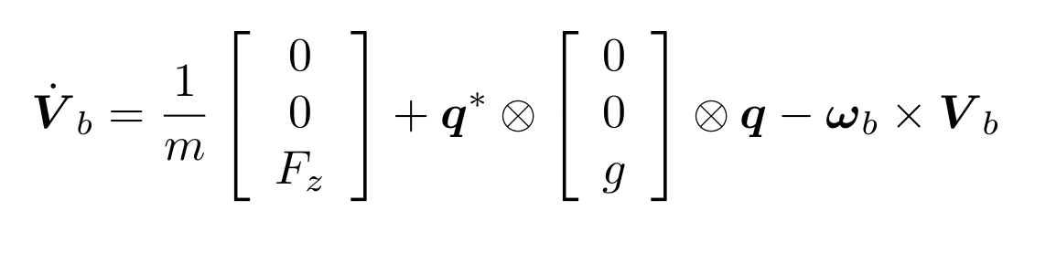
Body Translation
High school physics: F = ma
Acceleration due to
  Thrust
  Gravity (rotated)
  Fictitious forces

Slide 41
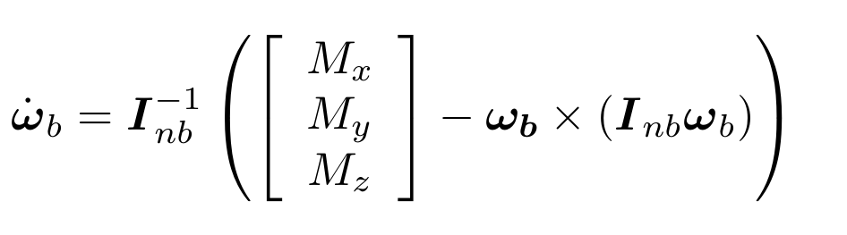
Body Rotational Motion
Similar to translation equation
Rotation due to
  Moments
  Fictitious forces

Slide 42
Specific Hardware
Propeller
Brushless Motors
Eagle Tree Sensors
IMU

Slide 43
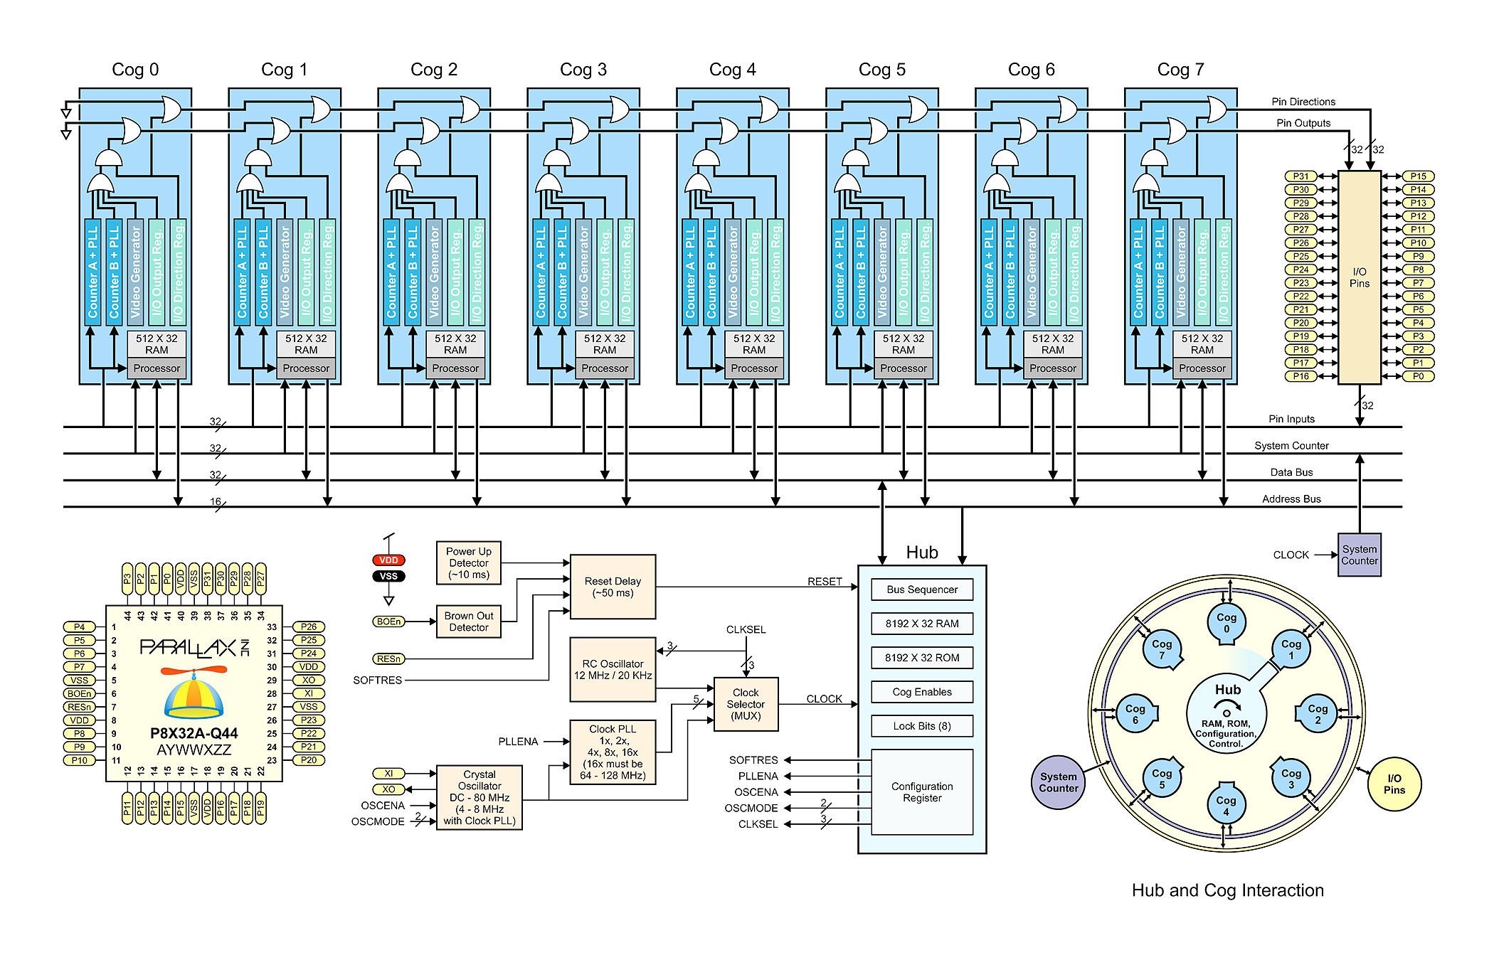
Propeller Microcontroller

Slide 44
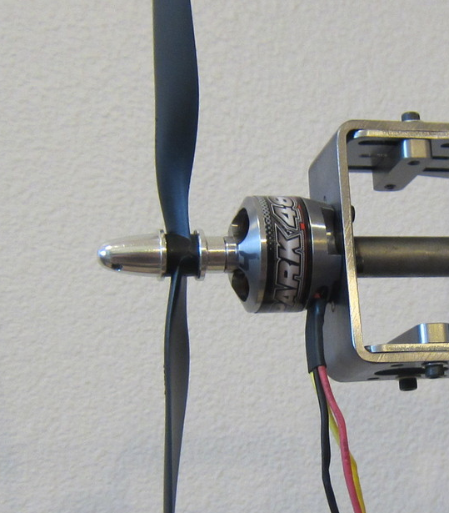
Brushless Motors

Slide 45
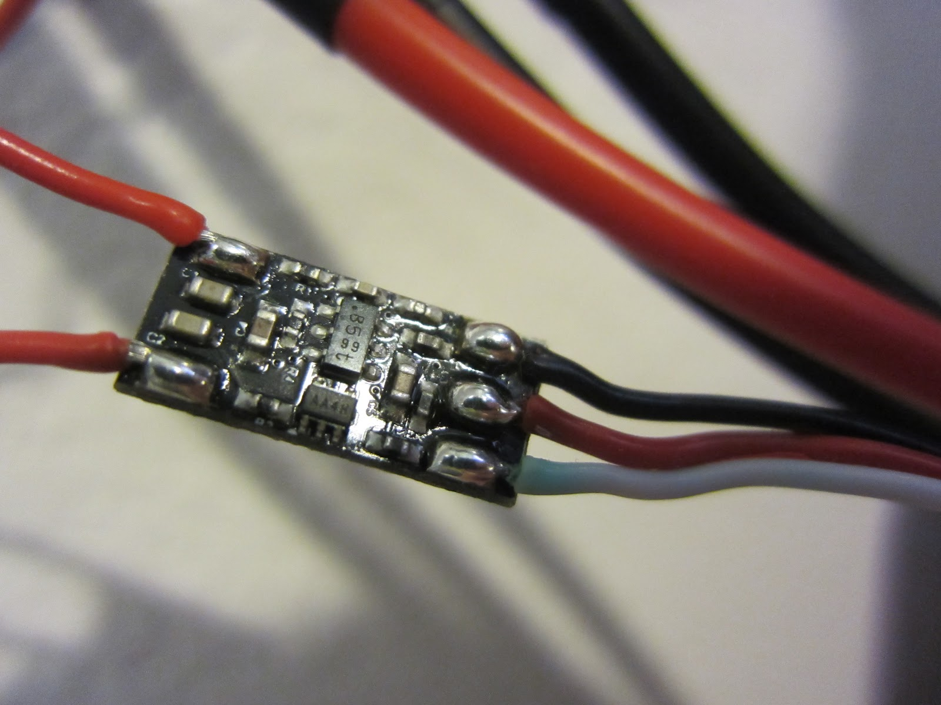
Eagle Tree
Measures BLDC control pulses

Slide 46
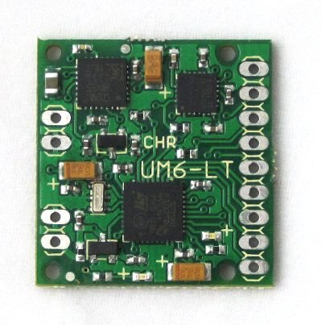
Inertial Measurement Unit
9 axis of measurement
  3 Gyro
  3 Accelerometer
  3 Magnetometer
Onboard Extended Kalman Filter

Slide 47
Next Steps
Compute PID constants
Achieve Stable Hover
Achieve Altitude Lock

Slide 48
Acknowledgement
Laser Cutting: Rich Harman(W9GFO)
Machining: Dale Holtkamp and Gene Sherman
Algorithms: Frank Lewis and Emanuel Stingu
Design: Dr. Brisk, Dr. Liang, Dr. Kastner, Tom Wypych, Dr. Chomko
Workshop: Elmar Palma
Components: TI, Microchip
Other: Mr. McBroom (Luke)

Slide 49

Conclusion

Slide 50
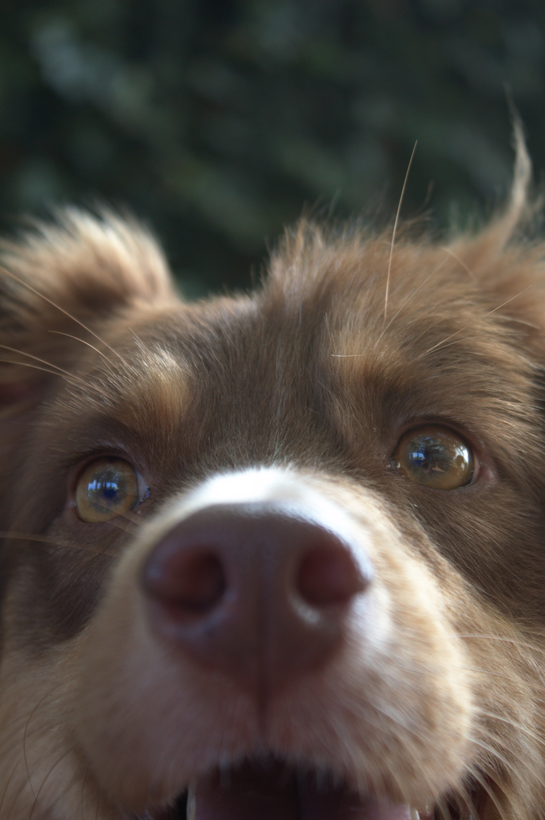
Questions?

