Slide 1

Luke DeRuyter ilukester@anzhelka.com
Cody Lewis srlm@anzhelka.com

Slide 3
The Problem:
It's difficult to film extreme sports
  Mountain biking
  Snowboarding/skiing
  Cross country running
  White water rafting

Slide 4
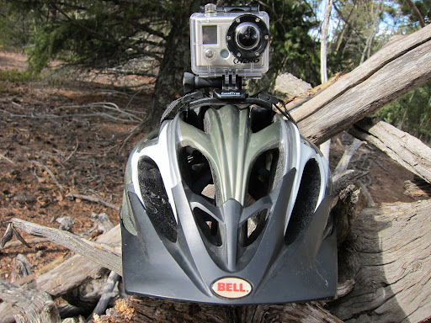
Helmet mounted GoPro Camera

Slide 5

Note the poor focus, blurriness, and distortion

Slide 6
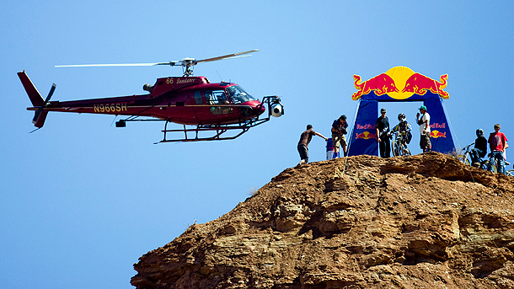
Traditional Options
Helmet cameras get borring fast
Cameramen along the path are no good
A vehicle might work...
  But is expensive

Slide 7

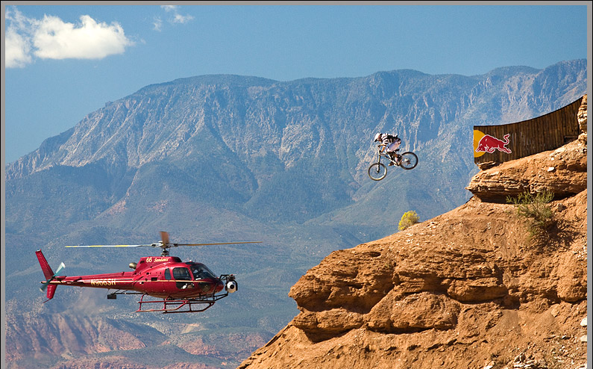

Slide 8
Quadrotor Advantages
A quadrotor can
  Fly closer to the athelete
  Operate at lower costs
  Be more portable and available
  Carry large payloads

Slide 9
Goal
Create a fully programmable aerial quadrotor that is autonomous, stable, and controllable

Slide 10
Specifically:
  Maintain pitch/roll/yaw to desired angle
  Traverse to desired position
  Carry a payload of small video camera
  Be able to yaw/tilt payload

Slide 11
Architecture

Slide 12
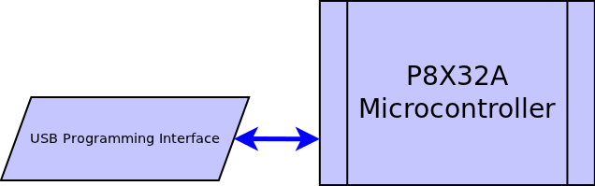

Slide 13
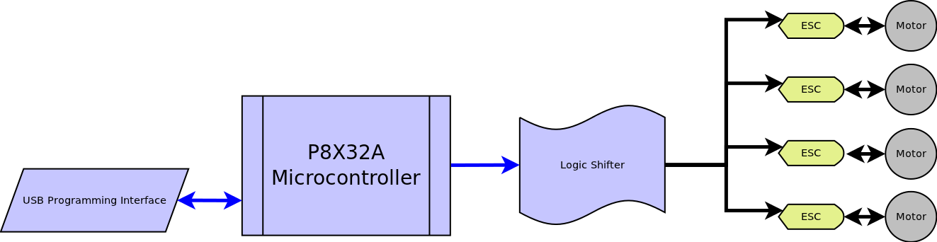

Slide 14
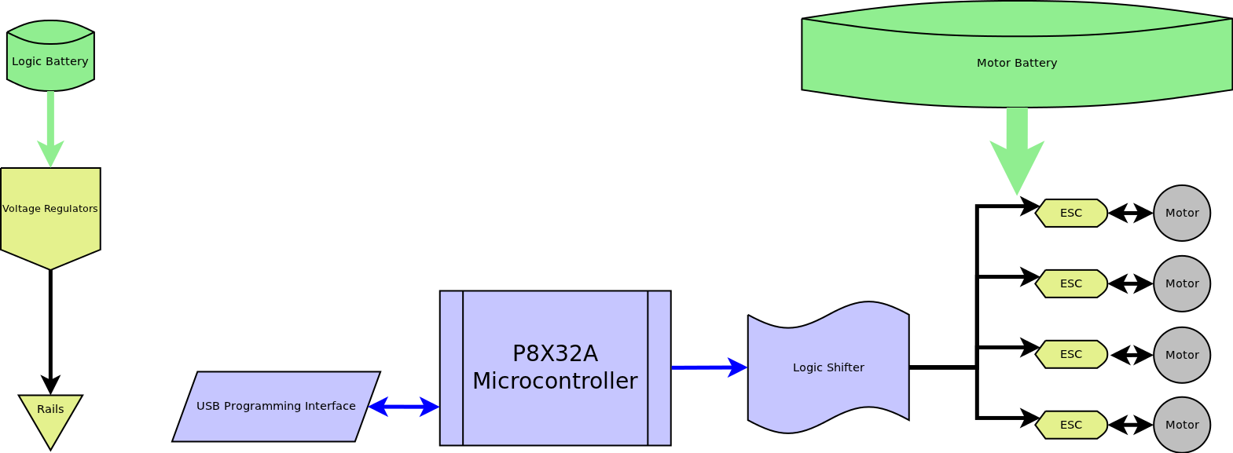

Slide 15
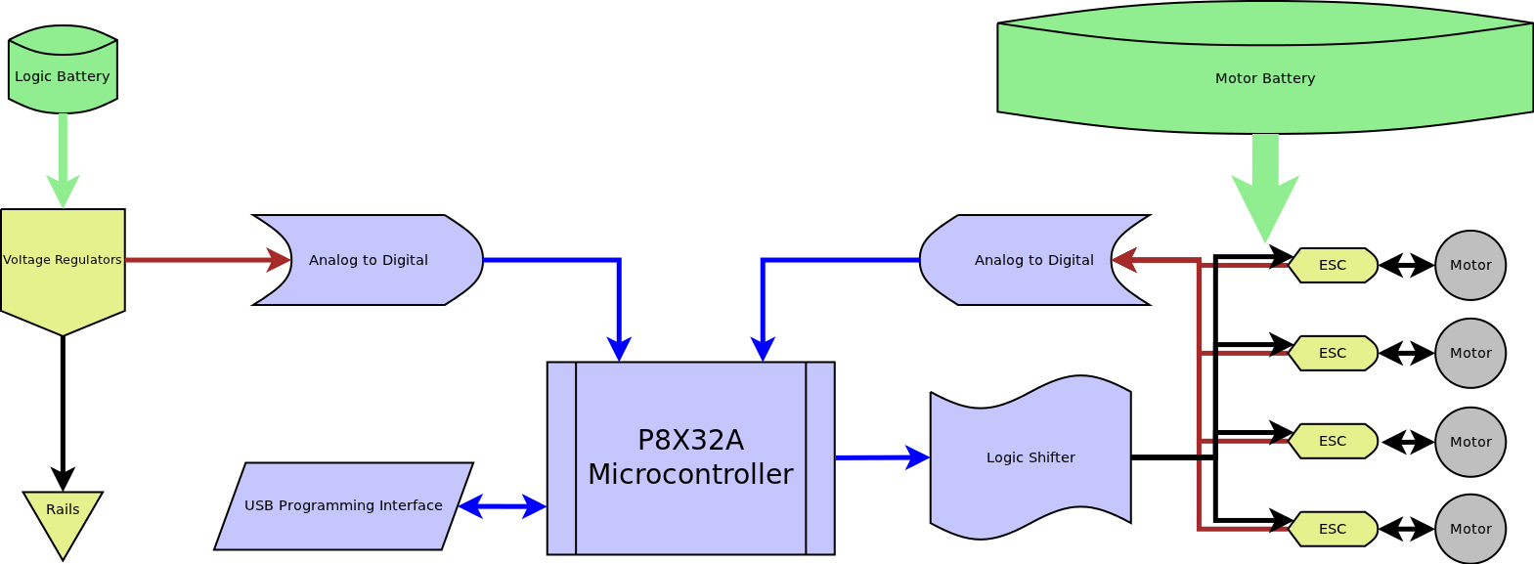

Slide 16
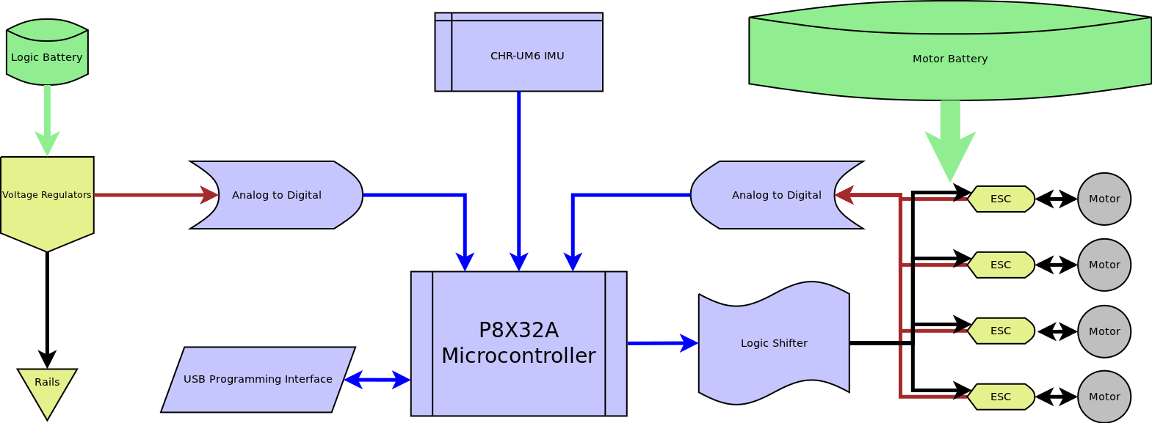

Slide 17
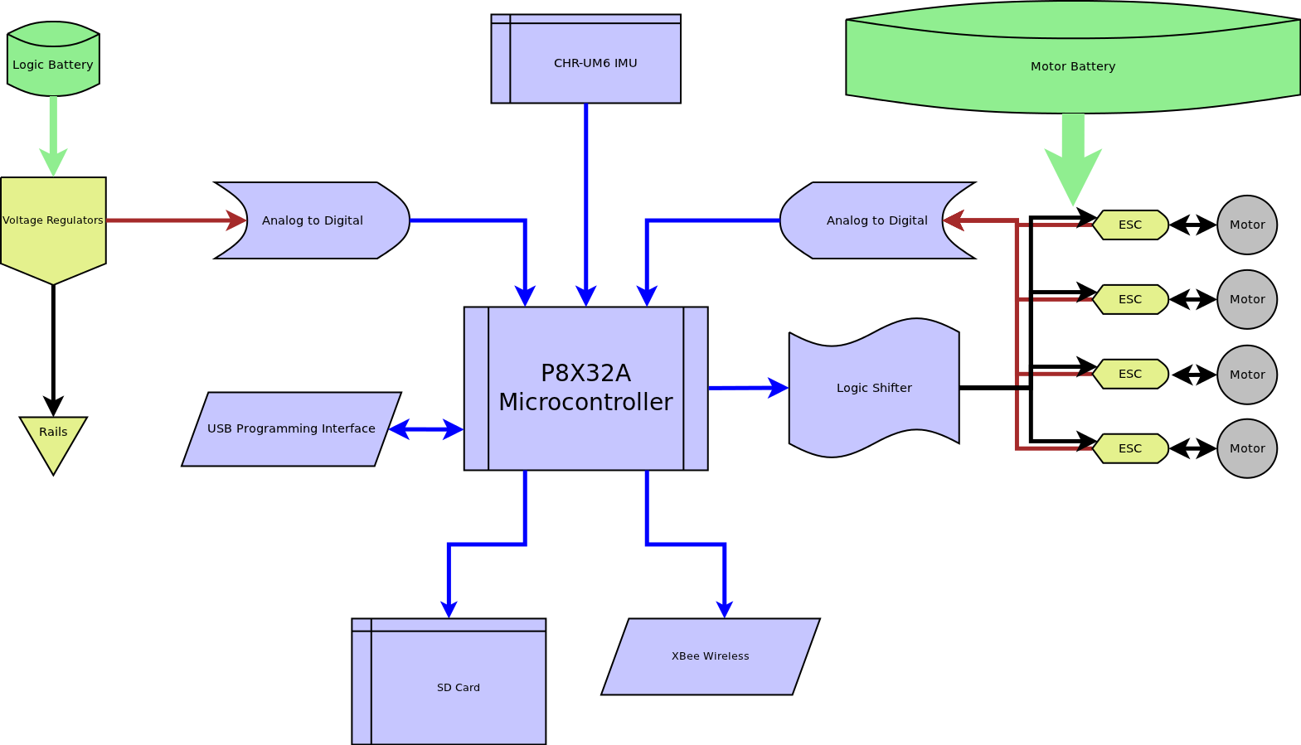

Slide 18
Do not Delete: overlaid slide

Slide 19
Features
Propeller Multicore Processor
Buck regulators for 5v (x2) and 3.3v
Level shifting for up to 24 I/O lines
Voltage and current sensing for
  Motors, 5v and 3.3v rails
8 free analog channels
Mounting accomadations for
  SD card, IMU, Quickstart, BoE formfactor
Servo and I/O 3 wire headers (WRB)

Slide 20
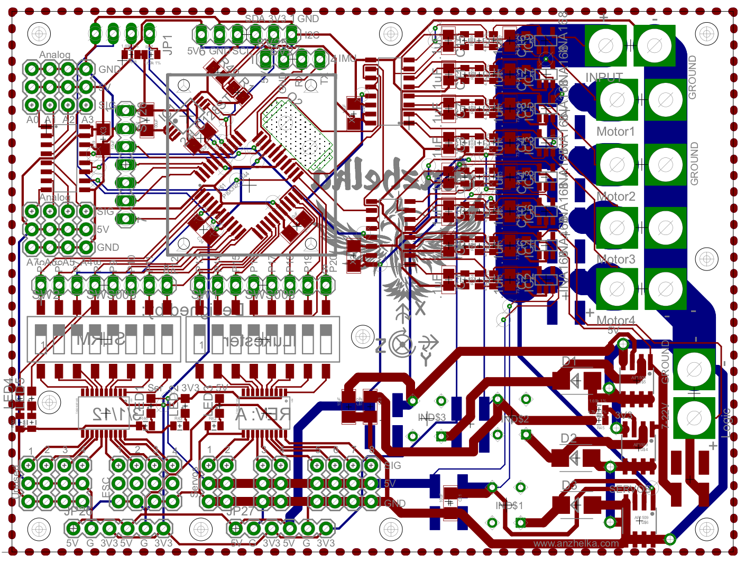
Rev A PCB

Slide 21
Tasks
http://www.jasondavies.com/wordcloud/#
Test~Motors
Design~PCB
Populate~PCB
Select~Frame
Build~Frame
Research~Control~Algorithms
Select~Hardware
Write~Drivers
Code~Algorithm
Develop~Motor~Test~Stand
Create~Project~Management
Document~Project

Slide 22

Tasks
Joint effort on all tasks
No arbitrary division of labor

Slide 23
Minimum Costs
Supplier | Name | Unit | Qty | Total
Parallax | Altimeter | $29.99 | 1 | $29.99
Parallax | Protoboard USB | $29.99 | 1 | $29.99
Parallax | Propeller Chip QFP | $7.99 | 1 | $7.99
Parallax | 64KB EEPROM | $1.99 | 1 | $1.99
Parallax | 5 MHz Crystal | $1.10 | 1 | $1.10
Sparkfun | Radio Modem UM96 | $44.95 | 2 | $89.90
Hobby King | 450 Outrunner Motor - Trinigy | $14.04 | 4 | $56.16
Hobby King | 30A ESC | $5.99 | 4 | $23.96
Hobby King | 3S 30C 1000mAh Battery | $8.99 | 1 | $8.99
Hobby King | 3S 30C 8000mAh Battery | $44.11 | 1 | $44.11
Hobby King | Deans XT Plugs (10 pairs) | $3.08 | 2 | $6.16
Hobby King | 12 AWG 1 meter wire BLACK | $2.49 | 3 | $7.47
Hobby King | 12 AWG 1 meter wire RED | $2.49 | 3 | $7.47
!McMaster-Carr | 5/8" Aluminum Tubing 6' | $16.38 | 1 | $16.38
!McMaster-Carr | 3/32" Delrin 24"x48" | $70.67 | 1 | $70.67
!McMaster-Carr | 1/4" Delrin 12"x12" | $27.87 | 1 | $27.87
!McMaster-Carr | 4-40 5/8" Standoff | $0.46 | 12 | $5.52
Amazon | Optima 7 RC Receiver | $58.04 | 1 | $58.04
DIY Drones | Propellers 10x4.5 1 push 1 pull | $6.00 | 2 | $12.00
Pololu | CHR-UM6-LT IMU Sensor | $149.99 | 1 | $149.99
$655.75 per quadrotor

Slide 24
Test Plan

Slide 25
Design Considerations
Realistic constraints
Industry Standards
Time/Skills

Slide 26
Summary of progress

Slide 27
Technical Challenges

Slide 28
Acknowledgement

Slide 29
All done!

