Slide 1


3115-Meenakshi Sundararajan Engineering College DEPARTMENT OF INFORMATION TECHNOLOGY
Algebra Assist ( Created Connected Classrooms for Math Mastery)
Srinivasan L (311522205054)
Lakshana R (311522205018)
Harini Karpagam V (311522205010)
Anuradha Anand (311522205004)
Project Code: DT001
Team Name: DT314
Guide Name: Mrs. Karthihayini M-Assistant Professor
Date of Exam: 05/08/2024

Slide 2
2.PROBLEM STATEMENT
John, a high school learner, struggles with understanding complex algebraic functions. Despite paying attention in class, he often finds himself puzzled over homework assignments and feels hesitant to ask for help during the busy classroom sessions.
Activity: Include a chat or discussion board feature that allows students to post questions, receive answers, and receive input from the teacher. Perform a brainstorming session to prepare a list of specifications to design chat sessions.

Slide 3
3.OBJECTIVE
Provide a safe space for students to ask questions and seek clarification on topics covered in class.
Enable peer-to-peer interaction, allowing students to learn from different perspectives and explanations.
Offer teacher supervision and guidance within the online platform, ensuring students receive accurate information and support.
Empower students to overcome hesitation and actively participate in the learning process.
Enhance overall understanding and solidify knowledge retention of complex subjects like algebraic functions.

Slide 4
4.SCOPE
The project aims to develop a web application that supports high school students struggling with complex subjects by providing supplementary learning resources, student-to-student chat, teacher interaction, and a question-answer board, with potential for advanced features and school system integration in future phases based on feedback and success.
Empathy: To identify the need for a platform for discussing doubts and assignment. Also to understand the communication gap between students and teachers.
Define: The lack of efficient communication and doubt clearing mechanism in educational environment. The target audience is students and teachers
Ideate: Brainstorming potential solutions and discussing about various features and functionalities like chat rooms, topic discussions and AI assistance
Prototype: Developing a chat application using Flask and SocketIO as a prototype, implementing user login, registration and chat functionalities
Test: Conduct user testing with students and teachers, gathering feedback and iterating on the prototype

Slide 5
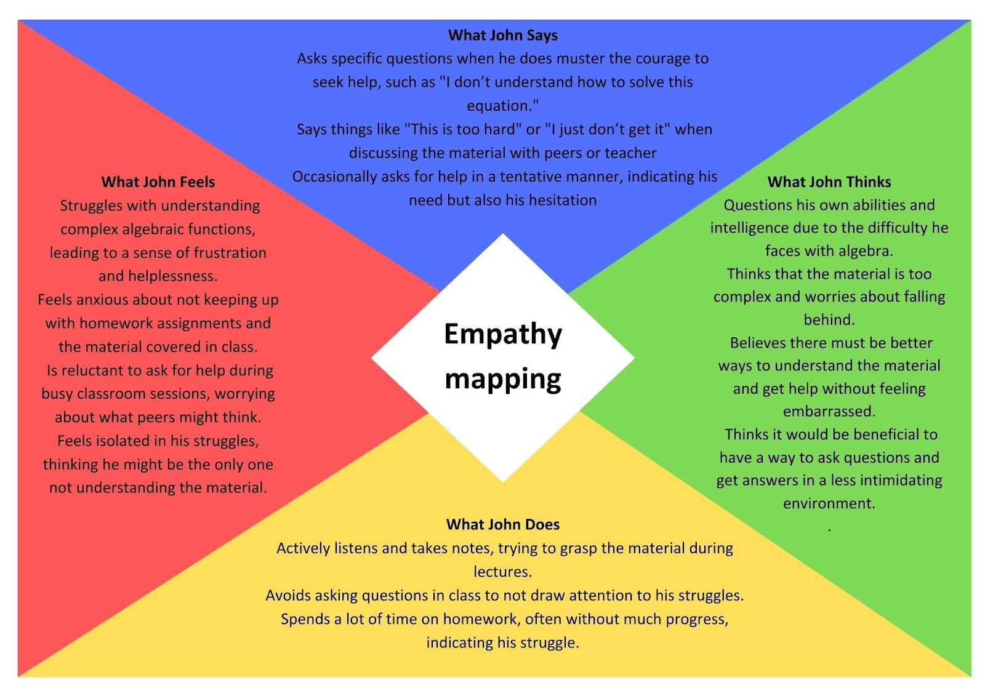
DESIGN THINKING PROCESS

Slide 6
5.ARCHITECTURE
Flask Server (Handles Http request, routing and session management )
WebSocket Connection
Groq API (Process queries that are tagged with @ai or @alas )
API Requests and Responses
Flask-SocketIO Server
(Handles WebSocket Connection, real-time messaging)
HTTP Requests and Responses
Client Side
(Browser)
Data Storage (Store user and chat room data as dicts)
Storing and retrieving data

Slide 7
6.METHODOLOGY
User Authentication: Implemented using Flask sessions
Real time Communication: Managed with SocketIO for instant message
AI Assistance: Integrated using Groq API for educational support.
Room Management: Users can create or join chat rooms with unique codes and rooms are visible to all users on home page.
Message Handling: Messages are stored in rooms with user details and timestamp and are stored and monitored.

Slide 8
7.PERIPHERALS USED
HARDWARE USED:
Desktops and Laptops
SOFTWARE USED:
Flask (Python web framework)
SocketIO (for real time communication)
HTML, CSS, Javascript for front end development
Groq API for AI chat assisstance
TOOLS USED:
Visual Studio Code
Github (version control)
Browser Developer or Debugging tools

Slide 9
8.RESULT and DISCUSSION
The Algebra Assist project aimed to improve the learning experience for high school students struggling with algebra by creating connected classrooms with digital solutions. The platform features an intuitive interface for easy navigation, a real-time chat feature for student-teacher interaction, and personalized learning support. Overall, Algebra Assist effectively fosters a supportive and collaborative educational environment.
User Engagement: Increased interaction between students and teachers.
Feedback: Positive feedback from users on ease of use and functionality.
Challenges: Initial issues with real-time communication stability.
Improvements: Enhanced UI/UX based on user feedback, optimized server-side code for better performance. Integrating AI assistance.

Slide 10
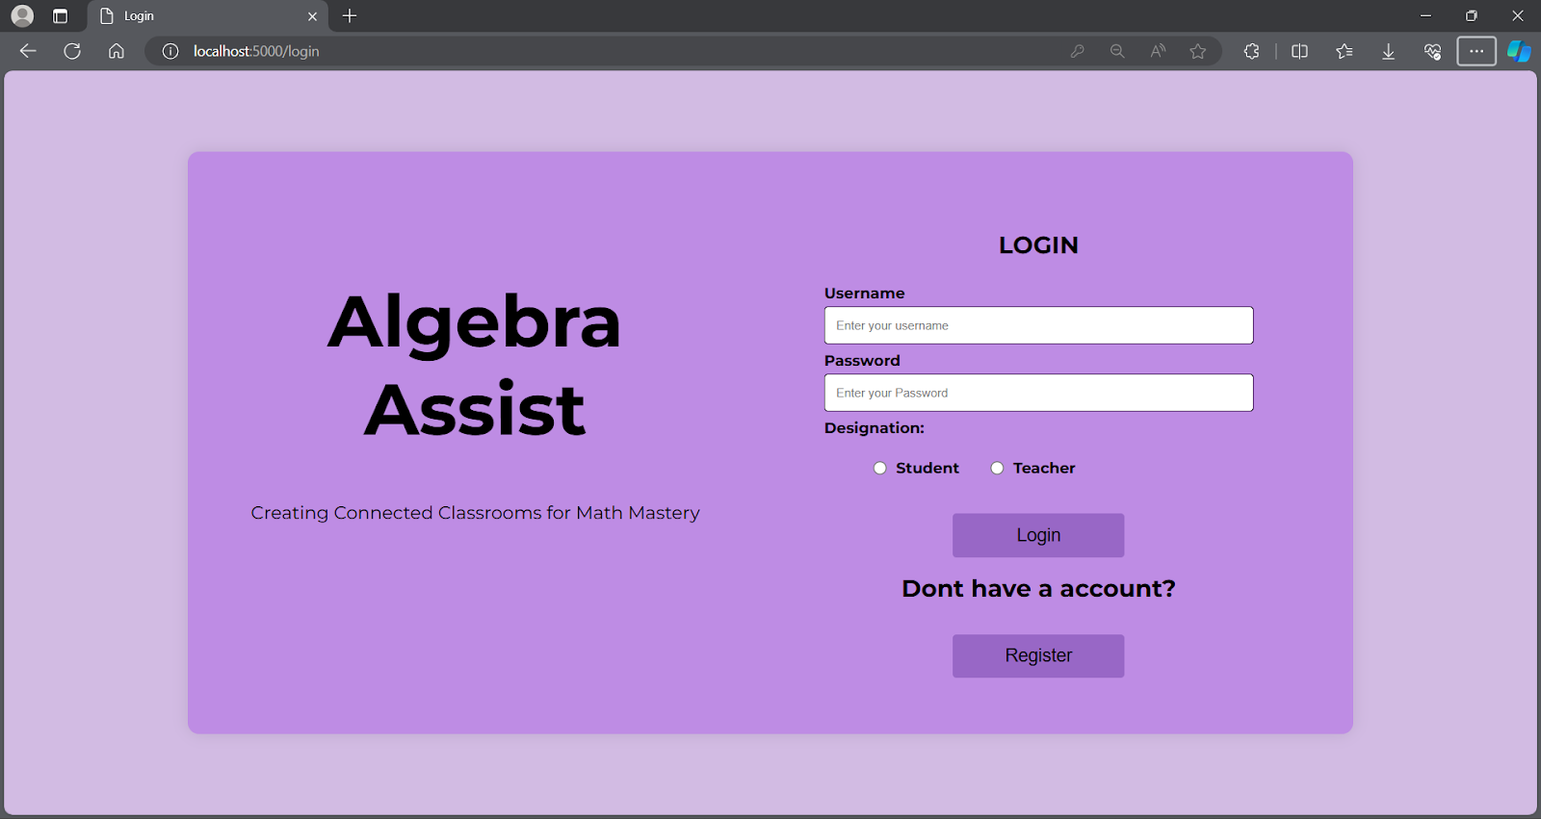
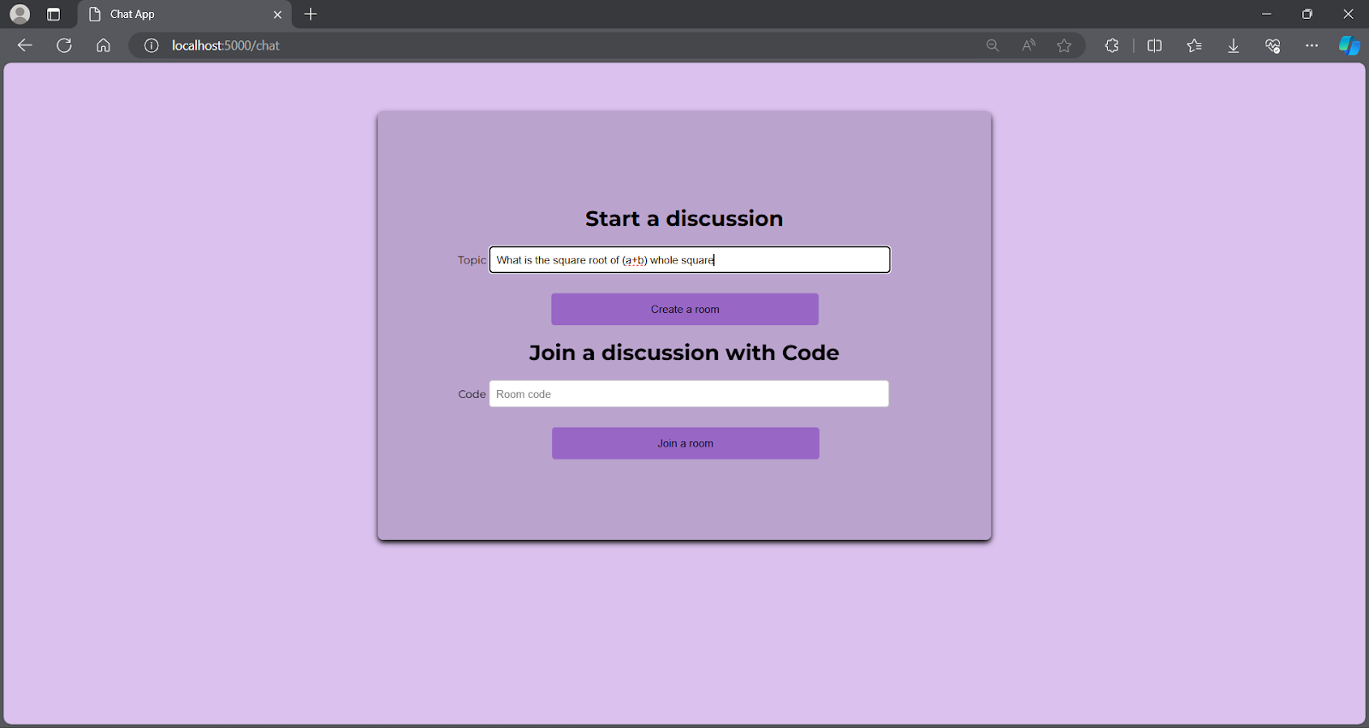
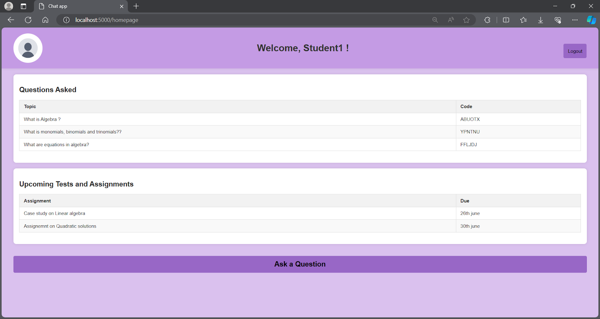
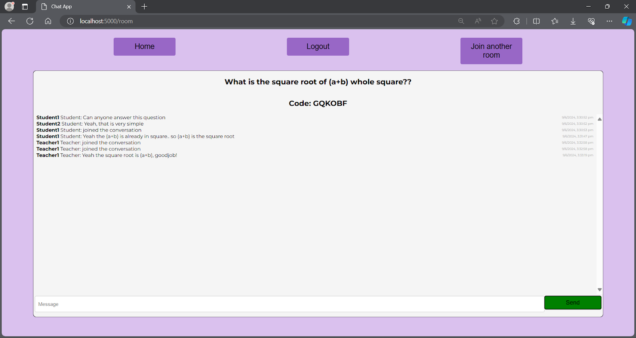
9.STEP BY STEP OUTPUT SCREENSHOT
1.
2.
3.
4.

Slide 11
10.CONCLUSION
The Algebra Assist project has successfully created a digital platform aimed at enhancing educational methods and fostering communication and problem-solving in high school math classrooms.
Following the prototype phase, the actual implementation of the platform has significantly improved student engagement and understanding of complex algebraic functions.
Key outcomes include a notable increase in student participation during and outside classroom sessions, and an overall improvement in homework completion rates.
Several further enhancements are planned for implementation in the next six months, such as expanding the chat and discussion board features to include peer-to-peer tutoring options. enhancing teacher tools with real-time student progress tracking and feedback mechanisms and launching a mobile app version of the platform to ensure accessibility and convenience for students.

Slide 12
11.REFERENCES
Google forms: https://forms.gle/Z2NdcMn8pNoPqE6d8
Flask documentation:https://flask.palletsprojects.com/en/3.0.x/
Flask SocketIO documentation: https://flask-socketio.readthedocs.io/en/stable/getting_started.html
Random module documentation:https://docs.python.org/3/library/random.html
Groq documentation: https://groq.com/docs/
"What is Design Thinking in Education?" by Design Schools
"The Empathy Map: A Powerful Tool to Understand User Needs" by XPLANE

