Slide 1
C#
Shea Moore and paul jones

Slide 2
“C# is an object-oriented, component-oriented programming language.”
Built in 2000 to meet demand for web applications
Runs on .NET (virtual execution system and class library)
Architecture based on Java and C++
Syntax resembles Java and C++
Currently used for web development, windows applications, and game development
Unity (game engine) was built using C# (Escape from Tarkov, Rust, Hearthstone)

Slide 3
Features
Garbage Collection – automatically reclaims memory occupied by unreachable, unused objects
Exception Handling
Lambda Expressions
Unified Type System – all types (including primitives) inherit from a single root object type and share common sets of operations

Slide 4

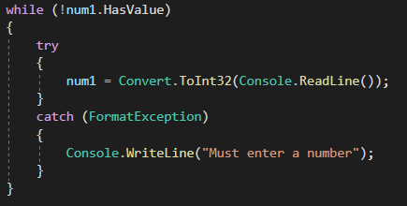
Favorite Features (Shea)
Nullable Type – allows you to use .Value, .HasValue, .GetValueOrDefault
Convenient way to loop
Need ‘?’ to pass nullable values

Slide 5
Favorite Features (Paul)
C# supports language interoperability (within .NET). C# can access code written in any .NET compliant language (C#, F#, Visual Basic).
C# namespaces are not related to the directories, unlike Java packages.
Building GUI elements is very intuitive (when using Visual Studio).
Properties – enables a class to expose a public way of getting and setting values, while hiding implementation

Slide 6

Challenges (Shea)
None, other than using ‘ + ’ or ‘ , ’ in Console.WriteLine() when combining text with an addition equation
If I used ‘ + ’, 1+1 would return 11
If I used ‘ , ’ , nothing would return
Fix:

Slide 7
Challenges (Paul)
C# nested classes behave differently than Java nested classes. Nesting only controls access and visibility, not behavior.
I frequently confused Java and C# syntax because of the similarity.

Slide 8
Recommended?
Yes, C# is very easy to learn if you already know Java.
C# is constantly evolving.
C# is still one of the most used languages.

