Slide 1
SQuire (Trainee KNighter)
Group 1: Project Proposal
Chinmay Dalal
Snehashish Reddy Manda
University of North Carolina at Chapel Hill

Slide 2
The Problem Statement
Large systems (e.g., Linux kernel) need robust static analysis to catch critical bugs early.
Traditional static analyzers are expensive to design/maintain and cover limited, predefined bug patterns.
Leverage LLMs to synthesize scalable, explainable, and updatable checkers that encode real-world bug knowledge and run efficiently on large codebases.

Slide 3
Why not use LLMs to check code directly?
Context limits and high compute cost
Hallucinations and inconsistent reasoning at scale
Leverage LLMs not to scan code directly, but to synthesize specialized static checkers from historical bug-fix patches.

Slide 4
What are static checkers?
Purpose: Lightweight analyzers that examine source code without executing it to detect specific bug patterns and policy violations early.
How they work: Rule- or state-machine driven logic hooks into compiler/analysis events (e.g., calls, branches, dereferences) and tracks program state along paths and aliases.
Examples of findings: null dereference after allocation, use-after-free/double-free, use-before-initialization, missing bounds or error checks, resource leaks.

Slide 5
What do LLMs solve that humans couldn’t?
Rapid coverage of new patterns
Scale and iteration
Knowledge aggregation
Notes:
Rapid coverage of new patterns: Learn bug semantics directly from patches/commits and synthesize checkers quickly, without weeks of expert rule engineering.
Scale and iteration: Auto-generate, validate, and refine many specialized checkers in parallel; continuously adapt as code and idioms evolve.
Knowledge aggregation: Fuse dispersed domain knowledge (APIs, idioms, macros) across subsystems to capture nuanced, system-specific rules humans may overlook.

Slide 6
Where did we get our inspiration?
KNighter (SOSP ’25): LLM-synthesized static checkers from bug-fix patches
Multi-stage flow: pattern → plan → checker → validate → refine
Real impact: 92 kernel bugs found, 30 CVEs; orthogonal to Smatch
Notes:
We’re adopting KNighter’s paradigm to use LLMs to learn from patches and generate explainable CSA-style checkers, then validate pre/post and refine via triage to keep false positives low. This paper hasn’t been assigned to any of us so I’m assuming Sishuai will present it himself.

Slide 7
How do you validate the correctness of the checker?
Patch-replay test: run on buggy vs fixed commits; expect hits only on buggy
Oracle tests: LLM must supply pos/neg code snippets; compile/run and assert outcomes
Cross-project sanity: run on unrelated repos; expect near-zero findings
Notes:
Patch‑replay test (buggy vs fixed commits)
What: For each real bug fix in your target repo, run the checker on both the buggy commit (pre-fix) and the fixed commit (post-fix).
Why: Establishes causal alignment: the checker should trigger on the bug but stop triggering once the fix is applied.
How:
Mine paired commits where a fix is clearly linked to a bug (e.g., by commit message keywords or issue links).
Build both revisions with the same toolchain; run the checker on identical scopes (same file set).
Record whether the checker fires and on which locations.
Expected outcome: High hit rate on buggy revisions; near-zero hits on fixed revisions for the same code locations.
Metrics: True positive rate on buggy versions, false positive rate on fixed versions; also log “disappearing alerts” percentage.
Pitfalls:
Non-deterministic build or environment differences between commits.
Large refactors in the fix commit change context so the checker can’t map locations; mitigate with path mapping or file-level scopes.
Oracle tests (synthetic positive/negative snippets)
What: Curate tiny, self-contained code examples that are guaranteed positives (must fire) and guaranteed negatives (must not fire).
Why: Gives you a precise ground truth that is independent of repo noise; helps probe boundaries.
How:
Ask the LLM to propose minimal pos/neg examples, then you review and minimize them.
Ensure they compile (if relevant) and, where applicable, include a tiny test invoking the behavior.
Run the checker on these files in CI.
Expected outcome: 100% precision on negatives, near-100% recall on positives.
Metrics: Precision, recall on the oracle set; time-to-signal (runtime).
Pitfalls:
Overfitting to the synthetic set (examples too similar to the prompt used to design the rule).
Positives that depend on undefined behavior; keep semantics unambiguous.
Cross‑project sanity (unrelated repos)
What: Run the checker on codebases that should not contain the targeted bug pattern.
Why: Measures spurious firing in the wild; checks generalization and conservativeness.
How:
Pick 1–2 repos different in style/domain/libraries.
Run the checker with default config; record hits.
Expected outcome: Near-zero alerts; any hits should be rare and explainable.
Metrics: Alerts per KLoC; manual sample FP rate on those alerts.
Pitfalls:
Third-party macros or code styles that mimic the pattern superficially; consider adding guard conditions.

Slide 8
How do you validate the correctness of the checker?
Differential check: compare against baselines (e.g., Clang-Tidy/Smatch) for overlap/novelty
Manual triage sample: inspect a small random set of hits for true/false positive rate
Stability check: perturb code (rename vars, reorder) to ensure rule is semantic, not brittle
Notes:
Differential check vs baselines (e.g., Clang‑Tidy, Smatch, Semgrep rules)
What: Compare your checker’s findings against established tools.
Why: Validates that you’re not reinventing a noisier wheel and quantifies novelty.
How:
Run baseline tools on the same commit(s).
Deduplicate findings by file:line:kind and by semantic equivalence (group with heuristics).
Classify your alerts into overlap vs unique.
Expected outcome: Some overlap is fine; unique findings should include genuine issues.
Metrics: Precision of unique findings; proportion of overlap; novel-true ratio.
Pitfalls:
Misaligned configurations or rule sets; lock versions/configs and document them.
Manual triage sample
What: Humans inspect a random subset of alerts to decide true vs false positives.
Why: Gold-standard precision estimate and qualitative insight into failure modes.
How:
Randomly sample N alerts (e.g., 50–100) across repos and categories.
Use a rubric: evidence, spec/contract violated, minimal fix sketch, confidence level.
Two reviewers if possible; resolve disagreements.
Expected outcome: A defensible precision estimate with confidence intervals.
Metrics: Precision, Cohen’s kappa (agreement), taxonomy of FPs.
Pitfalls:
Sampling bias (only easiest alerts); enforce randomness and stratify by repo/file type.
Stability checks (perturbation robustness)
What: Apply semantics-preserving code transformations and verify the checker’s decisions don’t flip.
Why: Ensures the rule is about meaning, not surface tokens or formatting.
How:
Automated transforms: rename variables, change whitespace/comments, reorder independent declarations, add trivial wrappers, inline/out-of-line small functions if semantics preserved.
Re-run checker before/after; compare decisions.
Expected outcome: Same alerts on equivalent code; no new spurious ones.
Metrics: Robustness score = 1 − (alerts_changed / total_alerts_checked).
Pitfalls:
Accidentally changing semantics; keep transforms simple and unit-tested.

Slide 9
How do you validate the correctness of the checker?
Regression suite: add any FP/bug to tests; rerun on every rule revision
Confidence gate: ship only if precision ≥ target on tests and LLM confidence ≥ threshold
Notes:
Regression suite (test-as-you-learn)
What: Every FP (False Positive) you discover and every missed TP (True Positive) gets turned into a test case.
Why: Prevents backsliding as you iterate on prompts/rules.
How:
Maintain a tests/directory with positive, negative, and edge-case fixtures.
CI runs all suites on every rule or prompt change.
Tag tests by checker version and pattern.
Expected outcome: Gradually growing suite that your checker consistently passes.
Metrics: Pass rate over time; time-to-fix regressions.
Pitfalls:
Letting flaky tests linger; quarantine or fix quickly.
Confidence gate (shipping criteria)
What: A decision rule that combines measured precision with the model’s self-reported or calibrated confidence.
Why: Forces discipline: you don’t adopt a checker until it meets quality bars.
How:
Define thresholds pre‑hoc, e.g., “precision ≥ 90% on oracle + patch-replay fixed commits, and ≥ 80% on cross-project sample; robustness ≥ 0.9; LLM confidence ≥ 0.7 if used for triage.”
Calibrate confidence using a validation split: map raw scores to calibrated probabilities (e.g., Platt scaling, isotonic).
Enforce in CI: block “release” unless thresholds pass.
Expected outcome: Only high-quality rules make it into the “ship” set.
Metrics: Pass/fail vs thresholds; calibration error (Brier score, ECE).
Pitfalls:
Data leakage from tuning on the same set you evaluate; keep a held-out set until the final evaluation.

Slide 10
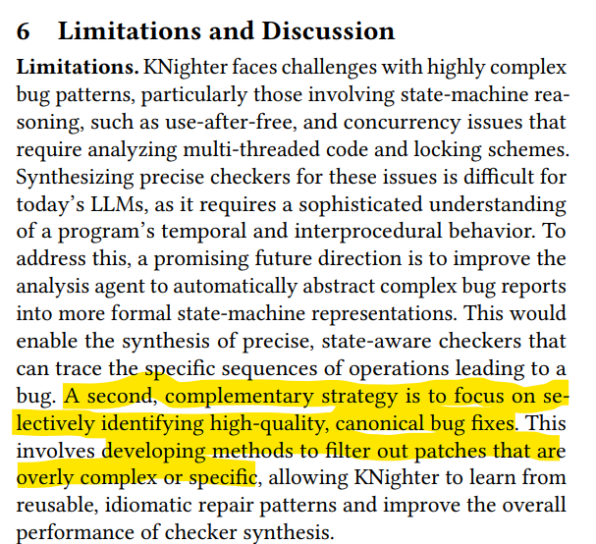
Our Twist: Confidence-Gated, Simple Patterns

Slide 11
Our Twist: Confidence-Gated, Simple Patterns
Scope: Only simple, local bug-fix patterns LLMs handle well (checks, null/len bounds, resource handling).
Confidence gate: Generate checker only if LLM reports high confidence and passes auto-tests.
Evidence loop: Keep/ship rules that pass replay on historical versions; discard or quarantine the rest.
Notes:
Presenter’s notes:
Process sketch:
Patch mining: extract pairs (buggy→fixed) with small diffs.
Pattern synthesis: prompt LLM to propose a minimal rule + rationale + examples.
Self-check: require LLM to rate confidence and produce negative/positive examples.
Auto-tests: run on fixed vs buggy snapshots; expect high precision on buggy, zero hits on fixed.
Confidence threshold: accept only if confidence ≥ X and tests pass; otherwise reject/refine.
Telemetry: record FP/FN from replay to tune prompts and thresholds.

Slide 12
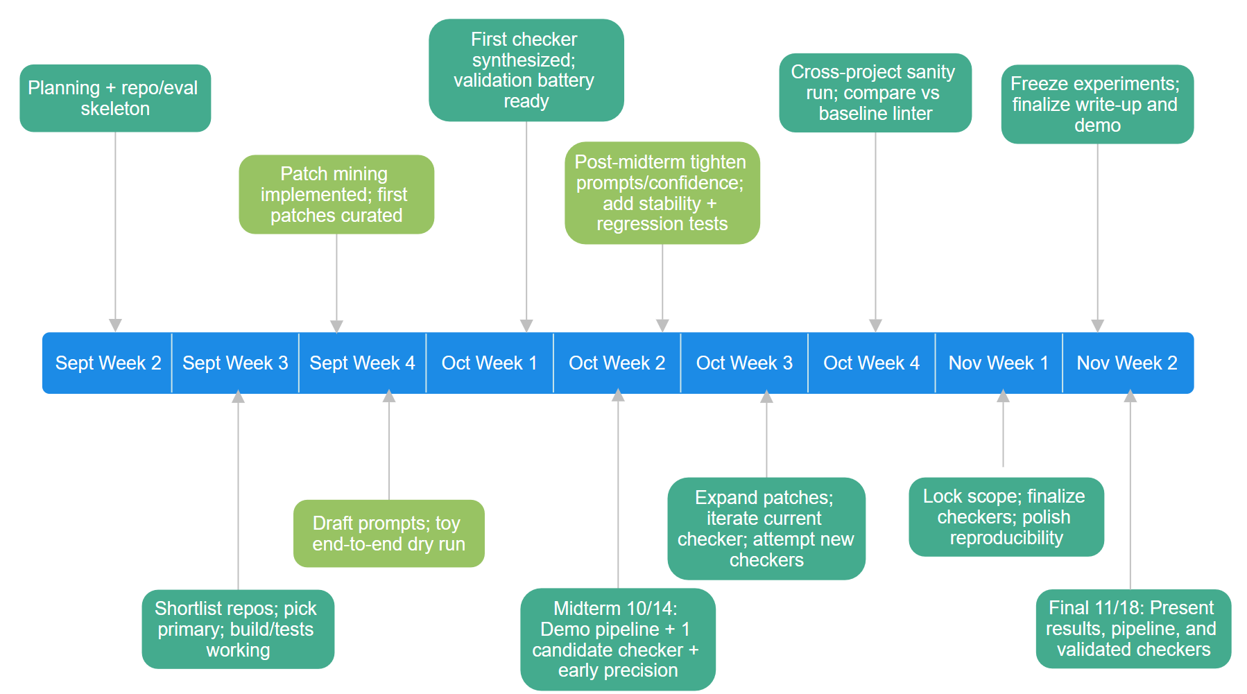
Where are we at right now?

Slide 13
Where are we at right now?
Team setup: roles aligned (rotating leads)
Pre‑milestone leads: Snehashish - LLM pipeline (prompts, synthesis, confidence); Chinmay - checker engineering (rule design, integration)
Post‑milestone swap: Snehashish takes checker refinement; Chinmay owns LLM prompt/tuning
Shared throughout: patch mining, eval, triage, and presentation
Notes:
How is this not just an LLM/NLP/AI project?
We implement and maintain real static checkers (CSA rules, program state, alias/flow tracking) that must compile, integrate, and run at scale.
We build the whole validation rig: patch‑replay tests, cross‑repo sanity, baselines, stability perturbations, and a growing regression suite.
We operate the system: mining patches, triaging reports, refining rules, wiring CI, measuring precision/cost—LLM suggests code, but correctness and reliability come from our engineering.

Slide 14
Where are we NOT at right now?
Codebase: not selected yet;
Patch data: not collected; mining scripts TBD
Patterns: none chosen; Patch data will determine;
LLM agent: model not chosen; agent not prototyped; prompts/design pending
Compute: not decided on university resources usage as agent might be API;
Tooling: repo setup pending on VM; eval pending;
Risks/blocks: time for data curation; codebase choice
Notes:
Possible candidates:
Codebase: most probably will be Linux simply due to amount of data available
LLM Agent: Only instruct models, Gemini 2.5-Flash is very promising due to price v. performance ratio with 1M input context tokens. KNighter uses o3-mini which is already outdated due to o4-mini being out
Prompt will also not be designed from scratch, KNighter paper provides some very promising templates
API: We can start today and iterate fast: no GPU queue, drivers, or serving to maintain. Just call the API and focus on checker synthesis and validation.
This project’s value is the pipeline and results, not running an LLM stack. It makes sense to outsource the infrastructure.

Slide 15
Comments, Questions or Clarification?
Notes:
Patterns come from patch data

