Slide 1

What Makes a Doubles Volleyball Partnership Successful?
An exercise in clustering
Spencer Matthews
University of California, Irvine
Abbreviated Abstract: Conventional beach volleyball knowledge says that a good team is typically made up of one ”big” player and one all-around player. The job of the big is to block and hit, while the all-around player focuses on defense and setting (while still being able to hit a ball if needed). Here we analyze data from men’s professional beach volleyball leagues in order to classify players as one of 4 groups (using k-means clustering) and determine which combinations of player groups are most successful. We find that for two of the player groups, success comes more often when they play with a partner from the same group, while the other two groups are more successful when paired with a player from a different group. We explore various metrics in the most successful pairing and discuss future applications using similar methods.
spencer.matthews@uci.edu
UCSAS 2021

Slide 2
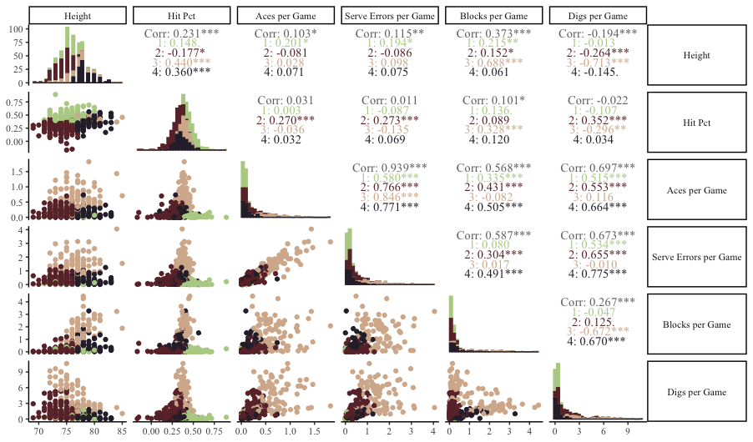
Data, Problem, and Initial Clustering
Problem:
Sand volleyball consists of partner pairs competing against each other
We want to use clustering in a novel way to examine relationships between player-type partnerships and success
Data:
Obtained from Kaggle
Contains data from professional men’s sand volleyball leagues from around the world
Initial Clustering:
Used k-means clustering to identify 4 clusters of players (based on where elbow occurred in within-cluster SS plot)
Relationships between clustering variables can be seen in the plot to the right (clusters shown by color)
Cluster results were joined with game data to summarize by teammate combination
Figure 1: Variables used to cluster the players included height, hit percentage, aces per game, serve errors per game, blocks per game, and digs per game
spencer.matthews@uci.edu
UCSAS 2021

Slide 3
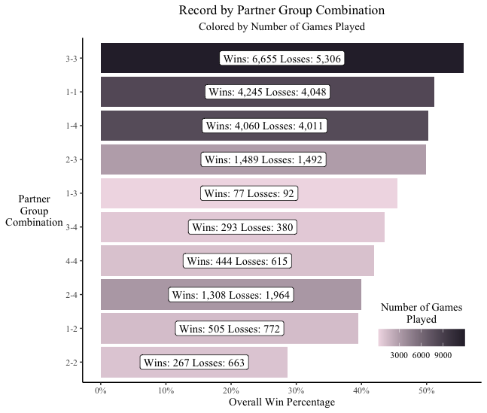
Analysis of Partner Group Combinations
The results in Figure 2 show that while some player groups seem to be better across the board (3), the top four partner group combinations contain players from all four groups.
Also interesting is that while 3 and 1 play well with teammates from their own group, they do not play as well together (and hardly ever play together, for that matter)
In Table 1 we see the results of the 3-3 partner group against all other partner groups
The closest games on average are against 1-4 if judging by point differential, and 1-3 if judging by the match going to three games
Opponent Combination | Total Games | Record | Average Score Diff. | % Games that were a Sweep
1-4 | 783 | 53.51% | 0.916 | 60.92%
1-1 | 691 | 56.73% | 1.260 | 59.91%
1-3 | 56 | 55.36% | 1.321 | 58.92%
2-3 | 1,529 | 59.71% | 2.173 | 67.95%
1-2 | 141 | 74.46% | 4.688 | 73.76%
3-4 | 311 | 73.31% | 4.881 | 66.23%
4-4 | 125 | 71.20% | 5.168 | 67.20%
2-4 | 611 | 78.72% | 6.905 | 73.49%
2-2 | 338 | 90.08% | 9.947 | 75.15%
Figure 2: Partner Group Combination results, with win percentage on the x axis and the combination on the y axis, darker bar indicates more total games in the dataset
Table 1: Partner group 3-3 stats against all other groups
spencer.matthews@uci.edu
UCSAS 2021

Slide 4
Application and Next Steps
spencer.matthews@uci.edu
UCSAS 2021

