Slide 1
Summary of Data files (DVB) (for HB2D OAM run 2023)
All runs at dead-reckoned current in the prisms (nominal "10A": )
From upstream to downstream the setpoints are: 9.29A, 10.17A, 6.42A, and 7.3A
V-cavity translation scan 4 Aug 2023
Images 6261 through 6302 from -18mm to +2mm in steps of 1 mm (Both spin states measured: 42 images).
Overnight transverse scan (4-5 Aug) 2023 (downstream nutator red polepiece placed in the neutron-portside pos’n).
Images 6304 through 6424: AC1 and AC2 both scanned from -2.5 to +2.5 in 0.5A steps (one spin state only, 11 images). Cav. Trans position -9mm. Nu-pre at +5A. N-post +5A (OOPS, this may give a zero crossing, DVB 5-Aug)
Longitudinal scan (5 Aug: AM). (downstream nutator has red polepiece UP).
Images 6425 through 6446. AC2=1, AC1 scanned -2.5 o 2.5 in 0.5 steps. Nu-pre is positive at +5A, Nu-post set to +5A
6447 repeat about for AC1=+2.5A, AC2=0, and Nu-pre at -5.0A
(5Aug. PM) Long run at one setting to get a nice picture. AC1=1 AC2=1 Nu-pre –5.0A, +5A, Nu-post -5A. 1 hour for each spin state.
Runs 6448/9:

Slide 2
5 Aug. Overnight: repeat longitudinal transverse scan with both spin states (Nu-pre at +/–5A) to facilitate polarization analysis in light of a non-uniform beam (and Nu-post now at –5A, wiggler confirmed this is properly aligned with the v-Cavity):
Runs: 6450 through 6691
6 Aug. Overnight, longitudinal scan to complement the above.
Runs 6692 through 6767 (~3 hr run @420s/image, looped to increase statistics, and stopped when ready for the next WP setting)
7Aug. AM: nominal 15A (15.00;16.155;10.710; 11.861) 2 runs to check period with both spin states: Runs 6768,6769
7Aug. -9Aug.: transverse scans AC1+AC2 both spin states (Nu-pre selected), 242 runs, 650 s/image
6770 through 7011 (anticipated on 7 Aug.)

Slide 3
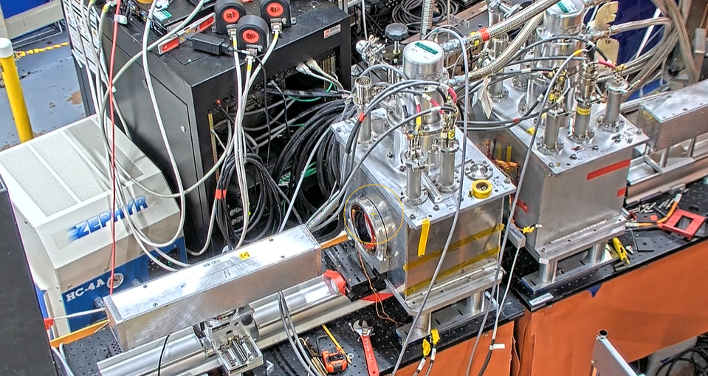
9 Aug. Longitudinal scan from 7012-7033. Ac2=2.5A
Fumi's: 7034-7043
Repeat the 15A with good statistics
Longitudinal component (alternating nu_post): 7044-7079
Note: not really the longitudinal component with ac_1=ac_2=0, but the transverse horizontal component

Slide 4
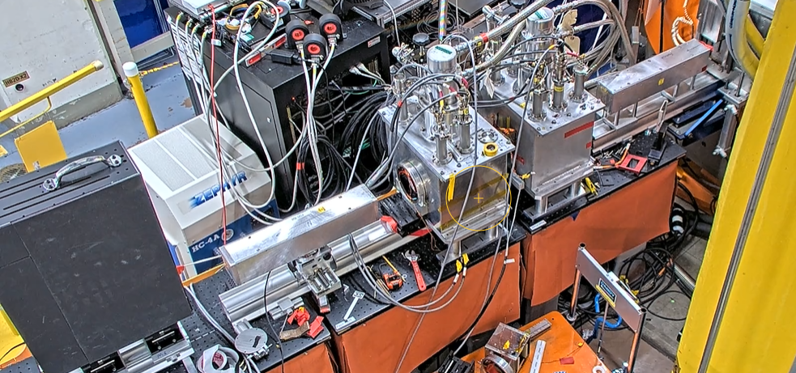
Overnight Aug 9-10: transverse mode scan: 7080-7115
With ac_2 in pi/2 mode: 7116-7151

