Slide 1
IBM Rational Performance Test

Slide 2





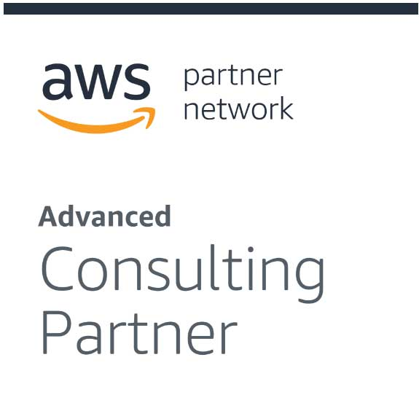


About CloudThat​
9+
350k+
100+
100+
350+
Years in Business
Professional Trained
Corporates Trained
Projects Delivered
Cloud Certifications
Leader in Training and Consulting on Cloud, Security, AI/ML, IoT and DevOps
Trained over 350k+ professionals across technologies and geographies
Proven track record of training delivery for all stages of employee lifecycle
Strong team of 125+ certified cloud experts with
industry consulting experience
Robust consulting division brings industry prospective to training delivery
Page 2

Slide 3
PREREQUISITES:
Basic understanding of software testing concepts
Familiarity with programming concepts
Understanding of web technologies
Database knowledge
Experience with test automation tools
Familiarity with version control systems
Basic understanding of Continuous Integration/Continuous Deployment (CI/CD)
Knowledge of GUI testing concepts (for RFT)
Understanding of load testing concepts and performance metrics (for RPT)
Knowledge of service-oriented architecture (SOA) concepts (for RIT)
Familiarity with managing virtual services and environments (for RTCP)

Slide 4
Rational Performance Tester Licence Configuration

Slide 5
Runtime License Runtime license is used during performance testing, not recording or developing. The most common on is the Virtual Test Pack used to simulate virual Concurrent user numbers

Slide 9
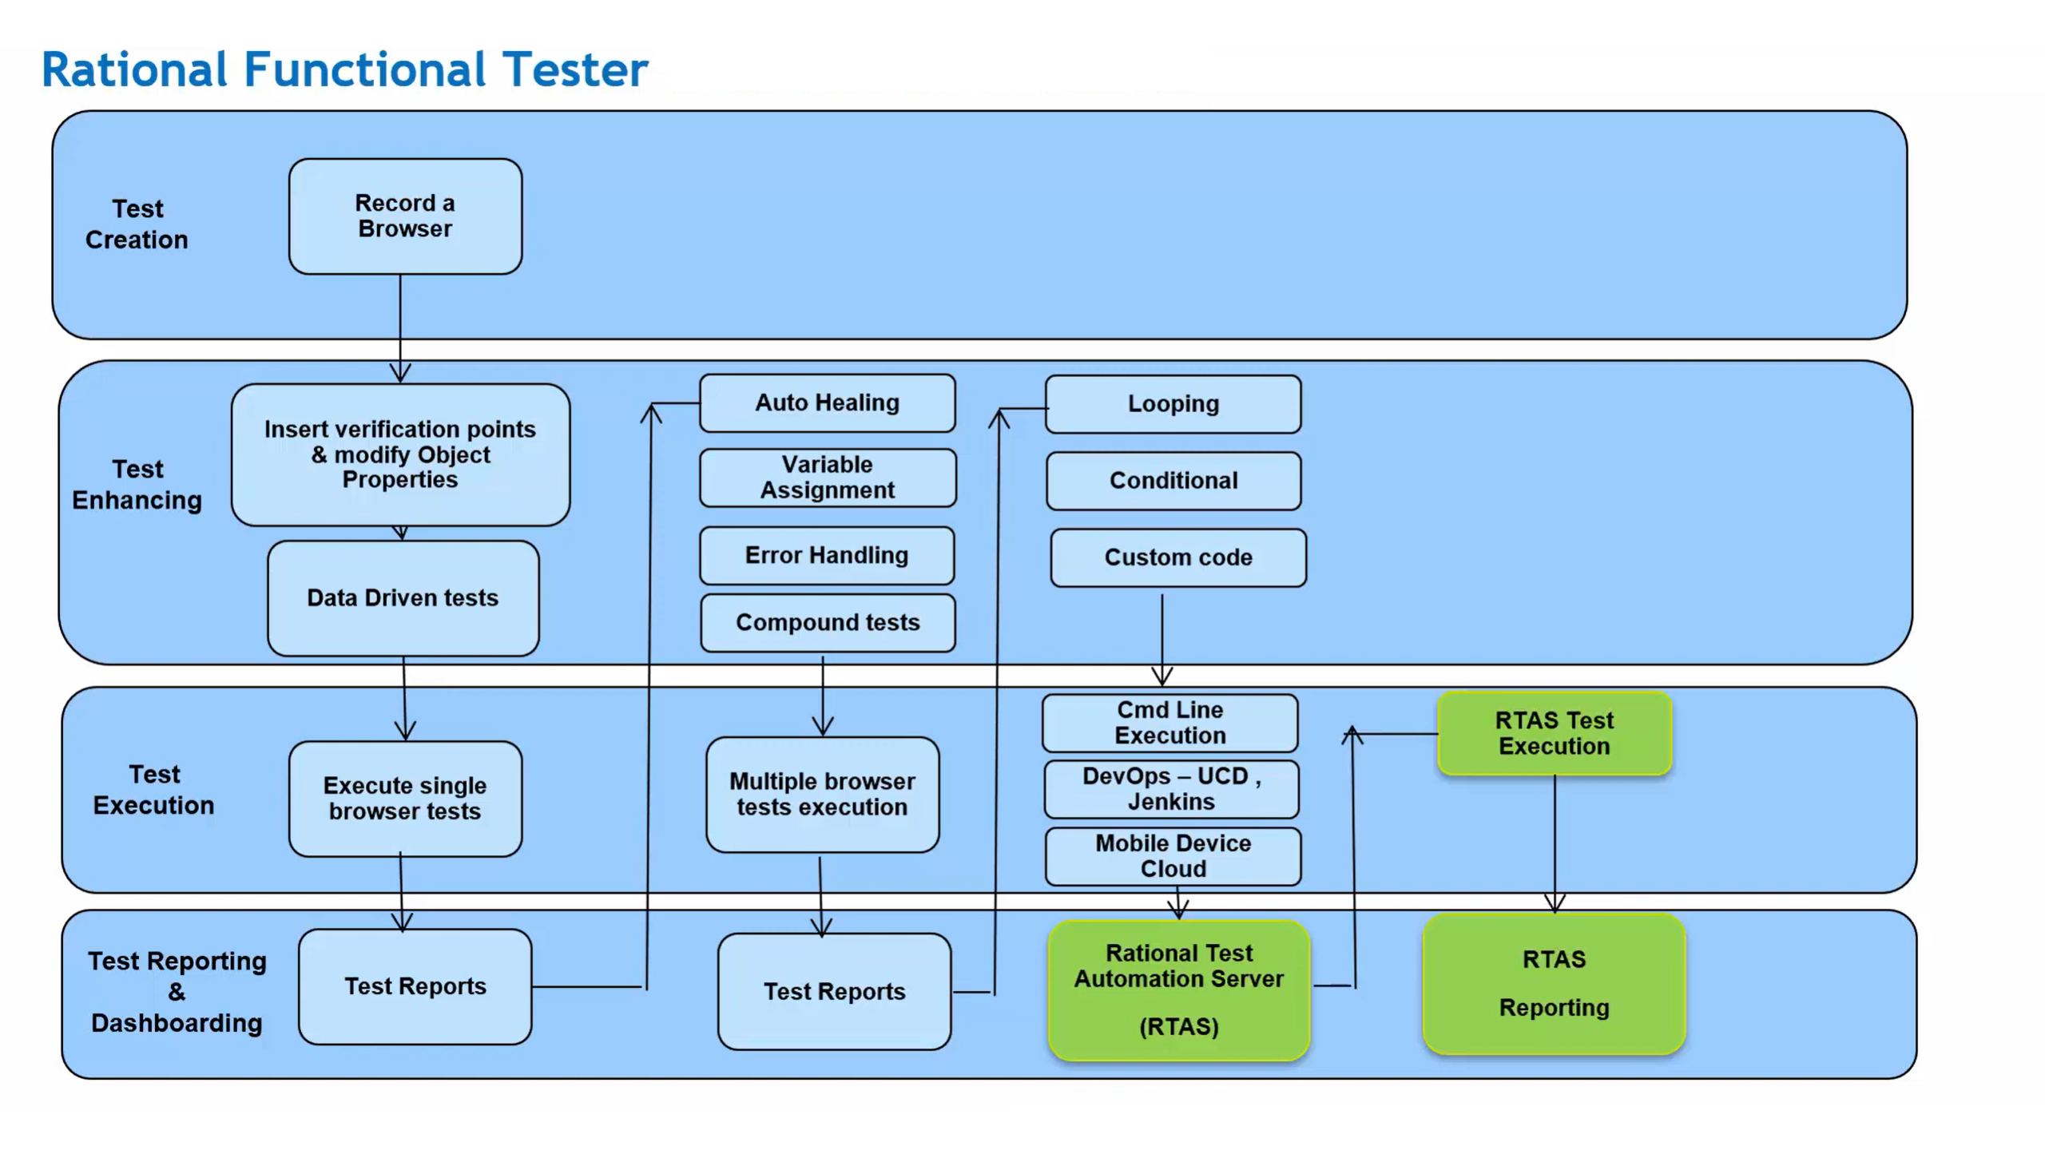

Slide 10
Questions ???

