Slide 1
IBM Rational Testing Tools

Slide 2








About CloudThat​
9+
350k+
100+
100+
350+
Years in Business
Professional Trained
Corporates Trained
Projects Delivered
Cloud Certifications
Leader in Training and Consulting on Cloud, Security, AI/ML, IoT and DevOps
Trained over 350k+ professionals across technologies and geographies
Proven track record of training delivery for all stages of employee lifecycle
Strong team of 125+ certified cloud experts with
industry consulting experience
Robust consulting division brings industry prospective to training delivery
Page 2

Slide 3
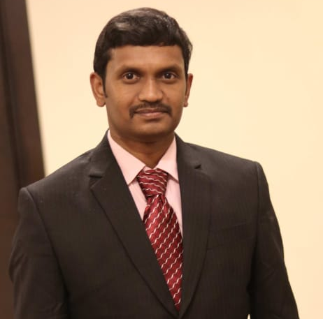





Trainer Profile
VENKATA SUBBARAO B Cloudthat Consultant CORPORATE TRAINER & DEVELOPER - UI | UX | FULL STACK | ARCHITECT | MICRO SERVICES | MICRO FRONTEND | MULTI CLOUD | DEVSECOPS | SRE | SQL/NO SQL DATABASES | DS | ML | GENERATIVE AI | PROMPT ENG | DIGITAL MARKETING
Cloud & Other Platforms
AWS, AZURE, GCP, Solution Architect,
DevSecOps, SRE
Front End
ES.Next, JavaScript, React, React Native, Vue, Angular Ext JS, UXD, UI , HTML, CSS, Bootstrap, Tailwind CSS, SASS, Wire Framing , Low & High Fiddle Design, RWD, PWA …
DELOITTE
SAPIENT
SALES FORCE
HITACHI
INTEL
IBM
IFUTURE
WILEY
GENPACT
CASPEX
PRAGATI SOFT
SEED INFOTECH
VOLKSWAGEN
CITI BANK
TESCO
3 EDGE
PRIME SOFT
QUICK PRIME
TECHWORLD LOGICS
Back End
UTTHUNGA
EY.AI
NEO GROWTH
STALWART
ANZ
RIVATECH
STANDARD CHARTERED
UPGRAD KHT
THINK INFINITY
JAVA, Spring Boot, Node, ExpressJS, PHP, Python, SQL(MySQL, PgSQL), NoSQL (Mongo, Firebase, Elasticsearch, Cassandra, Couchbase), API
COMVIVA
HP
CLOUDTHAT
IMARTICUS
RAKUTEN
EGV AFRICA GOV
VIRTUSA
COMCAST
6BENCHES
ALLIANZ
JANDIAL
UST-GLOBAL
SVARAAPPS
DBS
KVALUENT
JUST COMPILE
PANLEARN
INVENTATEQ
Miscellaneous Tools
Docker, Kubernetes, Jenkins, Kafka, Ansible, Terraform, SonarQube, Selenium, Atlassian Stack, Grafana, GraphQL, ELK Stack, Git, SVN, CVS, Redux, MobX, Thunk, Saga, Figma, Adobe XD, Karma & Jasmine, Protractor, Jest, SonarQube, Photoshop, Illustrator, Digital Marketing, Agile Scrum …
CASPEX
MANIPAL PRO
COGNIZANT
JIGSAW ACADEMY
TELSTRA
UNEXT
BAJAJ FINSERVE
CODING SUPER STAR
KOENIG
TSEEDU
PROBITS
HONDA
CRIO.DO
ETEAMINC
MANTT
AWIGN
MYYESM
TATA SED
MAZENET
NPCI
ANTHEM
PRODAPT
ADVAITH TECHNOLOGIES
MSYS
BARCLAYS
SUDAKSHA
COLORS SOFT
TRAINING CURVE
EDUPINNACLE
AIMS MBA COLLEGE
VERZEO

Slide 4
PREREQUISITES:
Basic understanding of software testing concepts
Familiarity with programming concepts
Understanding of web technologies
Database knowledge
Experience with test automation tools
Familiarity with version control systems
Basic understanding of Continuous Integration/Continuous Deployment (CI/CD)
Knowledge of GUI testing concepts (for RFT)
Understanding of load testing concepts and performance metrics (for RPT)
Knowledge of service-oriented architecture (SOA) concepts (for RIT)
Familiarity with managing virtual services and environments (for RTCP)

Slide 6
Questions ???

