Slide 1
Build Angular Apps
By venkat

Slide 2
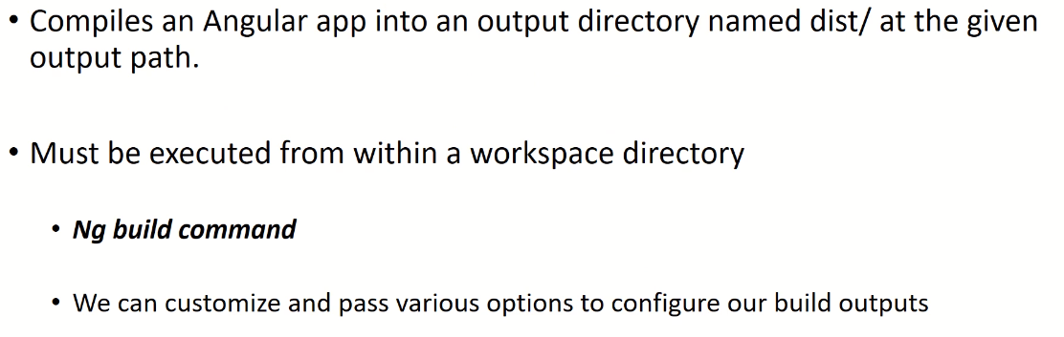
Build angular applications

Slide 3
Notes
Ng build
Ng build - -outputPath=conversion //build in specific folder
Ng build - -baseHref=http://localhost:7070 (dist folder index.html)
Ng build - -index=login
Ref: ng build --outputPath=conversion --baseHref=http://localhost/myproject/ --deployUrl=http://localhost/myproject/

Slide 4
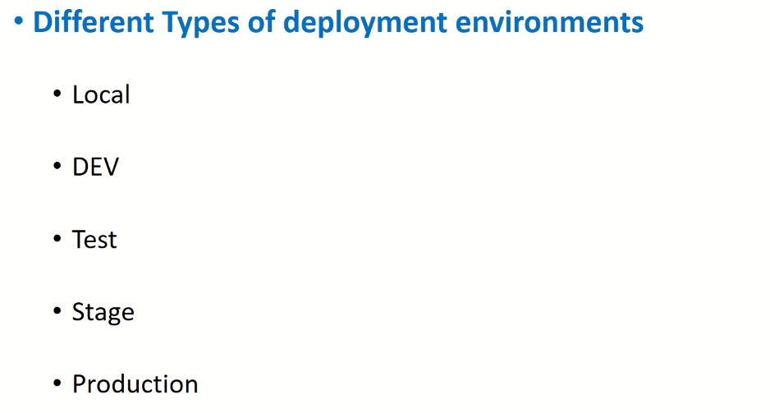
Environments

Slide 5
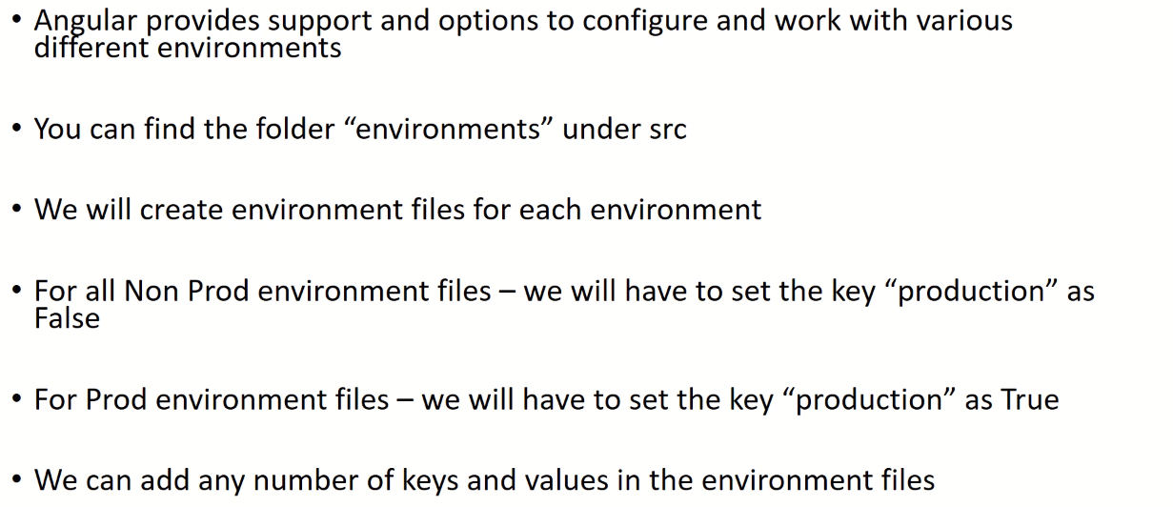
Configuration Environments

Slide 6
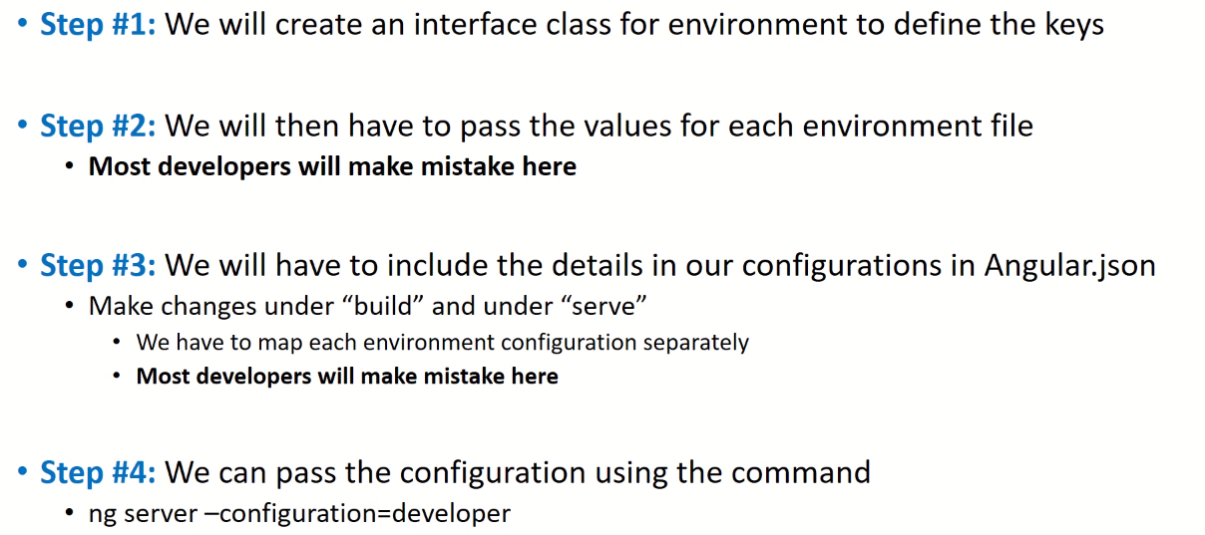
Configuration Environments

