Slide 1

Research Progress
Professor Shun Shiramatsu.
HOSSAIN Syeda Tanzina(35414100)

Slide 2
"StressSense: Multimodal Social Signal Processing including Facial Expression Recognition and Voice Analysis for Real-Time Stress Detection and Mental Health Support"

Slide 3
Contents
Introduction
Overview of System
Mental Health Care System
System worlfkow
Social Signal Processing
Multimodal LLM techniques
Stress texual analysis from audio
Interface
Voice feature method.
Conclusion

Slide 4
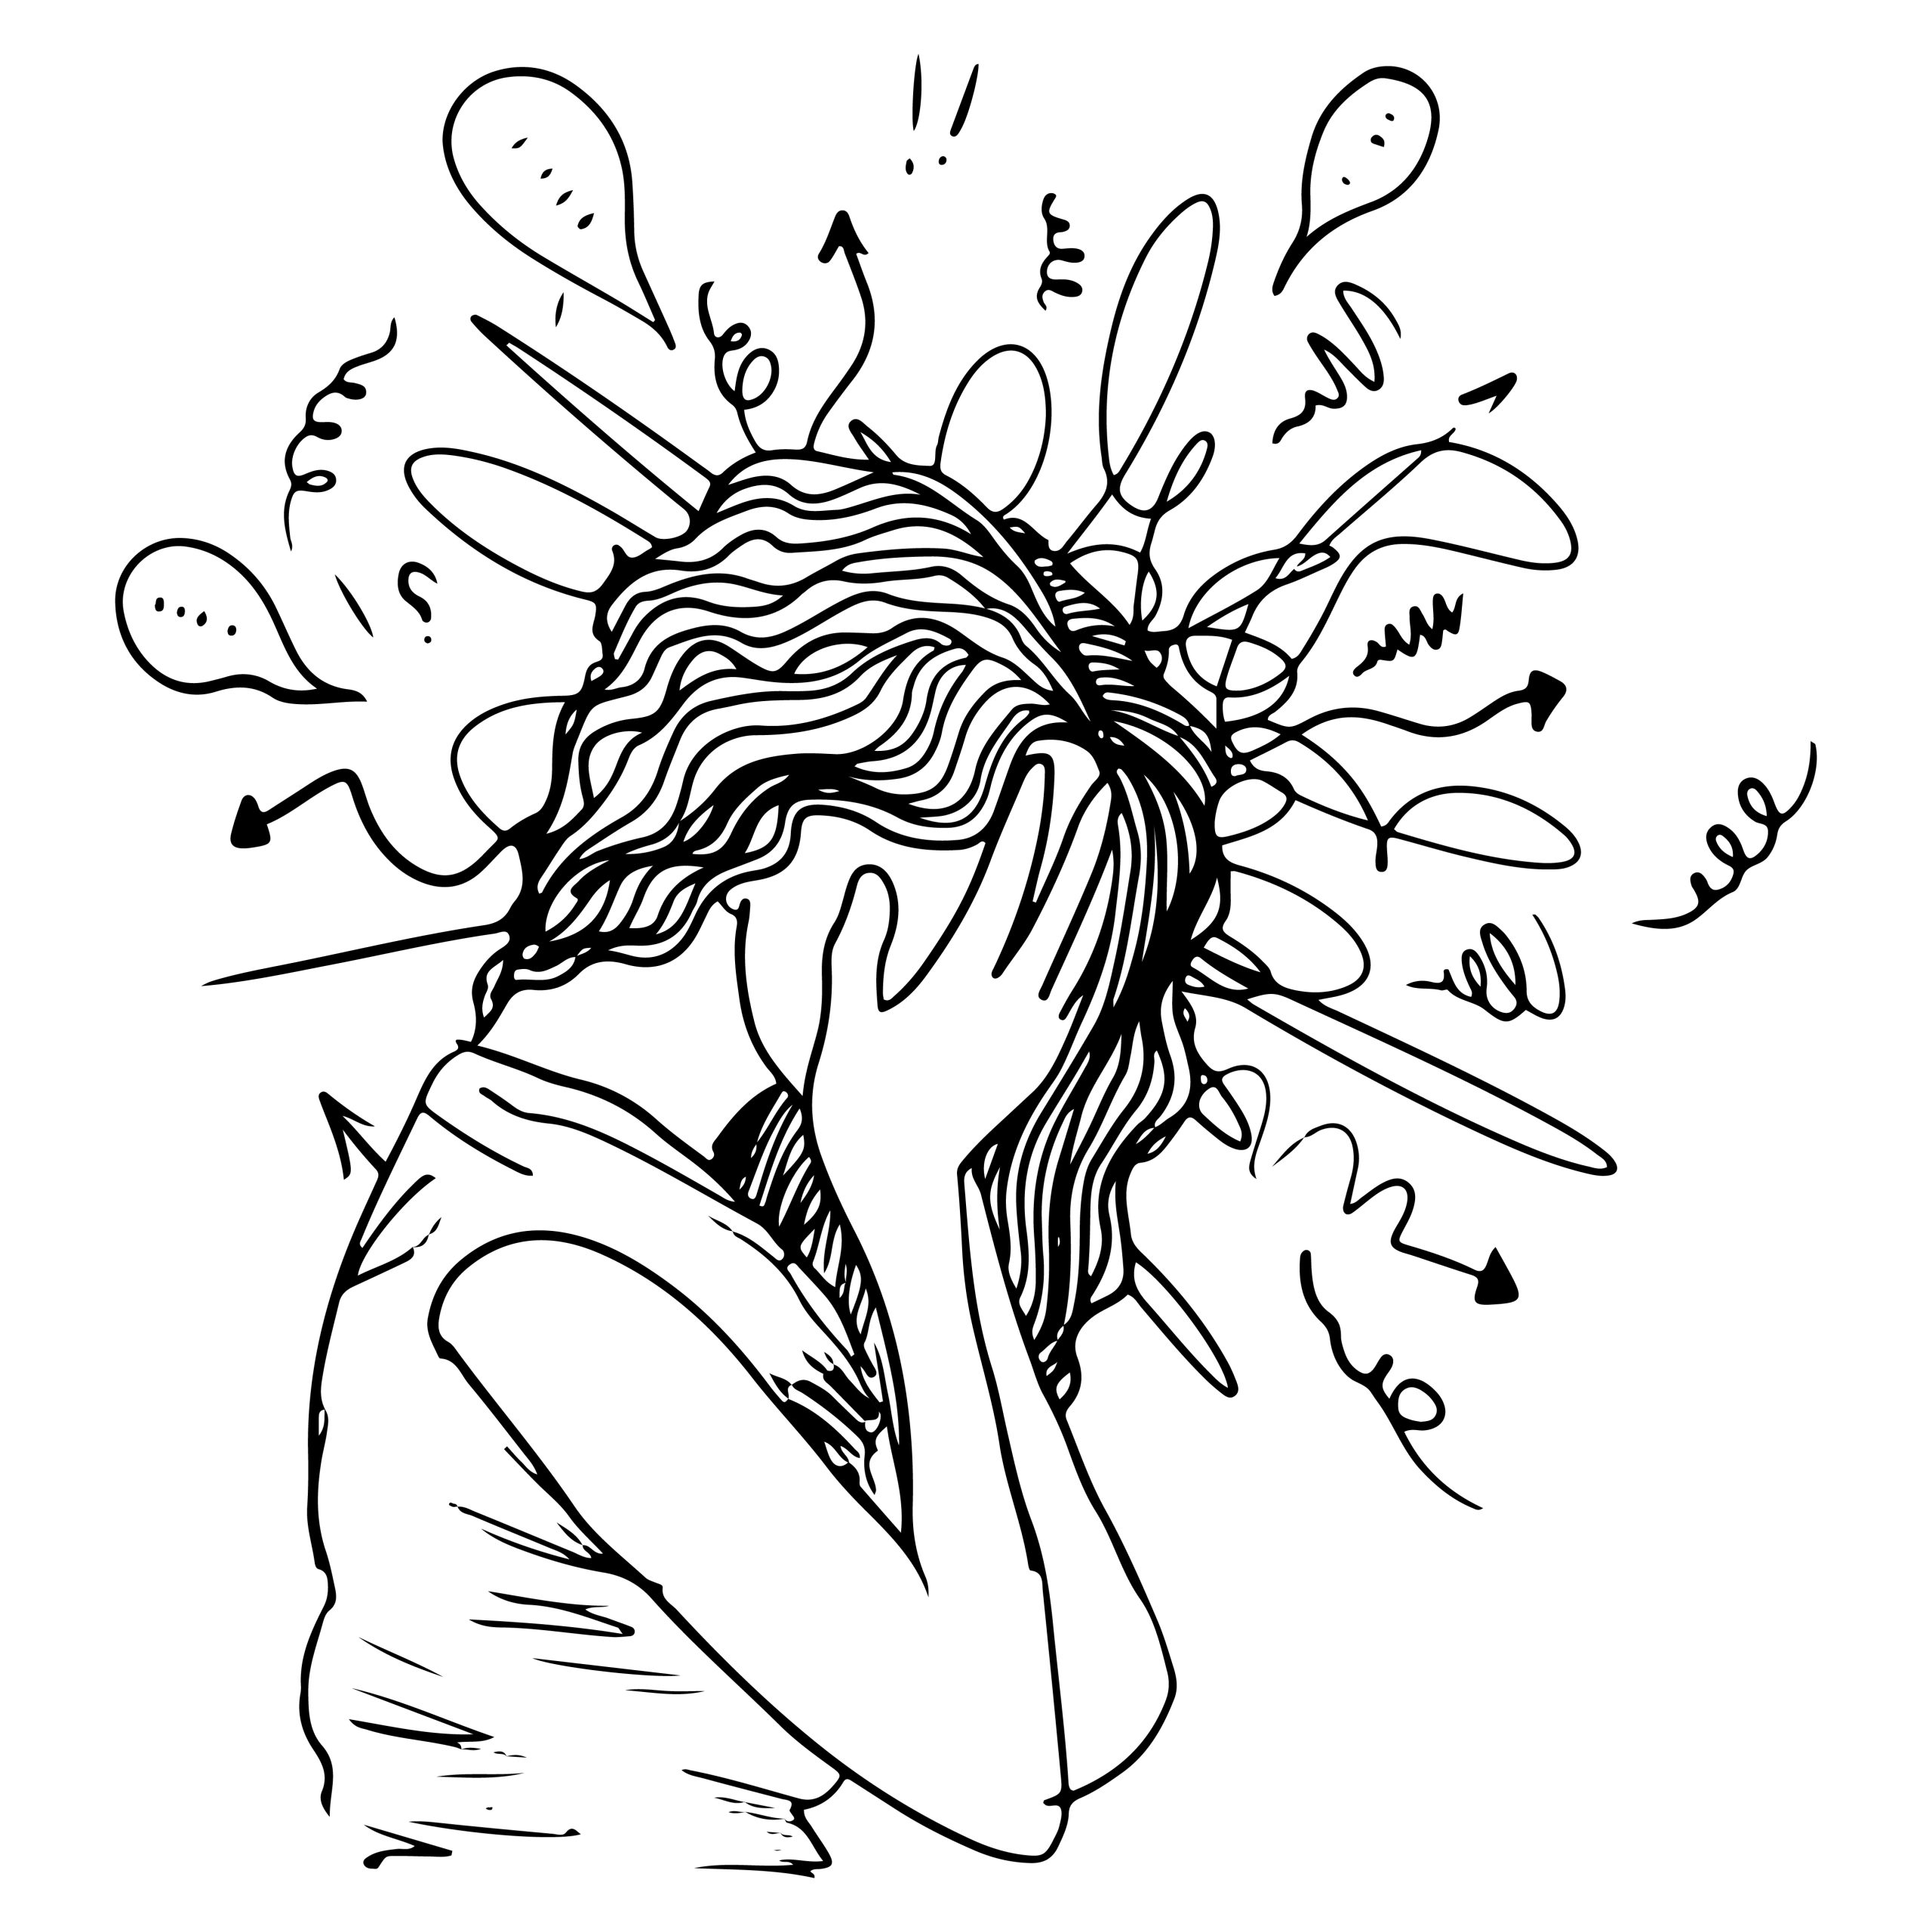
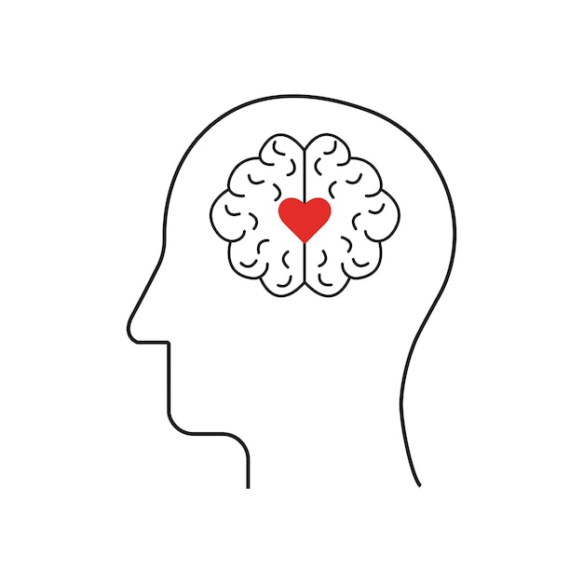

Introduction to Problem
Background
Challenge
Need
There’s a demand for real-time, objective, and non-invasive stress detection to enhance mental health support systems.
In 2023, the number of mental health disorder in Japan reached a record high,883 cases.
Traditional methods of detecting stress often rely on self-reported measures, which can be inaccurate or delayed.
3
Notes:
(HCAMag) Nippon.com

Slide 5
Overview
Integration: The system will be integrated with multimodal Large Language Models (LLMs) like GPT-4 for enhanced detection.
Outcome: Supporting metacognition and mental health care through personalized feedback and dialogue.
Goal: To develop a system that estimates and visualizes user stress levels using Social Signal Processing (SSP) techniques, including facial expression recognition and voice analysis.
4

Slide 6
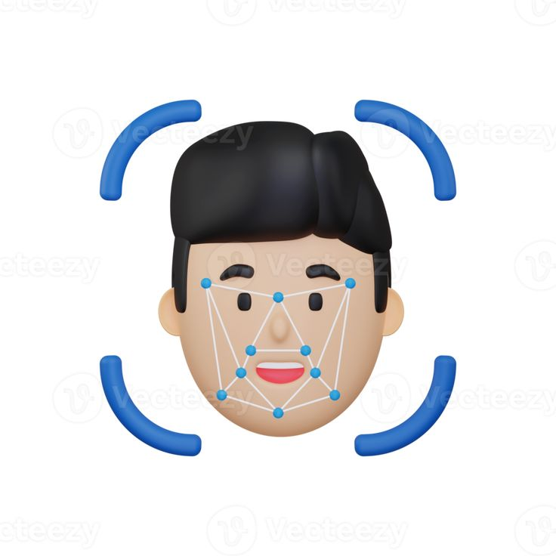
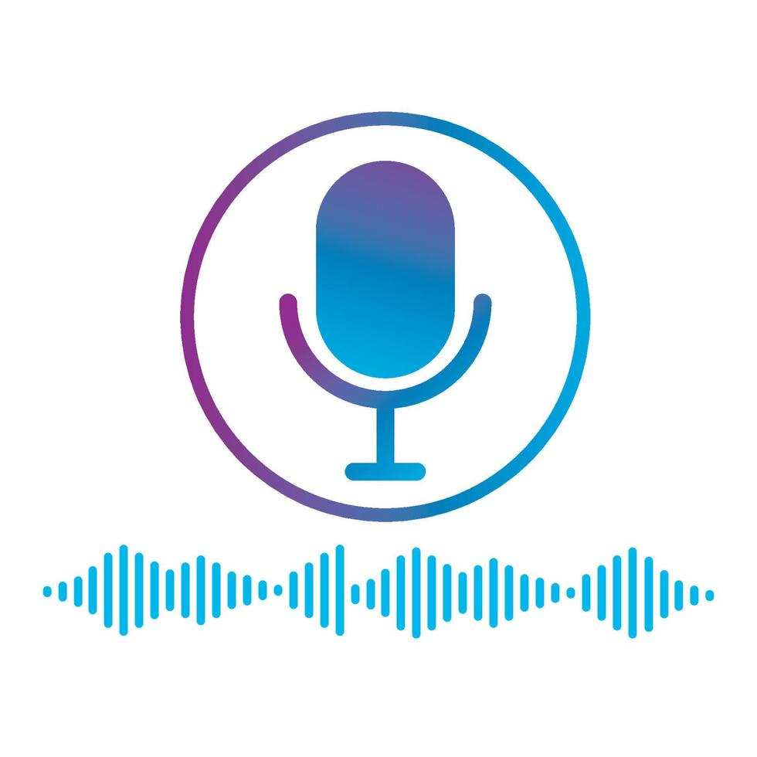

Social Signal Processing(SSP)
Facial Expression Recognition: Detects emotions (anger, sadness, happiness) through micro-expressions and facial cues.
Voice Feature Analysis: Analyses pitch, tone, speed, and other vocal elements to assess stress and emotional states.
Behavioral Cues: SSP also studies non-verbal behavior, including gestures, posture, and eye contact, to interpret social and emotional dynamics in real-time
5

Slide 7
Multimodal LLM Integration
GPT-4o:Powerful in understanding context from multimodal inputs (text, voice, and visual data).
LLM Capabilities: Enhances interpretation of stress-related signals.
Adapts to personalized mental health profiles and patterns over time.
Output: Generates real-time suggestions for stress management ( relaxation techniques, cognitive reframing).
6

Slide 8
Mental Health Care
Personalized Interaction: Tailored conversations based on user stress levels and emotional state.
Metacognition Support: Encourages users to reflect on their emotions and behaviour, improving emotional awareness and self-regulation.
Therapeutic Guidance: Offers therapeutic dialogue techniques such as cognitive-behavioural interventions, mindfulness, and self-compassion.
7

Slide 9
Use Cases and Applications
Clinical settings: Real-time stress monitoring for patients in mental health care.
Workplace wellness: Employee stress tracking and management to improve productivity and well-being.
Personal use: Individuals managing daily stress for improved emotional regulation.
Educational settings: Helping students manage academic stress in real time.
8

Slide 10
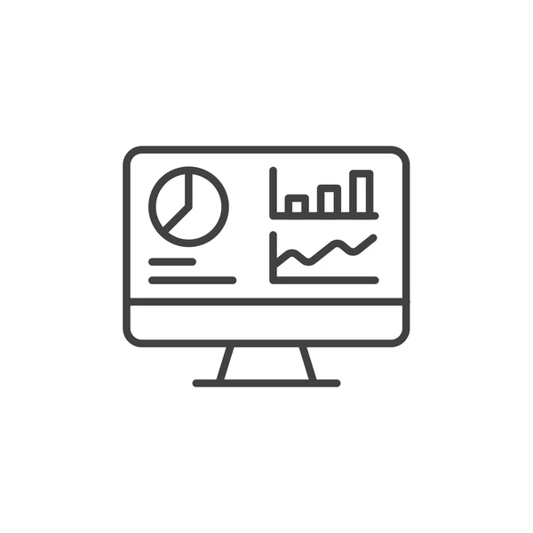


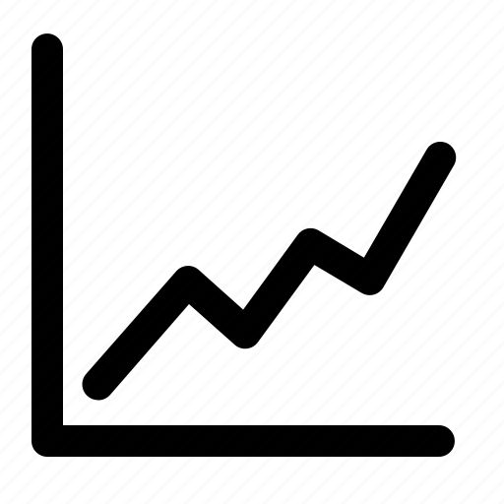

Example of workflow
→
→
→
→
User speaks
Voice is analysed (transcription + features )
LLM evaluates stress level
Stress level is sent to visual dashboard
Graph is updated
9
Notes:
User speaks → 2. Voice is analyzed (features + transcription) → 3. LLM evaluates stress level → 4. Stress level is sent to visual dashboard → 5. Graph is updated

Slide 11
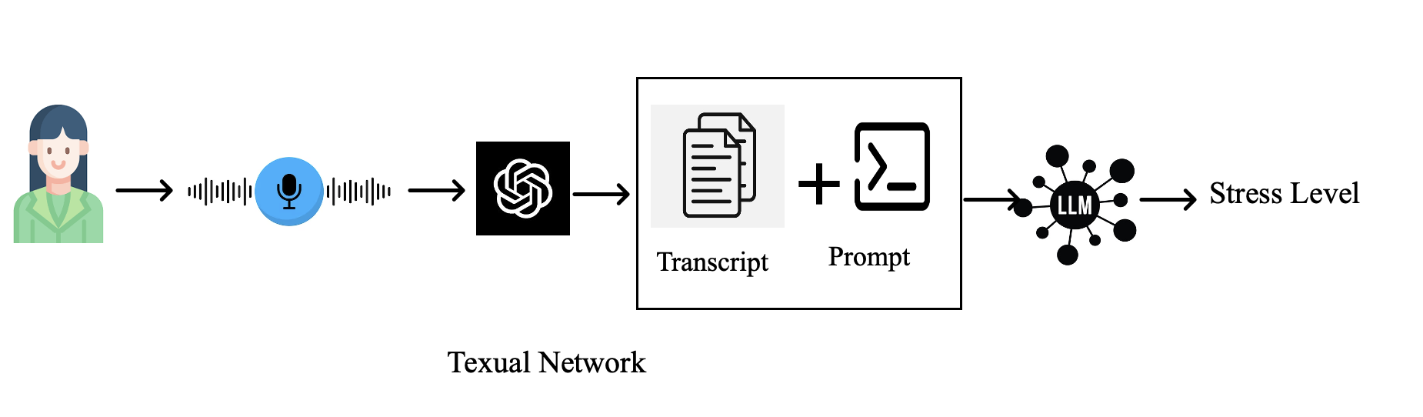
Texual analysis
Input: Voice feature analysis (via microphone)
Processing: Social Signal Processing (SSP) for real-time stress detection.
GPT-4 multimodal integration for interpreting stress patterns.
Output: Stress level visualization (prosodic signal, visualization-based graphs).
10

Slide 12
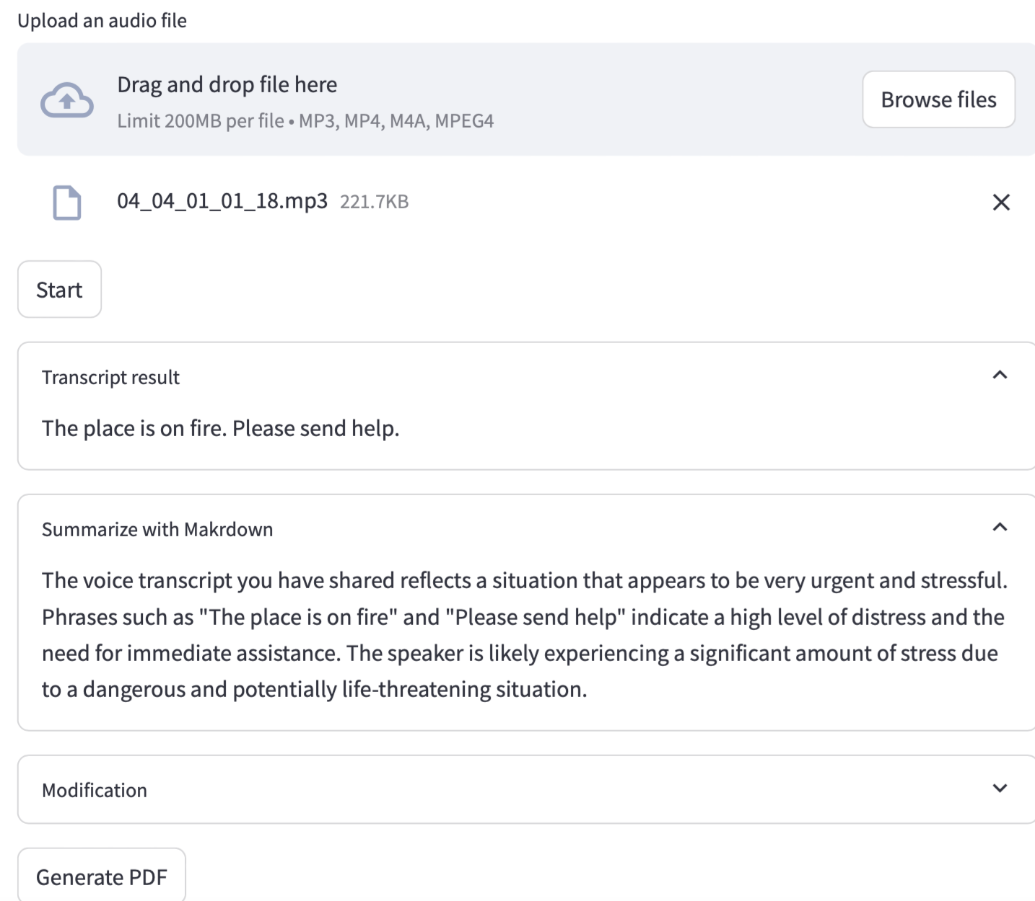
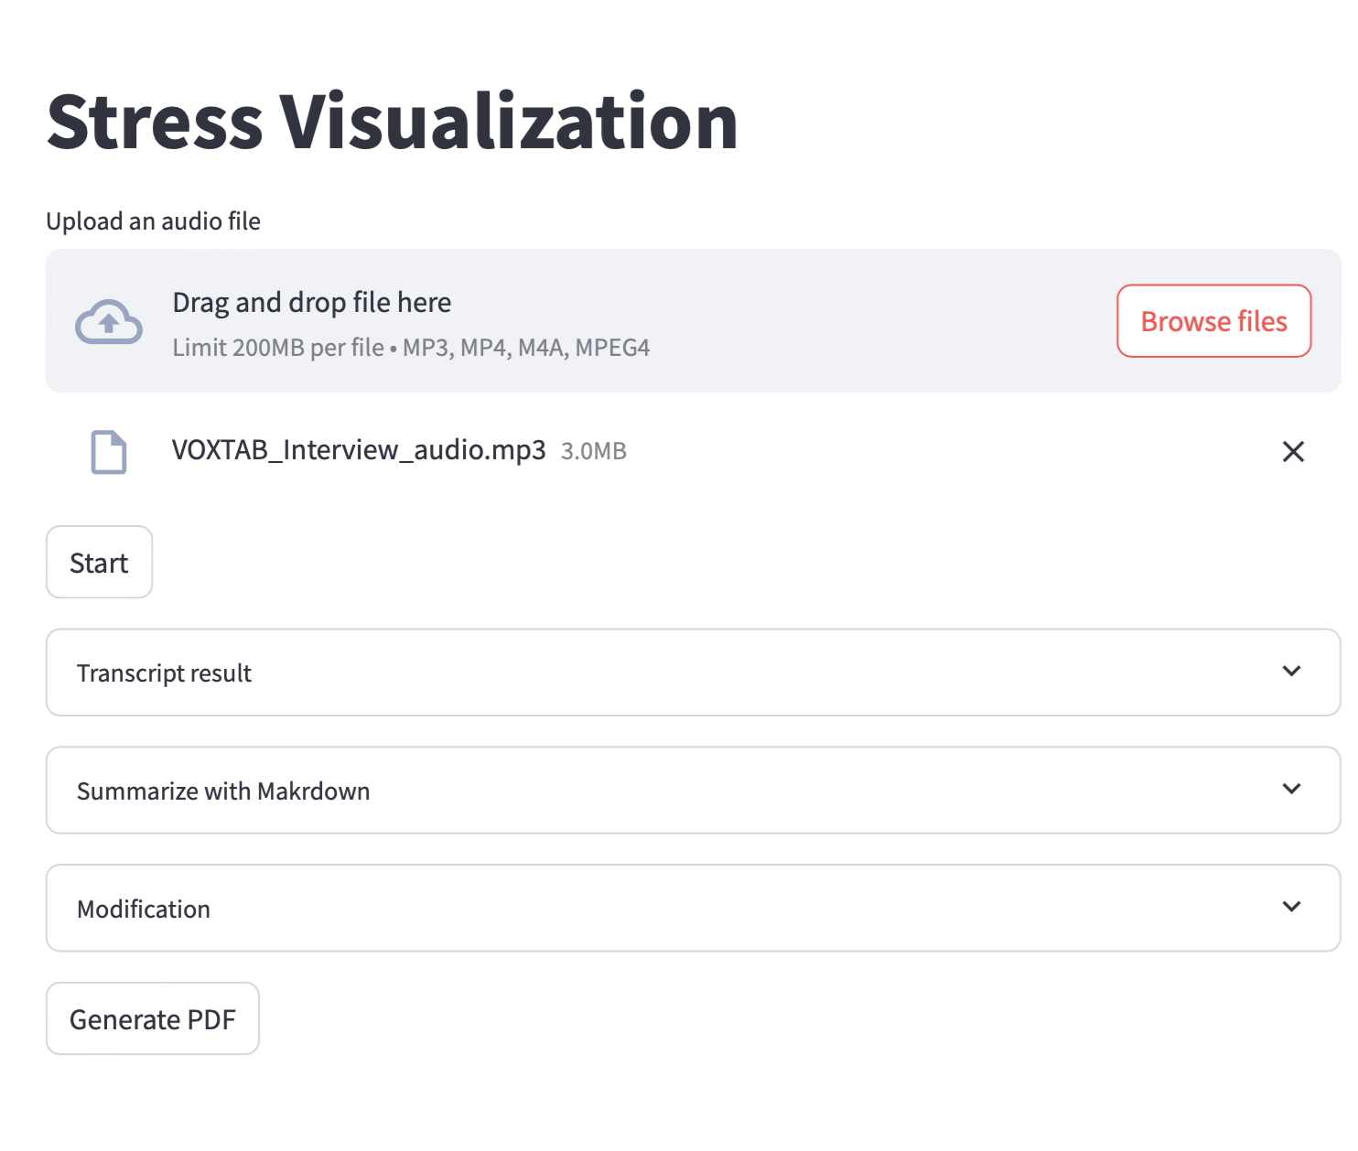
Stress Texual Analysis from audio
11

Slide 13
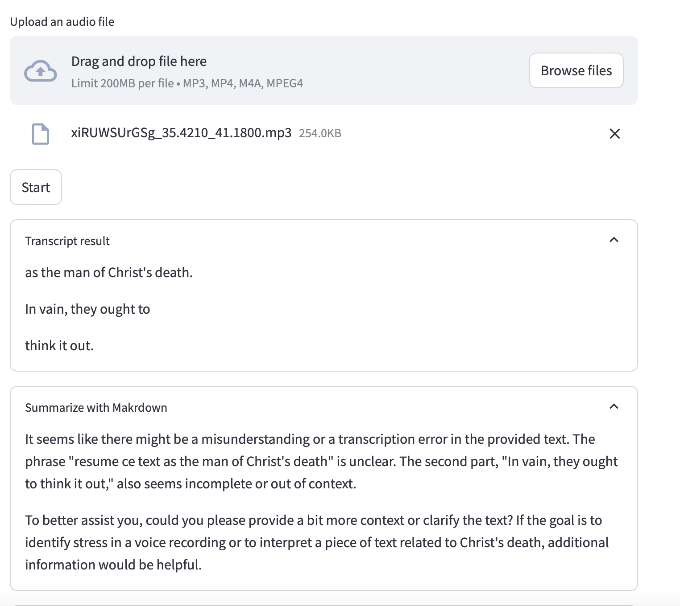
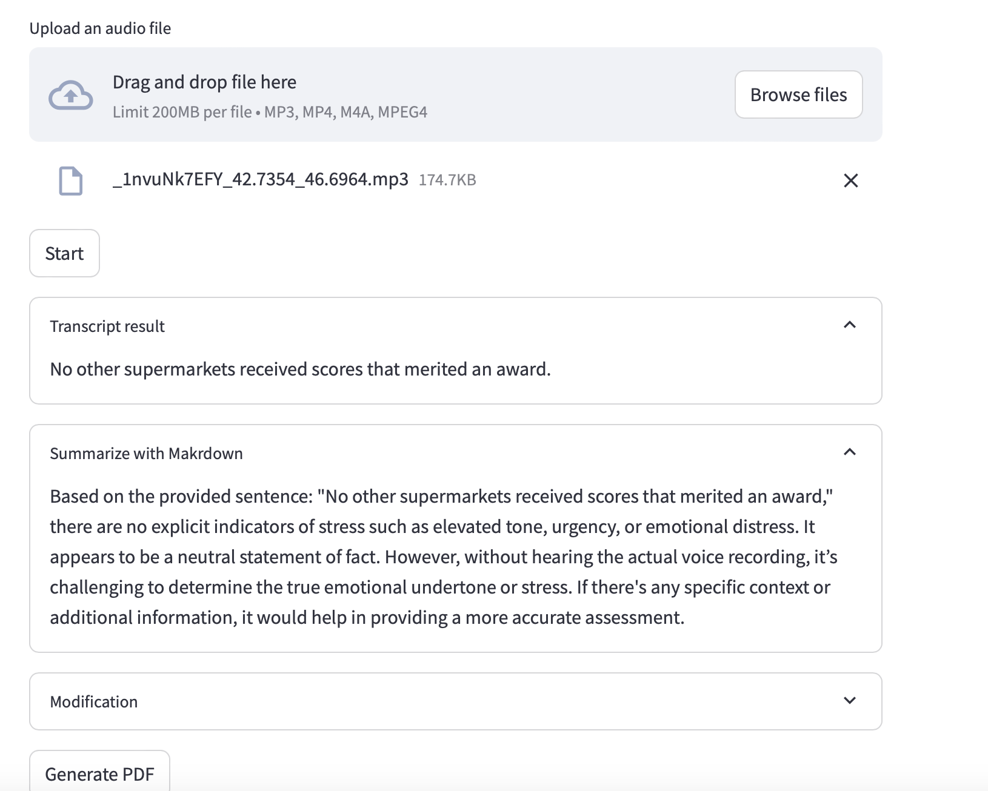
Stress Texual Analysis from audio
12

Slide 14
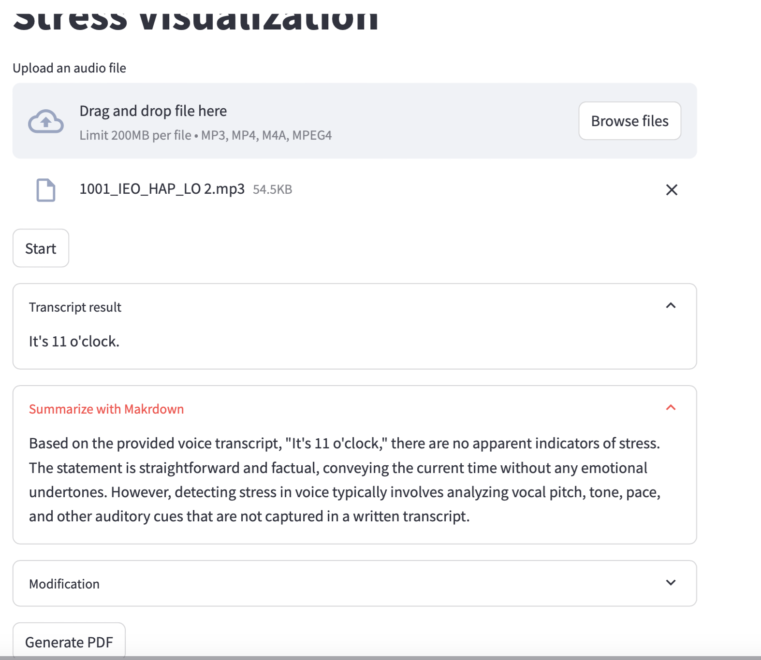
Stress Texual Analysis from audio
13

Slide 15
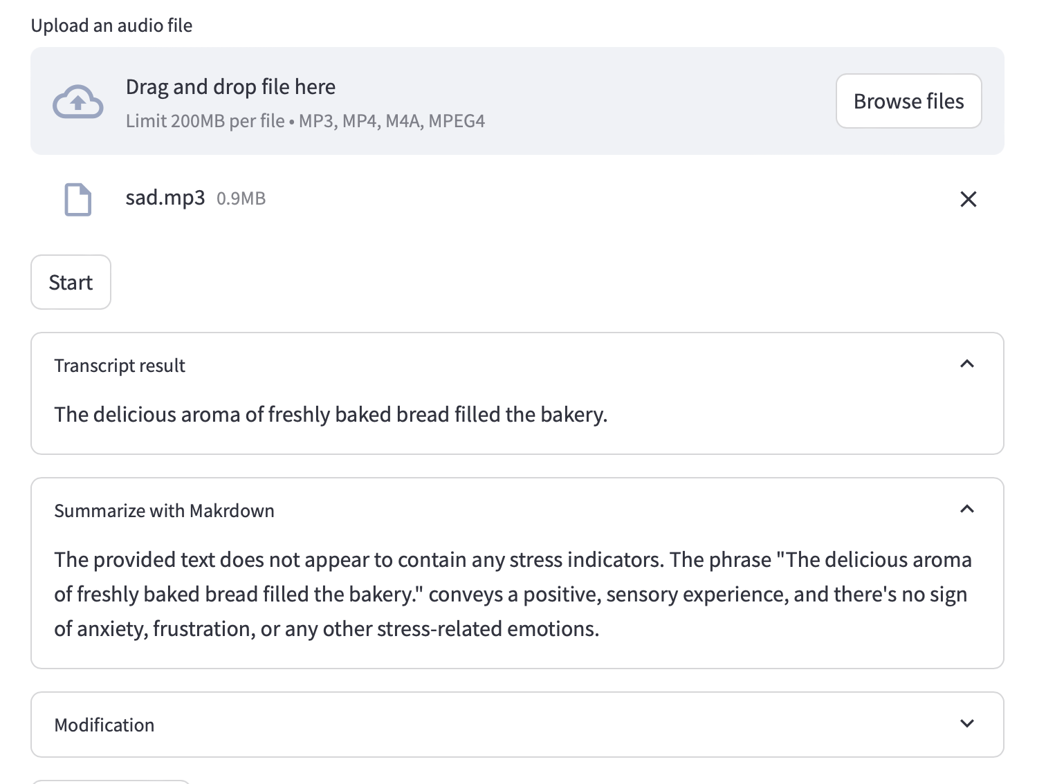
Stress Texual Analysis from audio
14

Slide 16
Explanation of texual analysis (verbal signal)
1. Audio capture: The system capture the audio.
2. Transcription(textual network)
Speech to text model : A raw audio is passed into speech recognition API
OpenAI`s Whisper to convert into text.
This is where the spoken input ("The place is on fire...") is converted into a textual transcript.
Here, I used faster_whisper for audio engine.
Text formatting: The transcript may be cleaned or standardized (removing unnecessary pauses or artifacts) to ensure it is ready for the next step.
15
Notes:
string manipulation techniques like tokenization

Slide 17
Explanation of Texual Analysis (verbal)
3.Texual analysis
Prompt generation: Once the transcript is ready, a prompt is formulated. The prompt might include instructions to analyse the transcript for emotional content or specific stress indicators. This can be done using a template-based approach or dynamic prompt creation, where certain keywords (example: “fire,” “help”) trigger stress-related prompts.
Prompt+transcript to LLM : The transcript and prompt are fed into an LLM (GPT-4o). This step involves packaging the input as a query that the LLM understands, potentially formatted as {"prompt": "from now you are expert to find any stress in the following voice transcript. "}.
LLM Prcoessing: The LLM processes the prompt and transcript, using its pre-trained knowledge of language patterns, semantics, and emotional cues to analyse the text. The LLM evaluates both the content ("fire," "help") and the context ( the urgency in the sentence structure).
4. Stress level estimation
LLM output ( returns a result that include emotional analysis and potential stress level indicators)
Visualization ( generating stress level graphs with prosodic feature)
16
Notes:
Current version of analysis is based on text

Slide 18
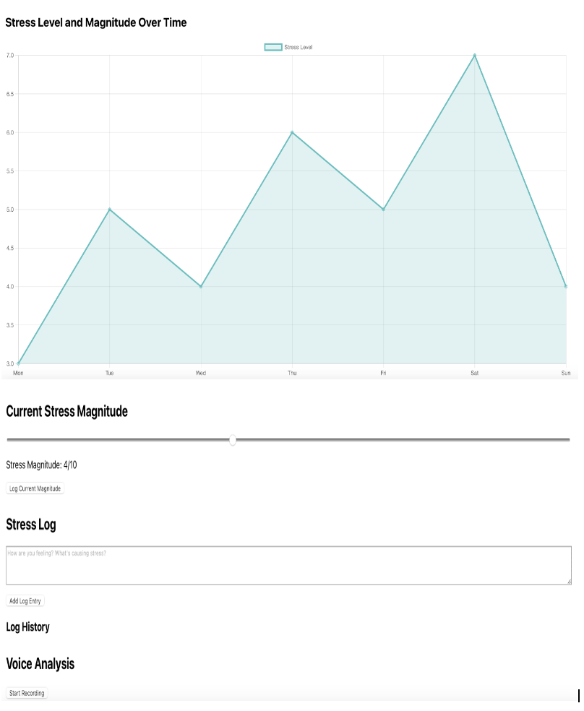
Interface for monitoring and logging stress levels

Slide 19
Key elements
Graph (Stress Level and Magnitude Over Time) : This line graph tracks stress levels over a week, with each day labelled (Monday to Sunday) along the x-axis. The y-axis represents the stress magnitude, ranging from 3.0 to 7.0. The graph shows fluctuations in stress levels throughout the week, with visible peaks and drops.
Current Stress Magnitude Slider – A slider allows users to log their current stress magnitude, which is currently set at 4/10. There’s a button labelled “Log Current Magnitude” to save the input.
Stress Log : A text box is provided for users to describe their feelings or the causes of stress. There's a button to “Add Log Entry” below the text box.
Log History – This section is presumably where previously entered stress logs are stored, but no data is currently visible.
Voice Analysis Section : This section appears to allow voice recordings for analysis. It includes a “Start Recording” button, likely to initiate a voice-based stress analysis feature.
18

Slide 20
Future consideration
Method for voice feature (pitch, speech rate, frequency, jitter, shimmer) analysis.
Stress Visualization technique.
Stress level visualization (non-verbal signal, visualization-based prosody signal).
Real time Facial expression recognition.
Mental health dialogue system for personalized support.
19

Slide 21
Voice feature analysis method
Prosodic Analysis: Pitch, loudness, rhythm, and intonation (highly useful for stress detection).
Spectral Analysis: MFCCs, formants, and frequency content.
Time-Domain Analysis: Amplitude, energy, and zero crossing rate.
Voice Quality Analysis: Jitter(発言変動), shimmer(音量変動), HNR.
Formant Analysis: Formant shifts related to vocal tension.
20
Notes:
Mel-Frequency Cepstral Coefficients, Harmonics-to-Noise Ratio,

Slide 22
Conclusion
This system will combine advanced SSP techniques with LLM capabilities to support stress detection and mental health care.
21

Slide 23
Thank you.

Slide 24
Question?

Slide 25
In voice feature analysis, I did the textual analysis. First, I create system where I upload my audio file and A raw audio is passed into speech recognition API. API convert the audio into text . I used whisper model for audio engine. Then its transcript the text from the audio and summarize it. Once the transcript is ready, a prompt is formulated. The prompt includes instructions to analyse the transcript for emotional content or specific stress indicators. Then based on my prompt, it describes about the stress on the text. The stress is detected from the feature of voice. For stress visualization I am creating a system where user can visualize their stress magnitude over time. Then can save the stress log history. I am using some technique like prosodic analysis for stress monitoring.
Currently, I am focusing on some stress detection model for prosodic feature analysis and real time facial expression analysis. After finishing all my task, I will start writing my thesis. This system will combine advanced SSP techniques with LLM capabilities to support stress detection and mental health care.

Slide 28
Some stress visualization technique
Waveform Visualization: Displays the amplitude of the voice signal over time.
Pitch Contour Visualization: Shows how the pitch varies over time.
Spectrogram Visualization: A visual representation of the voice's frequency content over time.
Energy Intensity Visualization: Shows how the loudness (energy) changes in the voice.
Jitter and Shimmer Plots: Visualizes variability in pitch and amplitude.
Emotion Flow: Tracks changes in emotional states, such as stress or calmness, over time.
Radar Chart: Plots multiple voice features (pitch, jitter, shimmer) on different axes to show stress levels.
20

Slide 29
Voice feature
Pitch: The fundamental frequency of the voice (F0).
Jitter: Variability in pitch over time.
Shimmer: Variability in amplitude over time.
Energy: Overall loudness of the voice.
Spectral Features: Frequency distribution in the voice signal.
Speech Rate: The speed at which the person is speaking.
Formants: Resonant frequencies of the vocal tract

Slide 30
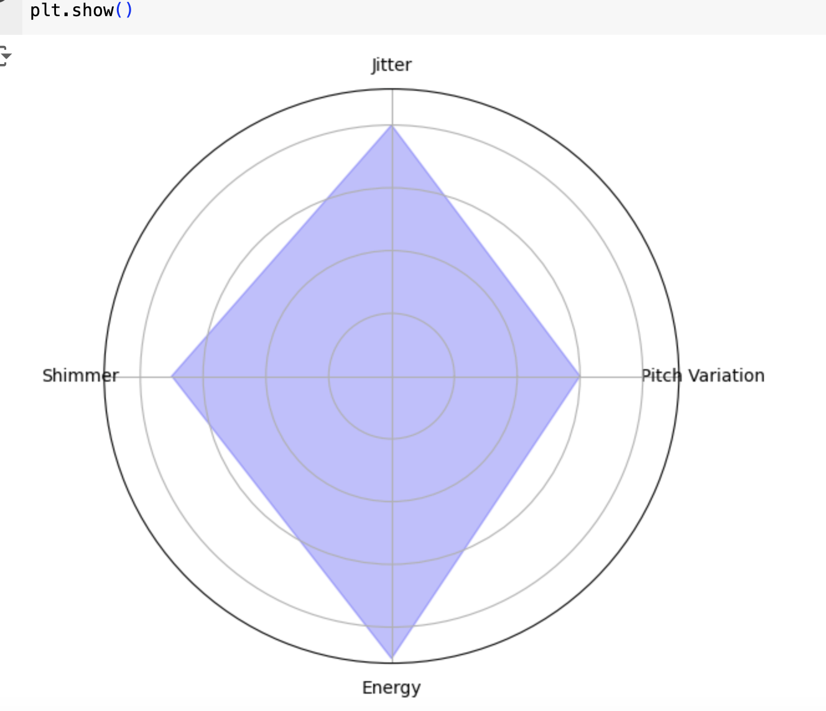
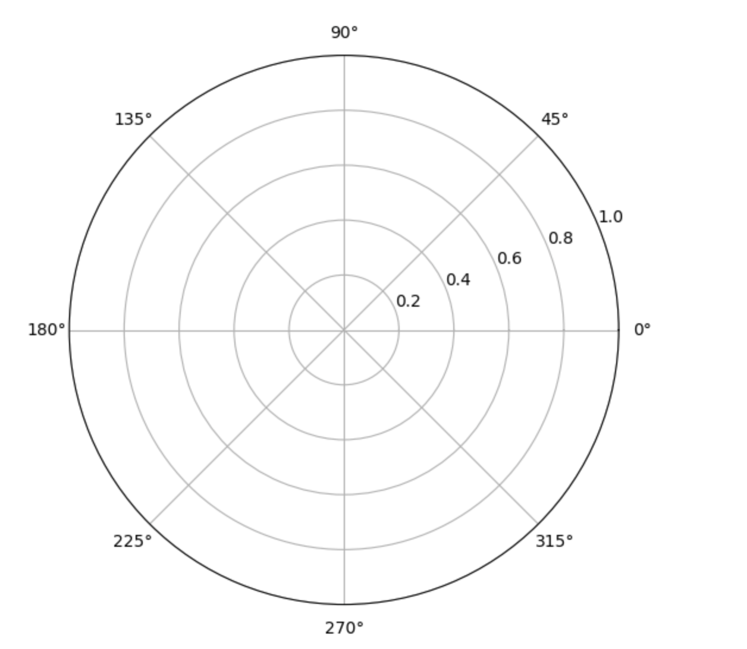
Stress radar(spider plot)
various stress-related vocal features and plot them on different axes of the radar chart. The more the chart expands outward (towards the high values for each feature), the higher the stress level.

Slide 31
Prosdy signal for stress visualization
Pitch
Speech rate
Intensity (loudness)
Shimmer and voice Jitter
Pause and hesitations
Formants frequencies

Slide 32
Stress elements

Slide 33
Prosody and voice

Slide 34
Pitch (Fundamental Frequency) 音高)
Description: Stress often causes a rise or fall in pitch, leading to higher or more variable frequency in speech.
Visualization: Visualize pitch variations over time as a wave or line plot, showing moments where pitch escalates or dips. High-frequency spikes often indicate stress

Slide 35
Speech Rate(発語速度）
Description: People under stress may speak faster or slower than usual. Speech rate, measured in syllables per second, is a clear indicator of anxiety or calmness.
Visualization: A bar or line graph can show speech rate fluctuations over time. Peaks in speech rate correlate with heightened stress or tension

Slide 36
Intensity (Loudness)
Description: Loudness tends to increase during moments of stress. A person may speak more forcefully or at a higher volume.
Visualization: A heatmap can represent loudness intensity, with varying color gradients showing changes in loudness. Red or bright colors can indicate high intensity and potential stress.

Slide 37
Voice Jitter and Shimmer
Description: Jitter (variability in pitch) and shimmer (variability in loudness) tend to increase when someone is stressed, leading to more unstable or irregular speech patterns.
Visualization: Line charts displaying jitter and shimmer changes can show where speech becomes unstable, signaling potential stress.

Slide 38
Pauses and Hesitations
Description: Longer pauses or frequent hesitations in speech can indicate cognitive load or emotional stress.
Visualization: Gantt charts or bar graphs that map speech segments can show where pauses occur, with longer gaps signaling potential stress

Slide 39
Formant Frequencies
Description: Formants represent resonance frequencies in the voice and change with emotional arousal or tension.
Visualization: Spectrograms can visually represent formant frequencies, with stress regions showing up as color or shape changes in the spectrum

Slide 40
Future work
Real time Facial expression recognition.
Visualization based on paralinguistic
Stress level visualization (non-verbal signal, emotion polarity, visualization-based prosody signal, heatmaps).
Mental health dialogue system for personalized support.
16

Slide 41
Stress radar(spider plot)

Slide 42
Future consideration
Visualization based on paralinguistic
Stress level visualization (non-verbal signal, emotion polarity, visualization-based prosody signal).
Real time Facial expression recognition.
Mental health dialogue system for personalized support.
16

Slide 43
Types of stress elements
Environmental ( noise, crowding)
Work-related (deadlines, conflicts)
Personal (relationships, financial problems)
Major life changes ( moving, loss of a loved one)

Slide 44
Stress trigger and context
Magnitude
When a person is stressed, their prosody often changes: pitch may rise, the voice may become louder or more tense, and the rhythm may become less regular. These prosodic features are critical for detecting stress and other emotional states.

Slide 45
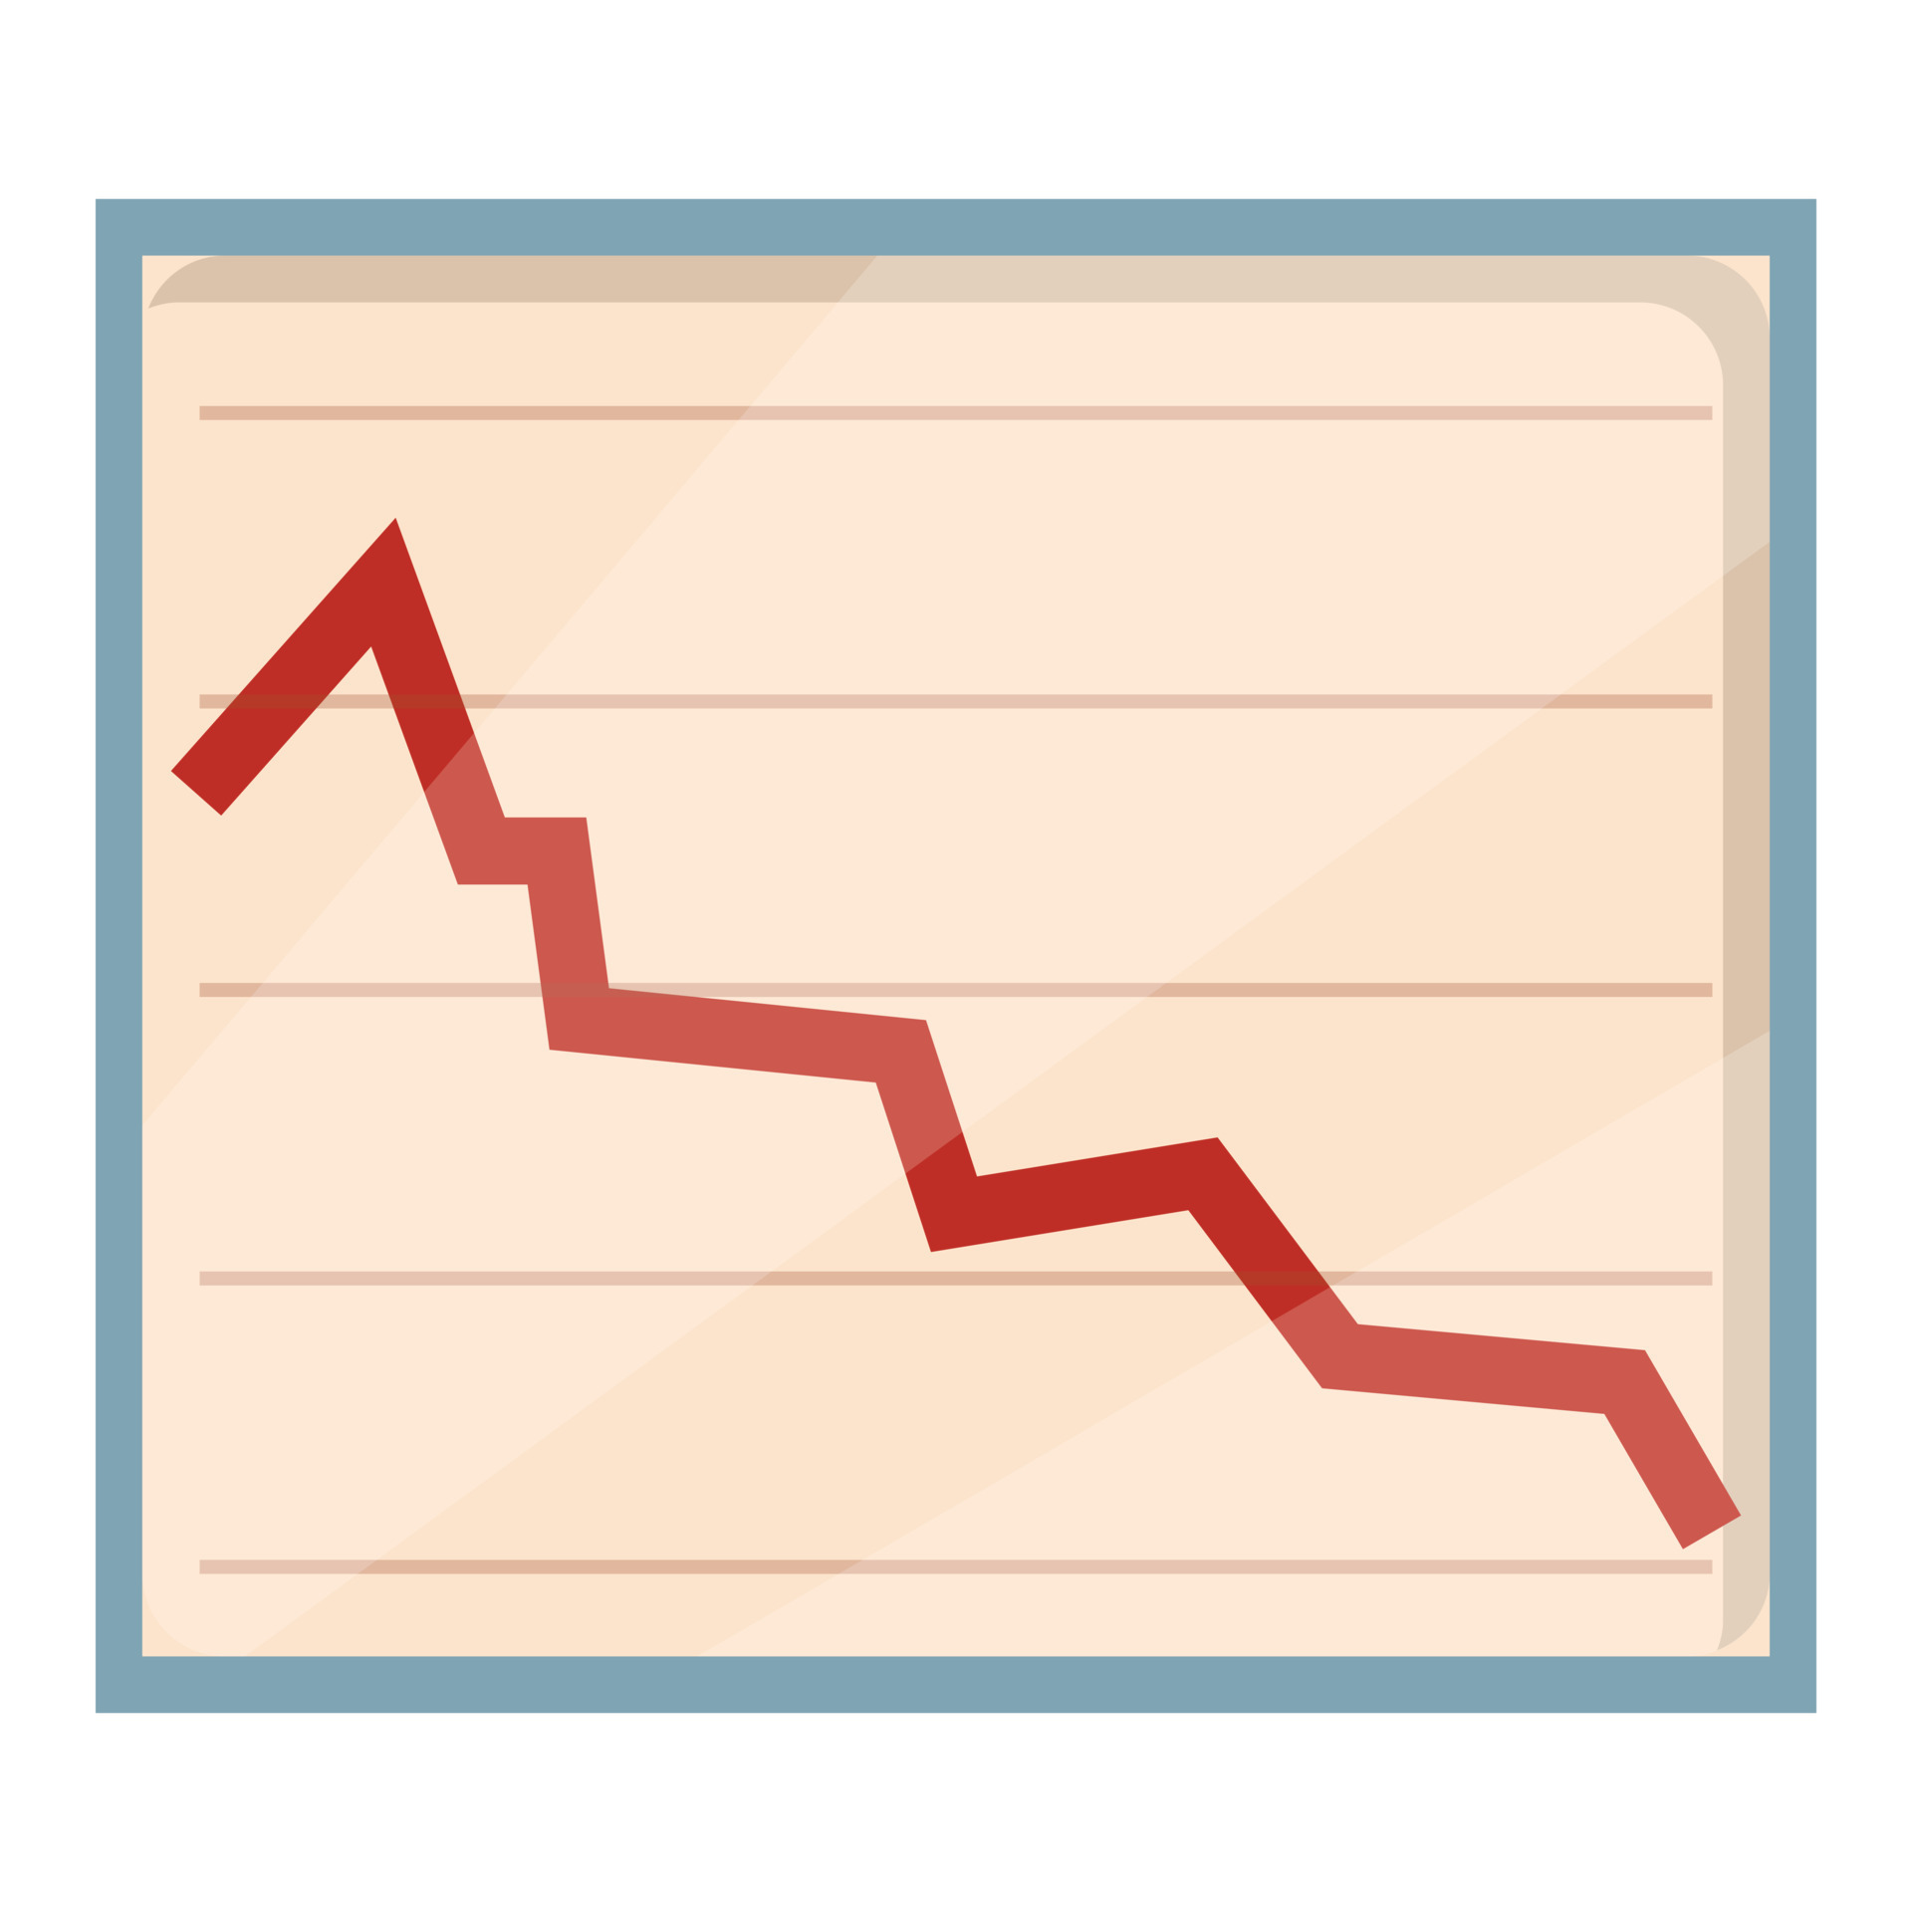
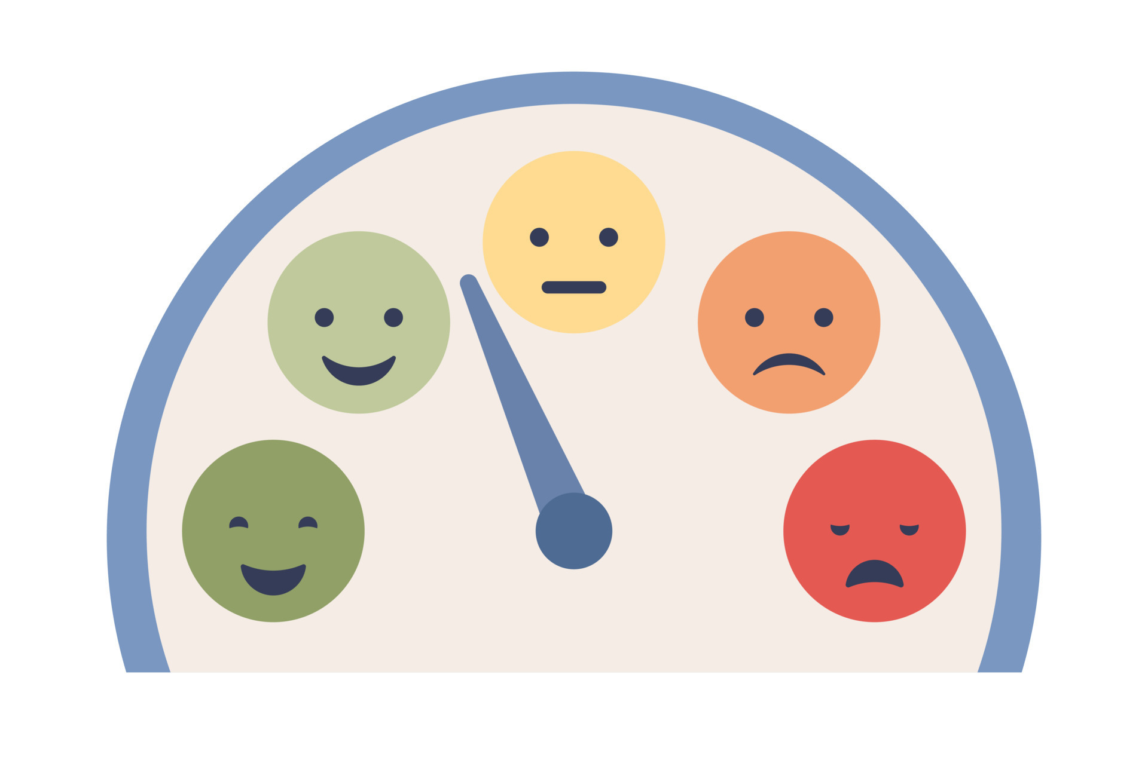

Slide 46
{"prompt": "Analyse the following transcript for signs of distress and urgency."}.
Next Steps: Prototype development, testing with real-world data, and clinical trials.
Audio capture
How to visualize the stress
Current version of visualization is based on text
My slides can be improved by appending more meaningful future work.
Notes:
ホサイン シエダ タンジイナ

Slide 47
Challenges and Limitations
Data Privacy and Ethics:
Managing sensitive user data (e.g., facial expressions, voice recordings) with privacy concerns.
Accuracy:
Ensuring the system accurately detects stress across different individuals and environments.
Technology Adaptation:
Balancing complex AI techniques with user-friendly interfaces.

Slide 48
Future Directions
Enhancing Accuracy: Improving algorithms for better stress prediction.
Broader Integration: Integrating with wearable devices (smartwatches, health trackers) for a more holistic approach.
AI-Empowered Therapy: Further development of the dialogue system into a full-fledged therapeutic assistant.

Slide 49



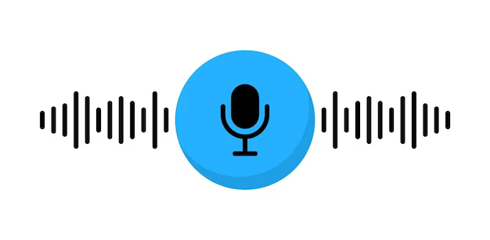



Texual Network
Stress Level
Transcript
Prompt
Texual Network

Slide 50
Input: Facial expression recognition (via camera)
Voice feature analysis (via microphone)
Processing: Social Signal Processing (SSP) for real-time stress detection.
GPT-4 multimodal integration for interpreting stress patterns.
Output: Stress level visualization (prosodic signal, visualization-based graphs).
Mental health dialogue system for personalized support.

Slide 51
Social Signal Processing Techniques
Facial Expression Recognition: Detects emotions (anger, sadness, happiness) through micro-expressions and facial cues.
Voice Feature Analysis: Analyses pitch, tone, speed, and other vocal elements to assess stress and emotional states.
Data fusion: Merges facial and voice data for a more accurate and comprehensive stress assessment.
5

Slide 52



ホサイン シエダ タンジイナ
自己紹介
バングラデシュ
工学専攻 情報工学系プログラム (M2)
35414100
cnq14100@ict.nitech.ac.jp
syedatanzin@gmail.com
趣味
ガーデニング 料理
愛知県のものづくり企業で働きたい

