Slide 1
A Multimodal System for Stress Detection and Visualization using Social Signal Processing and Large Language Models
工学専攻 情報工学系プログラム
HOSSAIN Syeda Tanzina(35414100)

Slide 2
Contents
Introduction
Overview of System
Background research
Social Signal Processing
System design
Audio prosodic features and techniques
Texual analysis with whisper
GPT-4 integration
UI/UX enhancements
Experimental data
Future work
Conclusion

Slide 3
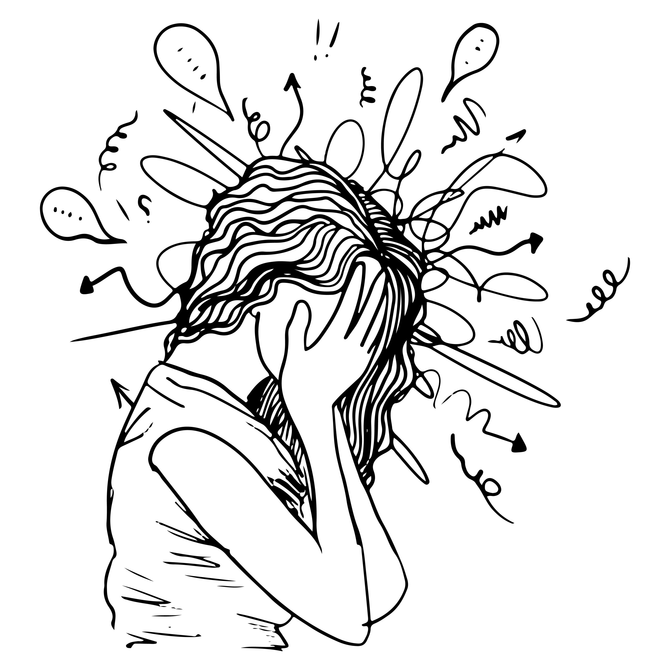

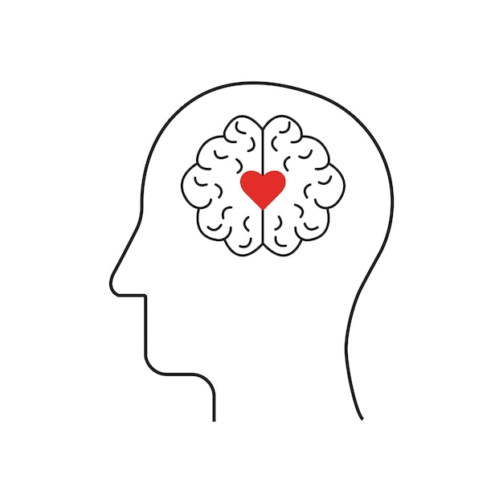
Introduction
Background
Challenge
Need
In 2023, the number of mental health disorder in Japan reached a record high,883 cases.
Traditional methods of detecting stress often rely on self-reported measures.
Relying on text or audio alone method .
Combination of Linguistic and paralinguistic features for stress detection to enhance mental health support systems.
3
Notes:
(HCAMag) Nippon.com
There’s a demand for real-time, objective, and non-invasive stress detection to enhance mental health support systems.

Slide 4
Related research
Year & Author | Technique | Findings | Limitations
Teye [2022] | Study on LLMs & StressPrompt for stress analysis in LLMs | LLMs & Demonstrates performance variations in LLMs under stress using psychological prompts; identifies internal representation shifts similar to humans. | Lacks real-world validation; limited generalizability; results depend on specific LLM design and controlled settings; no physiological equivalence to humans.
Yiqun [2024] | SVM with MFCCs | High accuracy for stress classification by extracting spectral features from speech. | Requires diverse and high-quality datasets; affected by environmental noise; computational challenges for real-time use; individual variability limits model generalizability.
Chyan [2024] | CNN for speech-based stress detection | Utilizes MFCCs and Mel Spectrograms to classify stress in speech with high accuracy. | Controlled setup; binary classification misses stress gradation; lacks real-time validation; ignores real-world noise and dataset variability.
Traditional stress detection methods often rely on single-modal data, such as text or audio.
Traditional methods of stress assessment often require in-person clinical evaluations.
4
Notes:
advancements in Artificial Intelligence (AI) have paved the way for automated stress detection systems.

Slide 5
Overview
Integration: The system will be integrated with multimodal Large Language Models (LLMs) like GPT-4 for enhanced detection.
Outcome: Supporting metacognition and mental health care through personalized feedback and dialogue.
Goal: To develop a system that estimates and visualizes user stress levels using Social Signal Processing (SSP) techniques, including voice analysis for both linguistic (text-based) and paralinguistic (audio-based).
5

Slide 6
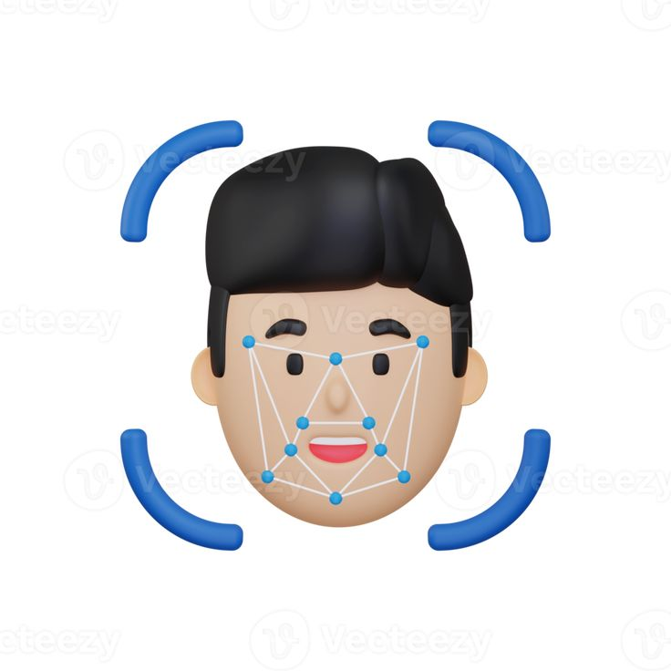
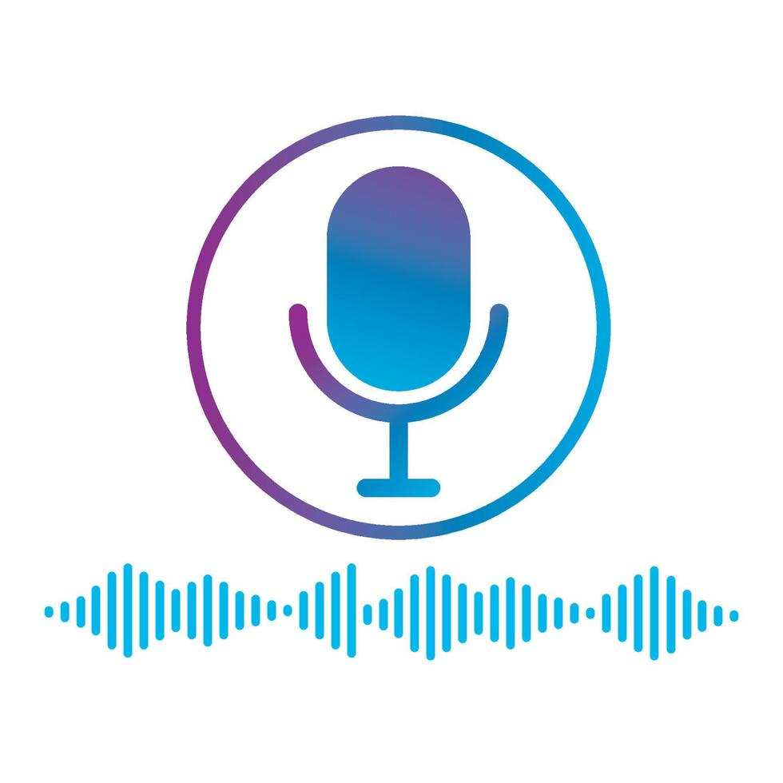

Social Signal Processing Techniques
Facial Expression Recognition: Detects emotions (anger, sadness, happiness) through micro-expressions and facial cues.
Voice Feature Analysis: Analyses pitch, tone, speed, and other vocal elements to assess stress and emotional states.
Behavioral Cues: SSP also studies non-verbal behavior, including gestures, posture, and eye contact, to interpret social and emotional dynamics in real-time
6

Slide 7
Proposed System
Input
Audio File
Audio Processing
Resample to 16 KHz
Convert to Mono
Normalized Audio
ASR
Whisper Model
MelSpectogram Transform
Feature Extraction
Energy Features
Special Features
Zero-Crossing Rate
Transcribed Text
Energy Mean and Std
Spectral Centroid
Signal Changes
Feature Normalization
Emotion Recognition Model (SpeechBrain)
Emotion Scores
GPT-4 Analysis
Stress Assessment
Stress Analysis
Output
Stress Level
Confidence Score
Stress Indicators
Recommendations
7

Slide 8
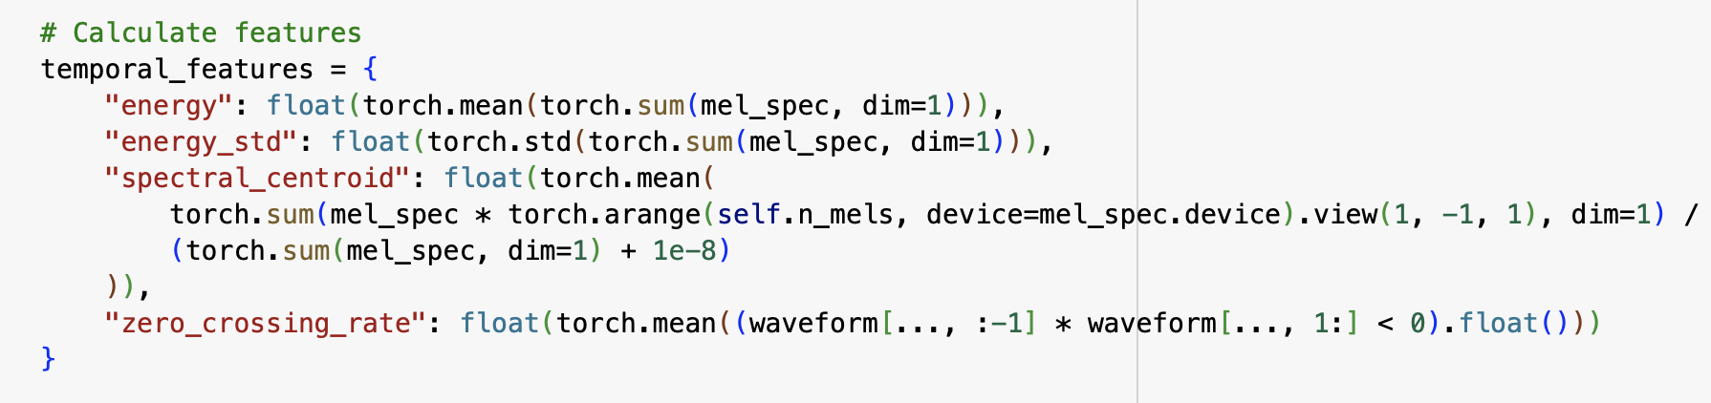
Audio prosodic features
The system utilizes MelSpectrogram transformation for detailed spectral analysis and extracts four critical acoustic features that correlate with emotional states and stress levels:
Energy: Measures the overall signal intensity, reflecting loudness variations, which can indicate heightened emotions such as anger or excitement.
Energy Standard Deviation: Captures fluctuations in volume, helping to differentiate between calm (steady energy) and stressed (irregular energy) states.
Spectral Centroid: Represents the center of frequency distribution, where higher values may indicate high-pitched, tense speech associated with stress or anxiety.
Zero Crossing Rate: Quantifies the rate of signal sign changes, linked to pitch variations; increased rates often reflect nervousness or agitation.
8
Notes:
Jitter: Variability in pitch over time.
Shimmer: Variability in amplitude over time.
Energy: Overall loudness of the voice.

Slide 9
Feature extraction techniques
A. Energy Features (Volume/Intensity)
Uses Root Mean Square (RMS) energy from Mel Spectrogram
Formula: E = √(1/N ∑|x(n)|²)
E is energy
x(n) is signal amplitude
N is frame length
Captures voice intensity and stress patterns
B. Pitch Features (Spectral Centroid)
Calculates weighted mean of frequencies
Formula: SC = ∑(f(n) * M(n)) / ∑M(n)
f(n) is frequency
M(n) is magnitude
Indicates voice pitch characteristics
C. Rhythm Features (Zero Crossing Rate)
Measures signal polarity changes
Formula: ZCR = (1/T) ∑|sign[x(n)] - sign[x(n-1)]|/2
T is frame length
x(n) is signal value
Detects speech rhythm and periodicity
9

Slide 10
Feature-Emotion Correlations
A. High Energy Features
Associated with active emotions (anger, happiness)
Indicates heightened emotional states
Higher stress correlation
B. Spectral Features
Higher frequencies → positive emotions
Lower frequencies → negative emotions
Mid-range → neutral states
C. Rhythm Features
Rapid changes → agitated states
Steady patterns → calmer states
Irregular patterns → stress indicators
A. Angry Speech Characteristics
High energy
High zero-crossing rate
Large energy variations
B. Happy Speech Characteristics
High energy
Higher spectral centroid
Moderate variations
C. Sad Speech Characteristics
Low energy
Lower spectral centroid
Moderate variations
D. Neutral Speech Characteristics
Medium energy
Consistent patterns
Low variations
10
Notes:
Acoustic-Emotional Mapping Principles

Slide 11
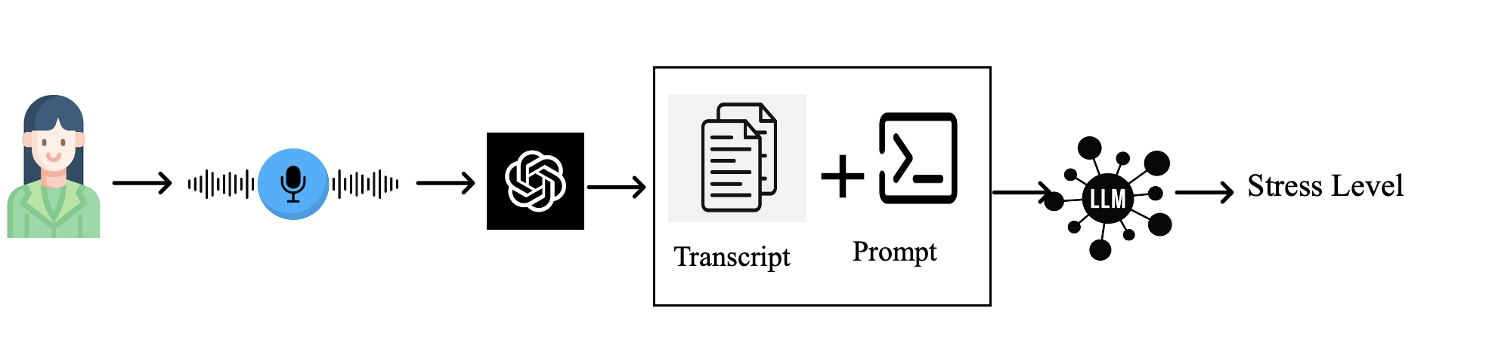
Whisper Texual analysis
1. Audio capture: The system capture the audio.
2. Transcription(textual network)
Speech to text model : A raw audio is passed into speech recognition API
OpenAI`s Whisper to convert into text.
This is where the spoken input ("The place is on fire...") is converted into a textual transcript.
Here, I used whisper for audio engine.
Text formatting: The transcript may be cleaned or standardized (removing unnecessary pauses or artifacts) to ensure it is ready for the next step.
11

Slide 12

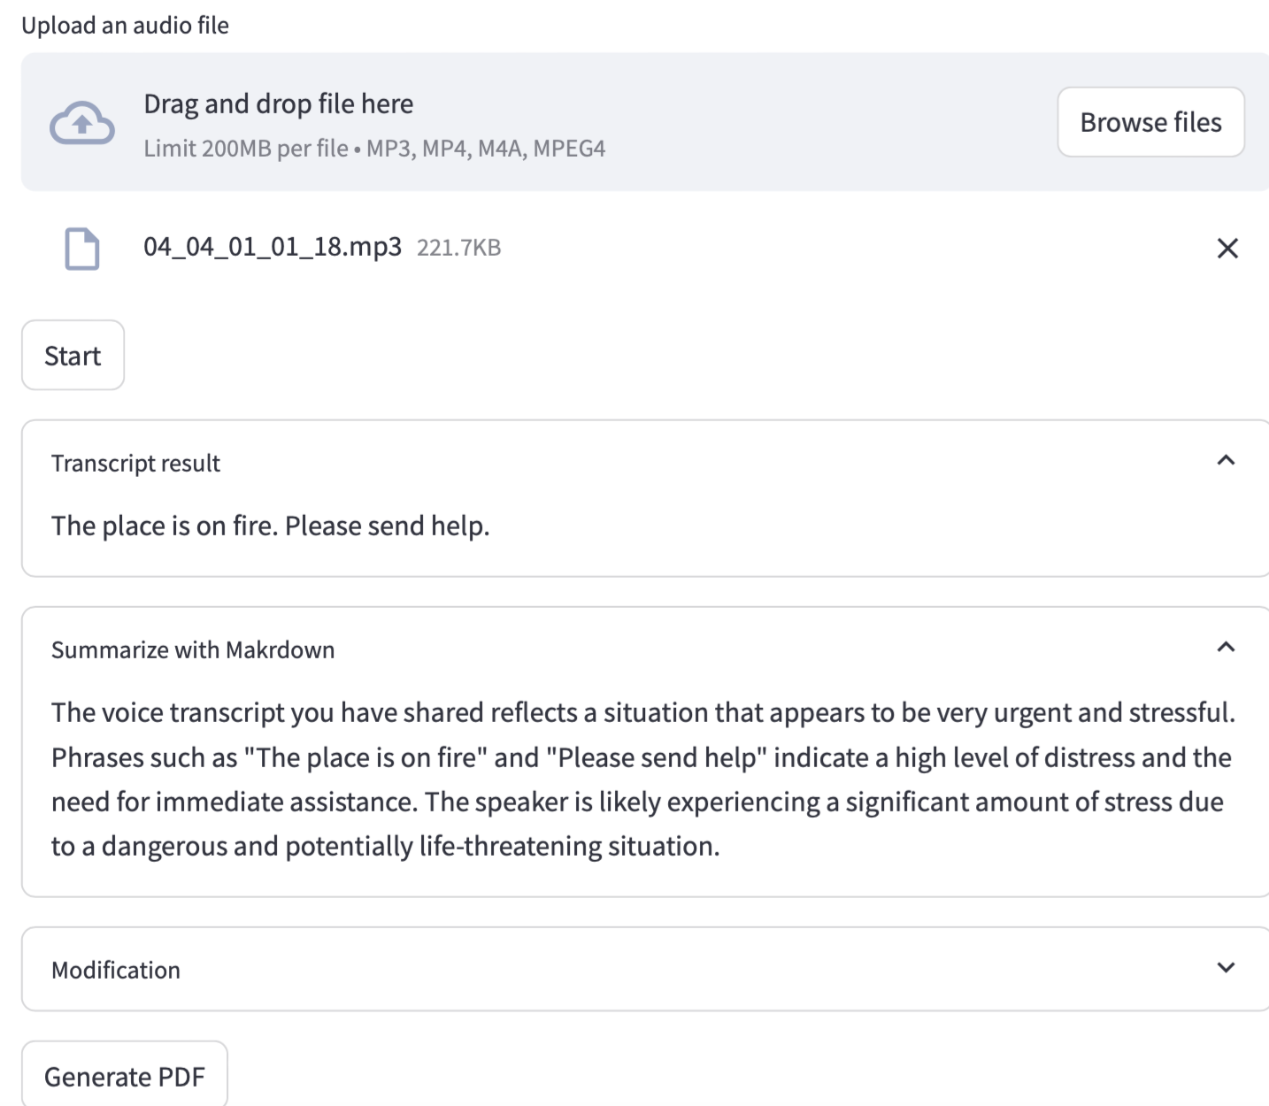
Stress Textual Analysis from audio
Upload Audio file
Audio file
Transcript result
Summary analysis
12

Slide 13
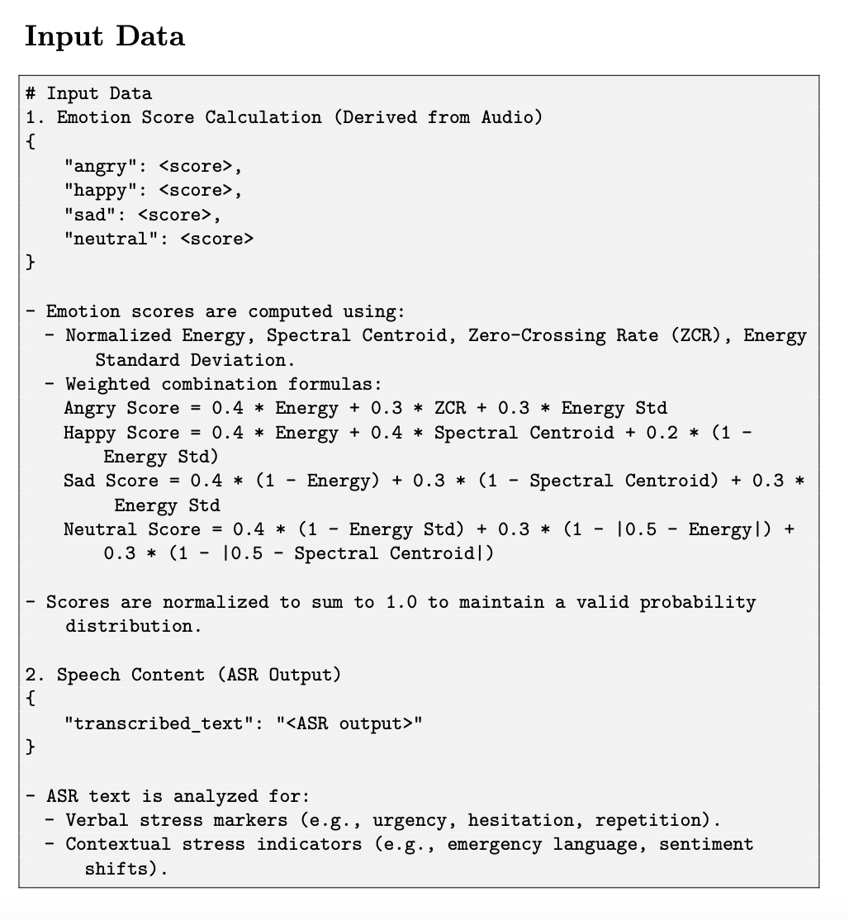
Stress analysis input sources
13

Slide 14
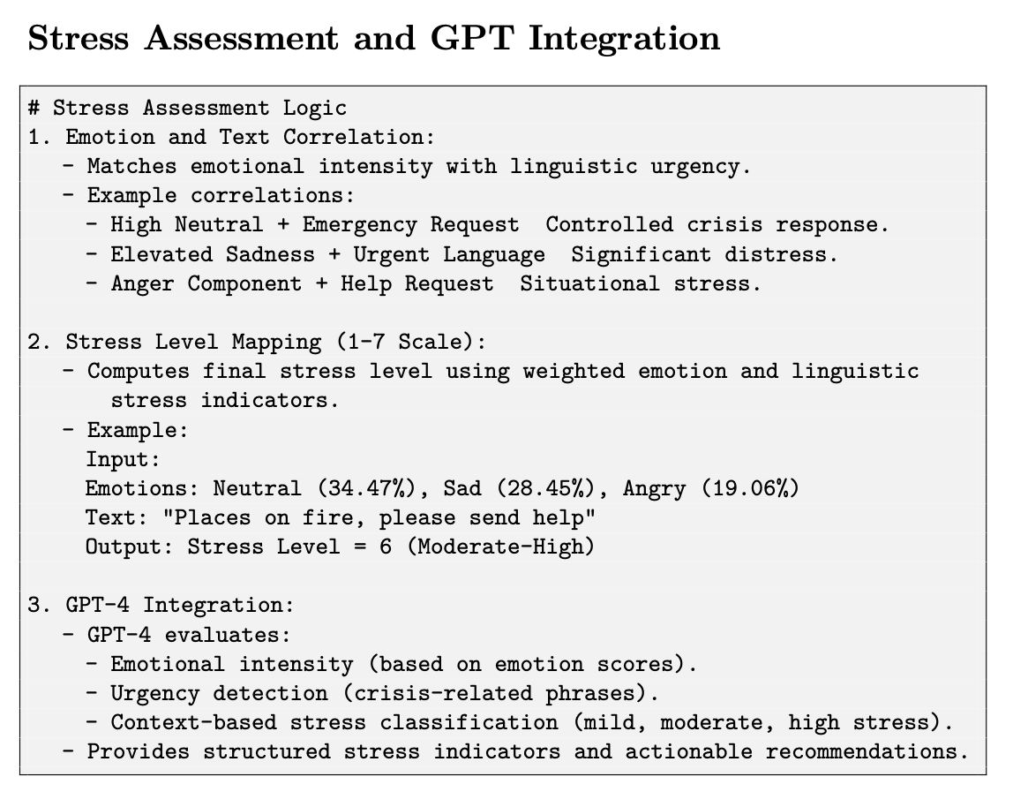
Stress Assessment and LLM integration
14

Slide 15
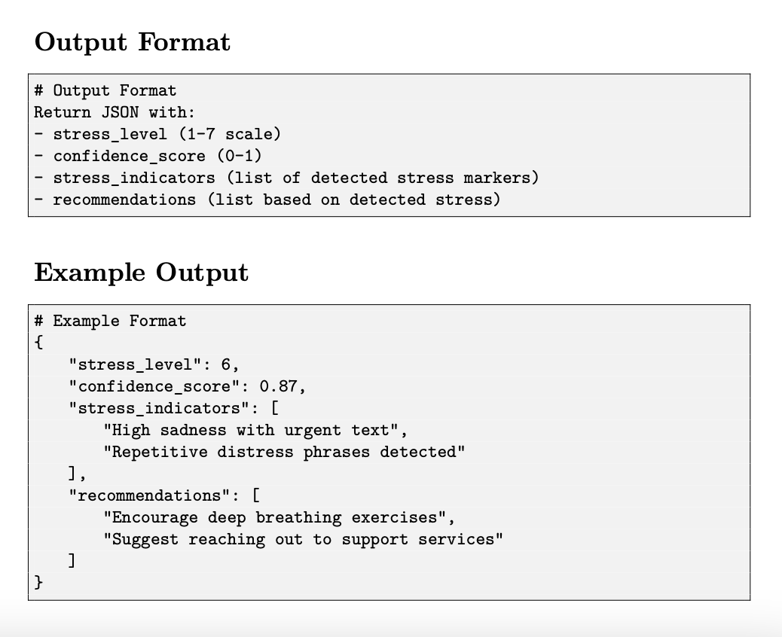
Stress Assessment and LLM integration
Combining Emotions and Text for Stress Detection
Workflow: Emotion scores + text transcription → Input to GPT-4.
GPT-4 combines linguistic and paralinguistic cues.
Outputs stress level, confidence score, and actionable recommendations
15

Slide 16
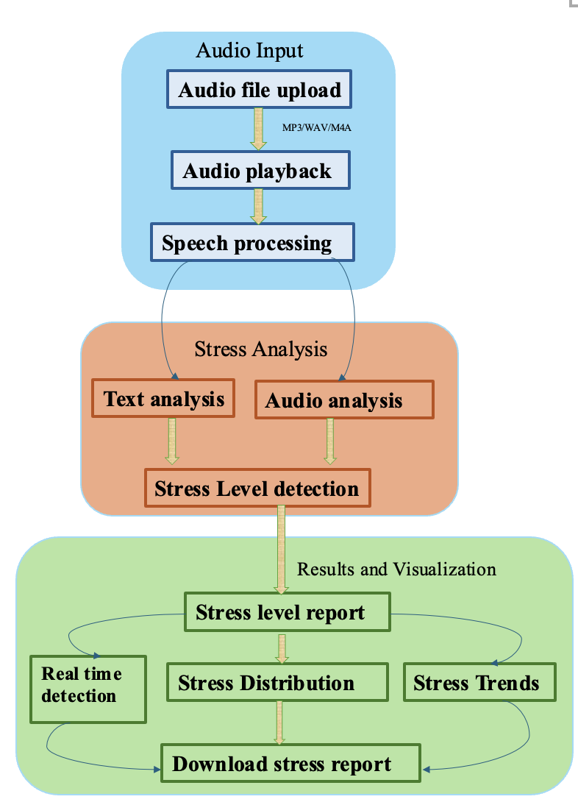
UI/UX enhancements
The stress detection system gives users insightful information about their stress levels and visualisation. Important elements:
Frontend (Streamlit): Manages input processing, output visualisation, and user interaction.
Backend (Flask): Controls response generation, model integration, and data processing.
16

Slide 17
Text and audio processing flow
Audio File
GPT-4
Stress Analysis
Response Generator
Whisper Model
Input audio file
Voice-to-text Conversion
Raw transcript text
System Prompt:
Role: Stress Analyzer
Task: Analyze stress related context
Output: Stress level 1-7 scale
Raw analysis text
Stress Level:
Low (1): Relaxed
Low (2): Normal
Low (3): Slight Stress
High (4): Moderate
Very High (5): Intense
Extreme (6): Severe
Critical (7): Maximum
Generate Response with:
Numeric stress level
Analysis explanation
Transcript text
Final Response Object
Audio File
Whisper Model
GPT-4
Stress Analysis
Response Generator
17
Notes:
text

Slide 18
Frontend to Backend Connection and Backend API Endpoint
Frontend (Streamlit)
Whisper Model
GPT-4
Storage
Backend (Flask)
POST/detect stress (audio file)
Save audio to data/latest_audio.mp3
Load base model
Transcribe audio
Return transcript
Send transcript for analysis
Analysis stress level (1-7 scale)
Return stress analysis
Save stress history
Return results (JSON)
Stress level
- Transcript
- Analysis Text
Frontend (Streamlit)
Backend (Flask)
Whisper Model
GPT-4
Storage
18
Notes:
audio

Slide 19
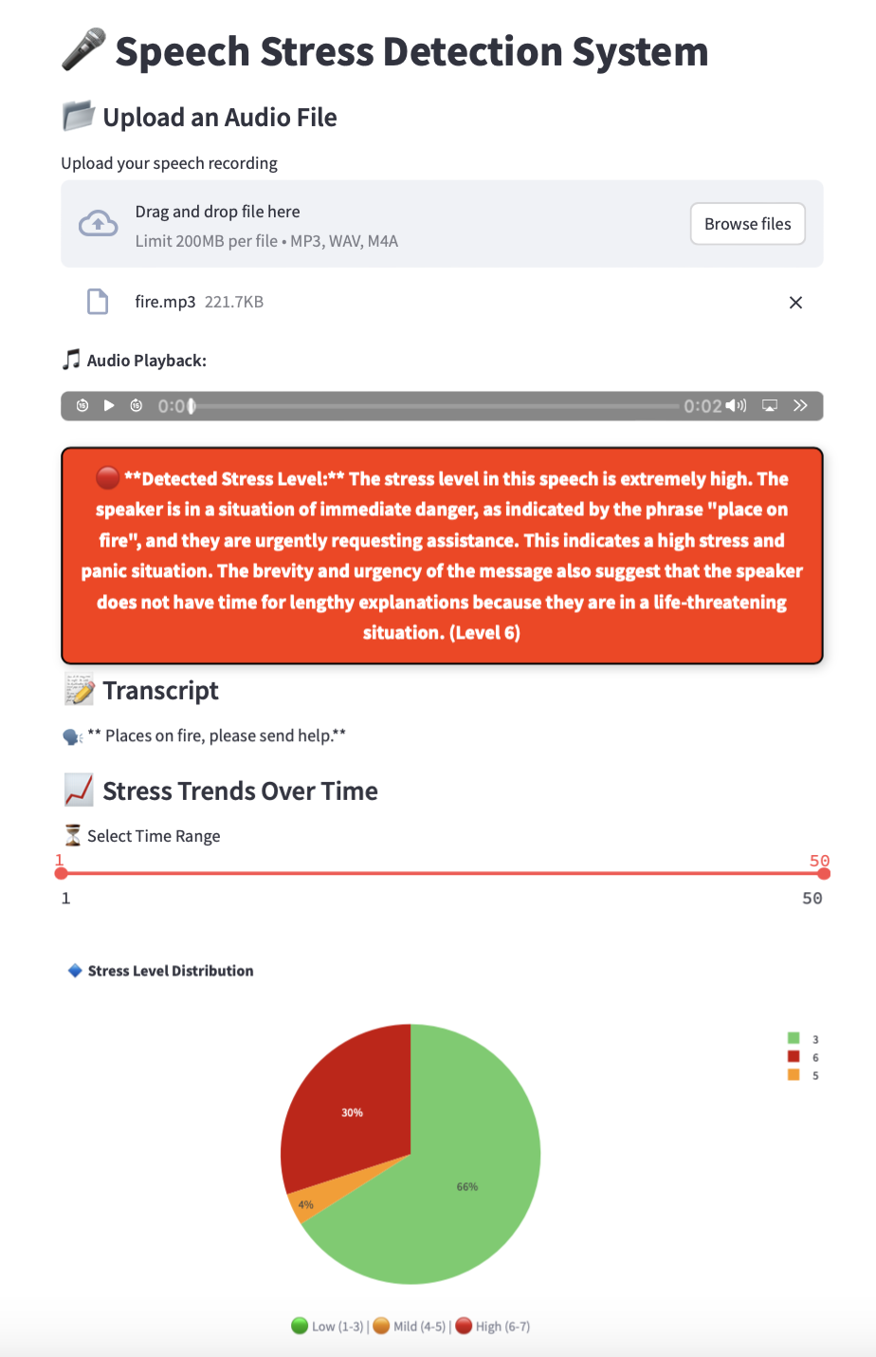
Voice stress detection system
Upload Audio file
Audio playback
Stress Level estimation and explanation about situation
Transcription
Selecting time range for visualize stress
Stress level distribution & Visualization
Low(1-3), Mild(4-5), High(6-7)
19
Notes:
Downloadable reports: Users have the option to obtain comprehensive reports with stress analyses in PDF format.

Slide 20
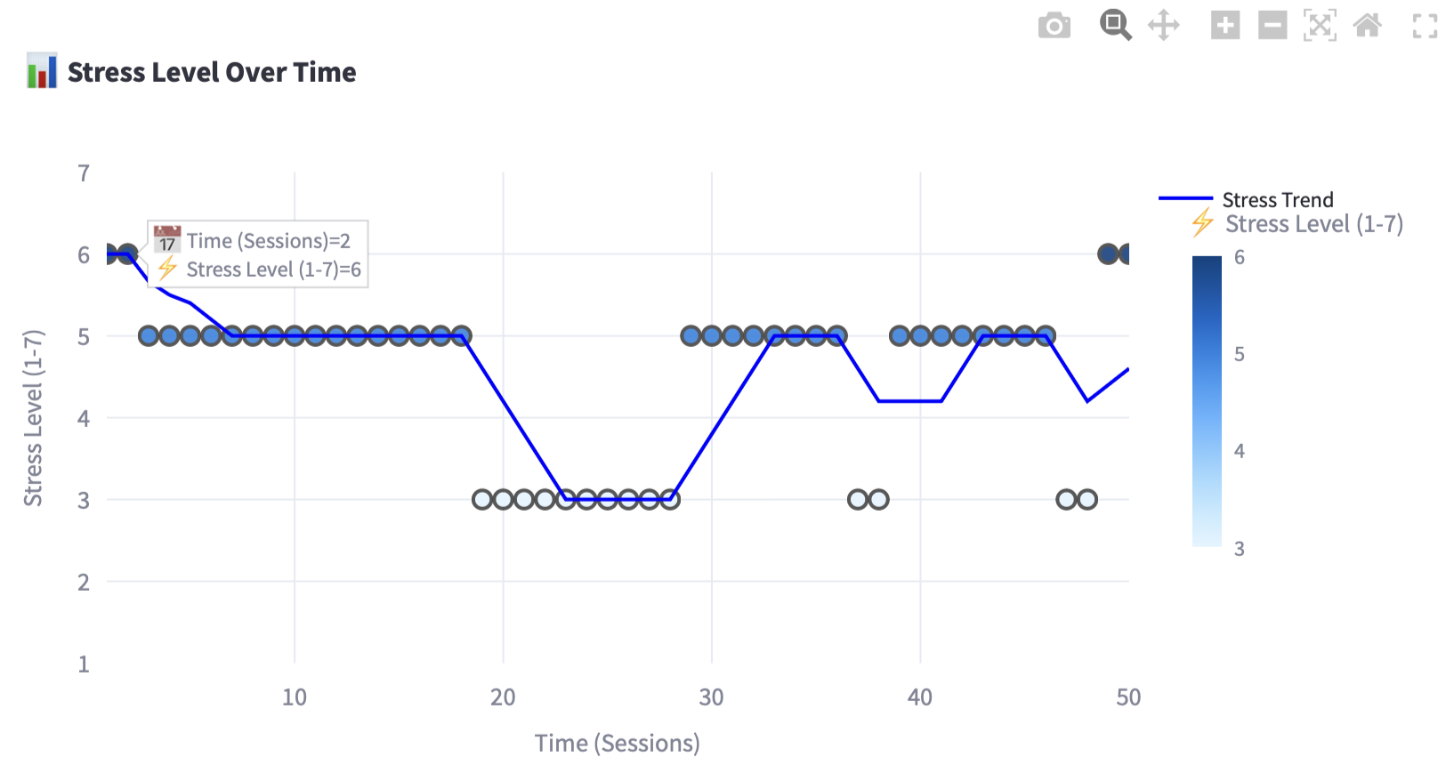
Stress trend Tracking
To help track past stress levels for long-term insights, figure present line graphs with markers to visualize user stress patterns.
The moving average is displayed by the blue trend line.
The dynamic stress trend graph which automatically updates upon each upload, improved readability
20

Slide 21


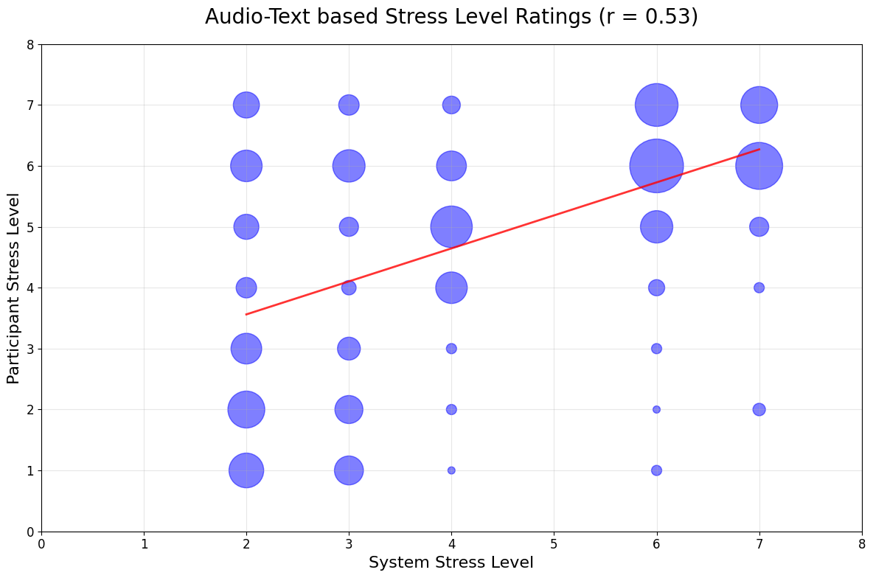
Experiment results
Survey for stress level assessment using a linear scale (1-7)
Rate the stress level for Audio
12 audio
40 Participants
Audio-Text-based coefficient is slightly higher than Text-based, indicating a marginally stronger relationship when integrating both modalities.
21

Slide 22
Conclusion
Limitations:
Instead of recording live speech inputs, the system processes pre-recorded speech.
Summary:
A multimodal stress detection system that uses (LLMs) and SSP to combine text-based and speech-based stress analysis.
User-centred Stress visualisation was used to create an interactive real-time user interface.
Stress trend visualization, which allows users to follow stress changes over numerous sessions, in contrast to traditional stress detection methods that provide immediate assessments.
22
Notes:
This study presented a multimodal stress detection system that uses large language models (LLMs) and Social signal Processing to combine text-based and speech-based stress analysis.
User-centred Stress visualisation was used to create an interactive real-time user interface (UI) that lets users upload audio samples, get stress scores, and see their stress levels on user-friendly dashboards.

Slide 23
Future consideration
Focus on audio files with significant differences to improve system accuracy and enhancements such as retraining the system with more diverse datasets and refine the model for edge cases.
To enhance generalisation, include real-time stress datasets from a variety of speakers. To increase robustness, use datasets with unplanned speech instead of recordings.
Real time Facial expression recognition.
23
Notes:
Combining Multimodal Physiological Information for a more stress evaluation, combine physiological cues (such as skin conductivity and heart rate) with speech-based stress detection. Investigate integrating wearable technology (such as smartwatches) for multimodal stress detection in real time.
The feasibility, scalability, and impact of AI-driven stress detection systems for mental health applications are the goals of these future areas

Slide 24
References
[1] Martha T. Teye et al. Evaluation of conversational agents: understanding culture, context and environment in emotion detection. IEEE Access,10:24976–24984, 2022
[2] Yiqun Yao et al. Muser: Multimodal stress detection using emotion recognition as an auxiliary task. arXiv preprint, arXiv:2105.08146, 202
[3] Phie Chyan et al. A deep learning approach for stress detection through speech with audio feature analysis. In 6th International Conference on Information Technology, Information Systems and Electrical Engineering (ICITISEE), pages 100–110. IEEE, 2022
[4] Nilu Singh, R. A. Khan, and Raj Shree. Mfcc and prosodic feature extraction techniques: A comparative study. International Journal of Computer Applications, 54(1):9–13, 2012.
[5] Muhammad Syazani Hafiy Hilmy et al. Stress classification based on speech analysis of mfcc feature via machine learning. In 2021 8th International Conference on Computer and Communication Engineering (ICCCE). IEEE, 2021
24

Slide 25
Thank you

Slide 26
Question?

