Slide 1
Hospital Financial Data Analysis A Statistical Exploration
Salina Najera

Slide 2
Introduction
Dataset Overview:
This dataset provides financial metrics for hospitals across different counties in California.
Statistical Questions:
How do financial metrics vary across counties?
Can we predict a hospital's net income based on its operational metrics?

Slide 3
Variables Description
Variable Name
Description
DIS_TOT: Total discharges from the hospital.
TOT_OP_EXP: Total operating expenses incurred by the hospital.
DAY_TOT: Total days of operation for the hospital.
Income_by_year: Net income for the hospital in a given year.
BED_UTIL: Bed utilization rate, indicating the efficiency of bed usage.
NURS_FTE: Number of full-time equivalent nurses

Slide 4
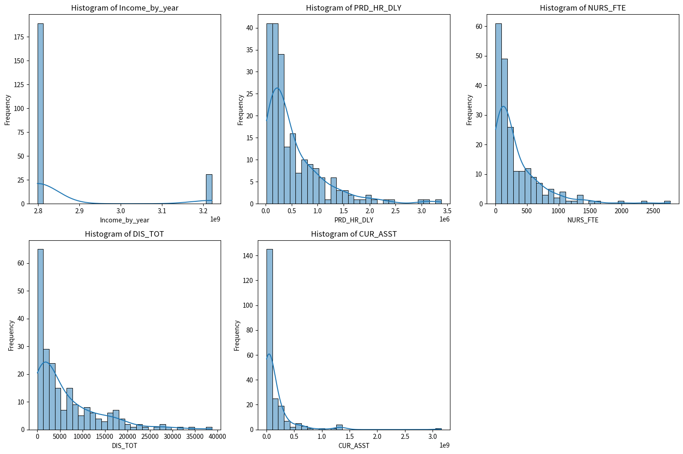
Histograms distribution of the five selected variables

Slide 5
Descriptive Statistics
Income_by_year (Net Income of the Hospital)
Mean: ~2.86 billion
Mode: ~2.80 billion
Spread (Standard Deviation): ~147.57 million
Skewness: 2.08 (positively skewed)
Kurtosis: 2.34 (leptokurtic distribution)
NURS_FTE (Number of Full-Time Equivalent Nurses)
Mean: ~335.42 nurses
Mode: 6 nurses
Spread: ~406.69 nurses
Skewness: 2.67 (positively skewed)
Kurtosis: 9.70 (leptokurtic distribution)
CUR_ASST (Current Assets of the Hospital)
Mean: ~153.39 million
Mode: ~297,403
Spread: ~319.12 million
Skewness: 5.32 (positively skewed)
Kurtosis: 39.59 (leptokurtic distribution)
PRD_HR_DLY (Total Operational Hours)
Mean: ~533,903 hours
Mode: ~200,574 hours
Spread: ~581,600 hours
Skewness: 2.18 (positively skewed)
Kurtosis: 5.85 (leptokurtic distribution)
DIS_TOT (Total Number of Patients Discharged)
Mean: ~6,391 patients
Mode: 266 patients
Spread: ~7,311 patients
Skewness: 1.69 (positively skewed)
Kurtosis: 2.95 (leptokurtic distribution)

Slide 6
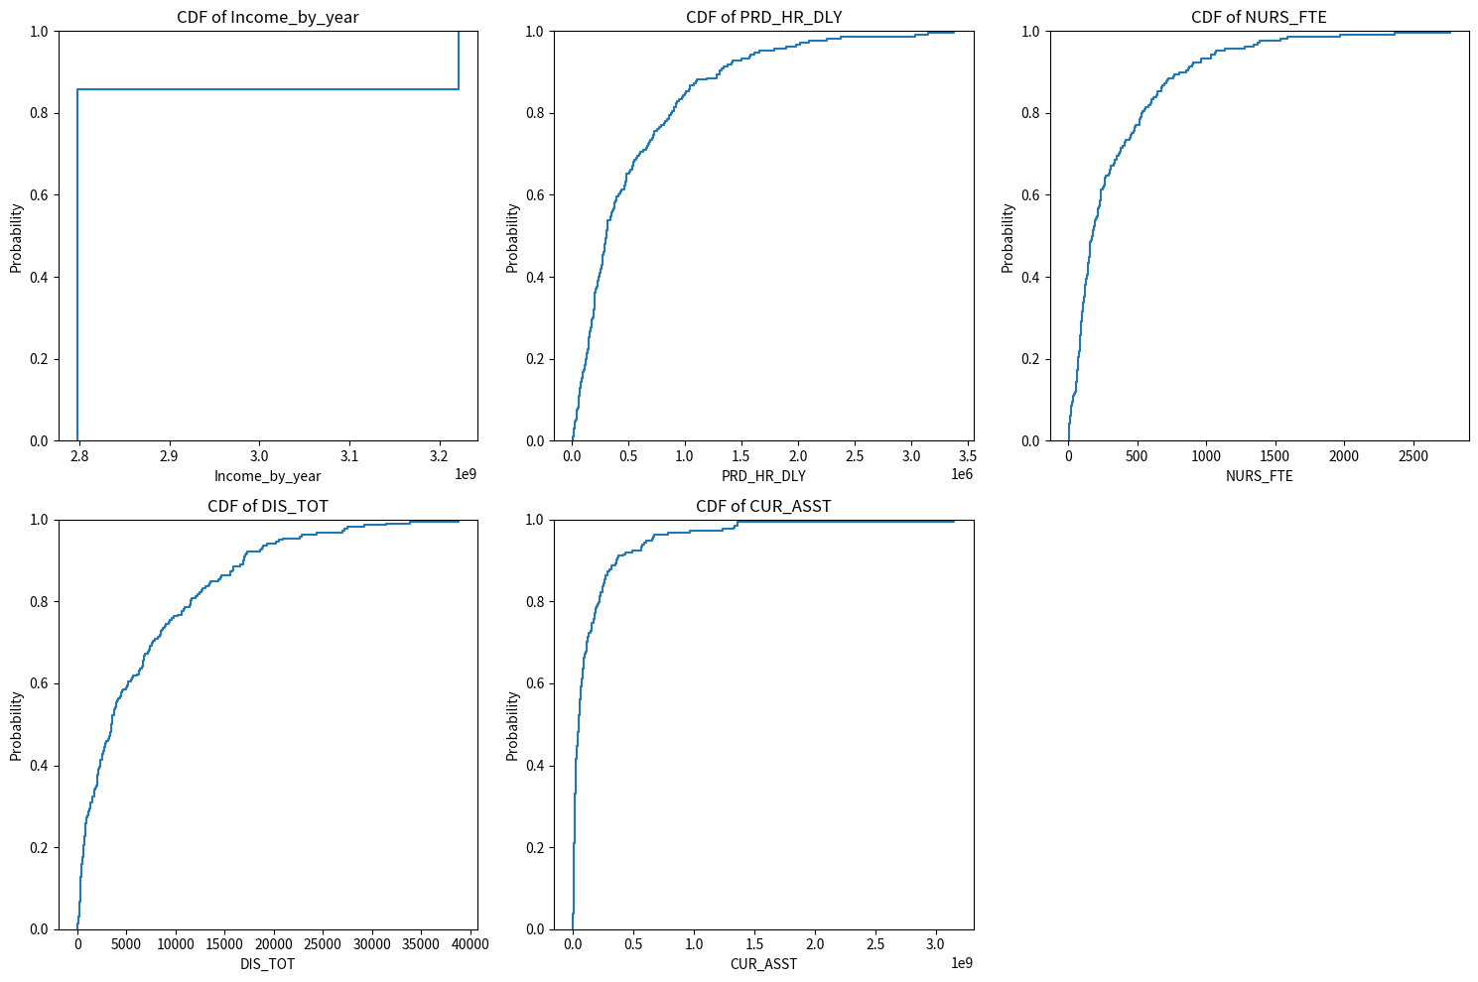
PMF Comparison Comparison of net income for hospitals in Riverside County vs. Los Angeles County

Slide 7
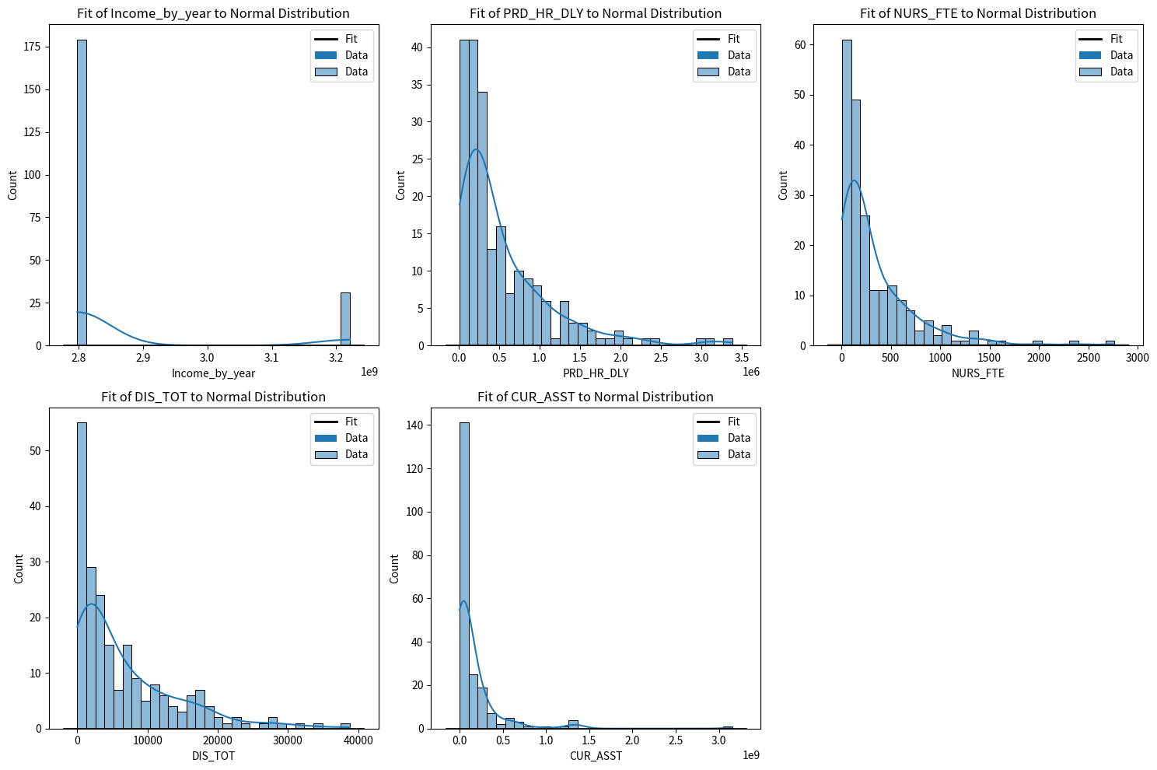
Analytical Distribution Plots

Slide 8
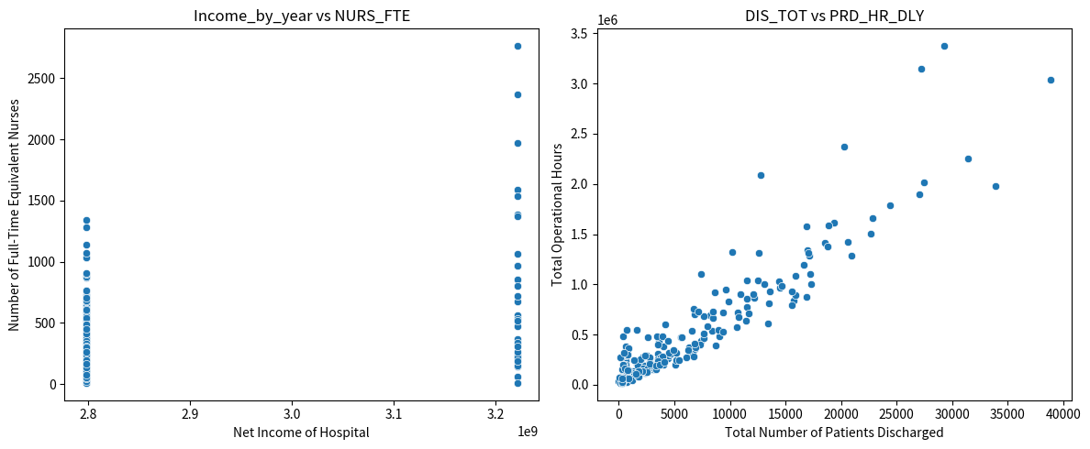
Scatter Plots & Correlation

Slide 9
Regression Analysis
OLS Regression Results
Dep. Variable: | NURS_FTE | R-squared: | 0.919
Model: | OLS | Adj. R-squared: | 0.918
Method: | Least Squares | F-statistic: | 776.3
Date: | Sat, 12 Aug 2023 | Prob (F-statistic): | 5.81E-112
Time: | 17:39:21 | Log-Likelihood: | -1295.6
No. Observations: | 210 | AIC: | 2599
Df Residuals: | 206 | BIC: | 2613
Df Model: | 3
Covariance Type: | nonrobust
 | coef | std err | t | P>|t| | [0.025 | 0.975]
const | -4.8669 | 11.891 | -0.409 | 0.683 | -28.31 | 18.576
DIS_TOT | 0.0237 | 0.003 | 7.708 | 0 | 0.018 | 0.03
TOT_OP_EXP | 3.58E-07 | 2.54E-08 | 14.104 | 0 | 3.08E-07 | 4.08E-07
DAY_TOT | 0.0022 | 0.001 | 3.718 | 0 | 0.001 | 0.003
Omnibus: | 245.4 | Durbin-Watson: | 1.224
Prob(Omnibus): | 0 | Jarque-Bera (JB): | 14001.165
Skew: | 4.642 | Prob(JB): | 0
Kurtosis: | 41.909 | Cond. No. | 7.71E+08

Slide 10
Hypothesis Testing
Hypothesis: Relationship between Hospital Income Between Rural vs. Urban Counties
Null Hypothesis (H0): The average net income for hospitals in Riverside County is equal to that in Los Angeles County.
Alternative Hypothesis (H1): The average net income for hospitals in Riverside County is different from that in Los Angeles County.
Results:
Based on the t-test, we fail to reject the null hypothesis, indicating no significant difference in average net income between the two counties.

Slide 11
Key Findings
Riverside County (typically more rural):
About 50% of hospitals in Riverside County have a net income below $2 million.
Around 80% of hospitals have a net income below $5 million.
The CDF curve for Riverside County rises more gradually, indicating a wider spread in net incomes.
Los Angeles County (highly urbanized):
Approximately 50% of hospitals in Los Angeles County have a net income below $1 million, which is lower than that of Riverside County.
The CDF curve for Los Angeles County rises more steeply at the beginning, indicating that many hospitals have similar, lower net incomes. However, it also has a longer tail, suggesting the presence of some hospitals with very high net incomes.
This CDF comparison further emphasizes the financial disparities between hospitals in urban and rural settings. While many hospitals in the urbanized Los Angeles County have lower net incomes, there are also some with significantly higher incomes, potentially due to the presence of larger or specialty institutions.

Slide 12
Key Findings cont.
Relationship between Operational Hours and Patients Discharged
Net Income vs. Number of Patients Discharged: This plot shows the relationship between the net income of hospitals and the number of patients they discharged. There doesn't seem to be a clear linear relationship, but there is a concentration of data points in the lower left corner, indicating many hospitals with lower net incomes and fewer discharges.
Net Income vs. Total Operating Expense: This plot shows the relationship between the net income of hospitals and their total operating expenses. There's a noticeable trend where hospitals with higher operating expenses also tend to have higher net incomes. This could be due to larger hospitals having both higher expenses and higher revenues, leading to higher net incomes.

Slide 13
Key Findings cont.
Correlation and Causation Analysis:
Correlation: The second plot suggests a positive correlation between net income and total operating expenses. As one increases, the other tends to increase as well.
Causation: While there's a correlation, it's essential to note that correlation doesn't imply causation. Higher operating expenses might be due to various factors, including the size of the hospital, the services they offer, their location, etc. Similarly, net income can be influenced by many factors, including the efficiency of hospital operations, the patient demographic, insurance coverages, and more. Further statistical analysis and domain knowledge would be required to determine any causal relationships.

Slide 14
Concluding Remarks
This analysis shed light on the financial landscape of California's hospitals. By understanding the relationships between operational metrics and net income, stakeholders can make informed decisions to optimize financial performance. As healthcare continues to evolve, data-driven insights like these will be invaluable in navigating the challenges ahead.

Slide 15
Thank you
Salina Najera
Bellevue University
DSC 540: Data Exploration & Analysis
August 12, 2023

